Slide 1

MOR methods for nonlinear Elliptic problem
Model Order Reduction
and
Machine Learning
a.a. 2024-2025
September 12, 2025
Maddalena Ghiotti s332834
Valerio Taralli s332689
Gaia Saroglia s332687

Slide 2
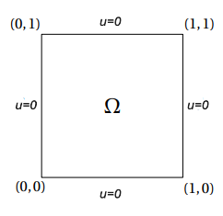
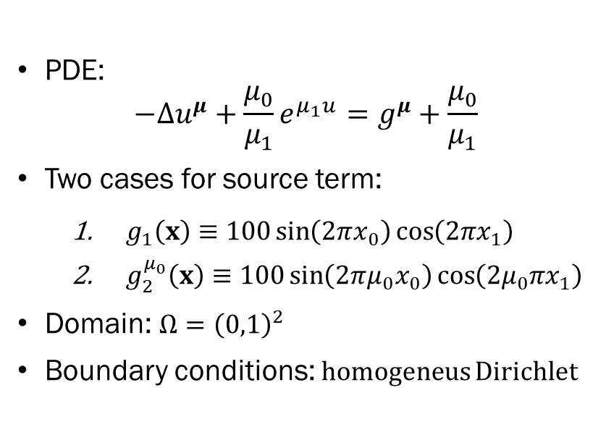
Problem Definition
PDE:
$$−Δu^{μ}+\frac{μ_{0}}{μ_{1}}e^{μ_{1}u}=g^{μ}+\frac{μ_{0}}{μ_{1}}$$
Two cases for source term:
$g_{1}\left(x\right)≡100\sin\left(2πx_{0}\right)\cos\left(2πx_{1}\right)$
$g_{2}^{μ_{0}}\left(x\right)≡100\sin\left(2πμ_{0}x_{0}\right)\cos\left(2μ_{0}πx_{1}\right)$
Domain: $Ω={\left(0,1\right)}^{2}$
Boundary conditions: homogeneus Dirichlet

Slide 3
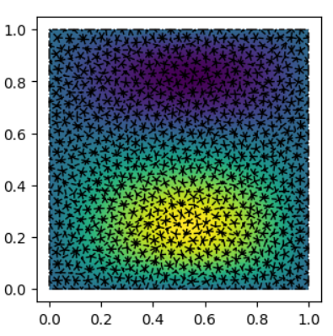
Motivation & Goal
POD
PINN
POD-NN
reduce
Motivation:
FOM (FEM) is accurate but expensive
Need Model Order Reduction (MOR) to reduce costs
Goal:
Compare POD-Galerkin, PINN, POD-NN vs FOM in terms of
Accuracy (absolute & relative errors)
Computational efficiency (speed-up)

Slide 4
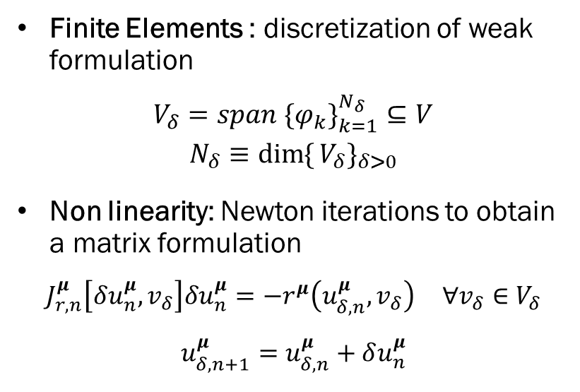
Full Order Model (FEM)
Finite Elements : discretization of weak formulation
$$V_{δ}=span \{φ_{k}\}_{k=1}^{N_{δ}}⊆V$$
$$N_{δ}≡\dim{\{}V_{δ}\}_{δ>0}$$
Non linearity: Newton iterations to obtain a matrix formulation
$$J_{r,n}^{μ}\left[δu_{n}^{μ},v_{δ}\right]δu_{n}^{μ}=−r^{μ}\left(u_{δ,n}^{μ},v_{δ}\right) ∀v_{δ}∈V_{δ}$$
$$u_{δ,n+1}^{μ}=u_{δ,n}^{μ}+δu_{n}^{μ}$$

Slide 5
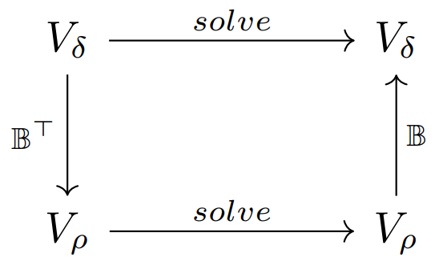
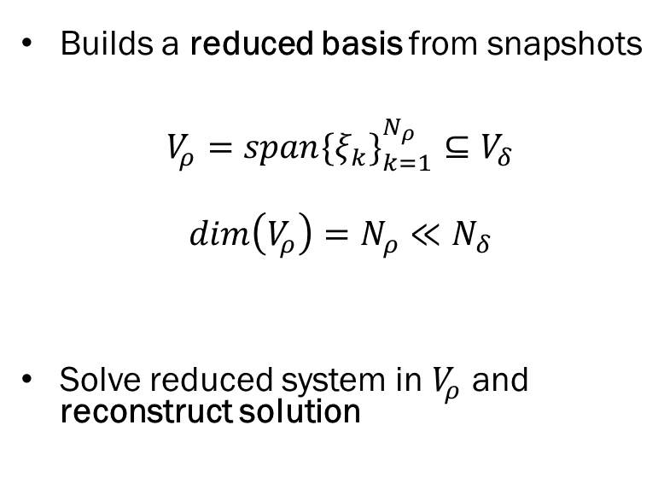
Proper Orthogonal Decomposition (POD)
Builds a reduced basis from snapshots
$$V_{ρ}=span{{\{ξ}_{k}\}}_{k=1}^{N_{ρ}}⊆V_{δ}$$
$$dim\left(V_{ρ}\right)=N_{ρ}≪N_{δ}$$
Solve reduced system in $V_{ρ}$​ and reconstruct solution

Slide 6
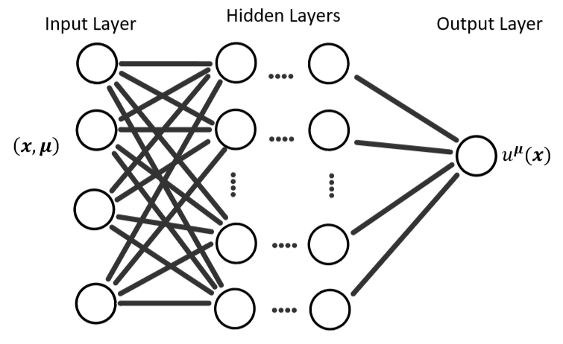
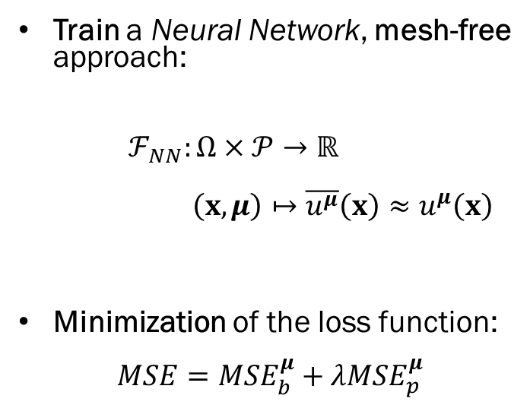
Physics-Informed Neural Network (PINN)
Train a Neural Network, mesh-free approach:
$ℱ_{NN}:Ω×𝒫→ℝ$
$$\left(x,μ\right)↦\overline{u^{μ}}\left(x\right)≈u^{μ}\left(x\right)$$
Minimization of the loss function:
$$MSE=MSE_{b}^{μ}+λMSE_{p}^{μ}$$

Slide 7
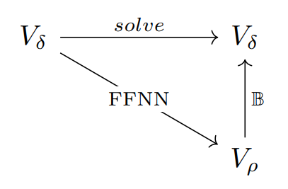
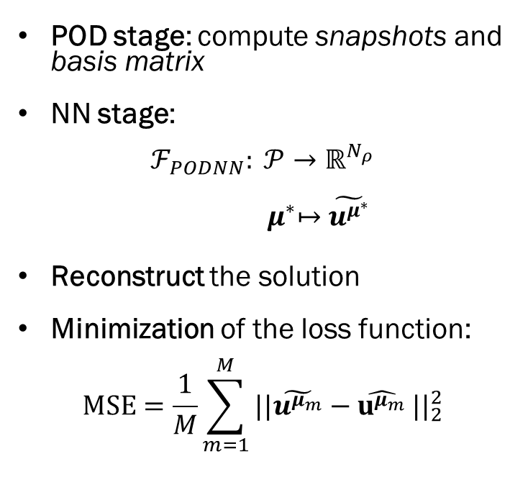
Hybrid Approach (POD-NN)
POD stage: compute snapshots and basis matrix
NN stage:
$$ℱ_{PODNN}: 𝒫→ℝ^{N_{ρ}}$$
$${ μ}^{∗}↦\tilde{u^{μ^{∗}}}$$
Reconstruct the solution
Minimization of the loss function:
$$MSE=\frac{1}{M}\sum_{m=1}^{M}{\left.||\tilde{u^{μ_{m}}}−\hat{u^{μ_{m}}}\right.||_{2}^{2}}$$

Slide 8
Numerical Studies

Slide 9
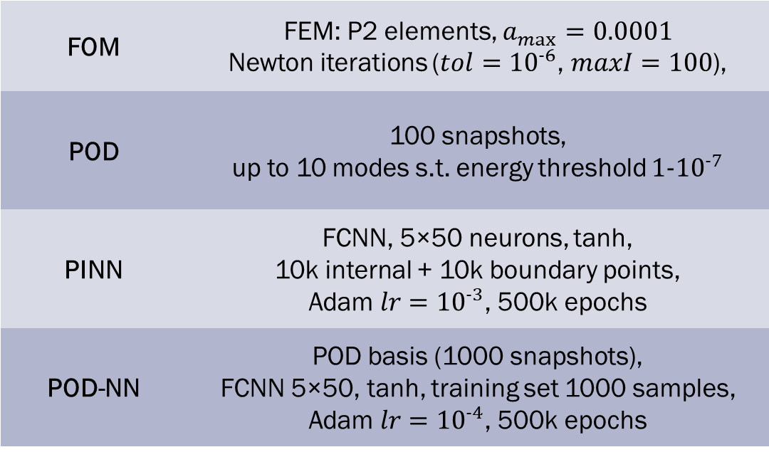
FOM | FEM: P2 elements, $a_{max}=0.0001$ Newton iterations ($tol={10}^{-6}$, $maxI=100$),
POD | 100 snapshots, up to 10 modes s.t. energy threshold $1-{10}^{-7}$
PINN | FCNN, 5×50 neurons, tanh, 10k internal + 10k boundary points, Adam $lr={10}^{-3}$, 500k epochs
POD-NN | POD basis (1000 snapshots), FCNN 5×50, tanh, training set 1000 samples, Adam $lr={10}^{-4}$, 500k epochs
Experimental Setup
Metrics:
absolute/relative error
speed-up

Slide 10
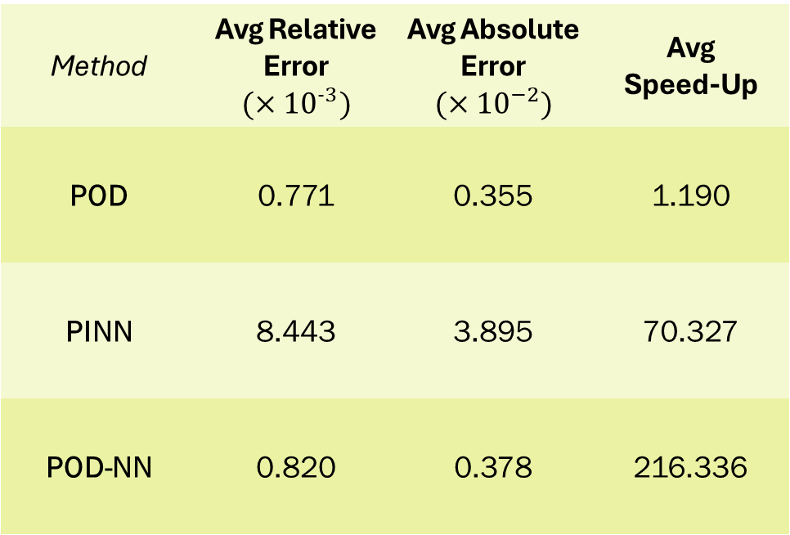
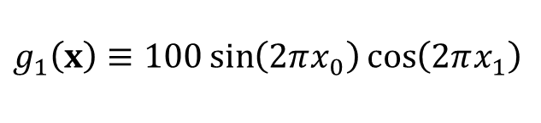
$$g_{1}\left(x\right)≡100\sin\left(2πx_{0}\right)\cos\left(2πx_{1}\right)$$
Method | Avg Relative Error $$(×{10}^{−3})$$ | Avg Absolute Error $$(×{10}^{−2})$$ | Avg Speed-Up
POD | 0.771 | 0.355 | 1.190
PINN | 8.443 | 3.895 | 70.327
POD-NN | 0.820 | 0.378 | 216.336
POD: best accuracy, negligible speed-up
PINN: very fast (after training), accuracy ~1 order worse
POD-NN: best compromise, POD-like accuracy and strong speed-up
Results – Case 1

Slide 11
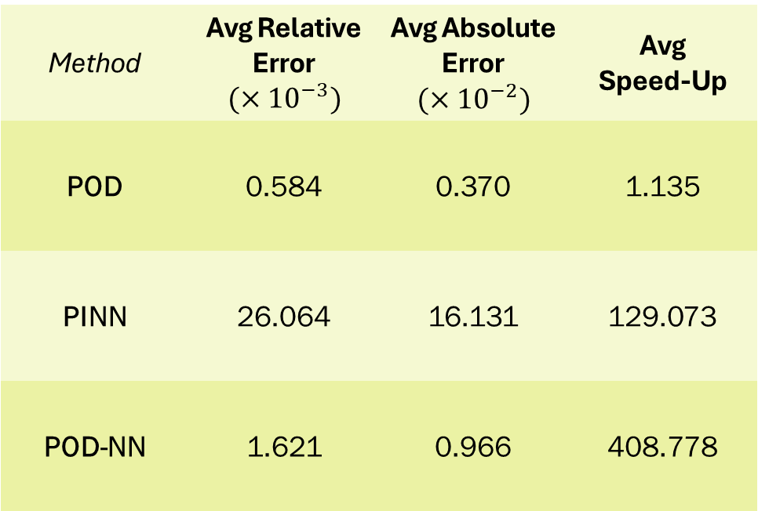
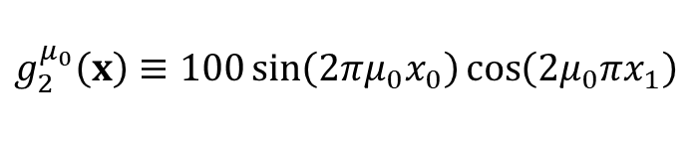
$$g_{2}^{μ_{0}}\left(x\right)≡100\sin\left(2πμ_{0}x_{0}\right)\cos\left(2μ_{0}πx_{1}\right)$$
Method | Avg Relative Error $$(×{10}^{−3})$$ | Avg Absolute Error $$(×{10}^{−2})$$ | Avg Speed-Up
POD | 0.584 | 0.370 | 1.135
PINN | 26.064 | 16.131 | 129.073
POD-NN | 1.621 | 0.966 | 408.778
Higher complexity amplifies performance differences:
POD: keeps highest accuracy, but no speed gain
PINN: strong speed-up, but accuracy worsens significatly
POD-NN: still best trade-off
Results – Case 2

Slide 12
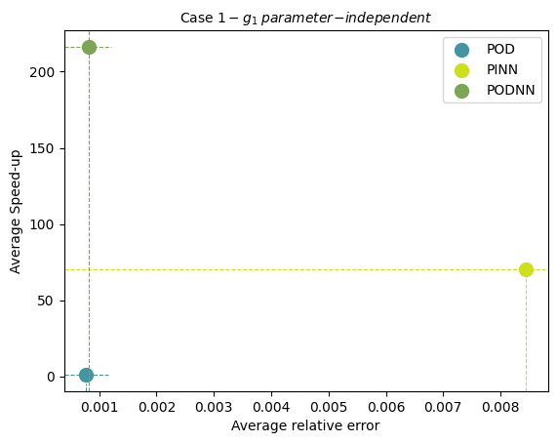
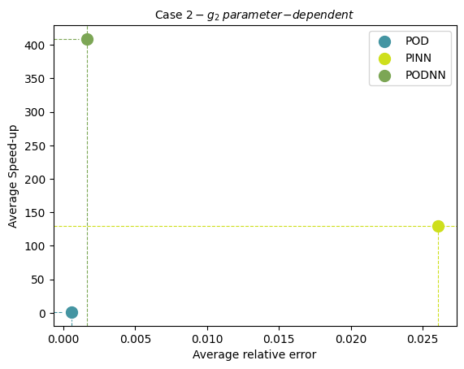
Conclusions
POD remains the preferred method when accuracy is the primary goal;
PINN and POD-NN offer remarkable advantages in computational speed.
Overall : POD-NN emerges as the most promising method when both accuracy and efficiency are required.

Slide 13
Thank you for listening

