Slide 1
Swiss: a pack for decks that argue
A grid, one family per voice, one signal colour, and a single recurring rule.

Slide 2
Every value in the deck comes from the pack
The pen takes names, never sizes or colours, so a slide cannot drift off the system.
Notes:
The pen takes names, never sizes or colours.

Slide 3
How the pack sets a slide
Part one

Slide 4
Regions snap to one grid on every slide
12
Every region spans whole columns, so text and figures line up from slide to slide.
columns in the grid
Source: pack.toml, [grid]
Notes:
Twelve columns, fixed margins, and rows that set the rhythm.

Slide 5
Sizes step up so titles always dominate the body
Source: pack.toml, [styles.presented]
Notes:
The headline is twice the body in presented mode.

Slide 6
Each style has one job in the deck
Style | Used for
Headline | Evidence and section titles
Lede | The line that follows a title
Body | Paragraphs and bullets
Label | Figure labels and table headers
Source | Source and note lines
Source: pack.toml, [styles]
Notes:
Nothing is set by hand; every text picks a style.

Slide 7
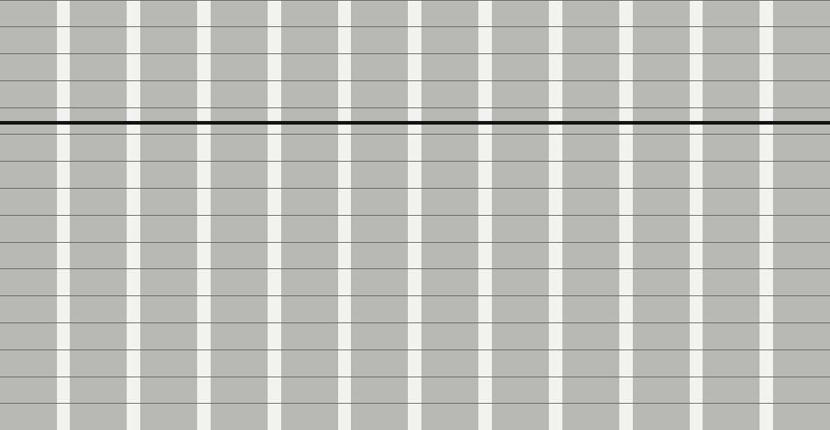
The grid, drawn to scale
Margins keep a clear edge
Gutters part the columns
Rows set the rhythm
Notes:
Margins, gutters and rows are fixed by the pack.

Slide 8
Statement slides are allowed to be mostly empty, and that emptiness is the point.
The Swiss pack README
Notes:
Read it slowly, then pause.

Slide 9
Build the next deck from the same tokens
Start from a brief, pick a voice, and let the pen set the rest.
Note: This specimen shows the pack itself, not a product.
Notes:
Start from a brief, pick a voice, and let the pen set the rest.

