Slide 1
ASSIGNMENT 5
DevOps & CI/CD
for Research Projects
1
Git
2
CI
Automating a reproducible software workflow
with Docker and Jenkins
3
Docker
4
Health
ReviewGuard | Python research API
A working CI demonstration,
not a claim of scientific validity
Dias Kazikhanov

Slide 2
Research results depend on more than source code
A result is produced by a whole computational setup. If any part is missing, another researcher may not be able to rebuild the same workflow.
CODE
DATA
CONFIG
RUNTIME
source revision
& tests
dataset version
& provenance
preprocessing
& parameters
packages, weights
& hardware
DevOps makes the software steps visible and repeatable.
It records and checks how code is built and run. It does not decide whether a dataset, label scheme, or research claim is scientifically sound.
REVIEWGUARD / DEVOPS & CI/CD
02

Slide 3
DevOps is a shared way of working
The goal is a short, reliable feedback loop from a proposed change to a tested, runnable artifact.
01
Version every change
Keep code, pipeline definitions, and configuration in reviewable history.
02
Automate routine checks
Run the same tests and builds after every change.
03
Describe environments
Make runtime and deployment setup explicit instead of relying on a laptop state.
04
Learn from failures
Use fast, visible feedback to fix defects near the change that caused them.
For research teams: fewer environment surprises, earlier regression detection, easier handoffs, and clearer provenance.
REVIEWGUARD / DEVOPS & CI/CD
03

Slide 4
CI/CD turns each change into a repeatable check
Continuous integration (CI) and delivery (CD) share a pipeline, but they answer different questions.
1
2
3
4
5
Commit
›
Integrate
›
Package
›
Verify
›
Deliver
Git records
a change
CI runs tests
and a build
Docker creates
a runnable image
Smoke test the
container
Promote to a test
or release target
CI
Integrate small changes and verify them automatically.
CD
Keep a tested version ready to release; deployment may remain gated.
In research software, a green pipeline proves the specified checks passed. It does not validate the scientific conclusion.
REVIEWGUARD / DEVOPS & CI/CD
04

Slide 5
ReviewGuard pipeline: from Git to a health-checked container
The Jenkinsfile is versioned with the Python API and runs three operational stages after checkout.
Git repository
Jenkins
Python agent
Docker image
Smoke check
→
→
→
→
Python API
+ Jenkinsfile
Pipeline as Code
local self-hosted
Python 3.12
pytest
reviewguard-ci:N
small CI variant
temporary API
+ /health
GitHub Actions also runs the full test suite on pushes and pull requests; Jenkins adds a local, Docker-aware demonstration path.
Data and model checkpoints stay outside the image. Mount the trained checkpoint at /models/latest when inference is required.
REVIEWGUARD / DEVOPS & CI/CD
05

Slide 6
Docker packages the API runtime, not the research evidence
The image makes the application easier to start consistently across a laptop, CI runner, and test host.
Python 3.12 slim base
KEEP OUT OF THE IMAGE
small, declared runtime
Raw and processed datasets
Trained model weights
ReviewGuard package + Uvicorn
API listens on port 8000
Local reports and development files
Non-root runtime user
CI uses INSTALL_INFERENCE=0 for a smaller startup image. The default image installs inference dependencies; it still needs a checkpoint mounted separately.
UID 10001 · explicit health check
→
Container starts → /health responds
A container controls application packaging. Dataset versions, model provenance, seeds, and hardware still need their own records.
REVIEWGUARD / DEVOPS & CI/CD
06

Slide 7
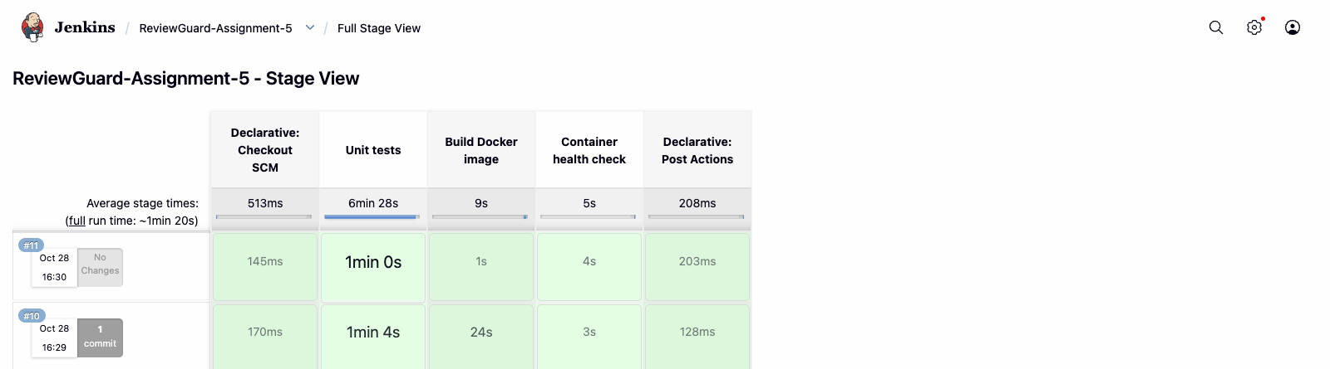
Jenkins shows each stage and its result
BUILD #10
Checkout → unit tests → Docker image → container health check → post actions
Builds #10 and #11 are green. The earlier red rows show setup iterations visible in the same local Jenkins history.
REVIEWGUARD / DEVOPS & CI/CD
07

Slide 8
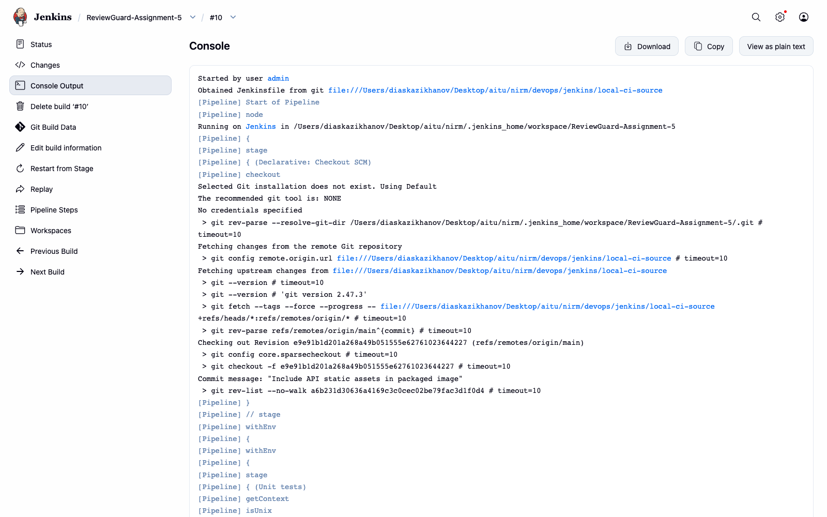
Build #10 started from the local SCM snapshot
SOURCE REVISION
e9e91b1
The demonstration ran against a temporary local Git snapshot while Assignment 5 files were being prepared.
The completed deliverables are now published on the repository's devops branch. This screenshot records the local demonstration run, not a post-push webhook run.
REVIEWGUARD / DEVOPS & CI/CD
08

Slide 9
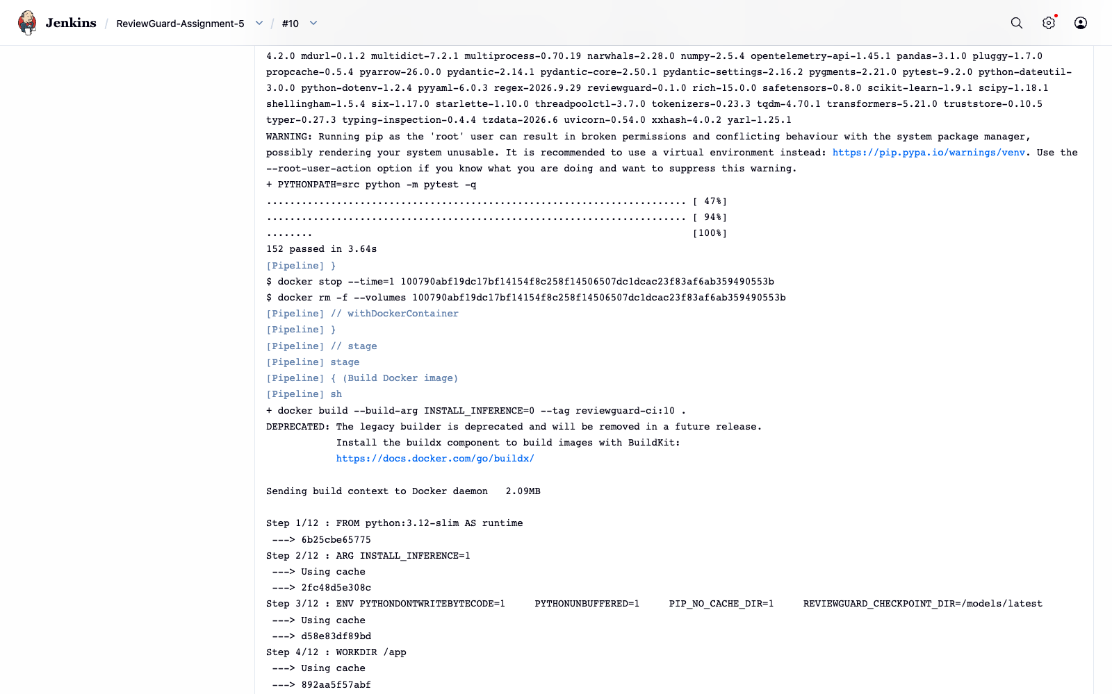
Automated tests give fast, repeatable feedback
152
tests passed
3.64 s
test stage duration
The Docker image build begins after pytest passes.
Evidence: Jenkins console output for build #10.
REVIEWGUARD / DEVOPS & CI/CD
09

Slide 10
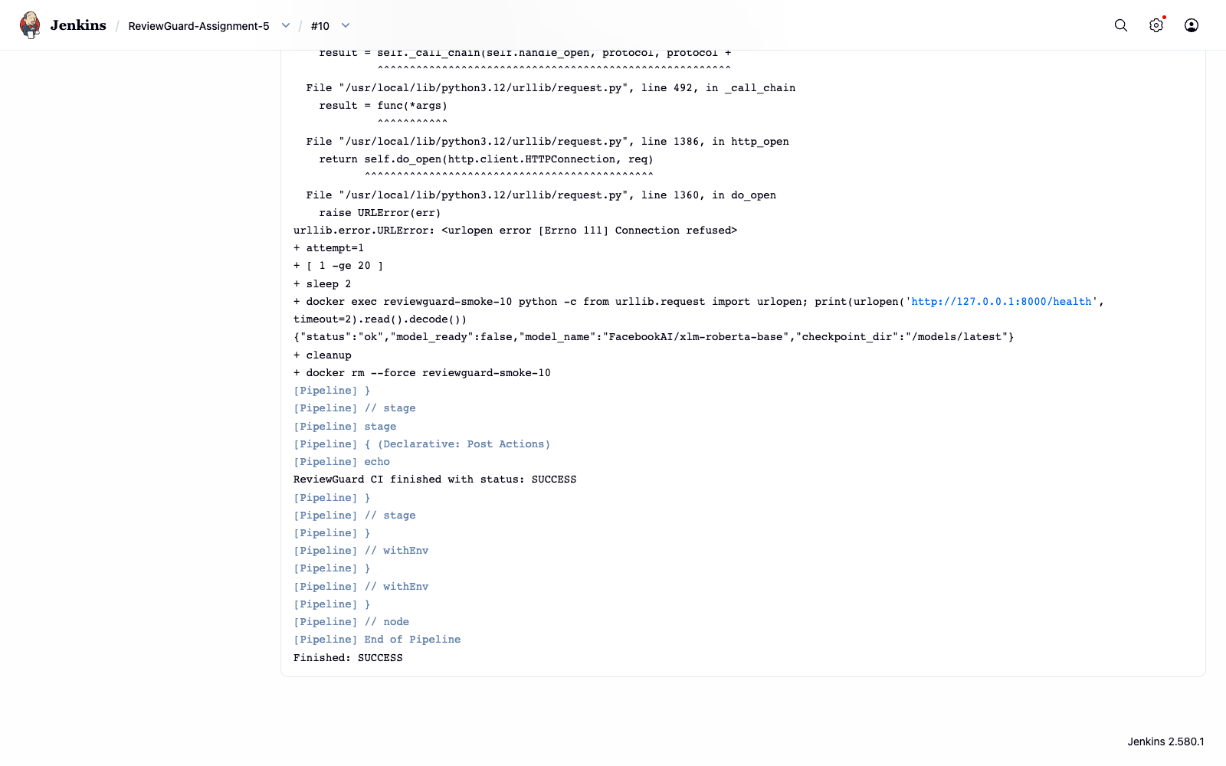
The container starts and answers its health check
IMAGE
reviewguard-ci:10
HEALTH RESPONSE
status: "ok"
model_ready: false
The initial request raced container startup; a retry returned the response and the pipeline finished SUCCESS.
Liveness verified; no trained checkpoint was loaded.
REVIEWGUARD / DEVOPS & CI/CD
10

Slide 11
Operational checks are not scientific validation
The pipeline provides evidence about software behavior at one recorded revision.
WHAT THE RUN SUPPORTS
WHAT IT DOES NOT ESTABLISH
The specified test suite passed on the recorded source snapshot.
Model accuracy or generalization to new review sources.
The Docker image built from the declared project files.
Dataset representativeness or label validity.
The API process started and /health returned a response.
Bitwise reproducibility across hardware and runtimes.
Research quality still depends on provenance for datasets, checkpoints, configuration, seeds, and source revisions.
REVIEWGUARD / DEVOPS & CI/CD
11

Slide 12
Implementation exposed integration issues early
A useful pipeline does more than automate the happy path. It reveals mismatches between packaging, the runner, and the application.
ISSUE
FIX / DESIGN CHOICE
No active Docker daemon
Start a local Docker runtime before building images.
Jenkins agent lacked Docker CLI / Git
Add required tools to the Jenkins image and Python test agent.
API HTML asset missing from package
Declare static HTML as package data; rerun the health check.
CPU-only CI runner
Install CPU PyTorch wheels to avoid unused CUDA downloads.
Container startup race
Retry /health briefly and always remove the temporary smoke container.
The health check now tests a real built container rather than only importing the API package.
REVIEWGUARD / DEVOPS & CI/CD
12

Slide 13
Kubernetes is a deployment option, not a requirement
The assignment's working scope is Docker + Jenkins CI. Registry publishing and cluster deployment remain optional because no credentials or target cluster are configured.
A PRACTICAL NEXT PATH
TAKEAWAY
Push a versioned image to a registry with scoped credentials.
DevOps makes research software easier to test, package, and rerun.
Add a webhook or multibranch job for the published devops branch.
Deploy to a test environment and keep promotion gated.
Use automation to strengthen traceability and reliability, while keeping scientific claims tied to data and empirical evidence.
Use Kubernetes when shared scheduling or multiple services justify it.
Repository: github.com/Svoppy/review-api/tree/devops
REVIEWGUARD / DEVOPS & CI/CD
13

Slide 14
References
1
Wilson et al. (2014). Best Practices for Scientific Computing. PLoS Biology 12(1): e1001745.
https://doi.org/10.1371/journal.pbio.1001745
2
Osborne et al. (2014). Ten simple rules for effective computational research. PLoS Comput. Biol. 10(1): e1003506.
https://doi.org/10.1371/journal.pcbi.1003506
3
DORA. Continuous Integration capability.
https://dora.dev/capabilities/continuous-integration/
4
DORA. Continuous Delivery capability.
https://dora.dev/capabilities/continuous-delivery/
5
Docker. Python language-specific guide.
https://docs.docker.com/guides/python/
6
Jenkins. Pipeline and Pipeline as Code documentation.
https://www.jenkins.io/doc/book/pipeline/
7
Kubernetes. Concepts documentation.
https://kubernetes.io/docs/concepts/
REVIEWGUARD / DEVOPS & CI/CD
14

