Slide 1


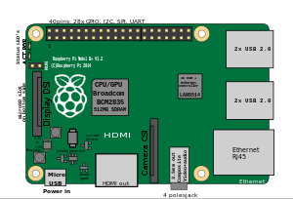

sTalk
sTalk SERVER
UART
Kmote
RPiLogger
TinyOS

