Slide 1
ADVANCED WEB PROGRAMMING(18CS551)

Slide 2
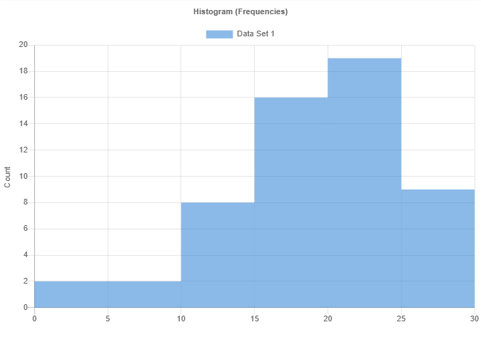
Histogram of IA Marks

Slide 3
IA 1 Data Analysis
Metric | Result
Mean | 19.24107
Median | 19.75
Std Dev | 5.8976
Skewness | -0.74428
Kurtosis | 0.09222
Min | 3.5
Max | 28.5
Range | 25.0
# of Scores | 56
# of Unique Scores | 31
Bin Boundary (Min) | 0
Bin Boundary (Max) | 30
# of Bins | 6
Bin Size | 5

Slide 4
IA 1 Data Analysis
Metric | Result | Bin | Count
 |  | 0 - 5 | 2
 |  | 5 - 10 | 2
 |  | 10 - 15 | 8
 |  | 15 - 20 | 16
 |  | 20 - 25 | 19
 |  | 25 - 30 | 9

