Slide 1
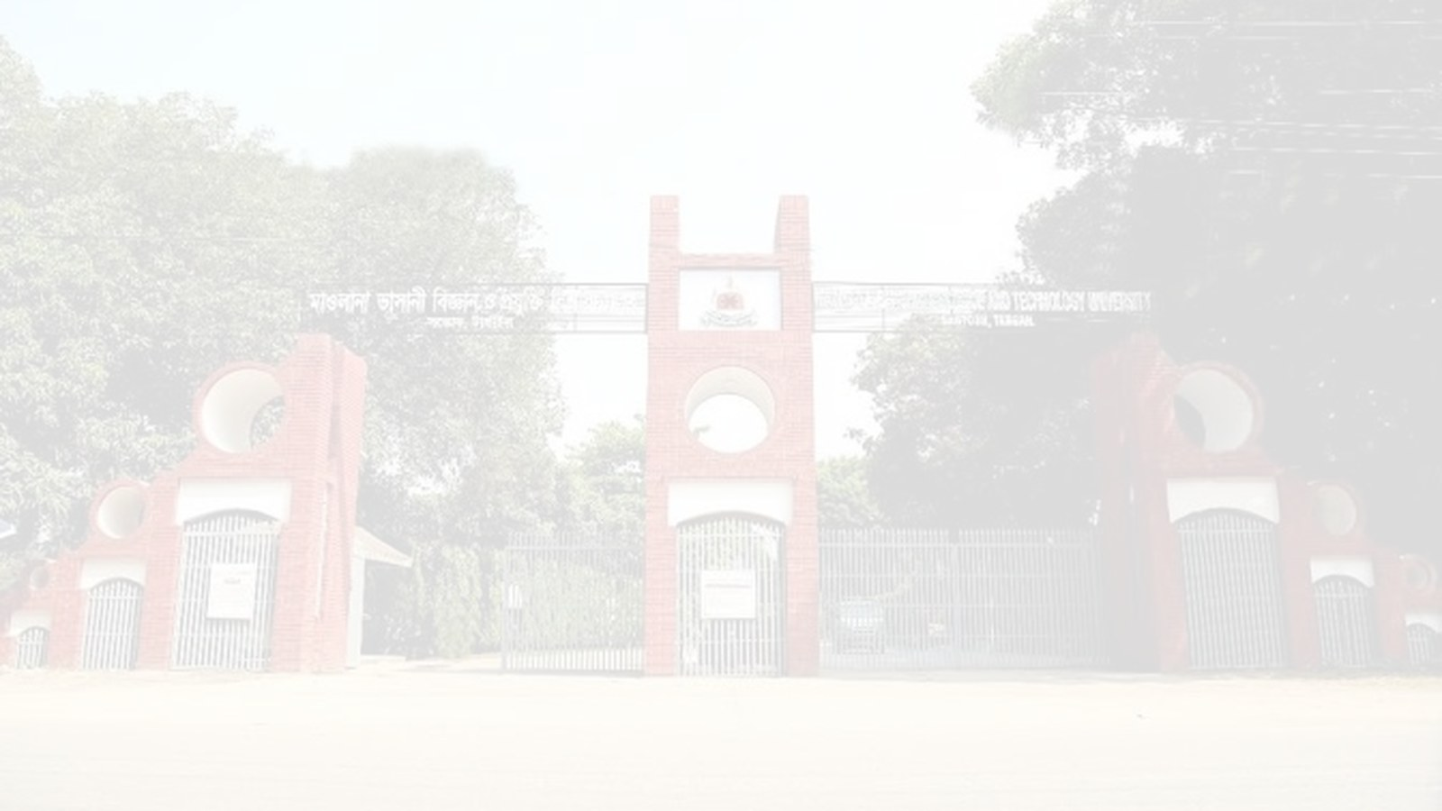


MBSTU
Mawlana Bhashani Science & Technology University
Dept. of ICT
MBSTU
Data Communication Lab (ICT3102)
Department of ICT, Mawlana Bhashani Science and Technology University
SMTPS: secure email transfer over TLS
Presentation topic: SMTPS (SMTP over SSL/TLS)
COURSE
Data Communication Lab (ICT3102)
SUBMITTED BY
Swapnil Nag Swachha | ID: IT24001
Dept. of ICT, MBSTU
SUBMITTED TO
Associate Prof. Dr. Nazrul Islam
Dept. of ICT, MBSTU

Slide 2
MBSTU
Mawlana Bhashani Science & Technology University
Dept. of ICT
MBSTU
Presentation Outline
01
Introduction and problem
02
Evolution of SMTP and research gap
03
Working: TLS handshake and mail delivery
04
Message format, commands and reply codes
05
Threats, authentication and certificates
06
Comparison and conclusion
SMTPS: Secure SMTP over TLS
ICT3102 | ID: IT24001
02

Slide 3
MBSTU
Mawlana Bhashani Science & Technology University
Dept. of ICT
MBSTU
Introduction and Problem
SMTPS is SMTP wrapped in SSL/TLS (implicit TLS, port 465) to deliver email securely.
01
Why it matters: email carries passwords and private data
02
What plain SMTP leaves unresolved: no encryption, no server authentication, easy sniffing
03
Objective: understand how SMTPS works and why it is more secure than SMTP
SMTPS: Secure SMTP over TLS
ICT3102 | ID: IT24001
03

Slide 4
MBSTU
Mawlana Bhashani Science & Technology University
Dept. of ICT
MBSTU
Evolution and Research Gap
Version | Key idea | Limitation
SMTP (1982, RFC 821) | Plain-text mail relay on port 25 | No encryption or authentication
STARTTLS (2002, RFC 3207) | Upgrades a plain session to TLS | Downgrade (stripping) attack
SMTPS (port 465, RFC 8314) | TLS from the first byte | Needs valid certificates
Gap
Plain SMTP exposes mail and passwords, which led to implicit TLS (SMTPS).
SMTPS: Secure SMTP over TLS
ICT3102 | ID: IT24001
04

Slide 5
MBSTU
Mawlana Bhashani Science & Technology University
Dept. of ICT
MBSTU
Working: TLS Handshake and Mail Delivery
CLIENT
(Mail client)
TLS connection
SERVER
(Mail server :465)
SMTP command: EHLO, MAIL FROM
SMTP reply: 250 OK
1 TCP 3-way
handshake
2 TLS handshake
+ certificate
3 EHLO, AUTH,
MAIL, RCPT
4 DATA sent,
server replies
5 QUIT, TLS
session closed
Everything after the TLS handshake travels encrypted.
SMTPS: Secure SMTP over TLS
ICT3102 | ID: IT24001
05

Slide 6
MBSTU
Mawlana Bhashani Science & Technology University
Dept. of ICT
MBSTU
Message Format
CLIENT COMMANDS
SERVER REPLIES
EHLO client.mbstu.ac.bd
AUTH PLAIN (base64)
MAIL FROM:<a@mbstu.ac.bd>
RCPT TO:<b@example.com>
DATA
(message body) .
220 smtp.mbstu.ac.bd ESMTP
250-AUTH PLAIN LOGIN
235 Authentication OK
250 Sender OK
354 Start mail input
250 Queued
TCP connect → TLS handshake → SMTP commands → 3-digit reply codes
SMTPS: Secure SMTP over TLS
ICT3102 | ID: IT24001
06

Slide 7
MBSTU
Mawlana Bhashani Science & Technology University
Dept. of ICT
MBSTU
Methods and Status Codes
Commands
EHLO, MAIL FROM, RCPT TO, DATA, QUIT
Ports
465 (SMTPS), 587 (STARTTLS), 25 (relay)
Class | Meaning | Examples
1xx | Unused | Reserved in SMTP
2xx | Success | 220 Ready, 235 Auth OK, 250 OK
3xx | Intermediate | 354 Start mail input
4xx | Temporary failure | 421, 450, 451 Try later
5xx | Permanent failure | 535 Auth failed, 550 No mailbox
SMTPS: Secure SMTP over TLS
ICT3102 | ID: IT24001
07

Slide 8
MBSTU
Mawlana Bhashani Science & Technology University
Dept. of ICT
MBSTU
Results: Plain SMTP vs SMTPS
Plain SMTP (25): readable by anyone
Main finding
SMTPS encrypts the entire session from the start.
Credentials and mail stay private from eavesdroppers.
TCP
MAIL
Plain
Close
TCP
MAIL
Plain
Close
TCP
MAIL
Plain
Close
SMTPS (465): TLS from the first byte
TCP
TLS
EHLO
AUTH
MAIL
DATA
250
Close
TLS encrypts the whole session.
SMTPS: Secure SMTP over TLS
ICT3102 | ID: IT24001
08

Slide 9
MBSTU
Mawlana Bhashani Science & Technology University
Dept. of ICT
MBSTU
Security Threats and Protection
Plain SMTP
Client
Login
Attacker
Sees all
Server
Delivers
STARTTLS
Client
EHLO
Attacker
Strips TLS
Server
Plain
SMTPS
Client
TLS
Server
Encrypted channel
Attacker blind
Cert checked
Plain SMTP exposes passwords and mail. STARTTLS can be downgraded by an attacker. SMTPS uses TLS from the start, so traffic stays encrypted.
SMTPS: Secure SMTP over TLS
ICT3102 | ID: IT24001
09

Slide 10
MBSTU
Mawlana Bhashani Science & Technology University
Dept. of ICT
MBSTU
Authentication (SMTP AUTH)
CLIENT
SERVER
AUTH PLAIN (base64 credentials)
235 Authentication successful
MAIL FROM:<a@mbstu.ac.bd>
250 OK (sender accepted)
Credentials are safe only because TLS encrypts the channel.
SMTPS: Secure SMTP over TLS
ICT3102 | ID: IT24001
10

Slide 11
MBSTU
Mawlana Bhashani Science & Technology University
Dept. of ICT
MBSTU
Certificate Validation
MAIL CLIENT
SMTPS SERVER
ClientHello (TLS 1.2 / 1.3)
ServerHello + Certificate
Verify CA, domain, expiry + key
Finished (encrypted session ready)
The client checks the certificate chain before sending any credentials.
SMTPS: Secure SMTP over TLS
ICT3102 | ID: IT24001
11

Slide 12
MBSTU
Mawlana Bhashani Science & Technology University
Dept. of ICT
MBSTU
Quantitative Comparison
Feature | STARTTLS (587) | SMTPS (465)
Port | 587 (submission) | 465 (implicit TLS)
Encryption starts | After STARTTLS command | From the first byte
Downgrade attack | Possible if not enforced | Not possible
Standard | RFC 3207 (2002) | RFC 8314 (2018)
Use | Mail submission | Preferred for submission
SMTPS is simpler and safer, but needs valid certificates and TLS-enabled clients.
SMTPS: Secure SMTP over TLS
ICT3102 | ID: IT24001
12

Slide 13
MBSTU
Mawlana Bhashani Science & Technology University
Dept. of ICT
MBSTU
Conclusions and Future Work
SMTPS is SMTP over TLS, which makes email transfer private and authenticated.
01
Contribution: implicit TLS, encrypted credentials, server certificate checks
02
Limitation: depends on valid certificates, and relay traffic may still be plain
03
Next step: study MTA-STS, DANE and end-to-end encryption (PGP, S/MIME)
SMTPS: Secure SMTP over TLS
ICT3102 | ID: IT24001
13

Slide 14
MBSTU
Mawlana Bhashani Science & Technology University
Dept. of ICT
MBSTU
Selected References
[1] J. Klensin, “Simple Mail Transfer Protocol,” RFC 5321, 2008.
[2] P. Hoffman, “SMTP Service Extension for Secure SMTP over Transport Layer Security,” RFC 3207, 2002.
[3] K. Moore, C. Newman, “Cleartext Considered Obsolete: Use of TLS for Email Submission and Access,” RFC 8314, 2018.
[4] E. Rescorla, “The Transport Layer Security (TLS) Protocol Version 1.3,” RFC 8446, 2018.
SMTPS: Secure SMTP over TLS
ICT3102 | ID: IT24001
14

Slide 15
MBSTU
Mawlana Bhashani Science & Technology University
Dept. of ICT
MBSTU
Thank you
Questions and Discussion
Swapnil Nag Swachha
Dept. of ICT, MBSTU
snswachha@gmail.com
SMTPS: Secure SMTP over TLS
ICT3102 | ID: IT24001
15

