Slide 1

CUSTOMER SEGMENTATION
(Using K-Means Clustering)
SWADHA KUMARI (NSIT, Patna)
KARAN KUMAR (NSIT, Patna)
PRITI KUMARI (NSIT, Patna)

Slide 2
PROBLEM STATEMENT:
Understand the customers like who can be easily converged so that the sense can be given to marketing team and the strategy can be planned accordingly.
The gender and age distributions had to be visualized and thereby analyzing their annual incomes and spending scores.

Slide 3
CUSTOMER SEGMENTATION:
Dividing a company's customers into groups that reflect similarity among customers in each group.
Goal of segmenting customers is to decide how to relate to customers in each segment in order to maximize the value of each customer to the business.

Slide 4
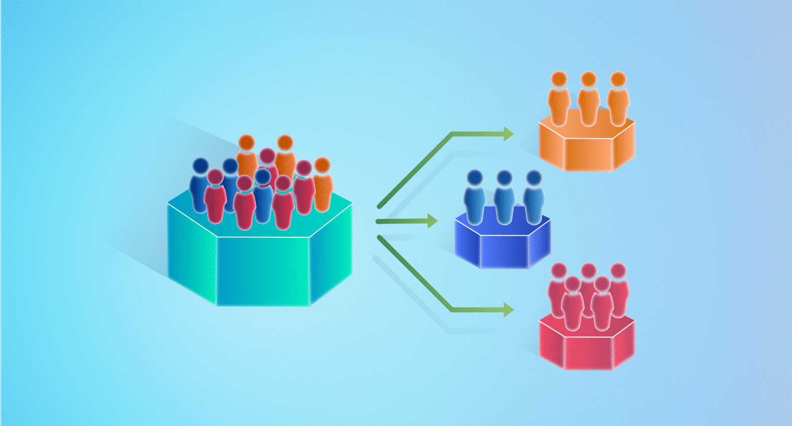

Slide 5
K-MEANS CLUSTERING
K-Means Clustering is an Unsupervised Learning algorithm, which groups the unlabeled dataset into different clusters.
Main aim of this algorithm is to minimize the sum of distances between the data point and their corresponding clusters.

Slide 6
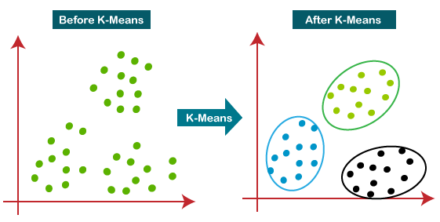

Slide 7
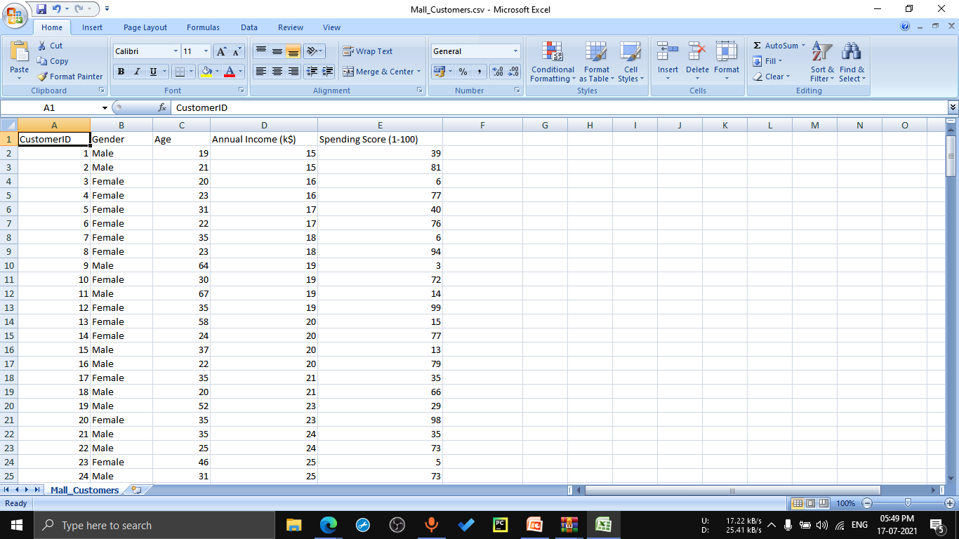
DATASET ANALYSIS:

Slide 8
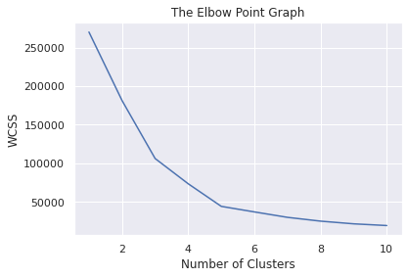
ELBOW GRAPH:
Number of Clusters assumed = 5

Slide 9
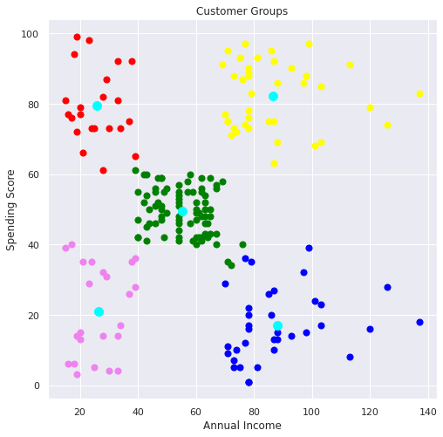
CLUSTERS AND CENTROIDS:

Slide 10
THANK YOU

