Slide 1

Machine Learning Based Prediction of Transformer Health Index using Dissolved Gas Analysis Parameters
PROJECT MEMBERS
CB.EN.U4ELC24035 | SANJITH M P
CB.EN.U4ELC24042 | SWAGAT A
CB.EN.U4ELC24043 | RAVISHWARAN S
CB.EN.U4ELC24046 | VEDHANTH M R
23ELC212 – Machine Learning
Batch: 2025- 2026 (Even Sem)
Supervised by
Mr. Nakkeeran M
Assistant Professor - EEE
Department of Electrical and Electronics Engineering, Amrita School of Engineering, Coimbatore

Slide 2

CONTENT
Introduction
Literature Survey
System Architecture
3.1 Machine Learning Framework
3.2 Dataset Description
3.3 Data Preprocessing and Feature Engineering
3.4 Model Training and Prediction
IV. Methodology
4.1 Machine Learning Techniques
4.2 Data Source
4.3 Implementation Steps
4.4 Evaluation Metrics
2

Slide 3
CONTENT
Implementation Detail
5.1 Development Tools and Environment
5.2 Data Preparation and Processing
5.3 Model Implementation and Training
5.4 Prediction and Performance Evaluation
VI. Results and Discussion
VII. Model performance and comparison
VII. Conclusion and Future scope
❖References
3

Slide 4
I. INTRODUCTION
Power transformers are critical components of electrical power systems, and their reliable operation is essential for maintaining uninterrupted electricity supply. Transformer condition is commonly evaluated using parameters obtained from transformer oil analysis, which provide information about insulation health and internal faults. However, analyzing multiple diagnostic parameters and predicting the overall transformer condition can be complex. Machine learning techniques provide a data-driven approach to analyze these parameters and predict the transformer Health Index more effectively.
PROBLEM STATEMENT :
Traditional transformer condition assessment methods rely on manual interpretation and rule-based analysis, which may not capture complex relationships between diagnostic parameters. Therefore, a machine learning-based approach is required to analyze transformer oil diagnostic data and accurately predict the transformer Health Index for better maintenance planning and improved power system reliability.
4

Slide 5
II. LITERATURE SURVEY
Sno | Author(s) | Title | Journal/ Conference | Year | Inference
[ 1 ] | Syeda Tahreem Zahra et al. | Power Transformer Health Index and Life Span Assessment | Engineering Applications of Artificial Intelligence | 2025 | System: Review of conventional and machine learning approaches for transformer health assessment using DGA and sensor data. Limitations: Need for real-time datasets and hybrid AI models. Future Scope: Integration of time-series analysis and advanced AI techniques for accurate fault prediction..
[ 2 ] | Alqudsi et al. | Application of Machine Learning in Transformer Health Prediction | Energies (MDPI) | 2019 | System: Machine learning models are applied on oil test datasets to predict insulation health condition of transformers. Limitations: Requires proper feature selection and data quality improvement. Future Scope: Reduced testing parameters can lower asset management cost without reducing prediction accuracy. .
[ 3 ] | Emme and Moola | Analysis of Transformer Health Index Using Statistical and Machine Learning Techniques | Iraqi Journal of Science | 2026 | System: DGA dataset analysis using PCA and ML classifiers like SVM, RF, XGBoost, and KNN for Health Index prediction. Limitations: Dataset imbalance affects model performance. Future Scope: Use of data balancing and advanced feature engineering for better prediction accuracy.
5

Slide 6
RESEARCH GAP / MOTIVATION
GAP 1 : Traditional transformer condition monitoring methods based on Dissolved Gas Analysis rely on rule-based interpretation, which may give non-diagnostic or inaccurate results when gas patterns are complex.
GAP 2 :Many machine learning approaches focus only on improving prediction accuracy, but require large datasets, high computational cost, and are not always suitable for real-time transformer health monitoring systems.
GAP 3:Limited studies compare multiple regression models to identify the most efficient and reliable algorithm for predicting transformer Health Index using available DGA parameters.
Motivation :To develop a simple, accurate, and computationally efficient machine learning framework that predicts transformer Health Index using oil diagnostic parameters and identifies the best model for reliable condition monitoring.
6

Slide 7

OBJECTIVE
To develop and compare machine learning models to predict transformer Health Index using DGA parameters and identify the best model for reliable condition monitoring.
Sub-objectives:
Sub-Obj1 :To collect and preprocess transformer oil diagnostic dataset containing gas concentrations and oil quality parameters.
Sub-Obj2 :To apply different machine learning regression algorithms for predicting transformer Health Index and compare multiple machine learning models and identify the most accurate and reliable model.
Sub-Obj3 : To evaluate the performance of models using metrics such as R², MAE, MSE, and RMSE.
Sub-Obj4 : To develop a predictive framework that can support condition monitoring and predictive maintenance of power transformers.
7

Slide 8
III. System Architecture​
• The proposed system predicts transformer Health Index using machine learning.
• Input consists of DGA gas concentrations and oil quality parameters
• The architecture includes stages such as data input, preprocessing, model training, and health prediction.
3.1 Machine Learning Framework
Uses DGA gases and oil diagnostic parameters as input features.
Machine learning models learn the relationship to predict transformer Health Index.
The trained model predicts Health Index for new data to support condition monitoring and maintenance.
3.2 Dataset Description
A public transformer condition dataset from the Mendeley repository is used.
The dataset contains diagnostic parameters obtained from Dissolved Gas Analysis and oil quality tests.
The dataset contains approximately 470 transformer samples collected under different operating conditions.
8

Slide 9
3.3 Data Preprocessing and Feature Engineering
• The dataset is cleaned to handle missing and inconsistent values.
• Column names are standardized for uniformity.
• Input features and target variable are separated.
• the missing values are filled by median
3.4 Model Training and Prediction
• Multiple regression models are trained to predict transformer Health Index.
• Model performances are evaluated using R² Score, MAE, MSE, and RMSE.
• Ensemble models show better prediction capability compared to simple linear models.
9

Slide 10
IV. Methodology
4.1 Machine Learning Techniques
• Various regression-based machine learning models are used to predict the transformer Health Index.
• Models include Linear Regression, Polynomial Regression, Ridge, Lasso, Elastic Net, SVR, KNN, Decision Tree, Random Forest, AdaBoost, and Gradient Boosting.
• Ensemble learning models are included to capture complex nonlinear relationships between DGA parameters and transformer condition.
• Model hyperparameters are tuned to improve prediction performance and generalization capability.
4.2 Data Source
The data is used to train and test machine learning models for predicting transformer Health Index.
Multiple gas concentrations and oil parameters are used as input features.
Health Index is the target variable representing overall transformer condition.
10

Slide 11
V. Implementation Details
5.1 Development Tools and Environment
• The project is implemented using Python in Google Colab environment.
• Libraries such as Pandas, NumPy, Scikit-Learn, and Matplotlib are used for data processing, model training, and performance visualization.
5.2 Data Preparation and Processing
• The transformer dataset is loaded and inspected for missing or inconsistent values.
• The irrelevant feature Life Expectation is removed to avoid bias.
• Input features and the target variable (Health Index) are separated.
• The dataset is split into training and testing sets (80:20).
• Feature scaling is applied to selected models.
5.3 Model Implementation and Training
• Multiple regression models such as Linear Regression, SVR, KNN, Decision Tree, Random Forest, AdaBoost, and Gradient Boosting are trained.
• These models learn the relationship between DGA parameters and transformer Health Index.
• Hyperparameter tuning is performed to improve prediction performance.
11

Slide 12
VI. Results and Discussion
Multiple machine learning regression models were implemented to predict the transformer Health Index using transformer oil diagnostic parameters. The models were evaluated using performance metrics such as MAE, RMSE, and R² score.
The experimental results show that ensemble learning models performed better than traditional regression models. Among all the algorithms tested, Gradient Boosting Regression achieved the highest prediction accuracy with a testing R² value of 0.7706.
Tree-based models such as Decision Tree and Random Forest also showed strong performance, while linear regression models showed lower accuracy due to their inability to capture nonlinear relationships in the data.
Overall, the results demonstrate that machine learning techniques, particularly ensemble methods, are effective for predicting transformer Health Index and supporting predictive maintenance in power systems.
12

Slide 13
VII. Model performance and comparison
MODEL | TEST R2 | TEST MAE | TEST MSE | TEST RMSE | CONDITION
Gradient Boosting Regression | 0.7706 | 6.2629 | 78.5727 | 8.8641 | Best Fitting
Decision Tree Regression | 0.7641 | 6.2245 | 80.7777 | 8.9876 | Best Fitting
Random Forest Regression | 0.7638 | 6.0380 | 80.8908 | 8.9939 | Over Fitting
AdaBoost Regression | 0.7228 | 7.2068 | 94.9344 | 9.7434 | Best Fitting
KNN Regression | 0.5332 | 8.4592 | 159.8833 | 12.6445 | Over Fitting
SVR | 0.5284 | 8.2826 | 161.5153 | 12.7089 | Over Fitting
Elastic Net Regression | 0.5194 | 9.5501 | 164.5969 | 12.8295 | Under Fitting
Ridge Regression | 0.4970 | 9.6216 | 172.2711 | 13.1252 | Under Fitting
Multiple Linear Regression | 0.4956 | 9.6272 | 172.7576 | 13.1437 | Under Fitting
Lasso Regression | 0.4529 | 10.1457 | 187.3827 | 13.6888 | Under Fitting
Simple Linear Regression | 0.2651 | 13.0016 | 251.7039 | 15.8652 | Under Fitting
Polynomial Regression | -0.1210 | 12.6020 | 383.9153 | 19.5938 | Over Fitting
13

Slide 14
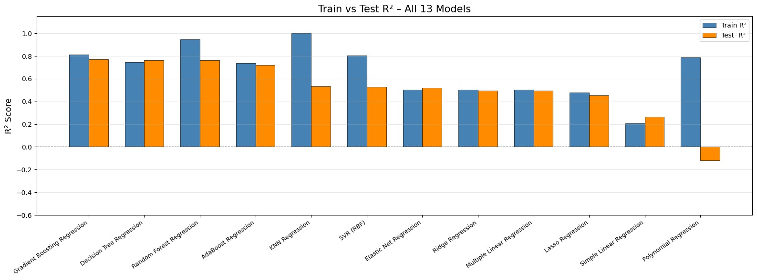
14

Slide 15
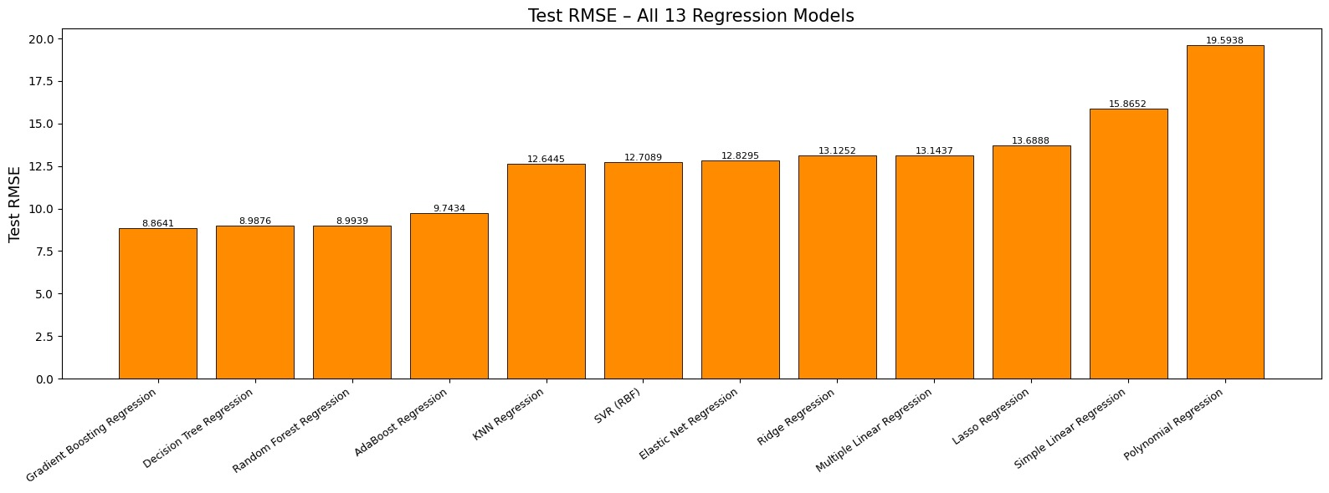
15

Slide 16
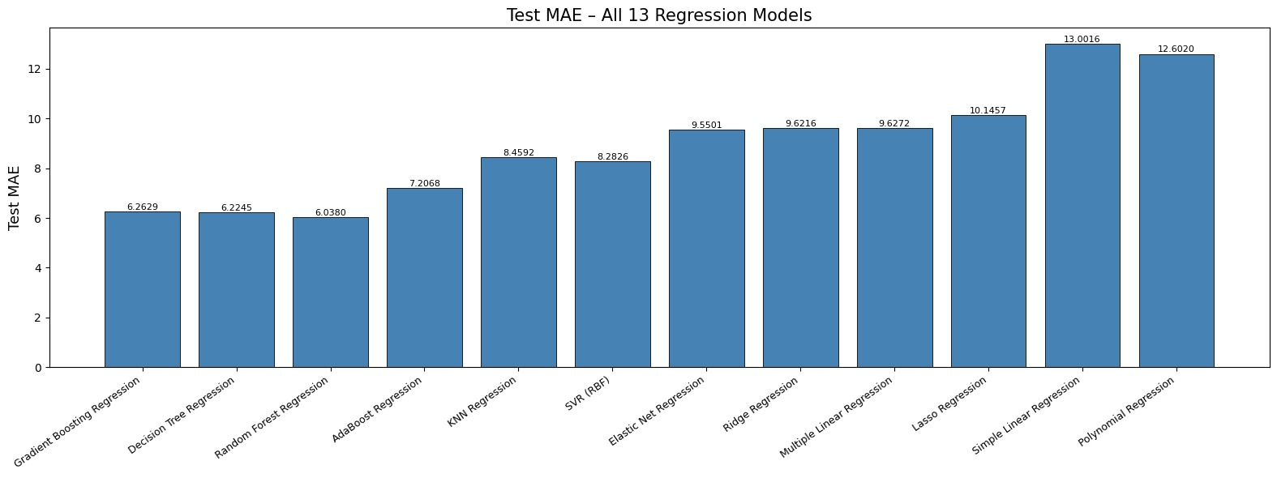
16

Slide 17
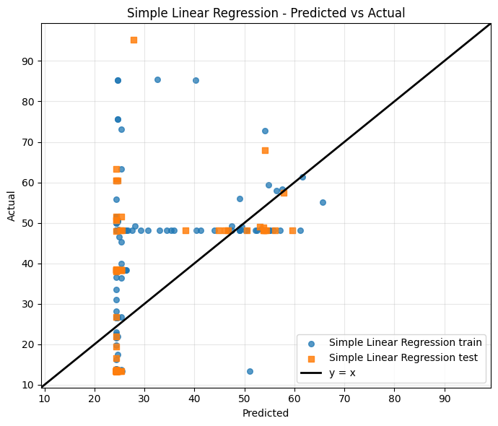
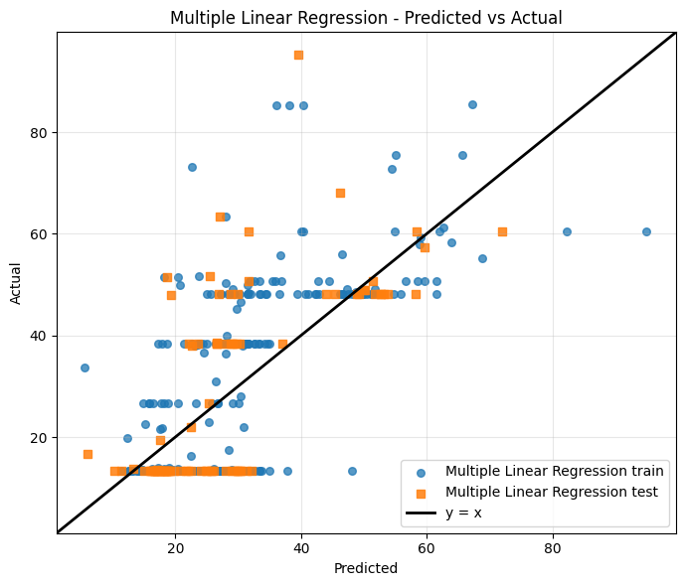
Simple Linear Regression Multiple Linear Regression
17

Slide 18
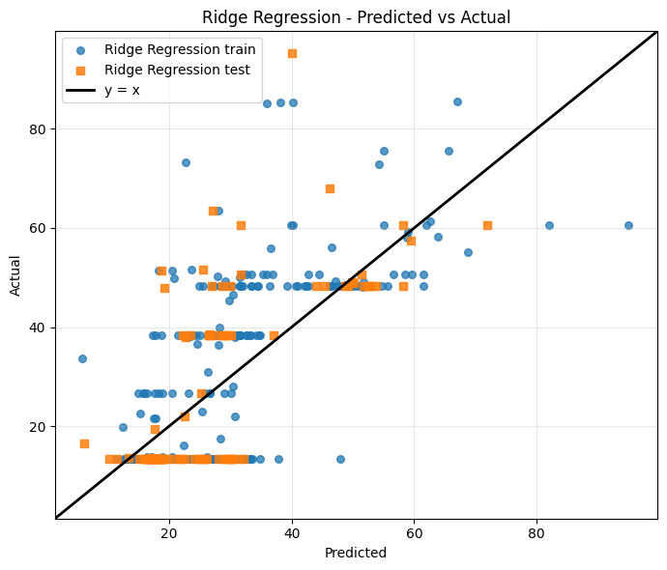
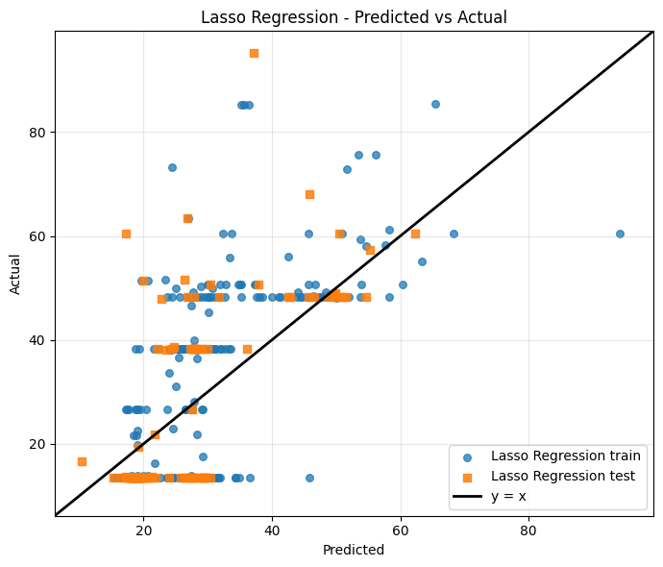
Ridge Regression Lasso Regression
18

Slide 19
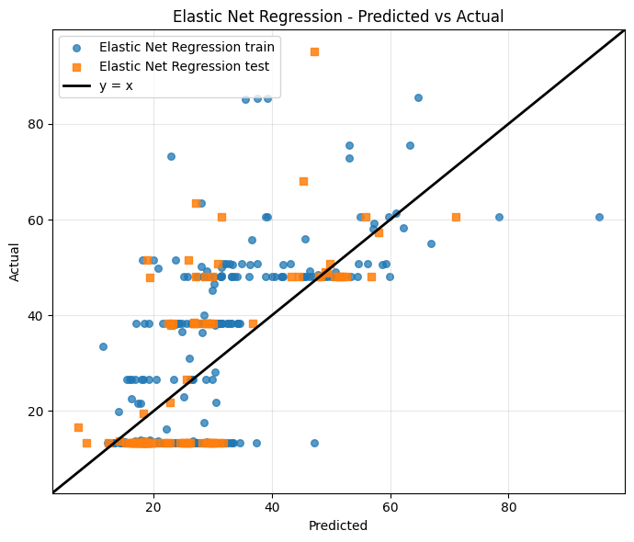
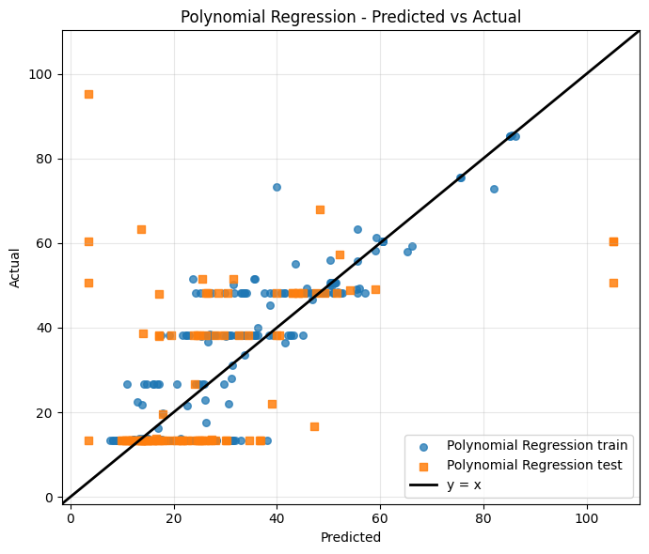
Elastic Net Regression Polynomial Regression
19

Slide 20
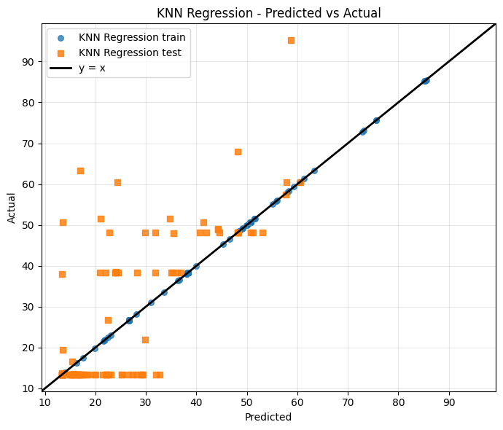
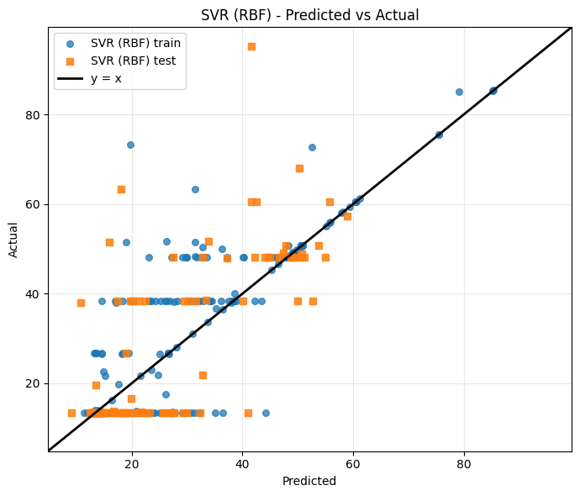
KNN Regression SVR Regression
20

Slide 21
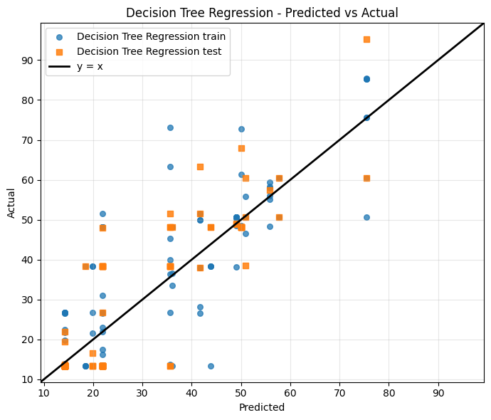
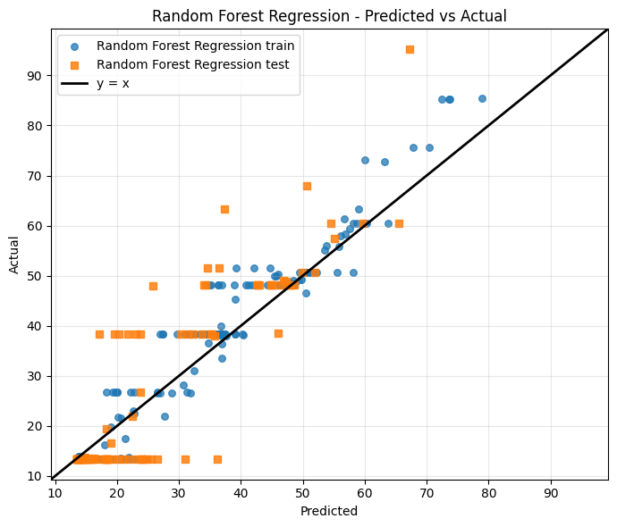
Decision Tree Regression Random Forest Regression
21

Slide 22
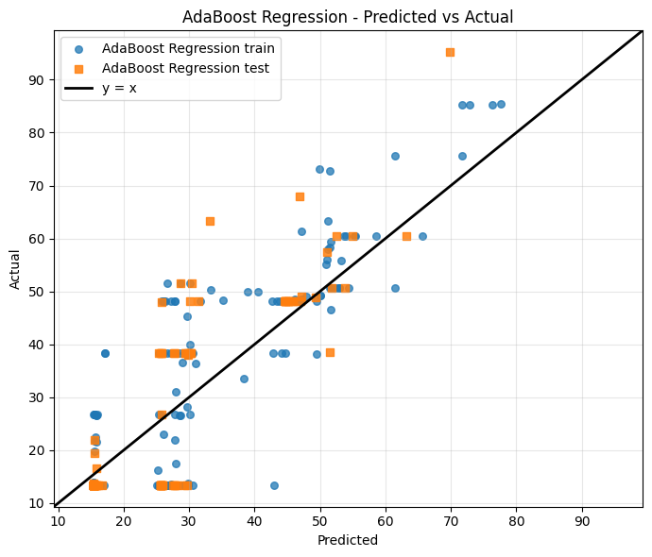
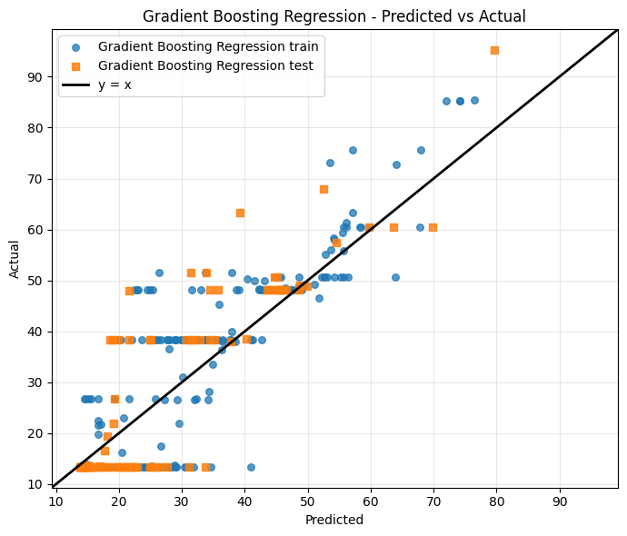
AdaBoost Regression Gradient Boosting Regression
22

Slide 23
VIII. Conclusion and Future Scope
Conclusion
• Machine learning models can successfully predict transformer Health Index using DGA gas and oil quality parameters.
• Comparative analysis shows that ensemble learning models perform better for complex nonlinear transformer condition data.
• Gradient Boosting Regression provides the best prediction performance with test R² around 0.77.
• The proposed approach enables automated condition monitoring and supports predictive maintenance planning.
• This helps in reducing unexpected transformer failures and improving power system reliability.
Future Scope
• Prediction accuracy can be improved by using larger datasets and real-time monitoring data from online sensors.
• Additional features such as temperature variations, load conditions, vibration signals, and environmental factors can be included.
• Advanced machine learning methods like deep learning and hybrid ensemble techniques can be explored.
• The model can be integrated into smart substation monitoring systems for continuous health assessment.
• Practical industrial deployment can help validate and further optimize the prediction framework.
23

Slide 24
REFERENCES
J. Lin, L. Y. Yeo, H. Nabipour Afrouzi, M. M. Ektesabi, and J. Tavalaei, “From limited data to reliable diagnosis: an interpretable deep learning framework for transformer fault analysis,” , 2025[Crossref]
R. A. Prasojo, M. A. A. Putra, E. Ekojono, M. E. Apriyani, A. N. Rahmanto, S. S. M. Ghoneim, K. Mahmoud, M. Lehtonen, and M. M. F. Darwish, “Precise transformer fault diagnosis via random forest model enhanced by synthetic minority over-sampling technique,” Electric Power Systems Research, vol. 220, 2023[Crossref]
P. A. R. Azmi, M. Yusoff, and M. T. M. Sallehud-din, “Improving transformer failure classification on imbalanced DGA data using data-level techniques and machine learning,” Energy Reports, vol. 13, pp. 264–277, 2025.[Crossref]
M. S. Ali, A. H. Abu Bakar, A. Omar, A. S. A. Jaafar, and S. H. Mohamed, “Conventional methods of dissolved gas analysis using oil-immersed power transformer for fault diagnosis: A review,” Electric Power Systems Research, vol. 216, 2023.[Crossref]
24

Slide 25
5 Q. Min, Z. Hong, D. Zou, H. Sun, Q. Chen, B. Peng, and T. Zhao, “A dissolved gas prediction method for transformer on-load tap changer oil integrating anomaly detection and deep temporal modeling,” Energies, vol. 18, no. 5079, 2025[Crossref]
6 B. C. Mateus, M. Mendes, J. T. Farinha, and A. Martins, “Hybrid deep learning for predictive maintenance: LSTM, GRU, CNN and dense models applied to transformer failure forecasting,” Energies, vol. 18, no. 5634, 2025[Crossref]
7 A. Nanfak, E. Samuel, I. Fofana, F. Meghnefi, M. G. Ngaleu, and C. H. Kom, “Traditional fault diagnosis methods for mineral oil-immersed power transformer based on dissolved gas analysis: Past, present and future,” IET Nanodielectrics, vol. 7, pp. 97–130, 2024.[Crossref]
8 A. Wajid et al., “Comparative performance study of dissolved gas analysis (DGA) methods for identification of faults in power transformer,” International Journal of Energy Research, 2023.[Crossref]
25

Slide 26
THANK YOU
26

