Slide 1
ARTIFICIAL INTELLIGENCE
Subhangi Ringasia RA1911003010663
Swagata Das RA1911003010695
MINI PROJECT

Slide 2
Cab Price Prediction

Slide 3
Introduction

Slide 4
Recent years are witnessing the rapidly rising worldwide ride-on-demand (RoD) services market, such as Uber and OLA cabs. RoD service attracts passengers by its comfort, affordable prices, and versatile service. In their daily transportation, a growing number of passengers now take RoD service as a standard option. Dynamic pricing is the central and distinctive characteristic of the RoD service and represents the attempt to balance supply (the number of cars on the road) and demand (the number of requests from passengers): higher prices decrease demand and increase supply in a busy area, whereas lower prices in a non-busy area do the opposite. For both drivers and passengers, this makes the service more responsive. We extract relevant features and predict the dynamic prices based on the data, taking the dataset from Kaggle as an example. We consider travel distance, tiime and weather conditions as the main features for predicting dynamic prices by analyzing the associations between dynamic prices and different data features.

Slide 5
A linear regression model is trained to make predictions of the dynamic data price. Linear Regression is one of the machine learning algorithms where the outcome is estimated by the use of known parameters that are associated with output. Instead of trying to classify values into different groups, it is used to predict values within a continuous range. The known parameters are used to predict the unknown parameter or the result. When known and unknown parameters are plotted on the X and Y axes, it forms a continuous and steady slope.

Slide 6
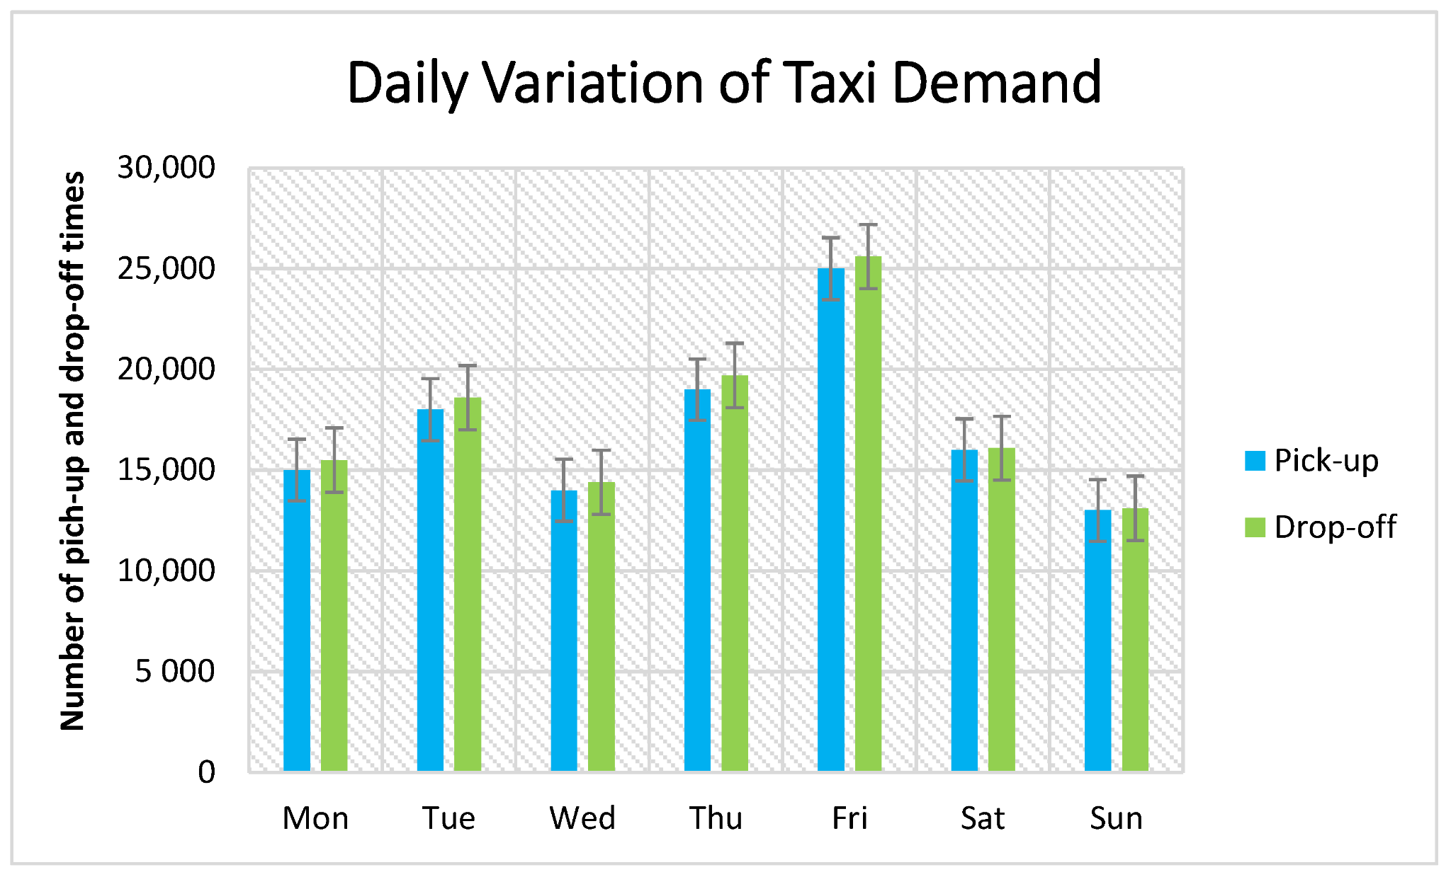

Slide 7
Objective

Slide 8
● To predict dynamic price (trip fare) by considering the features (travel distance, travel time and weather conditions) which are strongly correlated to dynamic price (trip fare)
● To achieve good accuracy.

Slide 9
Literature survey

Slide 10
The first paper is Predicting the price of Used Car Using Machine Learning Techniques.
In this paper, they investigate the application of supervised machine learning techniques
to predict the price of used cars in Mauritius. The predictions are based on historical
data collected from daily newspapers. Different techniques like multiple linear
regression analysis, k-nearest neighbors, naïve bayes and decision trees have been
used to make the predictions.
The Second paper is Car Price Prediction Using Machine Learning Techniques.
Considerable number of distinct attributes are examined for the reliable and accurate
prediction. To build a model for predicting the price of used cars in Bosnia and
Herzegovina, they have applied three machine learning techniques (Artificial Neural
Network, Support Vector Machine and Random Forest).

Slide 11
The Third paper is Price Evaluation model in second hand car system based on BP
neural networks. In this paper, the price evaluation model based on big data analysis is
proposed, which takes advantage of widely circulated vehicle data and a large number
of vehicle transaction data to analyze the price data for each type of vehicles by using
the optimized BP neural network algorithm. It aims to establish a second-hand car price
evaluation model to get the price that best matches the car.

Slide 12
Methodology

Slide 13
There are two primary phases in the system: 1. Training phase: The system is trained
by using the data in the data set and fits a model (line/curve) based on the algorithm
chosen accordingly. 2. Testing phase: the system is provided with the inputs and is
tested for its working. The accuracy is checked. And therefore, the data that is used to
train the model or test it, has to be appropriate. The system is designed to detect and
predict price of used car and hence appropriate algorithms must be used to do the two
different tasks. Before the algorithms are selected for further use, different algorithms
were compared for its accuracy. The well-suited one for the task was chosen.

Slide 14
Some other important phases of predicting values are as follows:
Data Acquisition – It is the primary stage of data analytics which includes a process of obtaining data. There may be more than one source to obtain the data such as downloading the data files from web, obtaining a real world data through sensors or surveys, or getting real world data from any organization or industry.

Slide 15
2. Data Cleaning– It is the process of preparing data for analysis by deleting or altering data which is inaccurate, incomplete, irrelevant, duplicate, or in improper format. Data cleaning include a variety of tasks such as dealing with missing values, identifying duplicity and removing it, coping with absurd values, and dealing with invalid formats, etc. It is a tedious task which can become interesting and amusing with the help of visualizations of data. Visualizations include various plots like histogram, line plot, bar graph, scatter plot, heat map, strip plot, regression plot, join plot, pair plot and many more.

Slide 16
3. Test Data– This stage can also be called as data splitting. There are two common approaches in which data split can take place. One approach is train- test split, in which data split takes place in two portions, training and testing dataset. In fact, the first part is a larger subset of data (such as 80% of the original data) and the second part is typically a smaller subset of data (the remaining 20% of the data). A predictive model is developed using the training set and such a trained model is then applied to the test set to make predictions. Figure 2 shows the pictorial representation of Train- Test split.

Slide 17
4. Model Training & Building– This stage is where the machine learning algorithms come into existence. Based on the type (i.e., continuous, categorical etc.) of target variable and many other circumstances of the analytical problem, one or more machine learning algorithms are chosen to build one or more models for the same problem. Some basic machine learning algorithms include linear regression, logistic regression, etc. Finally, the built model is trained using the training dataset.

Slide 18
5. Model Testing– In this stage, the trained model is tested by identifying errors in predictions. The errors in predictions are calculated by the difference between the actual value and the predicted value (using trained model) of target variable with the help of testing dataset.

Slide 19
System Flow Diagram

Slide 20
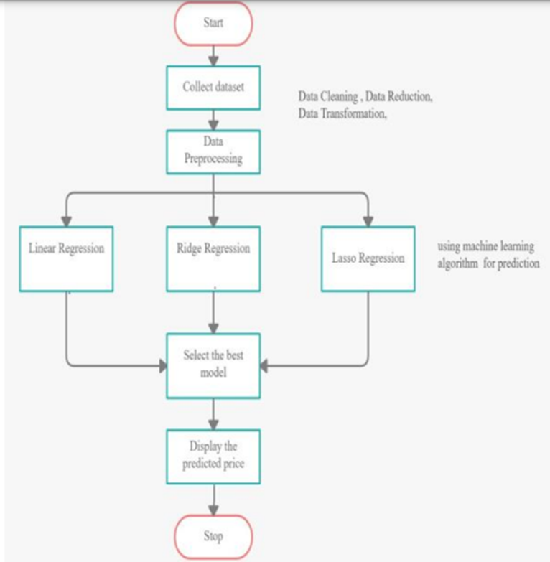

Slide 21
As shown in the above figure, the process starts by collecting the dataset. The next step
is to do Data Preprocessing which includes Data cleaning, Data reduction, Data
Transformation. Then, using Linear Regression algorithm, we will predict the
price.
This model gives best accuracy.

Slide 22
Results and discussion

Slide 23
This project uses dataset obtained from kaggle to predict cab price. In this project Linear Regression algorithm is selected for high accuracy. With Linear Regression, there are multiple models you can generate for the same set of data. You can designate many different values for θ0 and θ1 (as noted in the diagrams above), and generate different lines to model the relationship between the input x and prediction ŷ. Simple linear regression models the relationship between the magnitude of one variable and that of a second—for example, as X increases, Y also increases. Or as X increases, Y decreases. Correlation is another way to measure how two variables are related: see the section “Correlation”. The difference is that while correlation measures the strength of an association between two variables, regression quantifies the nature of the relationship. Linear Regression attempt to model the relationship between two variables by fitting a
linear equation to observed data. The other is considered to be dependent variable.

Slide 24
The best chosen algorithm analyses and processes the dataset for prediction of car
Price giving an accuracy of 92.8%.
In future this machine learning model may bind with various website which can provide
real time data for price prediction. Also we may add large historical data of car price
which can help to improve accuracy of the machine learning model. We can build an
android app as user interface for interacting with user. For better performance, we plan
to judiciously design deep learning network structures, use adaptive learning rates and
train on clusters of data rather than the whole dataset.

Slide 25
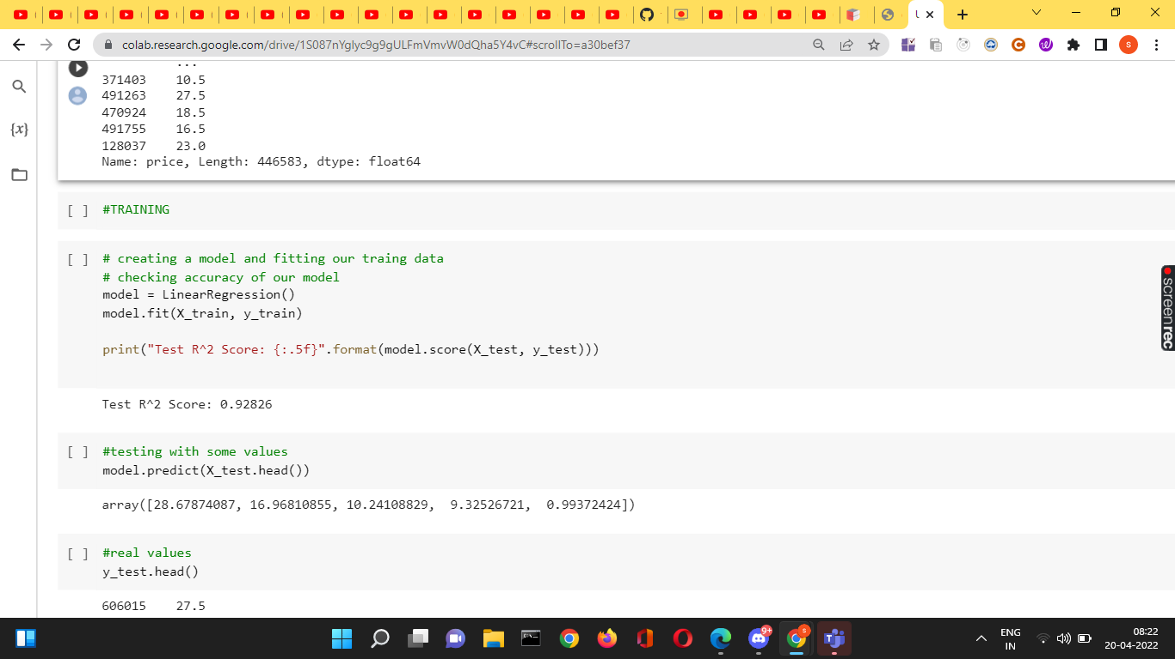

Slide 26
Conclusion

Slide 27
The increased prices of new cars and the financial incapability of the customers to buy
them, Used Car sales are on a global increase. Therefore, there is an urgent need for a
Used Car Price Prediction system which effectively determines the worthiness of the car
using a variety of features. The proposed system will help to determine the accurate
price of used car price prediction. This paper uses Linear Regression to predict values.

Slide 28
References

Slide 29
[1] Sameerchand Pudaruth, “Predicting the Price of Used Cars using Machine Learning Techniques”;(IJICT 2014)
[2] Enis gegic, Becir Isakovic, Dino Keco, Zerina Masetic, Jasmin Kevric, ”Car Price Prediction Using Machine Learning”; (TEM Journal 2019)
[3] Ning sun, Hongxi Bai, Yuxia Geng, Huizhu Shi, “Price Evaluation Model In Second Hand Car System Based On BP Neural Network Theory”; (Hohai University Changzhou, China)
[4] Nitis Monburinon, Prajak Chertchom, Thongchai Kaewkiriya, Suwat Rungpheung, Sabir Buya, Pitchayakit Boonpou, “Prediction of Prices for Used Car by using Regression Models” (ICBIR 2018)
[5] Doan Van Thai, Luong Ngoc Son, Pham Vu Tien, Nguyen Nhat Anh, Nguyen Thi Ngoc Anh, “Prediction car prices using qualify qualitative data and knowledge-based system” (Hanoi National University)

Slide 30
Thank You

