Slide 1

SQL Project 1
E-Commerce Retail Analysis
by Swagath Koyada

Slide 2
Project Objectives
Perform data analysis on a transactional dataset using SQL queries in SQL Server Management Studio (SSMS).
Extract valuable insights, metrics, and patterns from the dataset to inform business decisions and strategies.

Slide 3
Key Tasks:
Join multiple tables to integrate relevant data sources.
Aggregate data to calculate metrics such as total revenue, average transaction value, and quantity sold.
Filter data to focus on specific segments or time periods of interest.
Identify trends and patterns in customer behavior, product sales, and transaction dynamics.
Present findings through SQL queries and potentially visualize results using SSMS or external tools.
Provide actionable recommendations based on analysis results to optimize business performance and enhance decision-making processes.

Slide 4
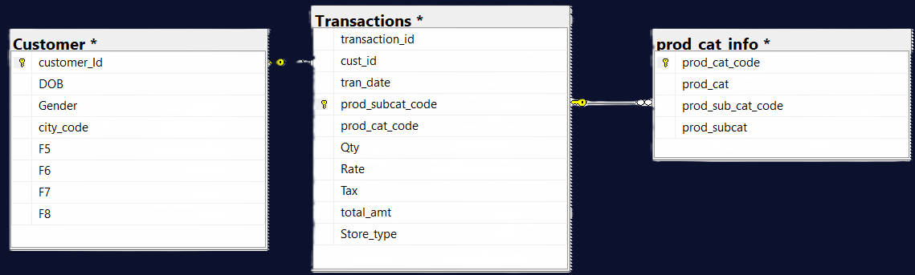
Database Schema

Slide 5
**Data Preparation and Understanding**

Slide 6
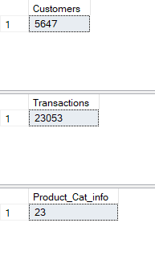
Question 1
Result
What is the total number of rows in each of the 3 tables in the database?
Query
SELECT COUNT(*) as Customers FROM Customer
SELECT COUNT(*) as Transactions FROM Transactions
SELECT COUNT(*) as Product_Cat_info FROM prod_cat_info

Slide 7

Question 2
What is the total number of transactions that have a return?
Result
Query
SELECT COUNT(*) as No_of_transactions FROM Transactions
WHERE total_amt < 0

Slide 8

Question 3
What is the time range of the transaction data available for analysis? Show the output in number of days, months and years simultaneously in different columns.
Result
Query
SELECT
DATEDIFF(DAY, MIN(tran_date), MAX(tran_date)) AS total_days,
DATEDIFF(MONTH, MIN(tran_date), MAX(tran_date)) AS total_months,
DATEDIFF(YEAR, MIN(tran_date), MAX(tran_date)) AS total_years
FROM Transactions

Slide 9

Question 4
Which product category does the sub- category "DIY" belong to?
Result
Query
SELECT * FROM prod_cat_info
WHERE prod_subcat = 'DIY'

Slide 10
**Data Analysis**

Slide 11

Question 1
Which channel is most frequently used for transactions?
Result
Query
SELECT TOP 1 Count(*) AS Most_Used, Store_type
FROM Transactions
GROUP BY Store_type
ORDER BY Most_Used desc

Slide 12

Question 2
What is the count of Male and Female customers in the database?
Result
Query
SELECT Gender, COUNT(*) AS Count FROM Customer
WHERE Gender IS NOT NULL
GROUP BY Gender

Slide 13

Question 3
From which city do we have the maximum number of customers and how many?
Result
Query
SELECT TOP 1 city_code, COUNT(*) AS Customer_count
FROM Customer
GROUP BY city_code
ORDER BY Customer_count DESC

Slide 14

Question 4
How many sub-categories are there under the Books category?
Result
Query
SELECT COUNT(Distinct prod_subcat) AS sub_cat_count
FROM prod_cat_info
WHERE prod_cat = 'Books'
GROUP BY prod_cat

Slide 15
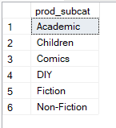
Additional Information for
Question 4
Result
How many sub-categories are there under the Books category?
Query
SELECT Distinct prod_subcat
FROM prod_cat_info
WHERE prod_cat = 'Books'

Slide 16

Question 5
What is the maximum quantity of products ever ordered in a single day?
Result
Query
SELECT TOP 1 CONVERT(VARCHAR, tran_date, 23) AS DATE, COUNT(Qty) AS Quantity FROM Transactions
GROUP BY tran_date
ORDER BY Quantity DESC

Slide 17

Additional Information for
Question 5
What is the maximum quantity of products ever ordered in a single day and which category and sub category it belongs to?
Result
Query
Select Top 1 Convert(Varchar, T.tran_date, 23) as Date, Count(T.Qty) as Quantity, P.prod_cat, P.prod_subcat from Transactions T
Inner Join prod_cat_info P
on T.prod_cat_code = P.prod_cat_code and T.prod_subcat_code = P.prod_sub_cat_code
Group By T.tran_date, P.prod_cat, P.prod_subcat
Order By Quantity Desc

Slide 18

Question 6
What is the net total revenue generated in categories Electronics and Books?
Result
Query
SELECT SUM(total_amt) AS Total_Revenue, prod_cat FROM Transactions t
Inner Join prod_cat_info p
on t.prod_cat_code = p.prod_cat_code
and t.prod_subcat_code = p.prod_sub_cat_code
Group by p.prod_cat
Having p.prod_cat IN ('Electronics', 'Books')

Slide 19
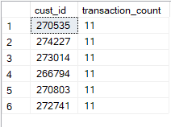
Question 7
How many customers have > 10 transactions with us, excluding returns?
Result
Query
SELECT cust_id, COUNT(transaction_id) AS transaction_count FROM Transactions
WHERE total_amt > 0
GROUP BY cust_id
HAVING COUNT(transaction_id) > 10

Slide 20

Question 8
What is the combined revenue earned from the "Electronics " & "Clothing" categories, from "Flagship stores"?
Result
Query
Select round(Sum(total_amt), 2) as combined_revenue, Store_type from Transactions t
Inner join prod_cat_info p
on t.prod_cat_code = p.prod_cat_code
and t.prod_subcat_code = p.prod_sub_cat_code
Where p.prod_cat IN ('Electronics', 'Clothing')
Group by store_type
Having store_type = 'Flagship store'

Slide 21
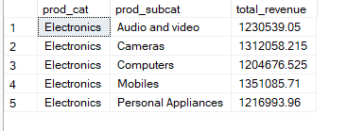
Question 9
What is the total revenue generated from "Male" customers in "Electronics" category? Output should display total revenue by prod sub-cat.
Result
Query
SELECT prod_cat, prod_subcat, SUM(total_amt) AS total_revenue FROM Customer c
JOIN Transactions t ON c.customer_Id = t.cust_id
JOIN prod_cat_info p ON t.prod_cat_code = p.prod_cat_code AND t.prod_subcat_code = p.prod_sub_cat_code
WHERE total_amt > 0 and Gender = 'M'
GROUP BY prod_cat, prod_subcat
Having prod_cat = 'Electronics'

Slide 22
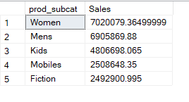
Question 10
What is percentage of sales and returns by product sub catgory; display only top 5 sub categories in terms of sales?
Result in terms of “SALES”
Query
SELECT TOP 5 (prod_subcat), SUM(total_amt) AS Sales FROM Transactions t
INNER JOIN prod_cat_info p
ON t.prod_cat_code = p.prod_cat_code
AND t.prod_subcat_code = p.prod_sub_cat_code
WHERE t.total_amt > 0
GROUP BY prod_subcat
ORDER BY Sales Desc

Slide 23
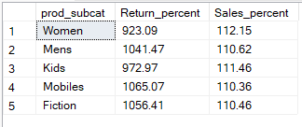
Question 10
Query
WITH perABS
as(SELECT TOP 5 (prod_subcat),
ABS(SUM(CASE WHEN total_amt < 0 THEN total_amt ELSE 0 END)) as Returns,
SUM(CASE WHEN total_amt > 0 THEN total_amt ELSE 0 END) as Sales FROM Transactions t
INNER JOIN prod_cat_info p
on t.prod_cat_code = p.prod_cat_code
and t.prod_subcat_code = p.prod_sub_cat_code
GROUP BY prod_subcat
ORDER BY Sales DESC)
SELECT prod_subcat, ROUND((((Returns + Sales)/ Returns)*100), 2) AS Return_percent,
ROUND((((Returns + Sales)/ Sales)*100), 2) AS Sales_percent FROM perABS
Result in terms of “PERCENTAGE”

Slide 24
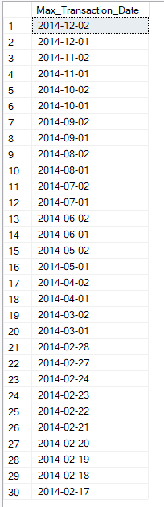
Result
Question 11
For all customers aged between 25 to 35 years find what is the net total revenue generated by these consumers in last 30 days of transactions from max transaction date available in the data?
Query
SELECT TOP 30 CONVERT(VARCHAR, tran_date, 23) AS Max_Transaction_Date FROM Transactions
GROUP BY tran_date
ORDER BY tran_date DESC

Slide 25

Question 11
Query
WITH ABC
AS(SELECT TOP 30 (tran_date), SUM(total_amt) AS Total_amount FROM Customer c
INNER JOIN Transactions t
ON t.cust_id = c.customer_id
WHERE DATEDIFF(YEAR,DOB,GETDATE()) BETWEEN 25 AND 35
GROUP BY tran_date
ORDER BY tran_date DESC)
SELECT SUM(Total_amount) AS Final_revenue FROM ABC
Result

Slide 26

Question 12
Which product category has seen the max value of returns in the last 3 months of transactions?
Result
Query
SELECT prod_cat, COUNT(Qty) AS No_of_returns FROM Transactions t
INNER JOIN prod_cat_info p
ON t.prod_cat_code = p.prod_cat_code
WHERE total_amt < 0 AND DATEDIFF(month, '2014-09-01',tran_date)=3
GROUP BY prod_cat

Slide 27

Question 12
-- product category having maximum value of returns in last three months --
Query
Result
WITH ABC
AS(SELECT prod_cat, transaction_id, total_amt FROM Transactions t
INNER JOIN prod_cat_info p
ON t.prod_cat_code = p.prod_cat_code
WHERE total_amt < 0 AND DATEDIFF(MONTH, '2014-09-01’, tran_date)=3)
SELECT ABS(SUM(total_amt)) AS Return_amount_cat FROM ABC

Slide 28

Question 13
Which store-type sells the maximum products; by value of sales amount and by quantity sold?
Result
Query
SELECT TOP 1 store_type, ROUND(SUM(total_amt), 2) AS total_sales FROM Transactions
GROUP BY store_type
ORDER BY total_sales DESC

Slide 29

Question 13
Query
WITH SalesByAmount AS (
SELECT store_type, ROUND(SUM(total_amt), 2) AS total_sales FROM Transactions
GROUP BY store_type
),
SalesByQuantity AS (
SELECT store_type, SUM(Qty) AS total_quantity_sold FROM Transactions
GROUP BY store_type
)
SELECT 'By Amount' AS sales_criteria, sba.store_type, sba.total_sales FROM SalesByAmount sba
WHERE sba.total_sales = (SELECT MAX(total_sales) FROM SalesByAmount)
UNION ALL
SELECT 'By Qty' AS sales_criteria, sbq.store_type, sbq.total_quantity_sold FROM SalesByQuantity sbq
WHERE sbq.total_quantity_sold = (SELECT MAX(total_quantity_sold) FROM SalesByQuantity)
Result

Slide 30

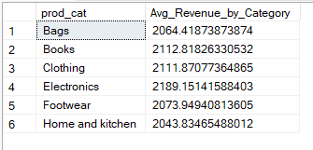
Question 14
What are the categories for which average revenue is above the overall average.
Result
Query
SELECT ROUND(AVG(total_amt), 2) AS Overall_Avg_Revenue
FROM Transactions
SELECT prod_cat, AVG(total_amt) AS Avg_Revenue_by_Category
FROM Transactions t
Inner join prod_cat_info p
on t.prod_cat_code = p.prod_cat_code
and t.prod_subcat_code = p.prod_sub_cat_code
GROUP BY prod_cat;

Slide 31
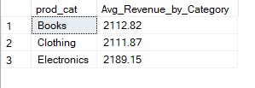
Question 14
Query
WITH CategoryAverage AS (
SELECT prod_cat, ROUND(AVG(total_amt), 2) AS Avg_Revenue_by_Category FROM Transactions t
Inner join prod_cat_info p
on t.prod_cat_code = p.prod_cat_code
and t.prod_subcat_code = p.prod_sub_cat_code
GROUP BY prod_cat
)
SELECT prod_cat, Avg_Revenue_by_Category FROM CategoryAverage
WHERE avg_revenue_by_category > (SELECT AVG(total_amt) FROM Transactions)
Result

Slide 32
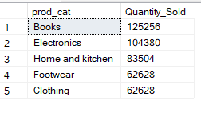
Question 15
Find the average and total revenue by each subcategory for the categories which are among top 5 categories in terms of quantity sold.
Result
Query
SELECT TOP 5(prod_cat), COUNT(Qty) AS Quantity_Sold FROM Transactions t
INNER JOIN prod_cat_info p ON t.prod_cat_code = t.prod_cat_code
WHERE total_amt > 0
GROUP BY prod_cat
ORDER BY Quantity_Sold DESC

Slide 33
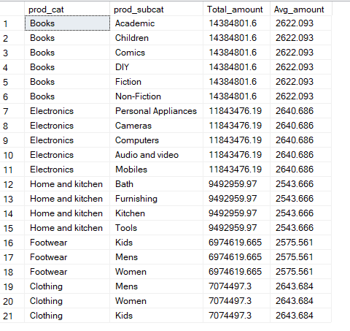
Result
Question 15
Query
SELECT prod_cat, prod_subcat, ROUND(SUM(total_amt), 3) AS Total_amount, ROUND(AVG(total_amt), 3) AS Avg_amount FROM Transactions t
INNER JOIN prod_cat_info p ON t.prod_cat_code = p.prod_cat_code
WHERE total_amt > 0 AND prod_cat IN ('Books', 'Electronics', 'Home and kitchen', 'Footwear', 'Clothing’)
GROUP BY prod_cat, prod_subcat
ORDER BY CASE WHEN prod_cat = 'Books' THEN 1
WHEN prod_cat = 'Electronics' THEN 2
WHEN prod_cat = 'Home and kitchen' THEN 3
WHEN prod_cat = 'Footwear' THEN 4
ELSE 5
END

Slide 34
Conclusion:
In this project, we conducted data analysis on transaction data using SQL queries in SSMS (SQL Server Management Studio). The objective was to extract meaningful insights and metrics from the dataset. We performed various tasks such as joining tables, aggregating data, filtering records, and sorting results to fulfill specific analysis requirements.
Throughout the project, we demonstrated proficiency in SQL query writing, leveraging a variety of SQL functions, clauses, and operators to manipulate and analyze the dataset effectively. We utilized Common Table Expressions (CTEs), aggregation functions (e.g., SUM, COUNT, AVG), and logical operations to extract insights such as total revenue, average revenue, top-selling categories, and customer behavior patterns.

Slide 35
Conclusion:
Additionally, we utilized SQL features such as joins to combine related tables, WHERE clause to filter data based on specified conditions, ORDER BY clause to sort results, and TOP keyword to limit the number of rows returned.
By applying these SQL techniques, we were able to address the project objectives, derive valuable insights from the transaction data, and provide actionable recommendations based on the analysis results. Overall, this project demonstrates the power and versatility of SQL for data analysis tasks in SSMS.

Slide 36
THANK YOU

