Slide 1
iLoan
An online portal where user can check wheather he/she can get a loan or not just giving some basic details about them.

Slide 2
Tech Stack
1. Frontend (React)
The React frontend will:
  Show the input form (e.g., Age, Income, Credit History)
  Submit the form to the backend API
  Display the prediction result (e.g., "Loan Approved: Yes/No")
2. Machine Learning Model (Python + scikit-learn)
The ML model will take the input from user and predict wheather he/she can get the loan based on the details that user has given.

Slide 3
3. Backend (Flask or Django or Node.js)
Accept data from React, preprocess it, run the model, and return the result.
4. Database (MongoDB)
to store details like:
User details
Prediction logs
Application history, etc.

Slide 4
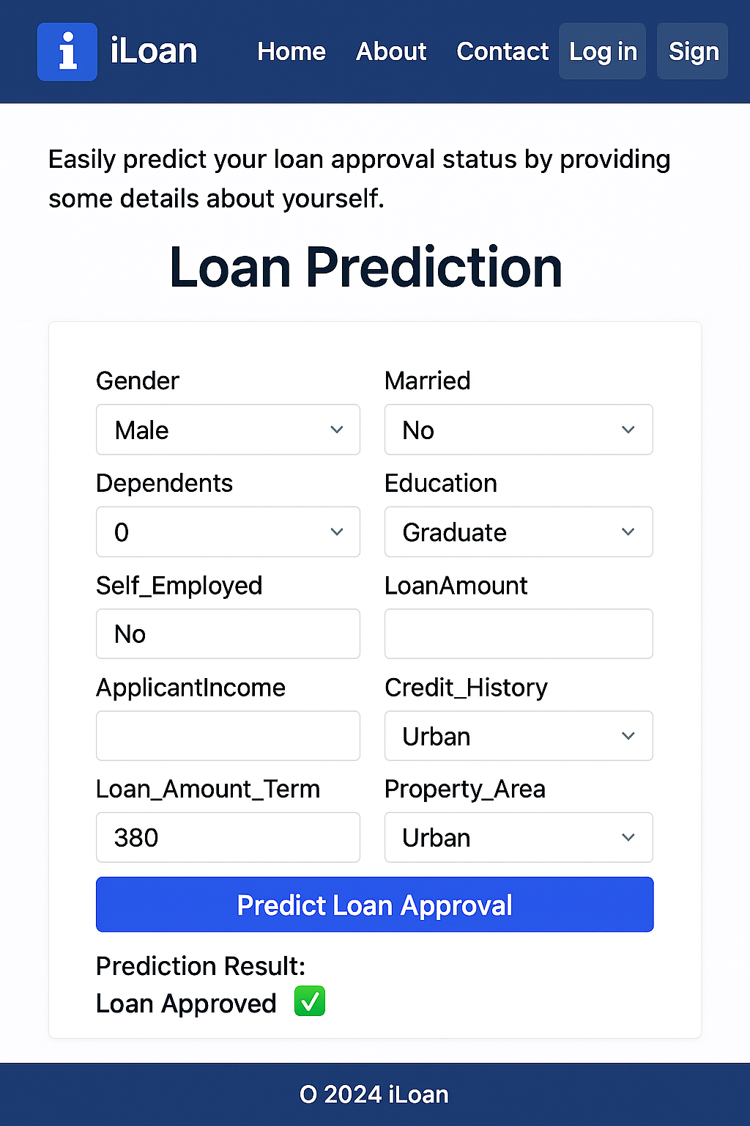
Design

