Slide 1
Tutorial
By Swajan Rajbanshi

Slide 2
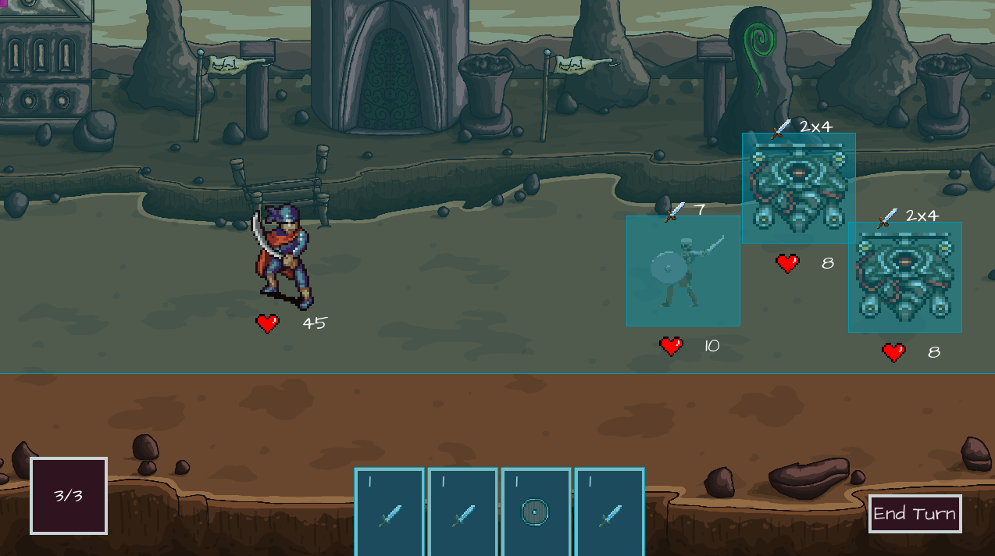
What the enemy will do next.
Hp of the player.
Hp of the enemy.

Slide 3



Mana bar/ Number of turns the player has.

Slide 4
Card UI

Slide 5

1 = number of mana it will take to use the card

Slide 6


Sword = Attack card
Shield = Defense card

Slide 7
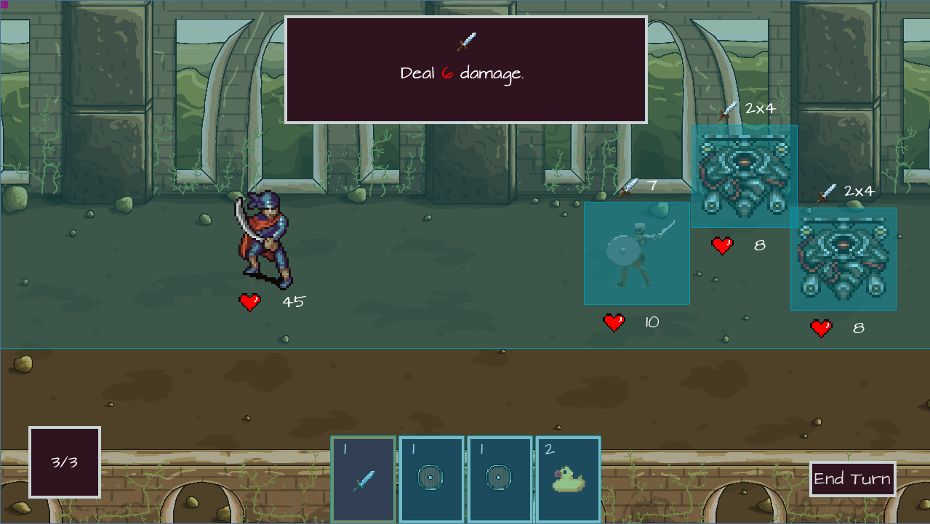


A tooltip to give info about the hovered card.
Hovering over a card highlights it.

Slide 8
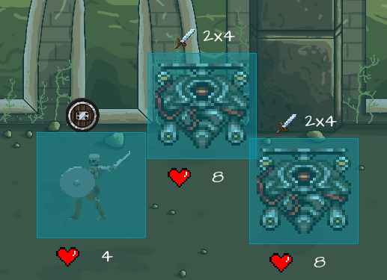
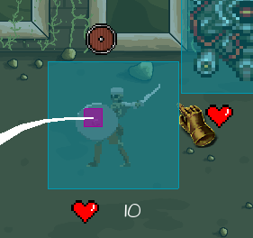
The Blue box is the hit-box of the enemy, if the player aims out site the hit box, the card will not be used. (Depends on the card).
If the player aims inside the hit-box then a point/hand will indicate that the attack card can be released.

Slide 9
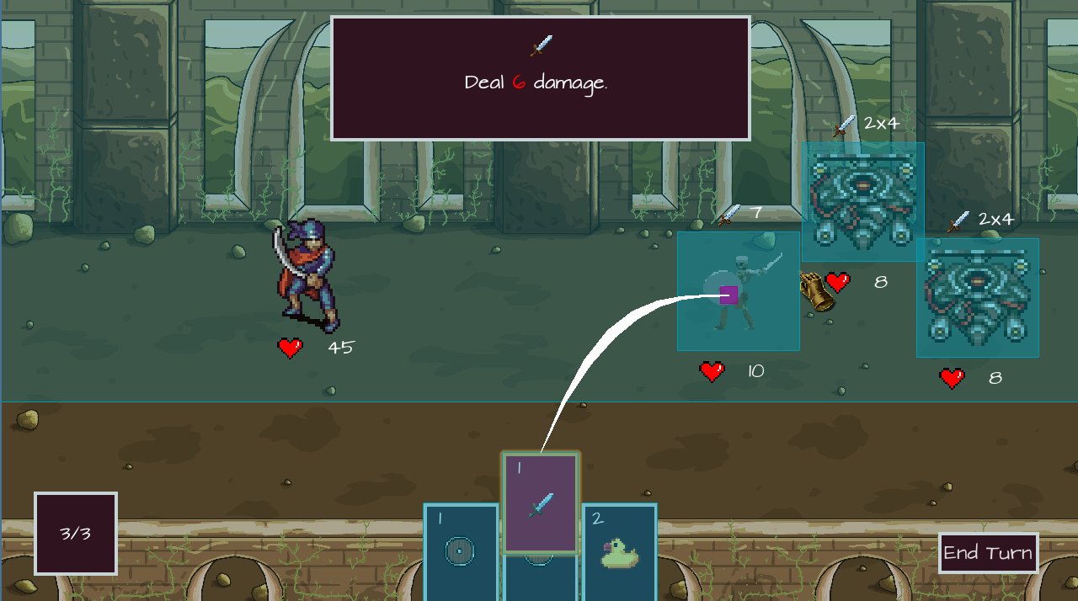
The hand when the player hovers in the hitbox.

Slide 10
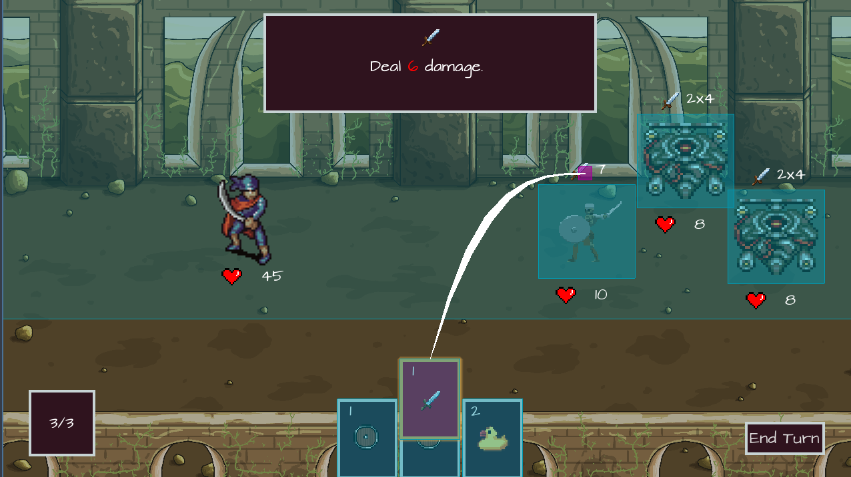
The hand will not appear if the player misses the hitbox.

Slide 11
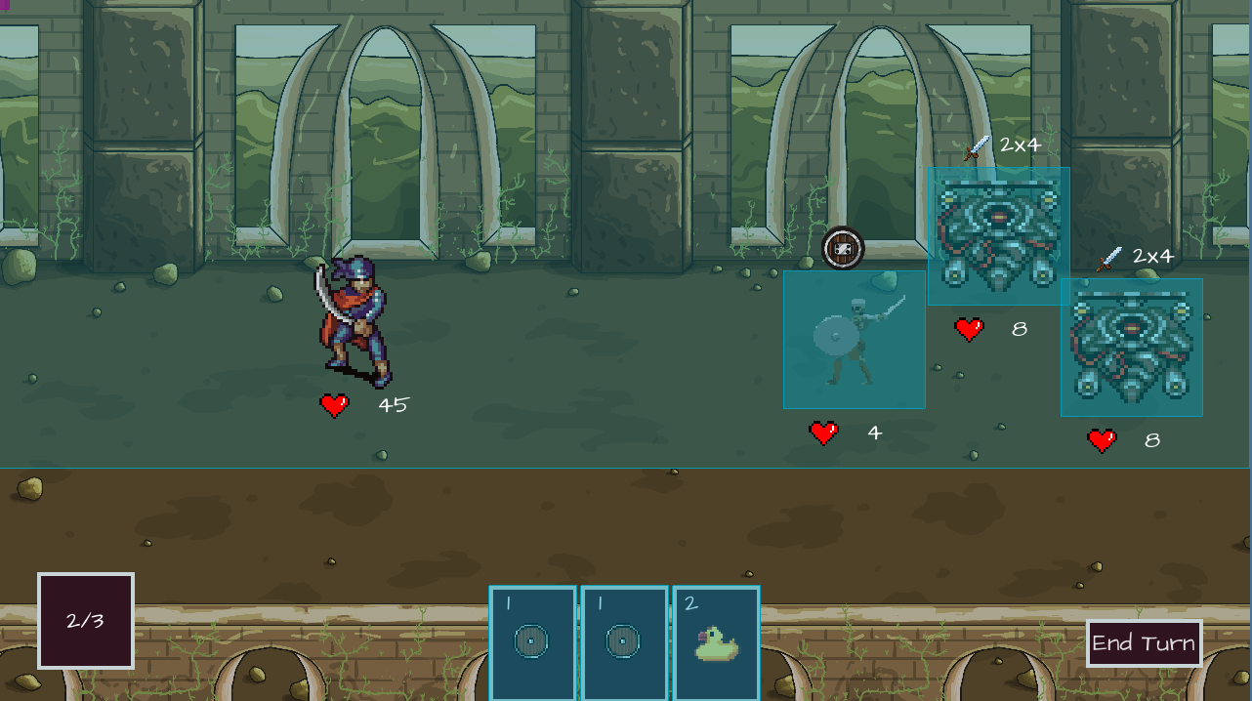
The card is disposed after used.

Slide 12
Mana bar decreases when card of certain value is used.

Slide 13
Big shield of certain value will be used next.

Slide 14
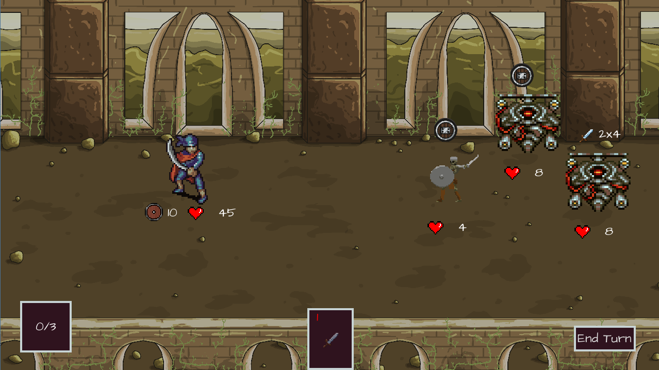
Shield Hero moment.

Slide 15
When all the mana in the mana bar is used (0/3) no other card can be used
and the card is dimmed.

Slide 16
The Player has to End turn.

Slide 17
All teachings are mere references.
The true experience is living one’s life.
- Ming-Dao Deng
Enjoy the game !! 😃😃

