Slide 1
Hw03 : shader

Slide 2
Assignment 03
Subdivision
Phong Shading

Slide 3
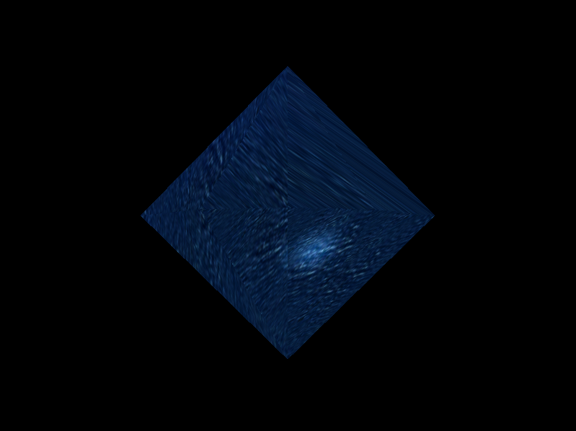
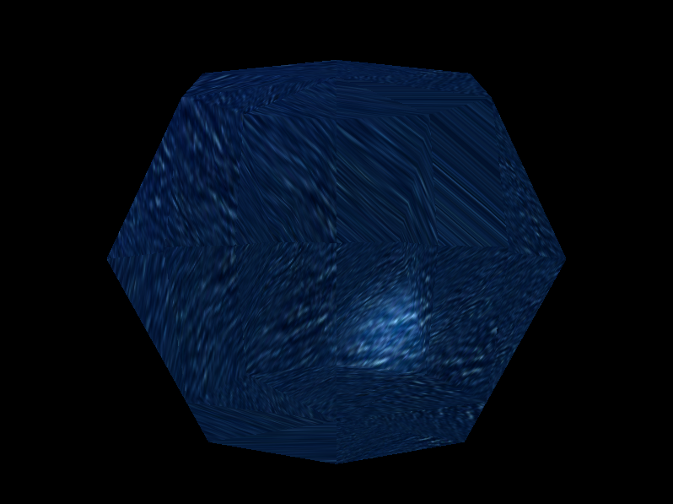
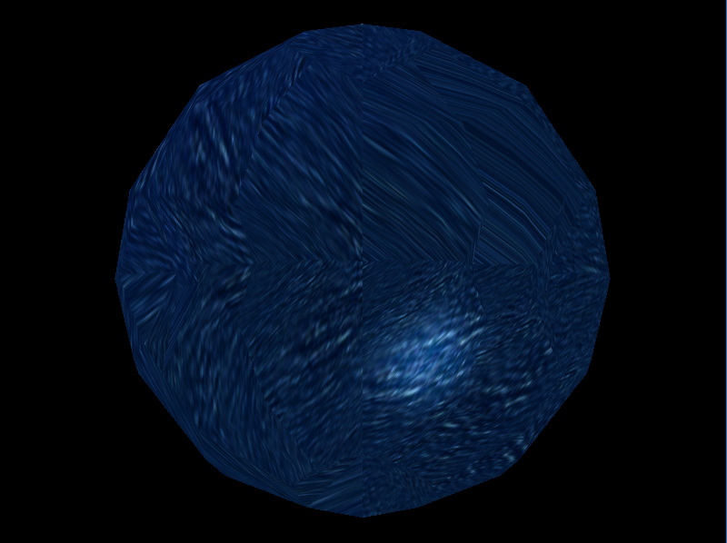
Result
LEVEL = 0
LEVEL = 1
LEVEL = 2

Slide 4
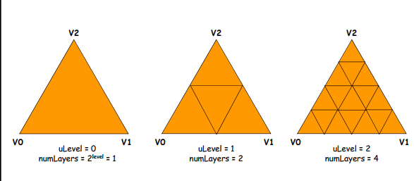
Subdivision (I)

Slide 5
Subdivision (II)
Uniform Variables
Level // subdivision 的等級
Radius = 1.0f// 距離質心的距離
Centroid = (0.0f,1.0f,0.0f,1.0f)// 質心的位置

Slide 6
Subdivision : Vertex Shader
out Vertex{
vec3 vertexEyeSpace;
vec3 normal;
vec2 _texcoord;
};
Output ModelView position / vertexEyeSpace
Output normal / texture coordinate

Slide 7
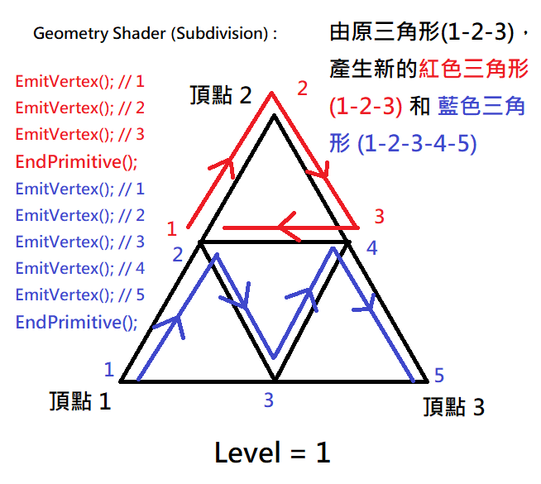
Subdivision : Geometry Shader
layout ( triangles ) in;
layout ( triangle_strip,
max_vertices=85 ) out;
in Vertex{
vec3 vertexEyeSpace;
vec3 normal;
vec2 _texcoord;
}vertex[];
out vec3 vertexEyeSpace;
outvec3 normal;
out vec2 tex;

Slide 8
Subdivision (II)
Geometry out Variables
//vertex position in eye space, eye position is (0, 0, 0).
vec3 vertexEyeSpace;
vec3 normal; //vertex normal
vec2 _texcoord; //you can have your own decision
vec4 gl_Position; //Projection vertex position

Slide 9
Subdivision : Fragment Shader
uniform sampler2D colorTexture;
in vec2 tex;
in vec3 vertexEyeSpace;
in vec3 normal;
Use Texture coordinate to Access Texture and combine with Phong Lighting Result by Multiply.

Slide 10
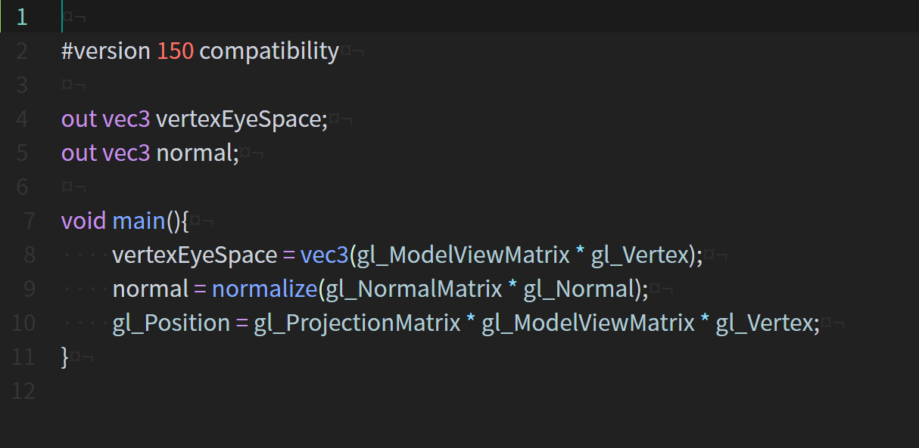
GLSL Program Example Phong Shading – (1 / 4)
Vertex shader
Fragment shader

Slide 11
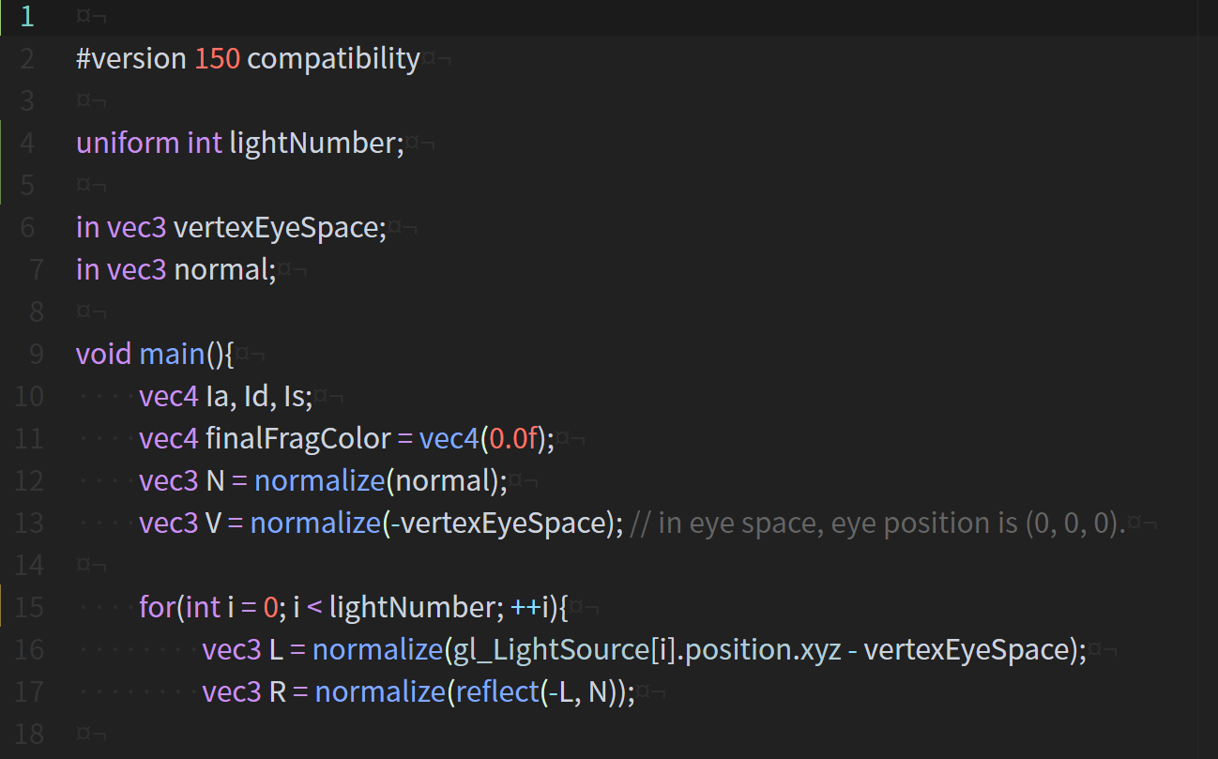
GLSL Program Example Phong Shading – (2 / 4)
Vertex shader
Fragment shader

Slide 12
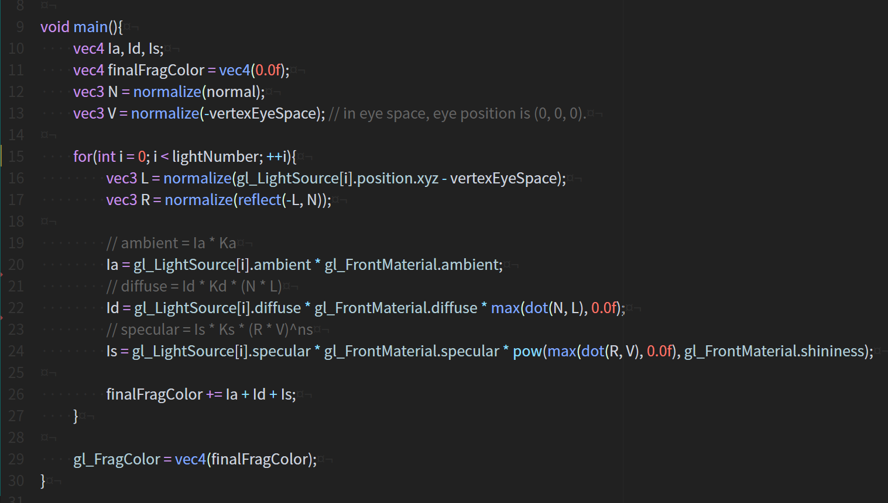
GLSL Program Example Phong Shading – (3 / 4)
Vertex shader
Fragment shader

Slide 13
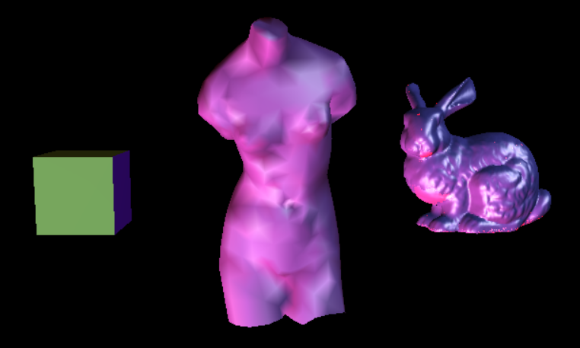
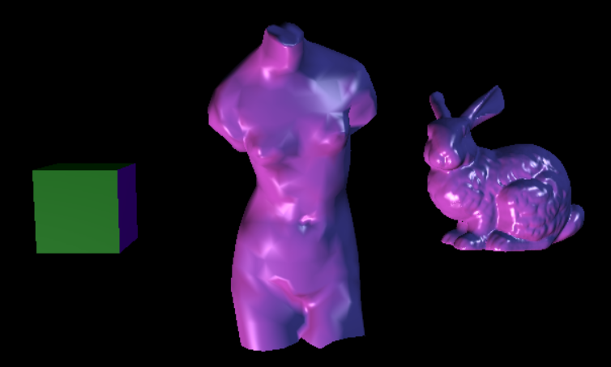
GLSL Program Example Phong Shading – (4 / 4)
Fixed pipeline
Phong shading

