Slide 1
Balanced scorecard slide 1
Customer Behavior Prediction
Data Mining Project
By – Group No. 24

Slide 2
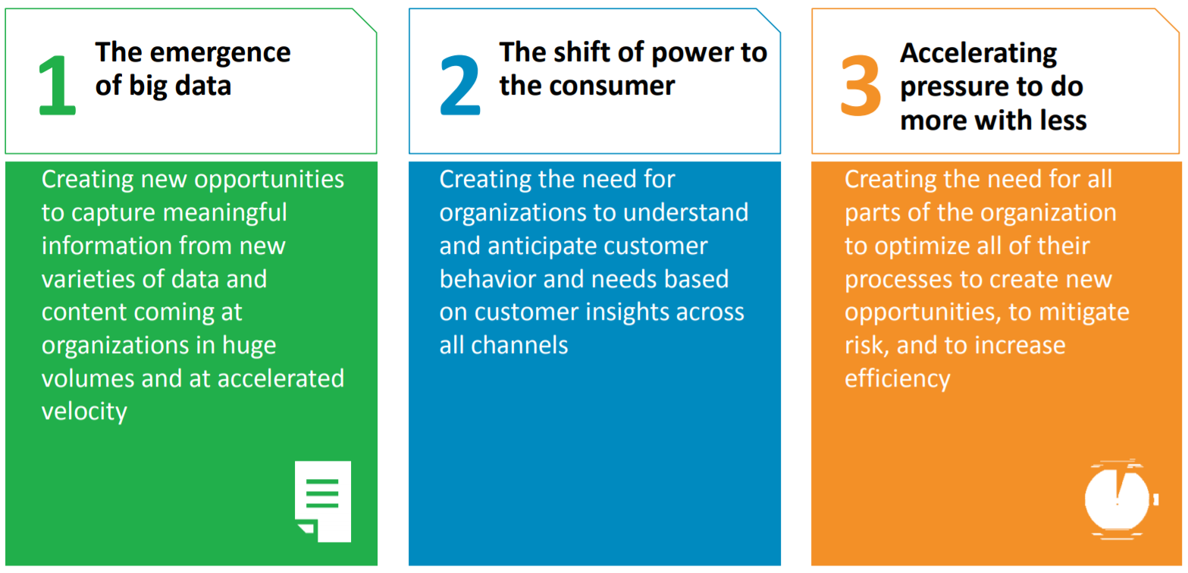
Balanced scorecard slide 2
Introduction

Slide 3
Balanced scorecard slide 2
Problem Statement
To study who buys where what when and how.
Learn about customer response to sales promotion.
Identification of customers and their buying behaviour pattern.
Increasing the profit by smart strategies.

Slide 4
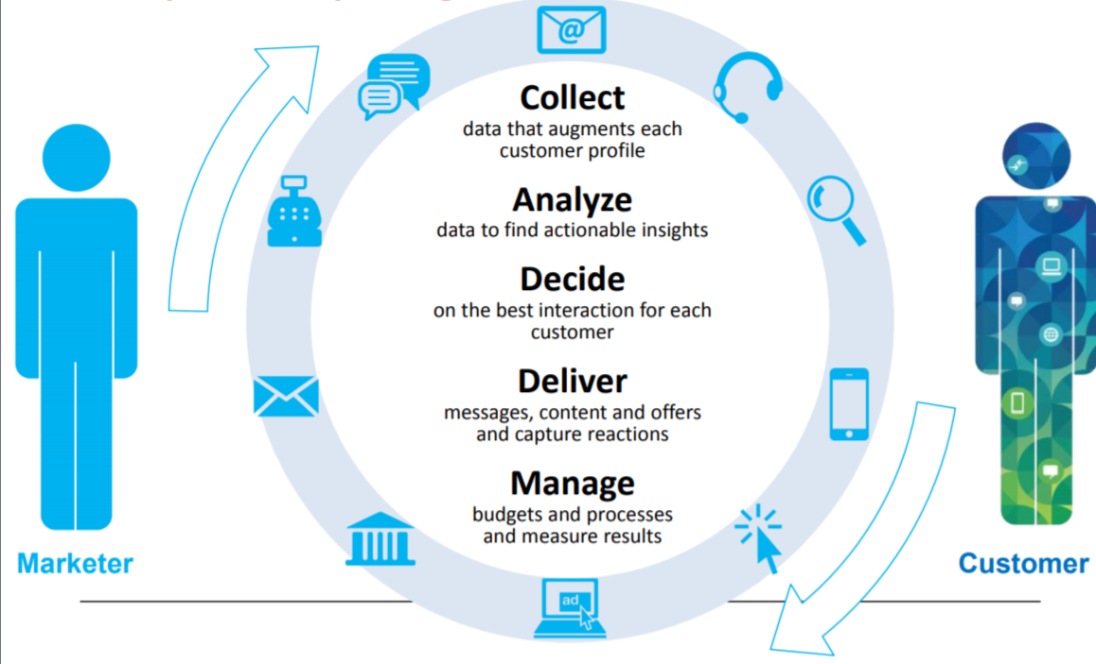

Balanced scorecard slide 2
Solution

Slide 5
Balanced scorecard slide 10
THANK YOU

