Slide 1

Savitribai Phule Pune University
K. K. Wagh Institute of Engineering Education and Research, Nashik
Department of Computer Engineering
A
Presentation on Final Year Project
Structural Defect Detection in Automobile Parts
Group Id: 24
Group members:
Sr.No | Roll No | Exam Seat No. | Name of Student
1 | 21 | 71705009C | Patil Swami Sunil
2 | 22 | 71704606M | Dandgaval Krutika Sandeep
3 | 23 | 71810087F | Chavan Hemant Narayan
4 | 24 | 71809993B | Bankar Nikhil Yashwant

Slide 2
Content
Problem Statement
Objective
System Requirements
Conclusion
Front-end
Result
Conclusion

Slide 3
Problem Statement
To detect multiple structural defects in automobile parts quickly and efficiently

Slide 4
Objectives
To detect multiple structural defects efficiently
To reduce human errors through automation
To speed up the quality control process

Slide 5
System Requirements
Software Requirements:
Python
Keras or Tensorflow
Tkinter
Anaconda
Hardware Requirements:
CPU: Intel Core i5 or above
GPU: Nvidia GTX 650 or AMD RX450 or above
Hard disk 250 GB or above
Linux or Windows operating system

Slide 6
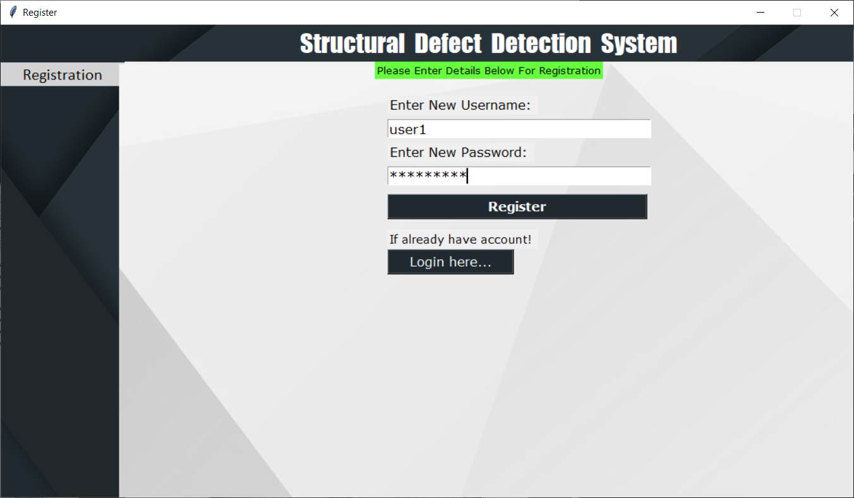
Front end: Register

Slide 7
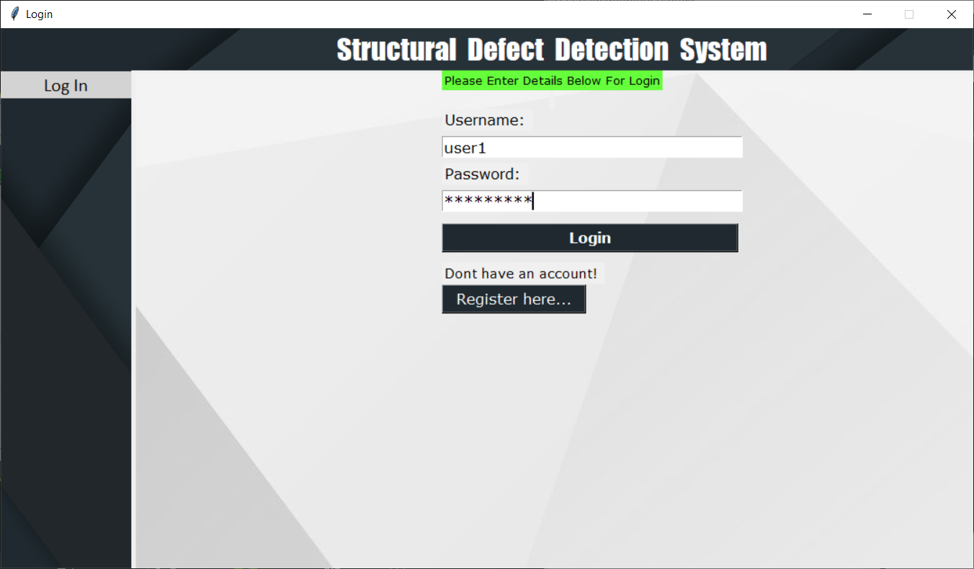
Front end: Login

Slide 8
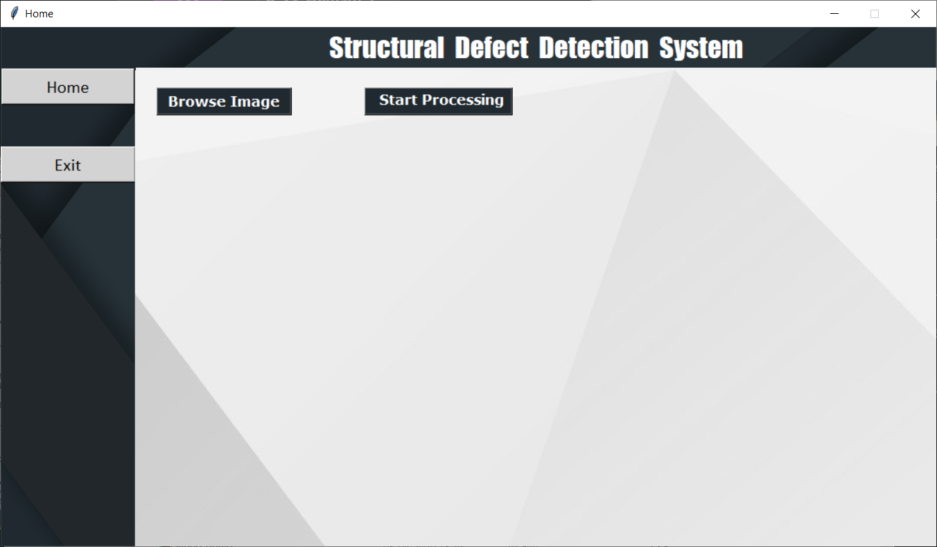
Front end: Home

Slide 9
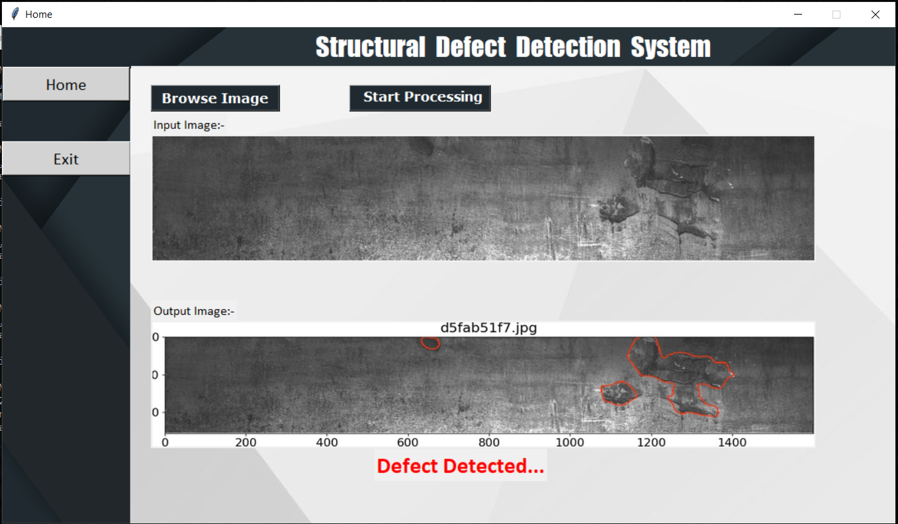
Result

Slide 10
Conclusion
The system will automate the defect detection process by capturing and processing images of automobile parts

Slide 11
THANK YOU!!!

