Slide 1






ONLINE PAYMENT FRAUD DETECTION
Project Title
Team Members: T.Tulasiram
G.Sri Rushikesh Raghavamsi D.Veera Venkata Swaminadh U.Soma Sankara Raju
Guide:Mr.Ramar Bose
Disclaimer: The content is curated for educational purposes only.

Slide 2
OUTLINE
Project Title
Abstract
Problem Statement
Aims, Objective & Proposed System/Solution
System Design/Architecture
System Development Approach (Technology Used)
Algorithm & Deployment
Conclusion
Future Scope
References
Video of the Project

Slide 3
Abstract
Project Title
Online payment fraud detection is a critical component of e- commerce and online banking systems, designed to safeguard financial transactions from fraudulent activities. As the digital landscape continues to evolve, ensuring the security and integrity of online payments has become paramount.
Briefly introduce the concept of online payment fraud.
Highlight the importance of detecting and preventing fraud in online transactions.
Provide a high-level overview of the proposed solution for online payment fraud detection.

Slide 4
Problem Statement
Project Title
The rapid growth of online transactions has brought unprecedented convenience, but it has also given rise to a significant challenge: the escalating threat of online payment fraud. As the volume and complexity of digital transactions increase, so does the sophistication of fraudulent activities.
Fraudsters exploit vulnerabilities in payment systems, employing various techniques such as identity theft, account takeover, and sophisticated phishing scams to compromise the security of
online transactions.

Slide 5
Aim and Objective
Project Title
Aims:
To develop a robust and proactive system for the detection and prevention of online payment fraud.
To enhance the security and integrity of online payment ecosystems, fostering trust among
businesses and consumers.
To stay ahead of evolving fraud tactics by implementing cutting-edge technologies and adaptive methodologies.
objectives:
Real-time Detection: Implement a system capable of detecting fraudulent activities in real-time to minimize potential financial losses.
Accuracy and Precision: Achieve high accuracy and precision in fraud detection to reduce false positives and negatives, ensuring legitimate transactions are not flagged incorrectly.
Adaptability: Develop a system that adapts to emerging fraud patterns and evolves alongside the dynamic nature of online threats.

Slide 6
Proposed Solution
Project Title
Machine Learning Algorithms: Implement advanced machine learning algorithms for pattern recognition and anomaly detection, allowing the system to learn from historical data and adapt to new fraud tactics.
Behavioural Analysis: Incorporate behavioural analysis to assess user patterns, identifying deviations that may indicate fraudulent activities.
Dynamic Risk Scoring: Introduce a dynamic risk scoring system that continuously
evaluates the risk associated with each transaction in real-time.
API Integration: Ensure seamless integration with existing payment gateways and systems through APIs, minimizing disruption to current processes.
User Education: Develop educational materials and features to enhance user awareness about online security practices, reducing the likelihood of falling victim to phishing or other fraud schemes.

Slide 7
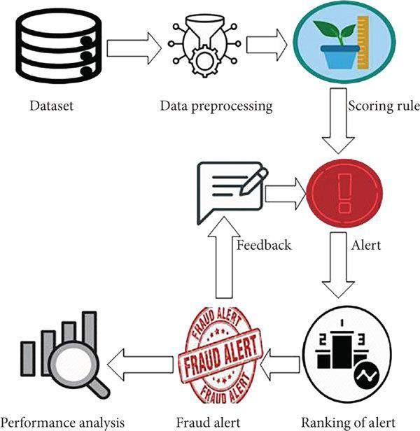
System Architecture
Project Title
Present the overall architecture of the online payment fraud detection system.
Break down the system into components/modules and explain their roles.
Using the following diagrams or flowcharts to illustrate the flow of data and processes within the system.

Slide 8
System Deployment Approach
Project Title
Requirement Analysis:
Gather detailed requirements from stakeholders, including financial institutions, merchants, and end- users.
Feasibility Study:
Conduct a feasibility study to assess the technical, operational, and economic feasibility of the
proposed solution.
System Design:
Develop a detailed system architecture that outlines the components, modules, and their interactions.
Design the user interface, ensuring it is intuitive for both administrators and end-users.
Technology Selection:
Choose appropriate technologies for the development of the fraud detection system.
Prototyping:
Build a prototype to validate key functionalities and obtain early feedback from stakeholders.

Slide 9
Algorithm & Deployment
Project Title
In the realm of online payment fraud detection, the key lies in employing sophisticated algorithms to unveil patterns indicative of fraudulent activities. Machine learning models, such as Random Forests and Support Vector Machines, are harnessed for supervised learning on historical transaction data, while unsupervised techniques like clustering address real-time anomalies. Neural networks, particularly deep learning models like LSTMs, specialize in complex pattern recognition. Behavioural analysis algorithms scrutinize user behaviour for anomalies, while dynamic risk scoring adjusts in real-time based on evolving patterns. Deploying this system involves cloud deployment for scalability, microservices architecture for flexibility, API integration for seamless connectivity, and real-time processing using stream frameworks.

Slide 10
Conclusion
Project Title
Online payment fraud detection plays a crucial role in the ever-evolving digital transactions landscape. The increasing volume and complexity of online payments necessitate advanced solutions to counter sophisticated fraudulent activities. Leveraging machine learning algorithms, neural networks, behavioural analysis, and dynamic risk scoring provides a robust defence against the dynamic tactics employed by fraudsters. A successful fraud detection system requires a holistic approach, including real-time processing, scalable deployment, and seamless integration with existing payment infrastructures. Embracing these technologies empowers businesses and financial institutions to fortify their online payment ecosystems, mitigating financial risks, preserving user trust.

Slide 11
Future Scope
Project Title
Explore potential enhancements or expansions for the system.
Discuss future technologies or trends that could be integrated for better fraud detection.
Highlight the adaptability of the system for future challenges.

Slide 12
Reference
Project Title
Module source:
https://scikit-learn.org/stable/
Dataset source:
https://www.kaggle.com/datasets/rupakroy/online-payments-fraud-detection-
dataset/download?datasetVersionNumber=1

Slide 13
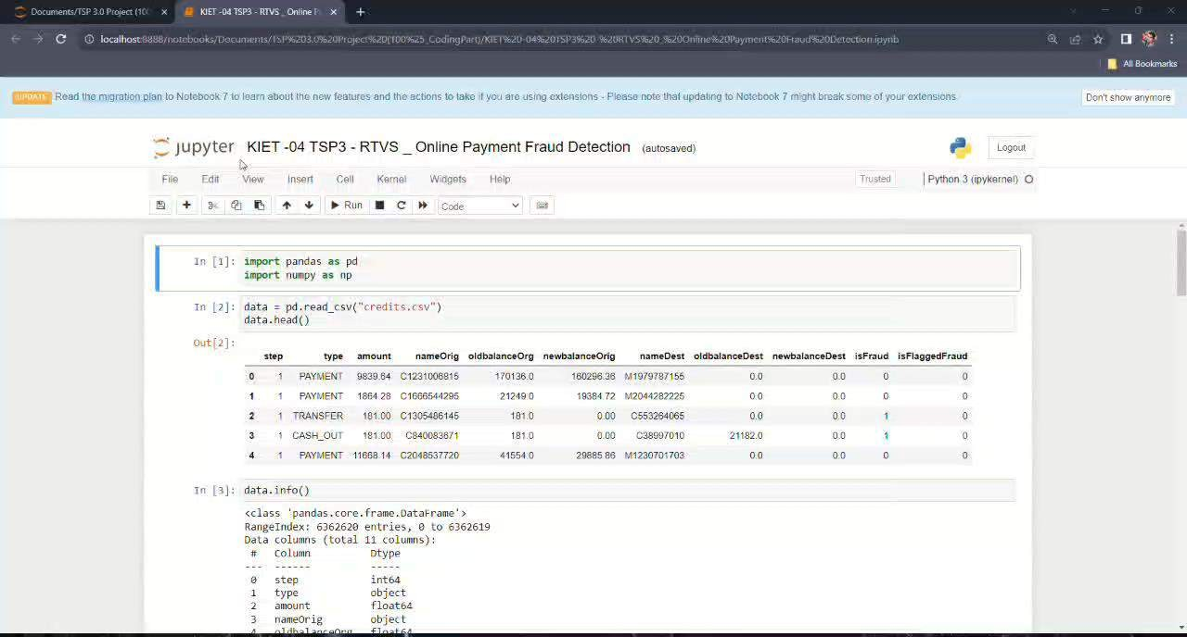
Project Title

Slide 14
Thank you!
Project Title

