Slide 1

A Gamified Web based Quiz Platform for Interactive Nursing Education
CYB23IN201 Internship -II
Final Review
Date: 10.7.2026
Presenter
G L Swaminathan (E0224033)
Project Guide
Dr. G. Jayanthi

Slide 2
INTRODUCTION
Need for the technology:
Domain-specific interactive learning platforms are scarce in the public domain. While general-purpose quiz systems exist, they lack the specialized modules required for professional academic disciplines. Each clinical domain requires tailored, high-fidelity question types and structured modules that align with their training needs. Through my collaboration with the Nursing Department at SRIHER, this critical gap in medical education technology was identified, prompting the development of a dedicated solution.
Applications:
Interactive & Gamified Learning
Rank & XP-Based Level Progression
User-Centric Customization (Clinical Avatars)
Real-Time & Daily-Resetting Leaderboards
9 Specialized Question Formats (Audio/Video/Clinical scenarios)
Curriculum-Aligned Study Modules
Live Multiplayer Classroom Mode (Socket.IO-powered)
And more…

Slide 3
Motivation behind the study:
The primary motivation of this study is to investigate how gamified and interactive learning systems can enhance engagement, active recall, and long-term knowledge retention in specialized nursing education. While general-purpose platforms like Kahoot!, Wayground, and Mentimeter provide high engagement, they are restricted to generic templates and lack domain-specific clinical modules, patient scenario simulations, and long-term student progression systems. By creating a dedicated, syllabus-aligned platform with structured learning modules and clinical-themed progression, this project aims to bridge this gap, driving consistent and motivated student participation within professional healthcare training.
Challenges to be addressed:
Handling Multiple Users at once (Scaling)
Creating Creative Question Modes
Selecting Suitable UI
Thinking of creative features to add
Making it portable for Multi Device
Designing User-centric customizations
Implementing security measures for security of the website

Slide 4
REVIEW OF LITERATURE
Author and Year | Materials and Methods | Datasets | Results/Outcome | Advantage / Key findings from the work | GAP Identified from the work
R. Nguyen 2026 | A review and Analysis of gamification elements applied in nursing syllabus. | This is a existing Literature on gamification in nursing ; Not a primary dataset | Gamification techniques (XPs, Led.Boa.s,etc) significantly increase the motivation and learning of students | Establishes the theoretical basis for applying gamification in nursing; directly supports NurseQuest's XP and leveling model. | Limited empirical data; lacks a controlled trial. Does not address technical implementation of gamification systems.
A. Azoulay & F. Lim 2026 | Integrative review of 22 studies examining gamification effects on nursing academic performance. | 22 peer-reviewed studies on nursing student cohorts in higher education institutions. | Gamified platforms improved academic performance scores by an average of 18% compared to traditional methods. | Provides strong evidence that gamified platforms improve academic scores; validates NurseQuest's evidence-based design. | Studies varied widely in gamification type and measurement; no standardized scoring metric across studies.
S. Aalaei et al. 2026 | Quasi-experimental pre-post study evaluating a gamified mobile app for cardiac rhythm interpretation. | 60 undergraduate nursing students tested pre/post on ECG interpretation using a gamified mobile application. | Significant improvement in ECG interpretation scores post-intervention (p<0.001); students rated engagement highly. | Domain-specific gamified assessment design; directly informs NurseQuest's Image/Audio-based clinical question types. | Single-institution study; limited generalizability. App was mobile-only with no web or multiplayer capability.
M. AlMekkawi et al. 2026 | Systematic review and meta-analysis of 18 RCTs and quasi-experimental studies on game-based learning in nursing. | 18 studies across undergraduate nursing programs globally; 1,200+ students aggregated. | Game-based learning showed statistically significant improvements in knowledge retention (SMD=0.72) and clinical reasoning. | Meta-analysis with strong statistical power confirming game-based learning effectiveness for nursing education. | High heterogeneity among included studies; most games were desktop-only and lacked real-time multiplayer components.
V. I. Bahar et al. 2026 | Descriptive, cross-sectional study evaluating a serious game's impact on palliative care awareness in nursing students. | 85 third-year nursing students from a Turkish university who played the serious game over 2 weeks. | Palliative care awareness scores significantly increased post-game (p<0.05); students reported higher empathy levels. | Demonstrates that serious games work in specialized nursing domains; aligns with NurseQuest's domain module concept. | Focused on a single nursing topic (palliative care); no leaderboard, progression system, or multiplayer component.
K. McMillan et al. 2026 | Scoping review protocol following JBI methodology for gamification design in preregistration nurse education. | Planned review of databases: CINAHL, MEDLINE, PsycINFO, Embase; no primary data collected yet. | Protocol identifies key design variables for nurse-targeted gamification: feedback loops, narrative, and leaderboards. | Defines design principles for nurse-targeted gamification; guides NurseQuest's leaderboard and badge system design. | Protocol paper only; full results not yet published. Lacks quantitative evidence of outcomes.

Slide 5
REVIEW OF LITERATURE
Author and Year | Methodology/ Materials and Methods | Datasets | Results/Outcome | Advantage / Key findings from the work | Disadvantage/ GAP Identified from the work
N. Aktaş & Y. Sazak 2025 | Quasi-experimental study using an escape room as the intervention for pharmacology knowledge acquisition. | 48 nursing students (intervention=24, control=24) at a Turkish nursing school over one semester. | Escape room group scored significantly higher on post-tests (p<0.01); higher satisfaction compared to lectures. | Supports scenario-based quiz format; informs NurseQuest's Jumbled Letters and Sequence question type design. | Physical escape room format; cannot scale digitally, no real-time scoring or remote accessibility.
M. White & T. Shellenbarger 2018 | Descriptive study examining the integration of digital badges as motivational gamification in nursing courses. | Undergraduate nursing students across 3 semesters in a US university nursing program. | Badge-earning behavior correlated with higher assignment completion rates and increased student engagement. | Pioneering work on badge-based motivation in nursing; directly informs NurseQuest's achievement badge system. | Study predates modern web platforms; no XP, leaderboard, or real-time feedback component evaluated.
S. Mishra et al. 2026 | System design and development using Next.js, Node.js, and Socket.IO for a scalable multiplayer quiz platform. | Load testing with 500 concurrent users; performance benchmarks for latency and throughput measured. | Platform achieved sub-100ms latency under 500 concurrent users; Socket.IO enabled reliable real-time sync. | Technical architecture reference for scalable quiz platforms; directly maps to NurseQuest's full-stack design. | Generic quiz content; no domain specificity, no gamification progression (XP/badges), no role-based access.
A. Kumar et al. 2025 | Software development study using React 18, Node.js Express, and Socket.IO for a gamified quiz application. | Developer testing environment with 50 concurrent WebSocket connections; functional testing performed. | Demonstrated real-time score updates, live leaderboard sync, and responsive React UI across device types. | Blueprint for React + Socket.IO quiz architecture; validates NurseQuest's front-end and real-time stack choices. | No nursing or clinical domain content; lacks a progression system, role-based access, or media-rich questions.
J. Silva & M. Santos 2023 | Comparative benchmarking study evaluating SQLite vs. PostgreSQL vs. MySQL for LMS-type web applications. | Synthetic LMS database workloads: 100K records, read/write benchmarks, concurrent access tests. | SQLite outperformed others in read-heavy single-server workloads; best suited for embedded deployments. | Justifies SQLite (better-sqlite3) selection as NurseQuest's embedded database for single-server deployment. | SQLite limitations in multi-server/distributed deployments are not addressed; not ideal for large-scale production.
L. Chen & X. Wang 2024 | Experimental performance comparison of WebSocket (Socket.IO) and WebRTC for browser-based multiplayer games. | Simulated 200-player game sessions; latency, jitter, and packet loss measured under varying network conditions. | Socket.IO achieved lower average latency (42ms) and simpler server-side architecture than WebRTC for game sync. | Performance data supporting WebSocket (Socket.IO) choice for NurseQuest's live multiplayer quiz synchronization. | WebRTC offers lower latency for peer-to-peer; Socket.IO may face scalability bottlenecks beyond 1000 concurrent users.

Slide 6
REVIEW OF LITERATURE
Author and Year | Methodology/ Materials and Methods | Datasets | Results/Outcome | Advantage / Key findings from the work | Disadvantage/ GAP Identified from the work
M. Yang et al. 2026 | Systematic review and meta-analysis of escape room interventions in Chinese nursing education programs. | 12 studies conducted at Chinese nursing universities; 850+ nursing students across various clinical specialties. | Escape room learning produced significantly higher clinical reasoning scores (SMD=0.61) vs. traditional teaching. | Validates interactive challenge-based formats; informs NurseQuest's Live Quiz (Kahoot-style) and scenario question types. | Geographically limited to China; escape room format is physical-first, lacking digital scalability and multiplayer realism.
Y. G. S. Barbalho et al. 2025 | Design and validation study using iterative prototyping and expert panel review for a serious game in nursing. | Expert panel of 12 nursing educators + 40 undergraduate students for usability and content validation testing. | Game achieved high content validity index (CVI=0.92) and usability scores; students showed improved knowledge scores. | Provides a validated serious game design and validation framework directly applicable to NurseQuest's development. | Single-cycle validation; long-term retention and multi-session engagement were not measured in this study.
D. Jones & R. Smith 2022 | Case study and iterative development using React.js for interactive SPA-based medical training tools. | Medical training application used by 120 students; usability and learning outcome data collected over 8 weeks. | React SPA achieved high usability scores (SUS=82.5); students showed measurable improvement in knowledge tests. | Validates React SPA architecture for medical education; confirms NurseQuest's frontend design approach. | Study used older React 16; did not address real-time features, multiplayer, or gamification components.

Slide 7
REVIEW OF EXISTING SYSTEM (S/W/H/W PRODUCTS, TOOLS)
Author /Developer Year | Methodology/ Materials and Methods | Datasets | Results/Outcome | Advantage / Key findings from the work | Disadvantage/ GAP Identified from the work
Moodle Pty Ltd (Open Source) 2002 | Learning Management System (LMS) built on PHP. Delivers course content, quizzes, forums, and grading through a structured course-module architecture. | Used by 300 million+ users in 250+ countries; deployed across universities, hospitals, and government institutions. | Provides comprehensive course management; supports blended and online learning with detailed progress reports. | Open-source and free; highly extensible via plugins; supports SCORM, rich media, peer assessment, and grading. | Heavy and complex server setup; no built-in gamification or competitive gameplay; poor UI/UX for student engagement; lacks real-time quiz session capability.
Quizlet Inc. 2005 | Spaced-repetition and active recall via digital flashcards. Students self-study using study modes (Learn, Match, Test). | 500 million+ study sets created by users; 60 million active learners across 130+ countries. | Improved memorisation of terminology and definitions; effective for vocabulary-heavy subjects like anatomy. | Easy flashcard creation; collaborative study sets; multiple study modes; supports images in cards. | No real-time multiplayer or live competitive sessions; no gamification engine (XP, badges, levels); not designed for clinical scenario-based assessment.
ProProfs (Merger of Snow Technologies) 2006 | Online quiz maker with branching logic, timed tests, certificates of completion, and performance analytics dashboard for instructors. | Used by 15 million+ users; deployed in corporate training, higher education, and professional certification programs. | Enables self-paced online assessment; auto-generates certificates; provides detailed student performance reports. | Rich quiz creation options; branching logic; certificate generation; white-label options; strong analytics. | No nursing-specific domain modules; no live multiplayer mode; limited question types; subscription-based pricing limits accessibility for academic institutions.
Socrative Inc. (acquired by Mastery Connect) 2011 | Classroom response system using teacher-created quizzes, exit tickets, and team "space races" for formative assessment in real time. | Used by 2 million+ teachers in 150+ countries; primarily higher education and secondary school environments. | Effective formative assessment tool; instant class performance reports; identifies student knowledge gaps. | Simple quiz creation; real-time feedback; team Space Race adds competitive element; downloadable reports. | Limited question types (MCQ, T/F, short answer only); no media-rich clinical scenarios; no gamification engine or XP/badge progression system for nursing education.

Slide 8
Nearpod Inc. 2012 | Teacher-paced interactive lesson delivery platform. Lessons include embedded quizzes, polls, VR experiences, and collaborative boards synced to student devices. | Used in 15,000+ schools; 2 million+ teachers; primarily K-12 in the US; integrated with Google Classroom & Canvas. | Improved student attention and lesson comprehension; real-time teacher visibility of student responses. | Rich lesson formats (VR, 3D, video); real-time student response monitoring; integrates with major LMS platforms. | Primarily a lesson delivery tool, not a standalone competitive quiz game; no XP system, no student rank progression, no nursing-specific content.
Kahoot! AS 2013 | Game-based learning platform using a host-device model. Teachers launch quizzes on screen; students respond via personal devices in real time using a join PIN. | 300 million+ registered users globally; used across K-12, higher education, and corporate training environments. | Demonstrated significant improvement in student engagement and short-term knowledge recall in classroom settings. | Simple, intuitive UI; real-time leaderboard; broad device compatibility; widely adopted in education worldwide. | No nursing-specific content or clinical question types; no XP/rank progression system; no role-based educator access; lacks media-rich clinical scenarios (ECG, audio).
Mentimeter AB 2014 | Interactive slide-based presentation tool using live audience polling, word clouds, and Q&A widgets embedded into teacher-driven slideshow sessions. | Used by 300 million+ participants across 200+ countries in corporate and academic presentation settings. | Increases audience participation and live feedback during lectures; reduces passive listening in classrooms. | Visually appealing real-time responses; easy to embed in presentations; supports anonymous participation. | Not a dedicated quiz/assessment platform; no scoring system, no XP or levels, no curriculum-linked assessments, and no nursing domain-specific content.
Wayground (EdTech Startup) 2019 | Online assessment and analytics platform with configurable test forms, auto-grading, and student dashboard reporting. | Used in select universities and training centers; primarily corporate and professional certification environments. | Enables structured online assessments with dashboard analytics for tracking student performance over time. | Customisable assessments; decent analytics; integration support with popular LMS tools; automated grading. | No gamification or competitive elements; no live multiplayer mode; generic content with no nursing or clinical domain specificity.
Google LLC 2012 | Web-based form/survey tool adapted for quiz delivery. Auto-grading via multiple-choice and short-answer types. | Used by millions of educators globally; integrated with Google Workspace (Classroom, Sheets, Drive). | Simple, fast quiz creation with automatic grade export to Google Sheets for teacher review. | Zero cost; no account needed for respondents; instant result collation; integrates with Google Classroom. | No gamification; no live multiplayer; no media-rich clinical question types; no student progression tracking, streaks, or achievement system.

Slide 9
PROBLEM STATEMENT
Traditional nursing education relies on passive learning methods (lectures, static PDFs, paper-based tests), leading to low student engagement, limited real-time assessment, and no personalized feedback — especially in clinical skill-building scenarios.
→Lack of engagement
→No competitive assessment
→Limited question formats
→Poor accessibility
A full-stack web platform featuring gamified learning (XP, clinical ranks, badges), real-time multiplayer quizzes via WebSockets, 9 distinct question types, role-based access control (Teacher/Student), and modular curriculum management — built with React 19, Node.js/Express 5, Socket.IO, and Supabase (PostgreSQL).
Target Audience & Scope: Developed a nursing-specific interactive quiz platform accessible to all nursing students for syllabus-independent self-assessment.
Frontend & Backend Architecture: Built with React 19 and Vite on the client side, powered by a Node.js and Express 5 backend RESTful API handling routing, file uploads, and controller logic.
Cloud Database Integration: Utilizes Supabase (PostgreSQL) with connection pooling to ensure secure, persistent, and scalable relational data storage.
WebSocket Integration: Integrated Socket.IO to enable live, real-time multiplayer quiz sessions where a teacher hosts and students join via a 6-digit game code.

Slide 10
OBJECTIVES
Objective - 1 :
To design a full-stack gamified nursing education platform (React, Node.js, Express, Supabase PostgreSQL) with role-based access control, interactive dashboards, and a comprehensive quiz management system.
Objective - 2:
To implement 9 interactive and multimedia-rich question types — including MCQ, image-based, video-based, audio-based, jumbled letters, sequence ordering, sliders, matching, and CAPTCHAs — enabling varied clinical assessments.
Objective - 3:
To integrate nursing-specific learning features including categorized clinical quizzes, unit-based organization (Units 1 to 15), scenario-based assessments, and domain-relevant gamification (XP, levels, streaks, badges).
Objective - 4:
To enable real-time multiplayer quiz sessions via Socket.IO with multi-device access, instant scoring, live leaderboards, and synchronized question delivery.
Objective - 5:
To ensure production-readiness through robust security (JWT, bcrypt, input validation), scalable cloud architecture, and real-world deployment.

Slide 11
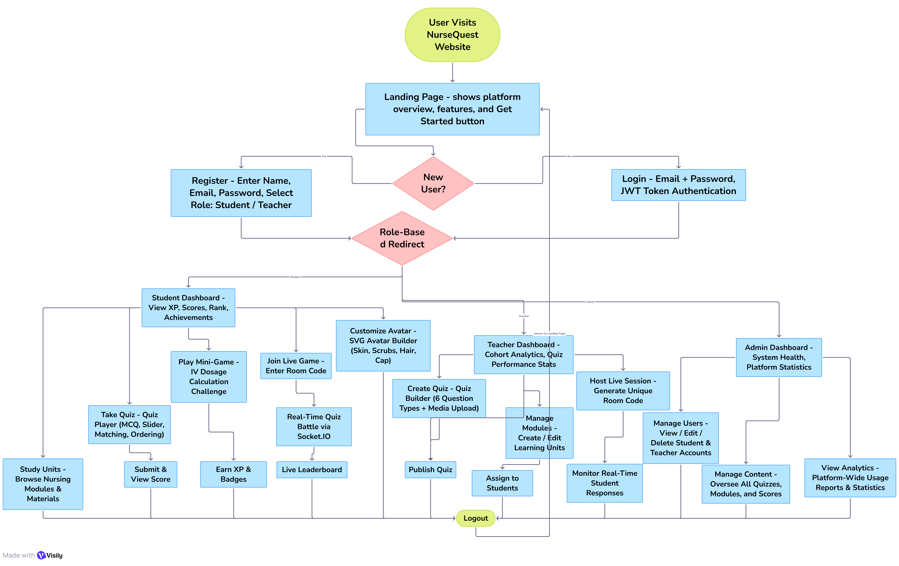
WORKFLOW DIAGRAM

Slide 12
MODULES
# | Modules | Methodology / Algorithm | Technologies (H/W and S/W) | Implementation
1 | Frontend Module (UI Layer) | Component-based SPA; client-side routing; Context API state management | S/W: React 19, Vite, React Router, Three.js, Lottie | 14 pages, reusable components, 2 context providers, API client
2 | Backend API Module (Server Layer) | RESTful API; MVC pattern; middleware chaining; MIME-filtered uploads | S/W: Node.js, Express 5, Multer, CORS with Node.js 18+ server | 6 route modules, file upload endpoint, media handler
3 | Auth Module (Security Layer) | JWT token auth; Supabase Auth (GoTrue) integration; role-based access control | S/W: jsonwebtoken, Supabase Auth, Express middleware | Token sign/verify, user management, role-gating middleware
4 | Database Module (Data Layer) | PostgreSQL relational schema; connection pooling; Supabase trigger-based user sync | S/W: Supabase (PostgreSQL), postgres driver H/W: Supabase Cloud (AWS Hosted) | 11 tables, schema.sql, init.js, seed.js
5 | Real-Time Module (WebSocket Layer) | Event-driven pub/sub; room-based sessions; Kahoot-style scoring | S/W: Socket.IO, Node.js event loop | Session lifecycle, in-memory store, live scoring & ranking

Slide 13
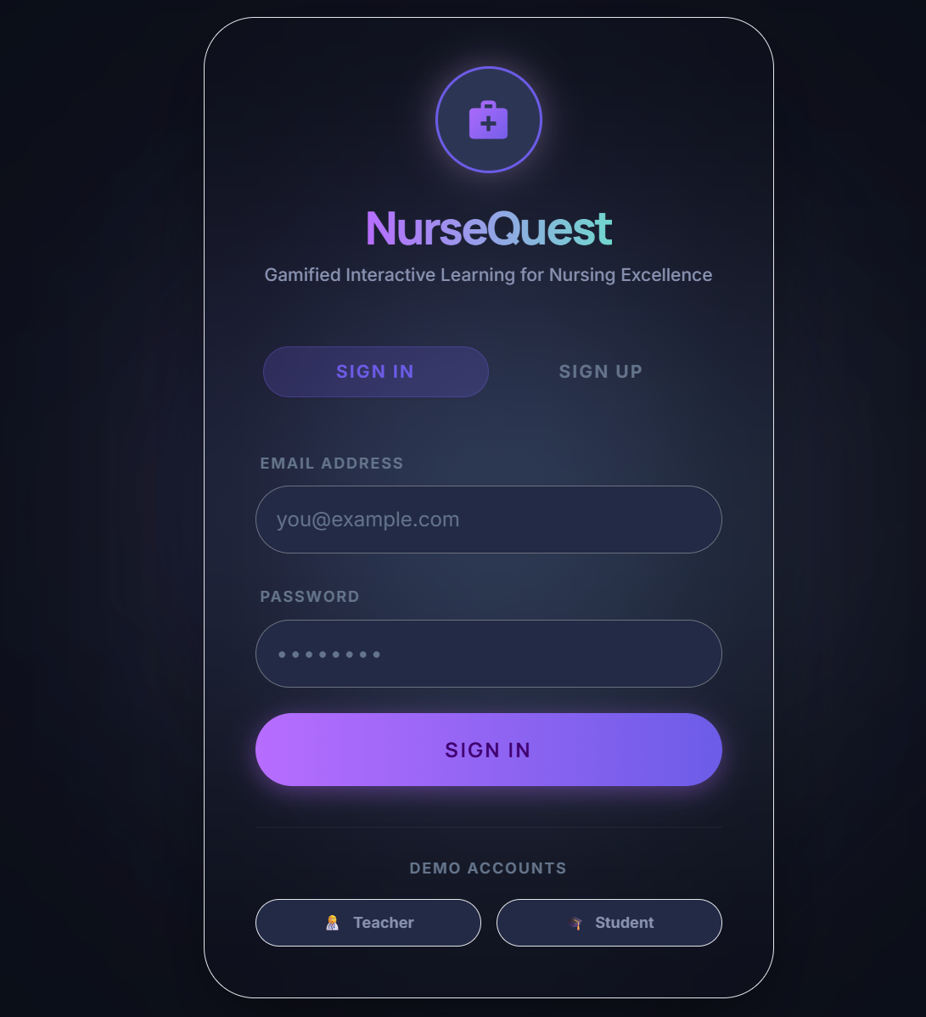
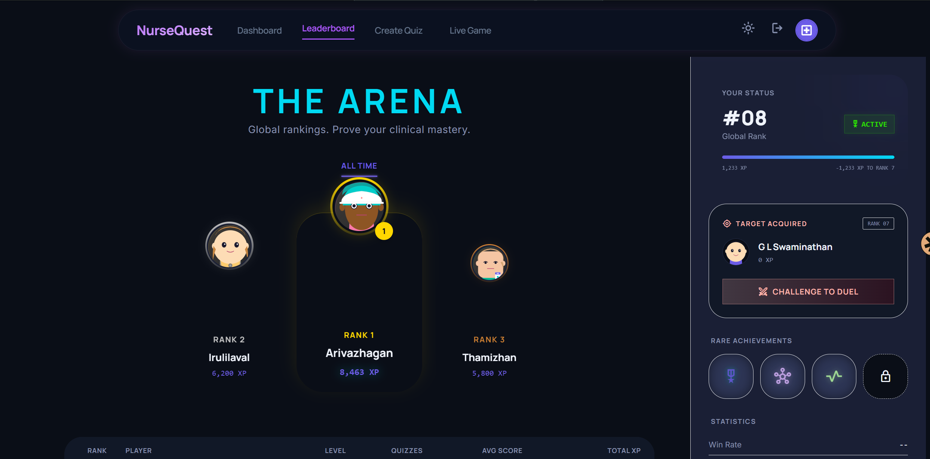
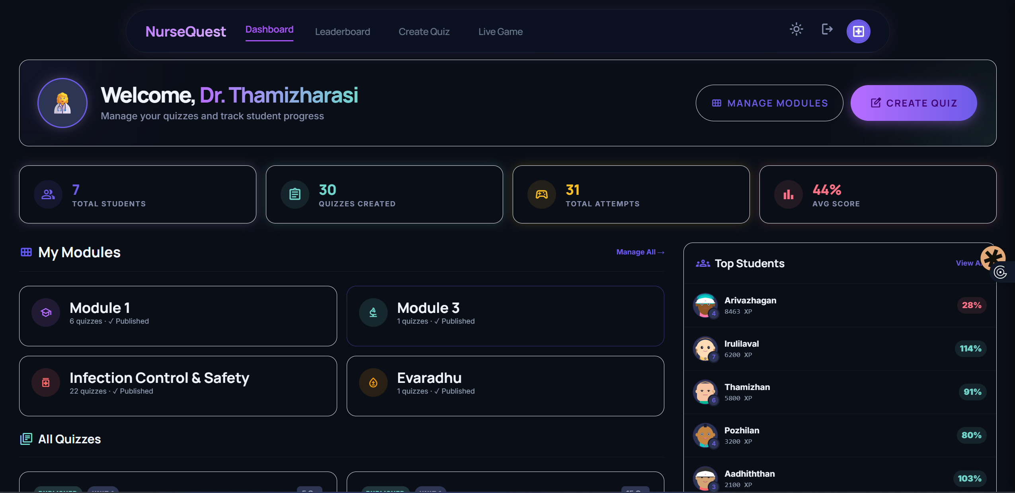
RESULTS / OUTCOMES

Slide 14
CONCLUSION
16 MAR – 21 MAR : Started collecting Literatures
23 MAR – 4 JUNE : Started and Finished Website’s Prototype
6 JUNE – 21 JUNE: Building a Production Ready Weebsite for Data Collection
23 JUNE – 1 JULY : Building a handheld App for Multi Disciplines
4 JULY – 9 JULY : Failed to Build a Multi Discipline App. Hosted the current website. Added Admin Role and modified some access roles.
Most Literature Review are summarized and identified the gaps and key findings with the help of AI

Slide 15
REFERENCES
[1] R. Nguyen, "Advancing Nursing Education Through Gamification," Am. J. Nurs., vol. 126, no. 6, pp. 8-9, Jun 2026.
[2] A. Azoulay and F. Lim, "The Impact of Gamification on Academic Performance: An Integrative Review," Nurs. Educ. Perspect., vol. 47, no. 3, pp. 160-167, May 2026.
[3] S. Aalaei, et al., "Design and evaluation of a gamified mobile application for teaching cardiac rhythm interpretation," BMC Med. Educ., vol. 26, no. 1, p. 882, Apr 2026.
[4] M. AlMekkawi, et al., "Game-based learning in undergraduate nursing education: A systematic review," Nurse Educ. Today, vol. 164, p. 107124, Sep 2026.
[5] V. I. Bahar, et al., "Effectiveness of Serious Game Activities in Raising Palliative Care Awareness," Comput. Inform. Nurs., vol. 44, no. 6, pp. 14-22, Jun 2026.
[6] K. McMillan, et al., "Gamification design and engagement in preregistration nurse education," BMJ Open, vol. 16, no. 1, p. e107037, Jan 2026.
[7] M. Yang, et al., "Effectiveness of escape room in Chinese nursing education: A systematic review," BMC Nurs., vol. 25, no. 1, p. 201, Feb 2026.
[8] Y. G. S. Barbalho, et al., "A Serious Game (Health Unit in Focus) for Older Adults' Health," JMIR Serious Games, vol. 13, no. 1, p. e66289, Nov 2025.
[9] N. Aktaş and Y. Sazak, "Use of an escape room-based learning strategy to enhance pharmacology knowledge," BMC Nurs., vol. 25, no. 1, p. 106, Dec 2025.
[10] M. White and T. Shellenbarger, "Gamification of nursing education with digital badges," Nurse Educator, vol. 43, no. 2, pp. 78-82, Mar 2018.
[11] shivam kumar, Zafar hussain, Shaaz alfaiz and Aman shankar mandale (2026). "QuestMitra". INTERNATIONAL JOURNAL OF EMERGING TRENDS IN ENGINEERING AND DEVELOPMENT (IJETED), vol. 16, Issue 3, 2026, pp.9/1-9/5. DOI: 10.26808/RS.2026.c6be38.
[12] A. Kumar, et al., "Design and Development of a Real-Time Gamified Quiz Application using React and Socket.IO," Int. J. Innov. Res. Comput. Commun. Eng., vol. 13, no. 8, pp. 14671-14678, Aug 2025.
[13] J. Silva and M. Santos, "Comparing SQLite and Embedded Databases for Storage in Web-Based LMS," J. Softw. Eng. Appl., vol. 16, no. 4, pp. 112-120, Apr 2023.
[14] L. Chen and X. Wang, "Full-Duplex Communication in Browser-Based Multiplayer Games: WebSockets vs. WebRTC," IEEE Trans. Games, vol. 17, no. 3, pp. 312-320, Sep 2024.
[15] D. Jones and R. Smith, "Developing Interactive Single Page Applications for Medical Training: A React-Based Approach," Comput. Educ., vol. 188, p. 104581, Oct 2022.

Slide 16
REFERENCES
WEB REFERENCES:
Youtube
AI Platforms(Gemini,ChatGPT,Claude,etc.,.)
AI Builders (Google AI Studio, Stitch.io,etc.,.)
Online Forums (Pinterest,Reddit)
Online Quiz Platforms (Kahoot, Wayground, Mentimeter,etc,.,)
Publishers (ResearchGate, ebc.uk.com, etc,.,)

Slide 17
https://www.researchgate.net/publication/405100802_Advancing_Nursing_Education_Through_Gamification https://europepmc.org/article/med/41943200 https://link.springer.com/article/10.1186/s12909-026-09138-2 https://pubmed.ncbi.nlm.nih.gov/42048998/ https://pubmed.ncbi.nlm.nih.gov/41498142/ https://bmjopen.bmj.com/content/16/1/e107037 https://pubmed.ncbi.nlm.nih.gov/41634701/ https://games.jmir.org/2025/1/e66289/ https://www.researchgate.net/publication/399253963_The_use_of_an_escape_room-based_learning_strategy_to_enhance_pharmacology_knowledge_among_nursing_students https://pubmed.ncbi.nlm.nih.gov/28817476/ https://rspublication.com/ijeted/2026/e3/9.html

Slide 18
Thank you

