Slide 1
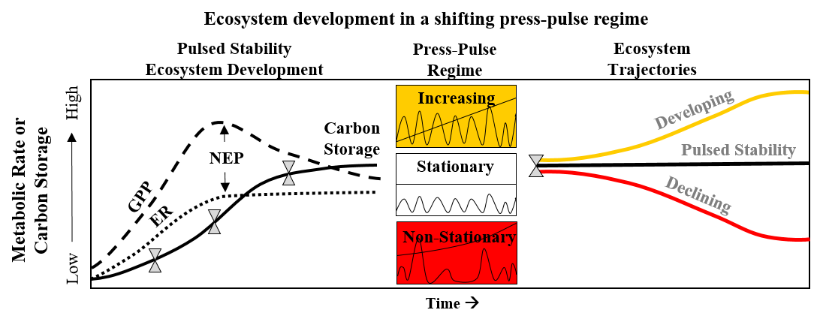
How do long-term changes in the marine and freshwater supplies alter microbially mediated biogeochemical cycling along coastal gradients?
Kominoski et al. 2018 BioScience

Slide 2
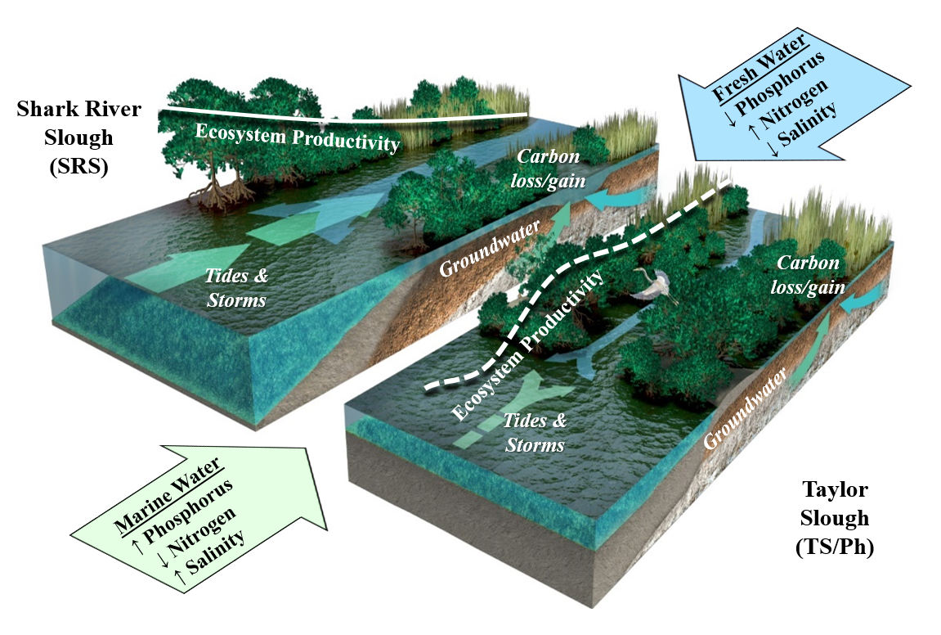
How do long-term changes in the marine and freshwater supplies alter microbially mediated biogeochemical cycling along coastal gradients?

Slide 3
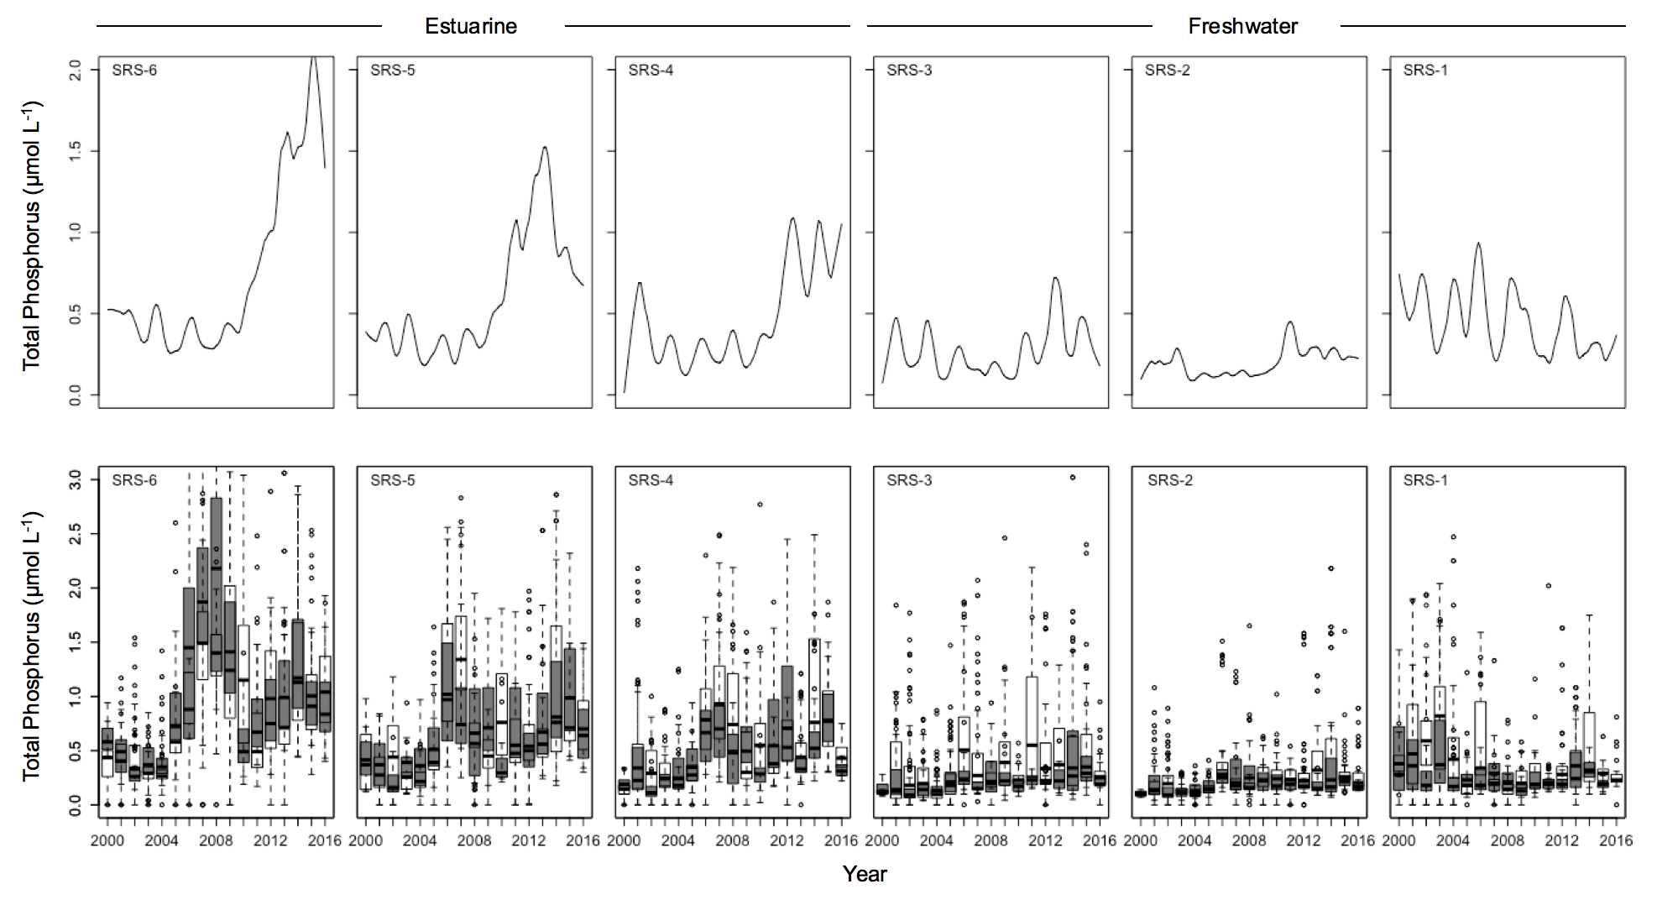
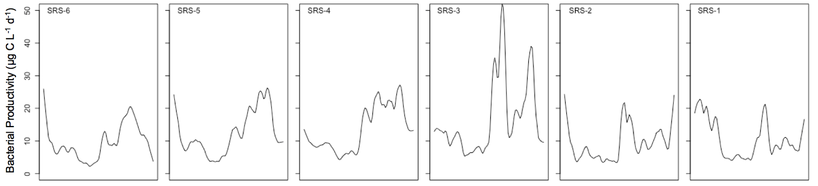
Long-term increases in surface water TP and bacterial productivity linked to hydrology
Kominoski et al., in revision

Slide 4
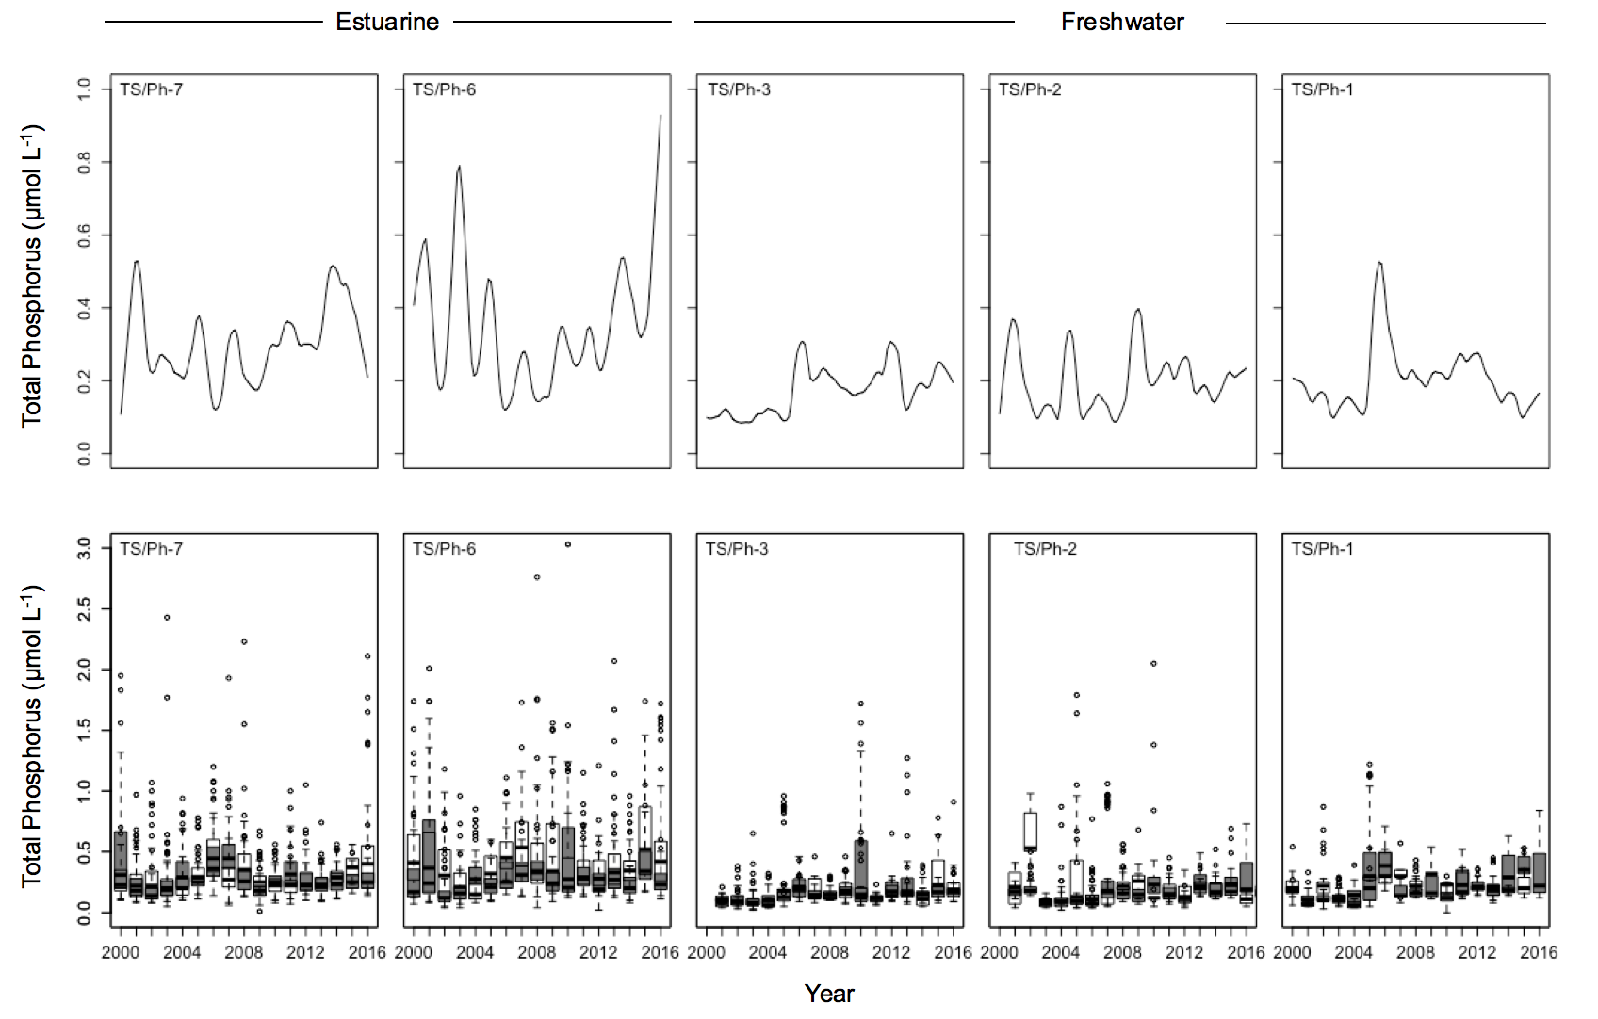
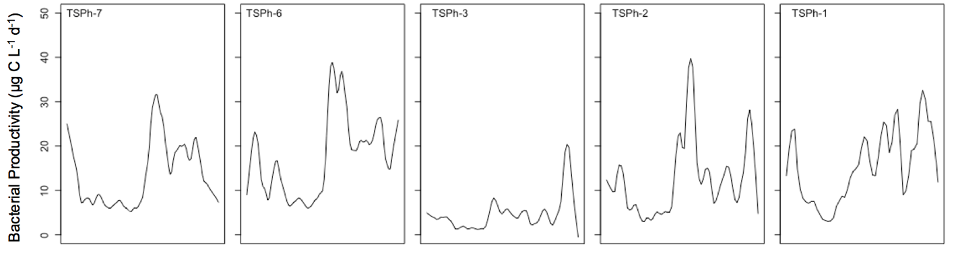
Long-term increases in surface water TP and bacterial productivity less connected by hydrology
Kominoski et al., in revision

Slide 5
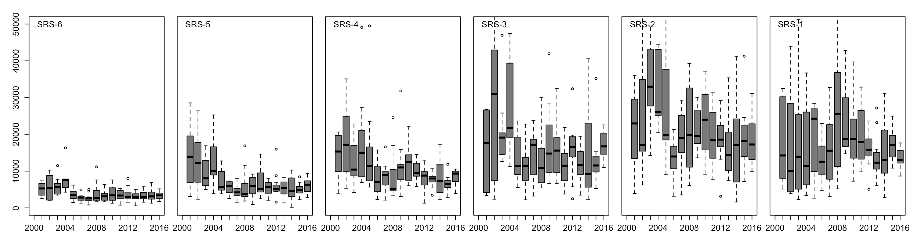
Bacterial productivity lags C:P in higher hydrologic connectivity wetlands
C:P
Year

Slide 6
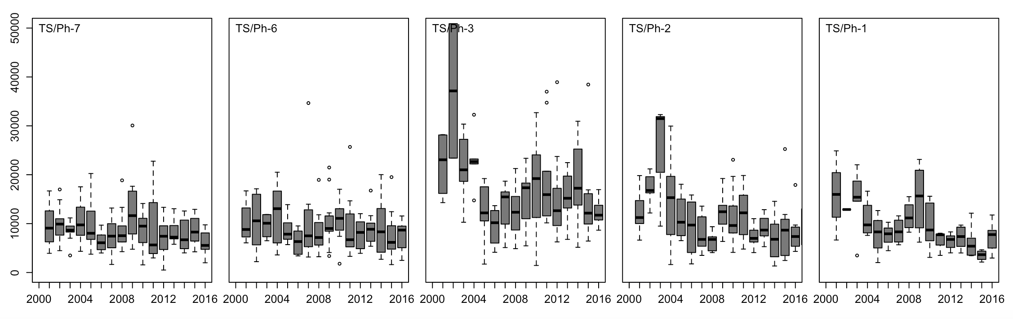
Bacterial productivity less explained by C:P in lower hydrologic connectivity wetlands
C:P
Kominoski et al., in revision

