Slide 1

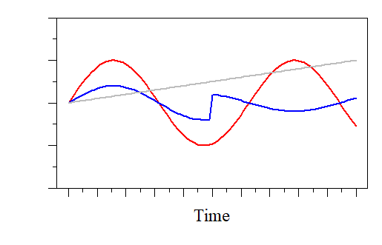




Ecological stoichiometry through the lens of long-term data: Using stoichiometry to understand dynamic ecological systems
Paul Julian¹, Adam Wymore² and John Kominoski³
https://www.deviantart.com/oo-ninart-oo

Slide 2
Approximate Schedule
Duration (Minutes) | Agenda Item
15 | General Introductions
7 | Speaker #1 Dr Walter K. Dodds
7 | Speaker #2 Dr Becky Ball
7 | Speaker #3 Dr John Kominoski
7 | Speaker #4 Dr Adam Wymore
35 | Round Table Discussion Everyone
 | 15 Minutes of Small Group Discussion
 | 20-Minutes Report Back
10 | Wrap-up

Slide 3
Objectives/Goals
The objective of this work is to stimulate cross-site syntheses related to biogeochemical cycling of energy and nutrients and to better understanding mechanisms that control productivity (via ecological stoichiometry).
The primary goal of this work is to foster collaborative synthesis between LTER sites related to ecological stoichiometry.

Slide 4
Introductions
Name
Site and Affiliation (LTER site, University/Agency, etc.)
Feelings on ecological stoichiometry? (love it? Hate it? Want to know more? How will it fit into my site?)

Slide 5
Ecological Stoichiometry
Growth Rate Hypothesis
Elemental Homeostasis
Elemental Threshold Ratio

Slide 6
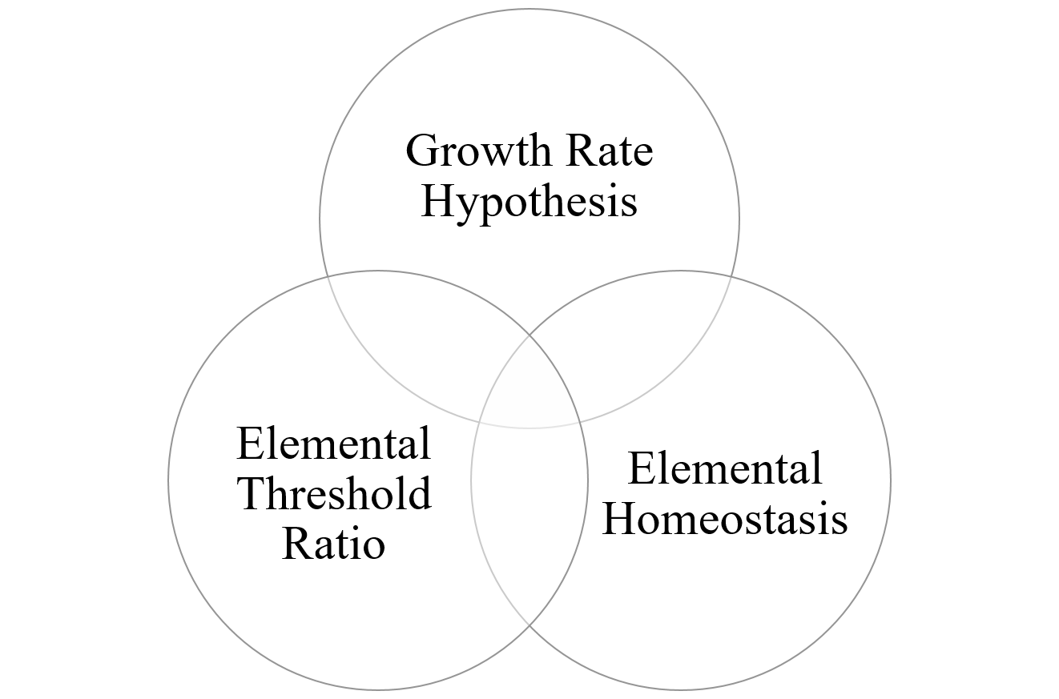
Global Change Drivers:
Sea-level rise
Nutrient mobilization
Fire
Temperature
Drought
Etc.

Slide 8
Growth Rate Hypothesis
Differences in maximum growth rate drive variation in organismal %P due to greater allocation to support rapid growth.
Supported by empirical tests from a variety of organisms as reviewed by Moody et al (2017).
Formulated specifically for invertebrate growth under P-limitation and constant temperatures.
Moody et al (2017) evaluated P-content and growth of macroinvertebrates in tropical streams.
Does not apply across temperature.
Other factors drive variation in organismal P for marcoinvertebrates
Elser et al (1996)
Elser et al (1996) Organism Size, Life History, and N:P Stoichiometry. BioScience 46:674–684.
Moody et al (2017) Does the Growth Rate Hypothesis Apply across Temperatures? Variation in the Growth Rate and Body Phosphorus of Neotropical Benthic Grazers. Front Environ Sci 5.

Slide 9
Elemental Threshold Ratio
Change in growth limitation from one element to another.
Optimal nutrient ratio in primary producers.
“stoichiometric knife-edge” in consumers
Nutritional mixture where growth is fastest characterized by high “dietary” and environmental supplies of all needed nutrients.
(Khattak et al. 2018)
(Frost et al. 2006)
Frost et al (2006) Threshold elemental ratios of carbon and phosphorus in aquatic consumers. Ecology Letters 9:774–779.
Khattak et al (2018) The threshold elemental ratio of carbon and phosphorus of Daphnia magna and its connection to animal growth. Scientific Reports 8:9673.

Slide 10
Elemental Homeostasis
Stoichiometric relationship between organisms and the environment.
Homeostasis: change in resource stoichiometry has not change in organism stoichiometry.
Non-Homeostasis: changes in resource stoichiometry drive corresponding changes in organism stoichiometry.
Meunier et al (2014) introduced terms conformer and regulator.
A better understanding of how organism are affect by and affect their environment.
(Cleveland and Liptzin 2007)
‘‘Without homeostasis, ecological stoichiometry would be a dull subject’’
Cleveland and Liptzin (2007) C:N:P stoichiometry in soil: is there a “Redfield ratio” for the microbial biomass? Biogeochemistry 85:235–252.
Meunier et al (2014) A New Approach to Homeostatic Regulation: Towards a Unified View of Physiological and Ecological Concepts. PLoS ONE 9:e107737.

Slide 11
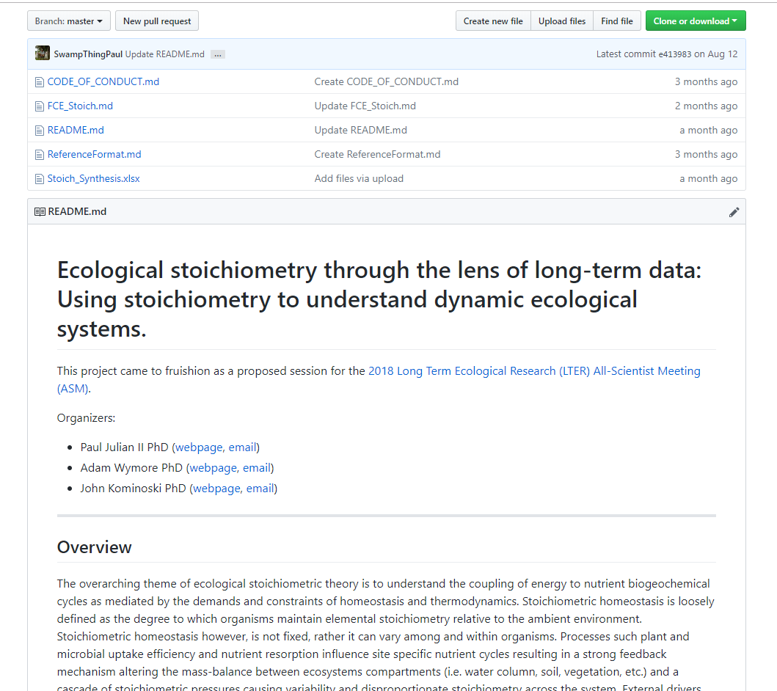
Workshop info and collaboration
https://github.com/SwampThingPaul/LTER_EcoStoich

