Slide 1
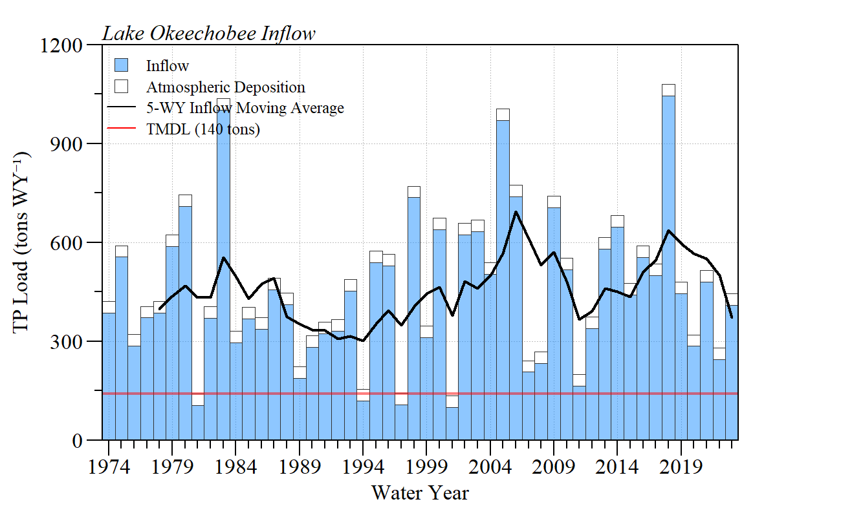
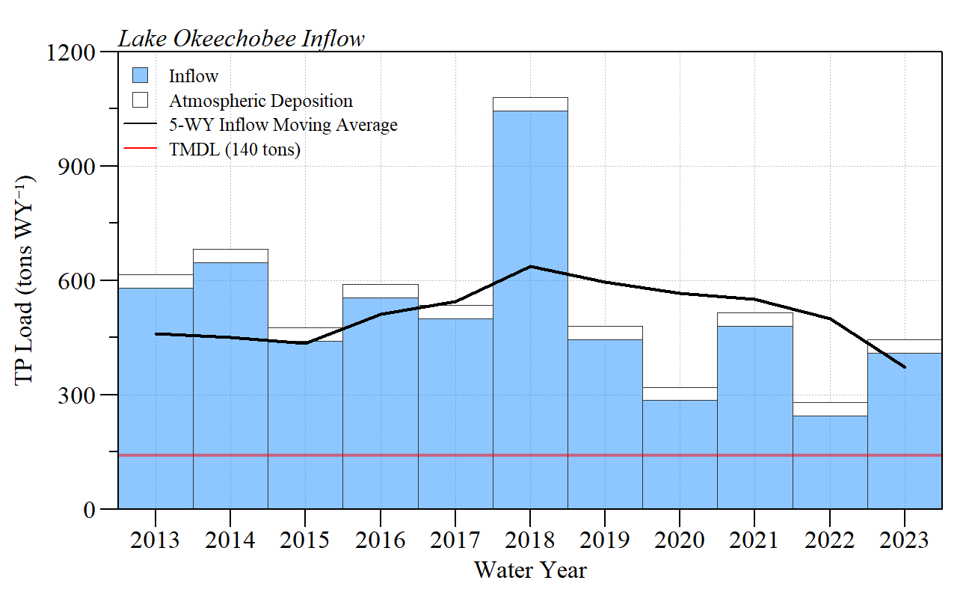
Lake Okeechobee inflow load from Water Year 1974 – 2023 (May 1973 to May 2023).
Lake Okeechobee inflow load from Water Year 2013 – 2023 (May 2012 to May 2023).
Plots reproduced with available data

Slide 2
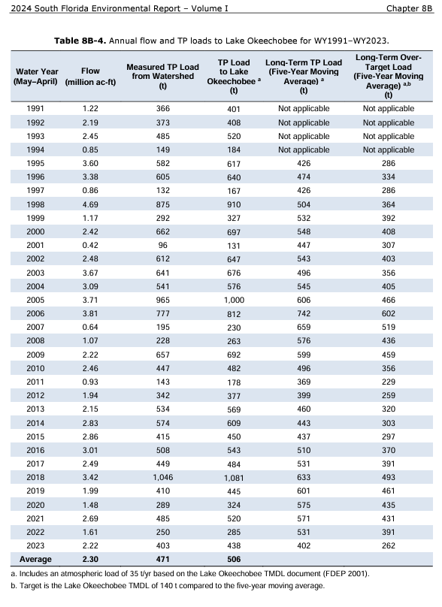
Data from 2024 South Florida Environmental Report
Water Year 2023 (May 2022 – May 2023) Lake Okeechobee received 403 metric tons of phosphorus nearly 3 times the TMDL limit of 140 metric tons.

Slide 3
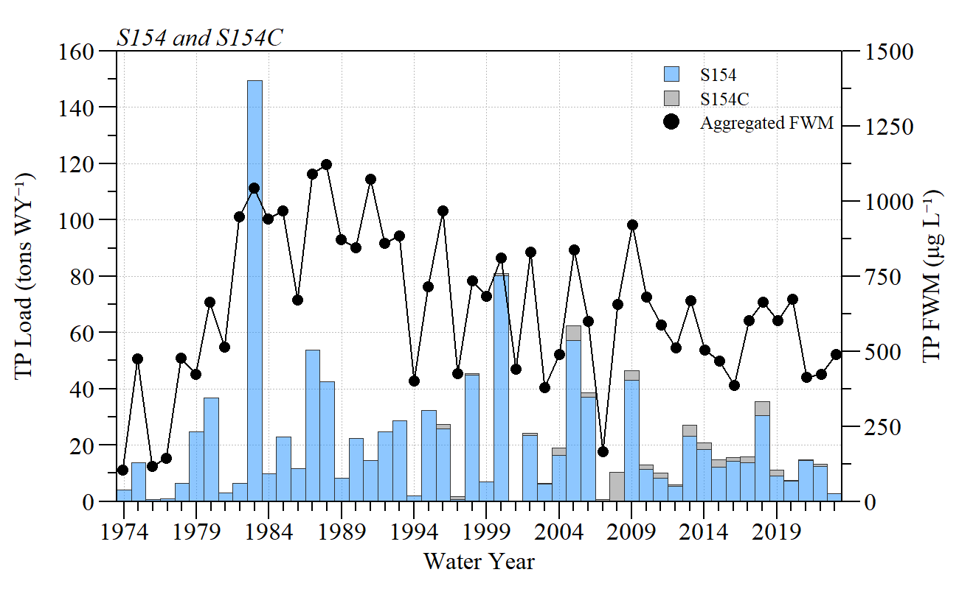
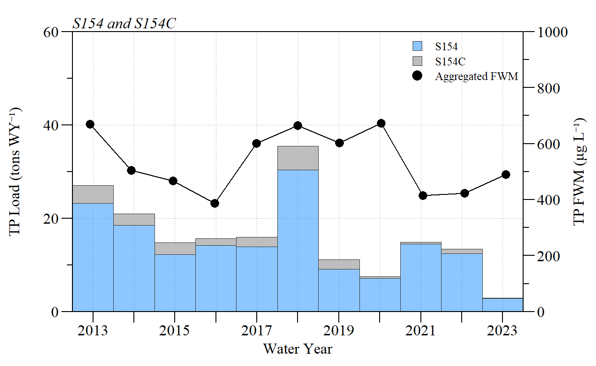
S154 and S154C load to Lake Okeechobee from Water Year 1974 – 2023 (May 1973 to May 2023).
S154 and S154C load to Lake Okeechobee from Water Year 2013 – 2023 (May 2012 to May 2023).
Plots reproduced with available data
Water Year 2023 (May 2022 – May 2023) loading from the S154 and S154C was ~2.8 metric tons, however in the last 10-WYs loading was 10x that much.
Flow-weighted mean TP concentrations are >400 µg L⁻¹ 10x greater than the in-lake TP concentration goal (40 µg L⁻¹) set by DEP.

