Slide 1

Robotics: Kinematics, Dynamics, and Motion
Control
WOAH
(Wirelessly Operated Animatronic Hand)
-Review
Members: -
Ankit Kumar (21BPS1148)
Swanand Yamgar (21BPS1211)
Sawan Kumar(21BPS1067)
Suraj Kumar(21BPS1128)

Slide 2
Table of contents:
• INTRODUCTION
> Abstract
> Motivation
> Problem statement
> Objectives
> Methodology
• TECHNOLOGY AND LITERATURE SURVEY
> Basics operation
> Hardware required
> Software required
• DESIGN AND IMPLEMENTATION
Schematic
Working Logic
> Cost estimation

Slide 3
INTRODUCTION
Abstract
• This paper presents a novel design of a robotic arm equipped with five fingers. The arm has been developed with the aim of providing a highly dexterous and versatile solution for various industrial and domestic applications. The five fingers offer a superior grip compared to conventional robotic arms with fewer fingers, allowing the arm to handle a wider range of objects with ease. The design features a compact and lightweight construction, making it suitable for integration into various systems.
• To control the hand, we use a computer vision to detect motion of hand and use the output to move the animatronic hand.
• Through this mechanism, we achieve enhanced artificial dexterity which is of high demand in tele-operated service robots (such as extraterrestrial rovers, satellite repair systems, and deep sea exploration submarines).
Motivation
• Design and fabricate an animatronic hand for demonstrative and educational purposes and explore possible applications of the same.
Problem Statement
• The lack of access to technical expertise in remote locations presents a significant challenge in the fields of high skilled labor jobs. This leads to limited availability of high efficiency physical manipulation and hinders the progress of these industries. The challenge is to construct a channel to make the technical prowess of individuals accessible from any location around the world through remote access to physical manipulation with high precision.
Objectives
• The objectives of making this project are-:

Slide 4
• Creating a model hand which can be operated from a distant place by detecting the motion of the fingers performed upfront of camera.
• To provide physical human expertise world wide. For example a patient in America being operated by doctor operating in India.
• Enhance our knowledge in the educational space of CV and Arduino programming
Methodology
• Decide upon the required hardware and software components to make the wirelessly operated animatronic hand.
• Selecting appropriate components which provide precise movements.
• Developing computer vision code to detect finger movements performed.
• Developing Arduino code to convert detected motion into desired result.
• Integrating the python code with Arduino.
• Connecting the required components correctly.
TECHNOLOGY AND LITERATURE SURVEY
Basic operations
• Detection of motion of fingers detected by the computer vision code and created a resultant output.
• Conversion of CV output as input for Arduino code.
• Processing of output by Arduino and providing required signals for servomotors for our fingers to move.
Hardware required
• Servo motors:
To provide desired and controlled range of motions.
• Arduino Uno
• Model hand
• Connecting wires

Slide 5
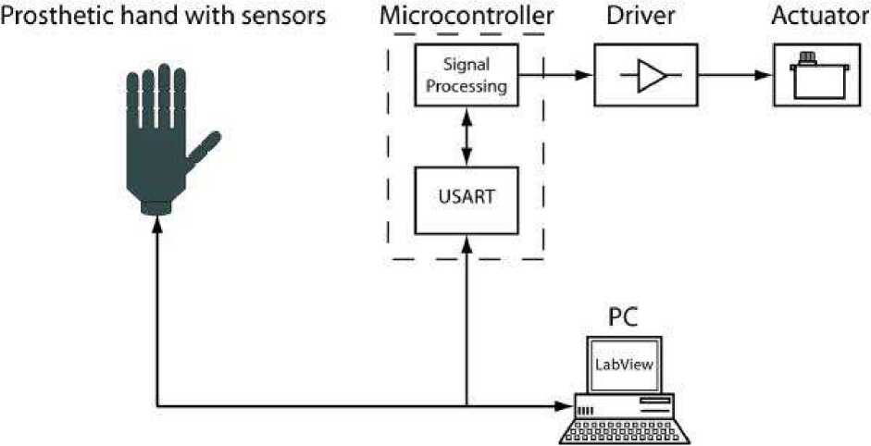
Software required
• Computer vision code:
CV code is required to detect the motion of fingers.
• Arduino code:
Arduino code is required to convert the CV output into useful result required for creating signals to activate servo motors when required.
DESIGN AND IMPLEMENTATION
Schematic
Working logic
• Finger moments done in front of our camera are detected by computer vision code. For a curved finger 0 is the resultant output while for straight finger 1 is our output computer vision code. Therefore, at an instant an array of 5 numbers including zeroes and ones created to detect movement of all five fingers done in front of our camera.

Slide 6
Cost estimation
• | Servo motors | x5 | = 750
• | Arduino uno | x1 | = 700
• | Model hand | x1 | = 500
• | Connecting wires |  | = 100
Total = 2050

