Slide 1
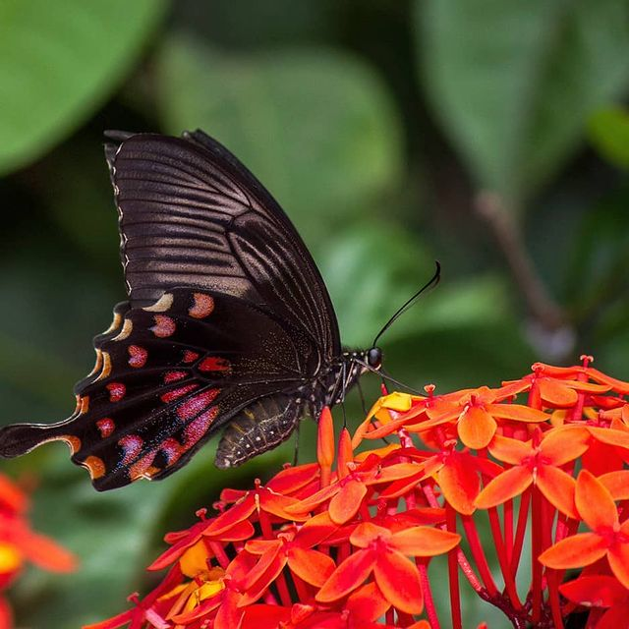
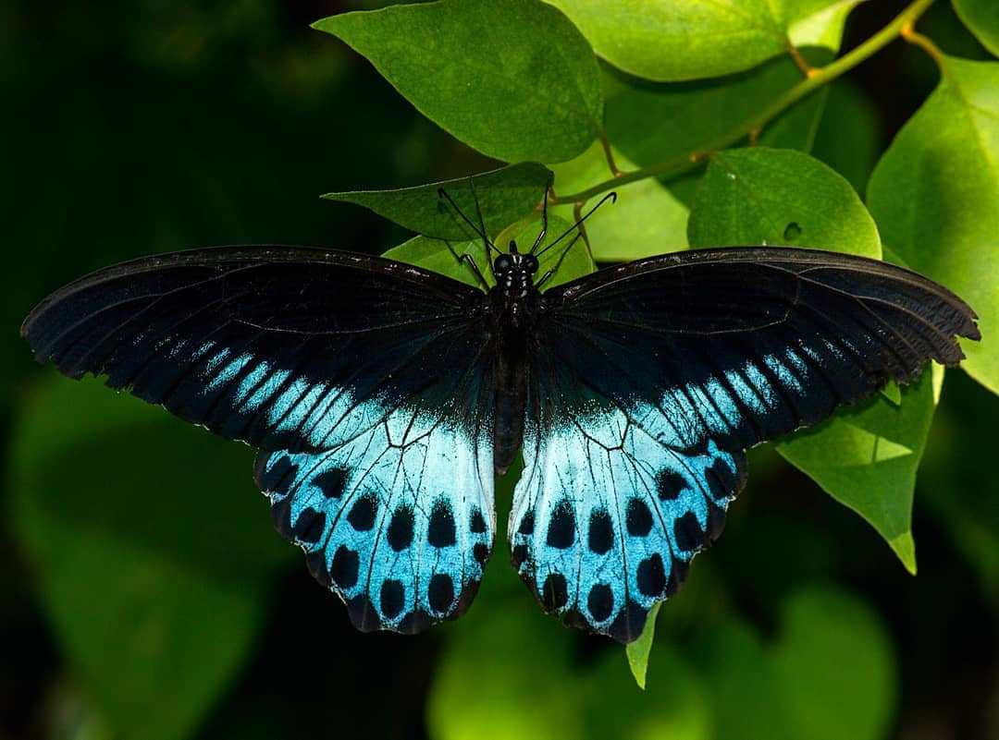
Mini-Project(Group-8) M.Sc.DSBDA Classification of Butterfly species using CNN
Project Guide:
Prof. Prajakta Soman
Team Members :
Atharwa Gokhale, Swanand Vaidya, Advait Chaudhari, Aditya Kulkarni

Slide 2
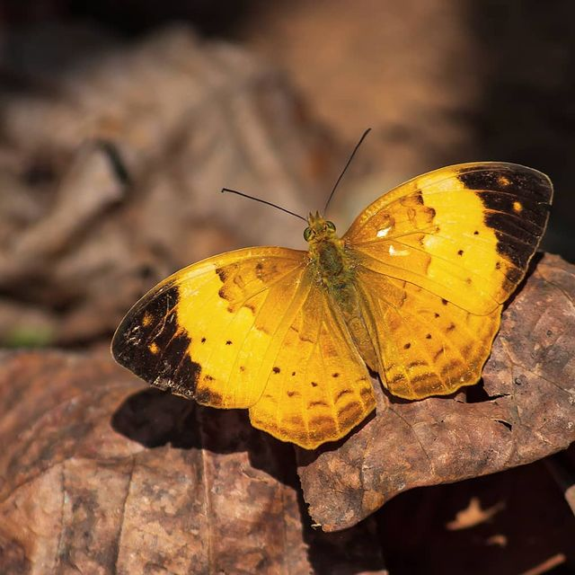
Inspiration
In the present scenario, lepidoptera experts claim that the genus, Emigrants and Tigers migrate from certain region to another. But as of today there is no data to prove this claim.
Hence we decided to build a CNN model which would we then deployed using a UI where butterfly experts as well as citizens can contribute to generate relevant data and either prove or disprove this claim.
As these are biological indicators of a healthy habitat/ecosystem, analysis of their threat status is a vital thing for human beings to know; whether the habitat they live in is healthy or not.

Slide 3
Introduction to the domain and the case study
The domain is Environment and Ecology, more specifically distribution of Emigrant and Tiger genus of butterflies.
Butterflies have been depicted as significant indicator species owing to their sensitivity to slightest change in environmental factors.
Problem statement : Classification of Butterfly species using CNN.
Aim : To classify butterfly species using CNN.

Slide 4
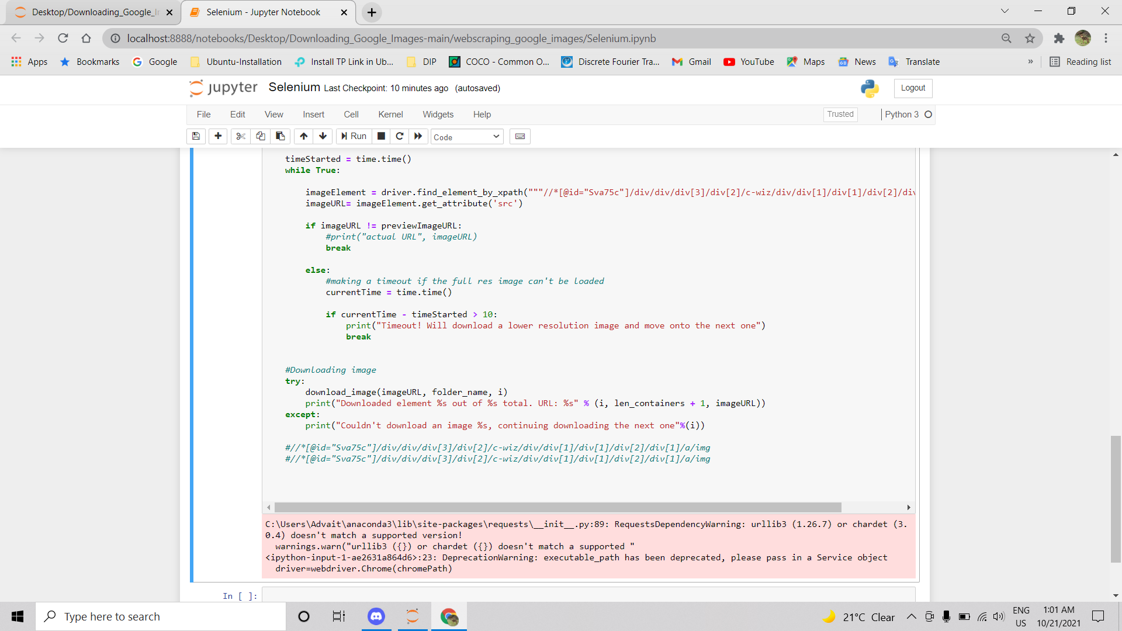
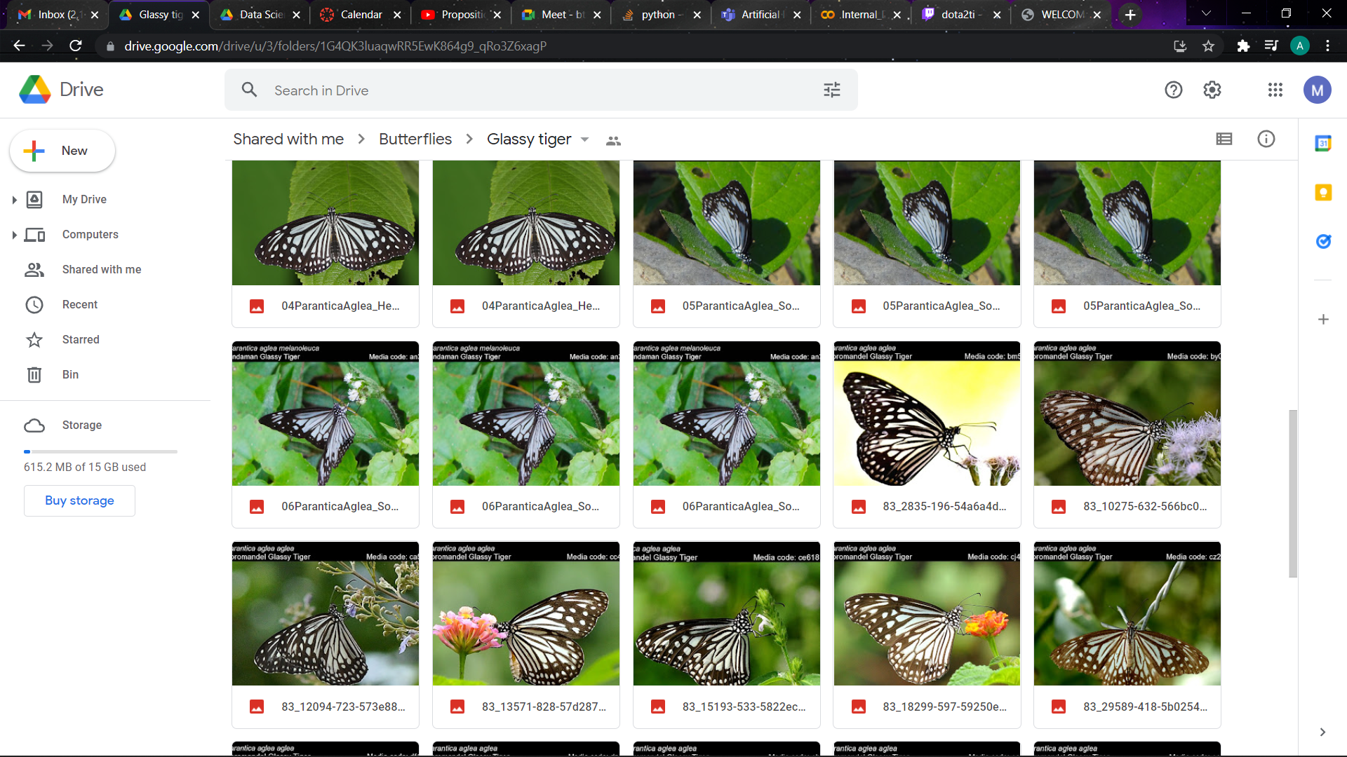
Dataset
There is no current dataset available for butterflies in India. So we have manually create the dataset with the help of information provided on a website https://www.ifoundbutterflies.org/[1].
We extracted the images using web scraping.
Our dataset consists of 4221 images.

Slide 5
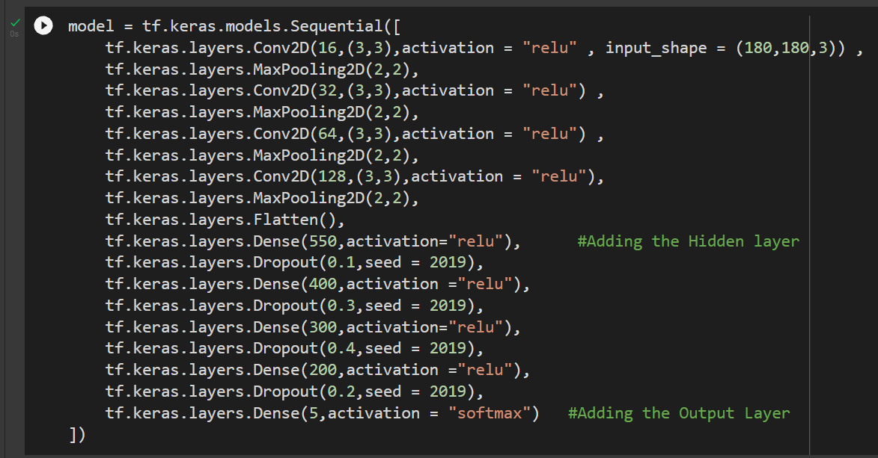
CNN Model:
Layers:
Input Layers: 4,Activation function-relu
Hidden Layers:4 ,Activation function-relu
Output layers: 1,Activation function-softmax

Slide 6
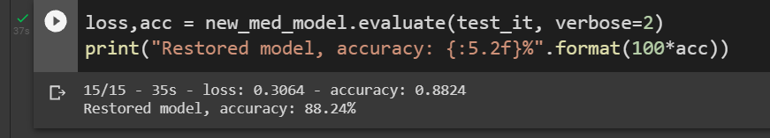
Result and conclusion
The accuracy for CNN was 0.86 and loss was 0.19
The validation accuracy was 0.90 and validation loss was 0.1
As seen from the results of the model, we have successfully built a model that gives a good accuracy for classifying butterfly species (5 Species).
TensorFlow is a powerful Deep Learning Library which can help build good image classification models with the help of Keras API.

Slide 7
Future scope
We want to build an application where we can add checklists of butterflies and which can help to classify and keep a record of selective genus/families of butterflies who are said to be migratory species. These records from various states, when analyzed can prove their migration.
This will help the layman contribute to the butterfly research community, by uploading checklists(live data from different days, seasons,etc), which will help the researchers to have live data almost daily, track the migration and metamorphosis cycle patterns and also update the threat status accordingly.

Slide 8
Literature Survey
https://www.sciencedirect.com/science/article/abs/pii/S0168169920313491
https://towardsdatascience.com/classify-butterfly-images-with-deep-learning-in-keras-b3101fe0f98
https://github.com/marian42/butterflies
https://www.analyticsvidhya.com/blog/2021/06/image-classification-using-convolutional-neural-network-with-python/

Slide 9
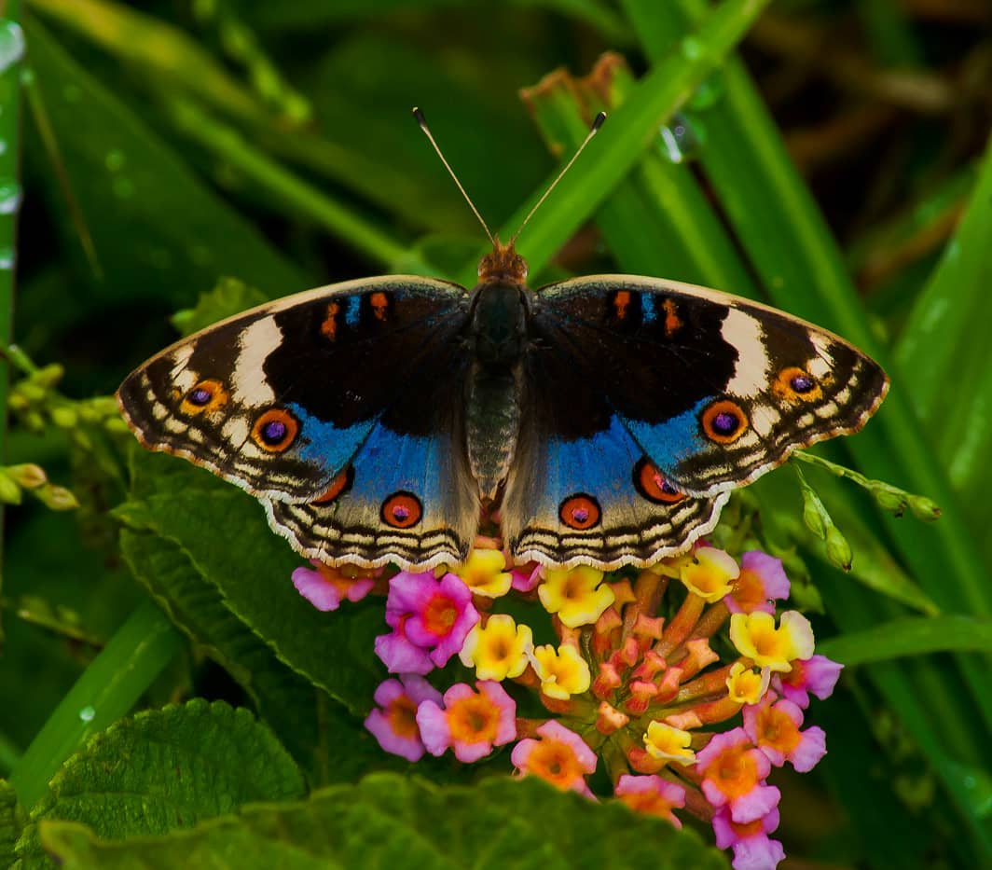
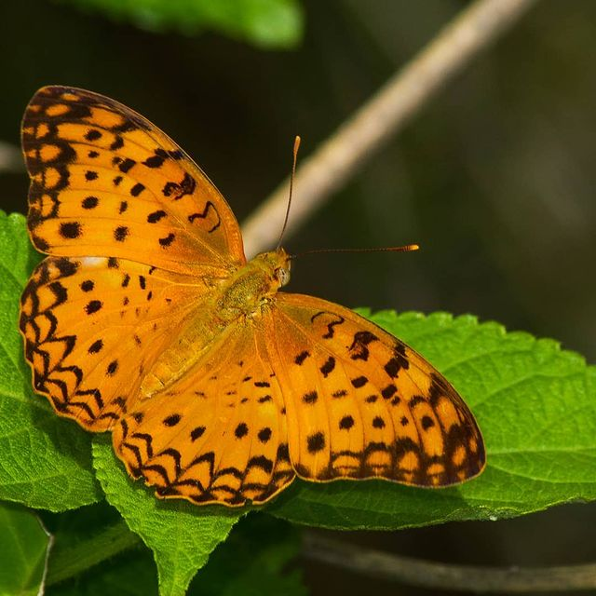
References:
[1] https://www.ifoundbutterflies.org/
[2] https://towardsdatascience.com/

Slide 10
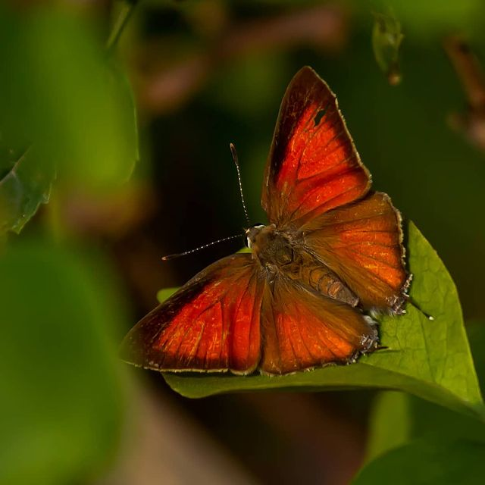
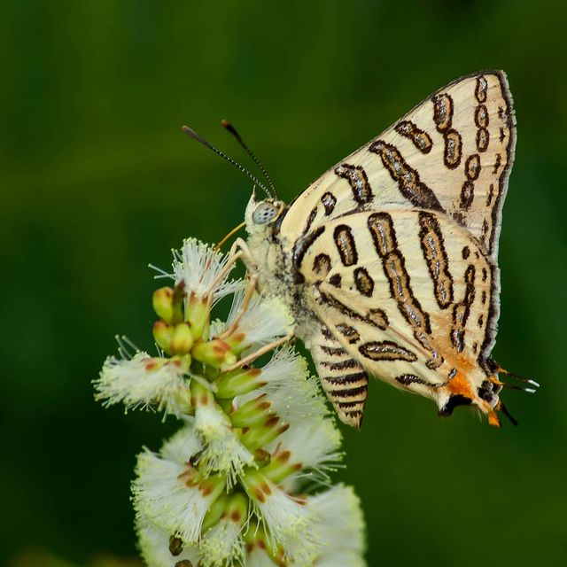
Thank you….!!!!!

