Slide 2
Titanic - Machine Learning from Disaster
Presented by
Naveena Kanderi - nkanderi@kent.edu
Vaishnavi Valluri - vvalluri@kent.edu
Jashwanth Reddy Baggari - jbaggari@kent.edu
Sandeep Narayanasetty - snaraya5@kent.edu

Slide 3
Overview
Project Objectives
Potential Customers & End Users
Constraints imposed by the Customer
Assumptions and Risks
Stakeholder
Tools Utilized
Literature Review

Slide 4
Project Objectives
To build a predictive model that helps us to get the probability of survival for the passengers that boarded the Legendary Titanic Ship.
Implement this predictive model for any disaster that might happen in future.
Get insights on various algorithms used in Machine learning techniques.
To get familiar working with large datasets, processing the data, data cleaning, training of datasets, visualization of the data and predicting the possible outcomes.

Slide 5
Potential Customers
Any Government organizations, travel agencies or any institutions that organize large events involving any potential risks to the lives of people that use their services.
End Users
Authorized personnel that handle Disaster Management in fields such as Police, Fire, Medical etc.

Slide 6
Constraints Imposed by the Customer
Obtained results shall be displayed to end users in the form of graphs so they can be easily understood.
Use the Box plots and density plots to visualize the probability of survival for various constraints.
Choose the most suitable patterns of correlation to predict your results.

Slide 7
Assumptions and Risks
When features that have less correlation are selected to train the data over the ones that might provide higher correlation, it could possibly predict the result with less accuracy.
Additional data such as differentiating the crew from passengers might help us to train the data with more accuracy.
Care should be taken while replacing missing values in the dataset as considering improper values might lead to less accurate results.
We should be cautious while adding more data to the dataset, as it might predict incorrect results.
While neglecting data from a given dataset, care should be taken not to omit data that might be relevant in producing results of higher accuracy.

Slide 8
Stakeholder
Srinadh B
Application Development Manager
CVS Health Corporation
Email ID: bssrinadh@gmail.com

Slide 9
Tools Utilized
Numpy
Pandas
Seaborn
Matplot
Scikit -learn
Jupyter notebook

Slide 10
LITERATURE REVIEW
Paper 1: Titanic: Statistical Analytics from Disaster
Authors: Joao Negreiros, Samia Loucif, Mohammad Amin Kuhail, Ahmed Seffah
Published In: International Journal of Academic Engineering Research (IJAER) ISSN: 2643-9085 Vol. 4 Issue 10, October - 2020.
Link: http://ijeais.org/wp-content/uploads/2020/10/IJAER201007.pdf

Slide 11
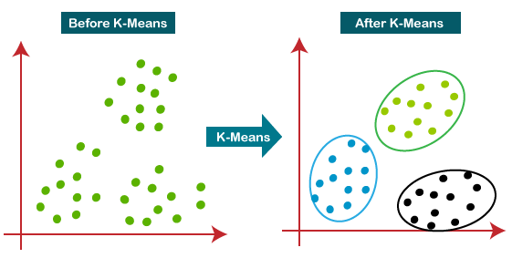
Techniques Used
K-Means: It is an iterative algorithm that partitions the dataset into K pre-defined distinct non-overlapping clusters where each data point belongs to only one sub-group. The less variation we have within clusters, the more homogeneous the data points are within the same cluster.

Slide 12
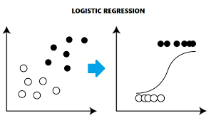
Logistic regression: It is an appropriate maximum likelihood estimator regression analysis to conduct when the dependent variable is binary. Used with predictive purposes, logit regression describes data and tries to explain the relationship between one dependent dualistic variable and one or more metric independent variables. The output is actually the percentage chance that a particular case gets a yes (1) on the dependent variable.

Slide 13
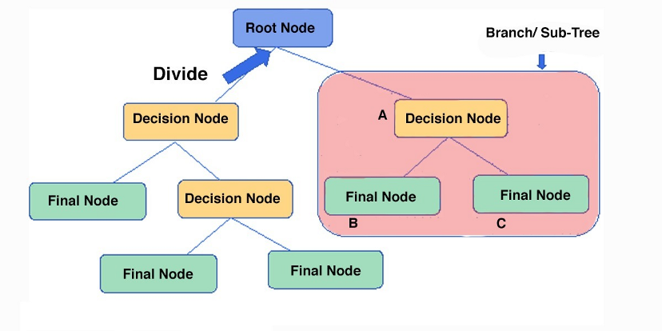
Decision trees: It creates a tree-based classification model by classifying individual cases into groups in order to predict values of a dependent variable based on values of independent variables.

Slide 14
Cont’d
Paper 2: A Comparative Study on Machine Learning Techniques using Titanic Dataset
Authors:Ekin Ekinci , Sevinç İlhan Omurca, Neytullah Acun
Published In: April 2018, Conference: 7th International Conference on Advanced Technologies, At: Antalya. E-ISBN: 978-605-68537-1-5
Link:https://www.researchgate.net/publication/324909545_A_Comparative_Study_on_Machine_Learning_Techniques_Using_Titanic_Dataset

Slide 15
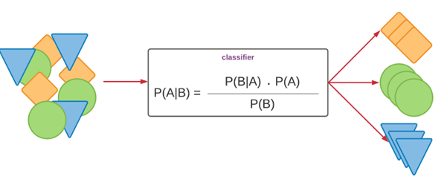
Naïve Bayes : This is based on Bayes theorem assuming all features are independent given the value of the class variable. This is a conditional independence assumption and true in real world applications. Due to this assumption NB performs well on high dimensional and complex datasets.

Slide 16
Techniques Used
Naïve Bayes (NB) — Accuracy: 0.789
k-Nearest Neighbors (kNN) — Accuracy: 0.802
Logistic Regression (LR) — Accuracy: 0.802
Decision Tree — Accuracy: 0.817
Random Forest (RF) — Accuracy: 0.848

Slide 17
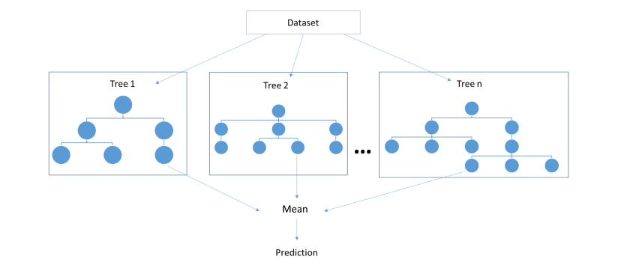
Techniques we are planning to use
We are planning to implement a combination of Random Forest and Decision Trees. Both these techniques can be used for regression as well as classification problems.

Slide 18
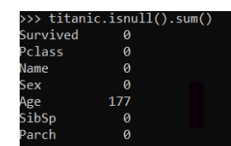
Dataset
Source: Kaggle website
Two datasets:
Training Dataset – 891 samples of data –12 unique features
Test Dataset - 418 samples - 11 unique features (without survived feature)

Slide 19
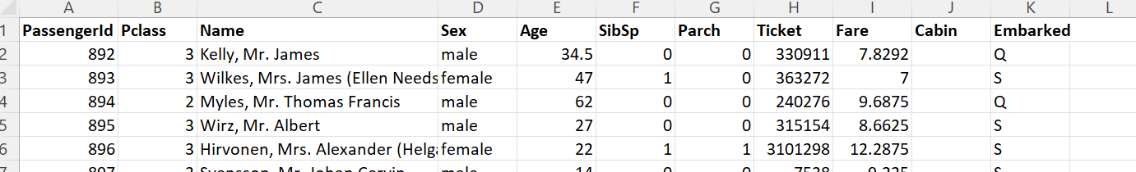

Slide 20
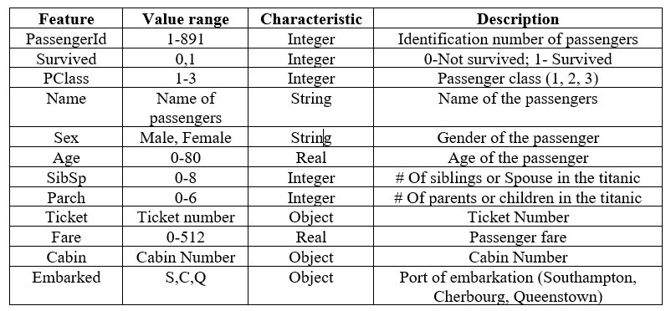
Features of the Attributes

Slide 21
Data cleaning and Preprocessing
PassengerID: It is a numerical feature which represents the number of passengers and it is used to just sort the dataset. So we can drop the dataset.
PClass: The feature PClass is given as a number but we can use it as a category. By using this feature, we can categorize the passenger from the wealthiest classes to other classes.
Name: We can extract the titles of the passenger like Mr., Mrs., Miss, Master. We can use the extracted title for filling the missing values in another feature as AGE.
SibSp and Parch: used to group the families together.

Slide 22
Age: highly relevant, but has 177 null values. can fill those null values using mean or median or by the title of the passenger.
Ticket: has no pattern to parse so we can drop this row.
Cabin: Shows us which cabin is booked by the passenger, as there 687 null values from 891 sample data we have. We are planning drop this attribute.
Embarked: This is considered as a string feature. We have three ports where people have boarded the titanic, we have only 2 missing values in this feature. We can either drop those two rows from the dataset or we can fill it with S as in the dataset the most number of people embarked at Southampton.
Sex: We can label male as 0 and female as 1.

Slide 23
Methodology : Decision Trees
Decision Tree algorithm is used to identify the patterns through predictive models by using of simple probability calculations.
It is a supervised machine learning algorithm using the tree structures to predict the outcome.
Conceptually, decision tree starts with ROOT node and data is divided into levels where the last level is called as leaf node where decision has been taken.

Slide 24
WHY Decision Trees?
This algorithm deals with both numerical and categorical data.
It provides a clear indication of which fields are most important for prediction or classification

Slide 25
In our project, for predicting the survival rate of titanic passengers
we will considered embark, class, sex features as a root node
firstly we are representing Embark as a root node.
The data at Embark is divided into 3 types Q is Queenstown, S is Southampton and C is Cherbourg.
After that the next level is considered as Sex as it is highly corelated to predict the survival rate. And as the leaf node, the passengers were divided according to the class.
Because there is a high chance to predict the survival rate based on class as it has sublevels like first class, second class and third class.
The Age and Ticket features are eliminated from the decision tree as we thought that the above three features would give us the accurate survival rate of passengers.

Slide 26
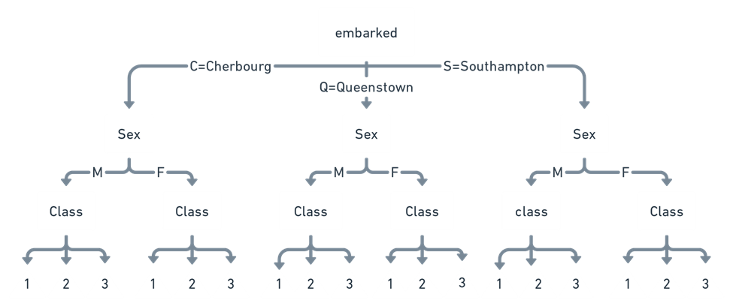
Decision Tree

Slide 27
EXECUTION FLOW
Titanic - Machine Learning from Disaster
1:DATA COLLECTION
3:FORMULATING CODE
STEP:1
STEP:2
STEP:3
STEP:4
2:DATA CLEANING
4: COMPARE RESULTS

Slide 28
Tools Utilized
Titanic - Machine Learning from Disaster
Numpy
Pandas
Seaborn
Matplot
Scikit -learn
Jupyter notebook

Slide 29
Filling Null values
Titanic - Machine Learning from Disaster
Age - Mean of Female passengers Age is used to fill Null values of them. Similarly for Men too.
Embarked- has just 3 null values, so the values are filled by “S” at which highest number of people embarked.
Cabin – still considering to use.

Slide 30
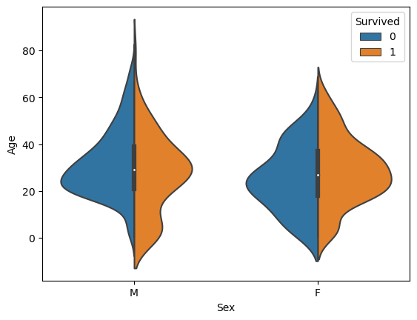
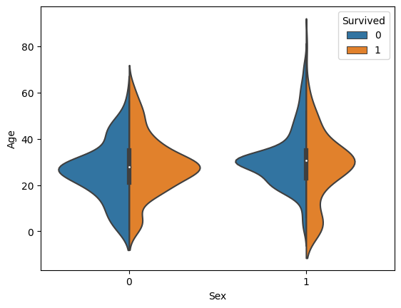
Plots
Titanic - Machine Learning from Disaster
This graph provides us the number
of passengers that survived, based
on the Gender and Age.
Age is taken on Y-axis and
Gender on X-axis.
Male- M
Female -F

Slide 31
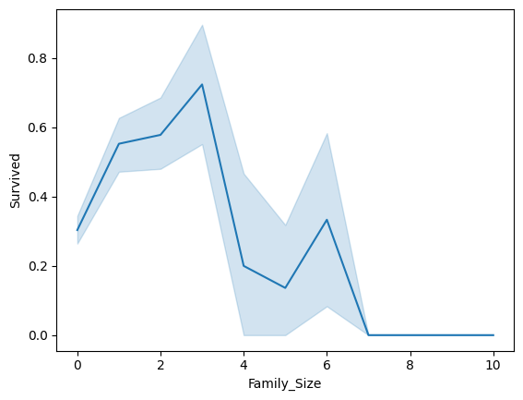
Plots
Titanic - Machine Learning from Disaster
The below plots are based on the Family size and if they survived.

Slide 32
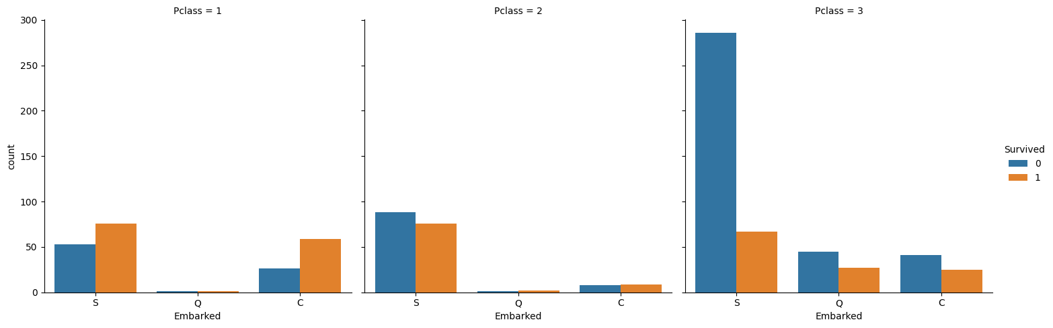
This graph provides us the relationship between
embarked, passenger class in the survival of passengers.

Slide 33
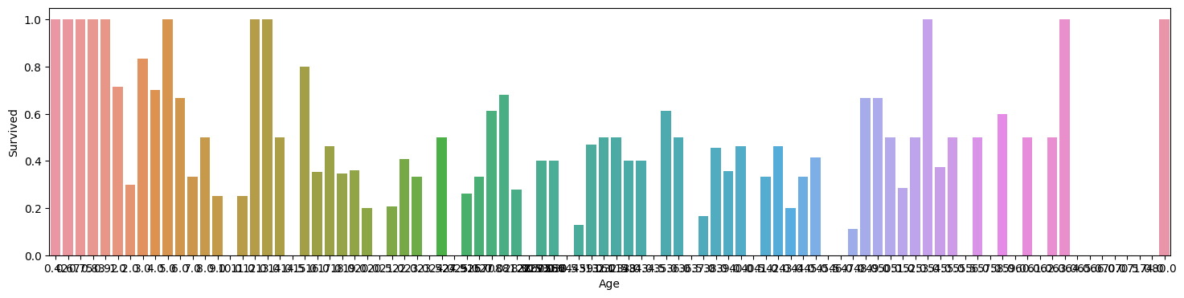
The below graph provides relation between age and survivability of the passenger
Titanic - Machine Learning from Disaster

Slide 34
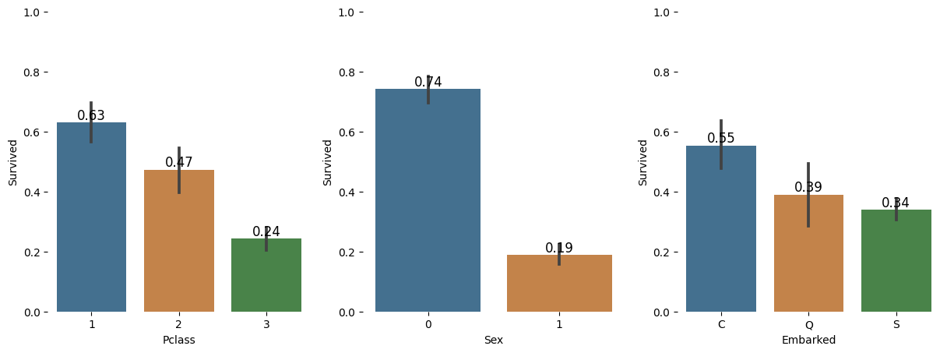
fraction of passengers survived in from each class, port they embarked and Gender (Male-1, Female-0).
Titanic - Machine Learning from Disaster

Slide 35
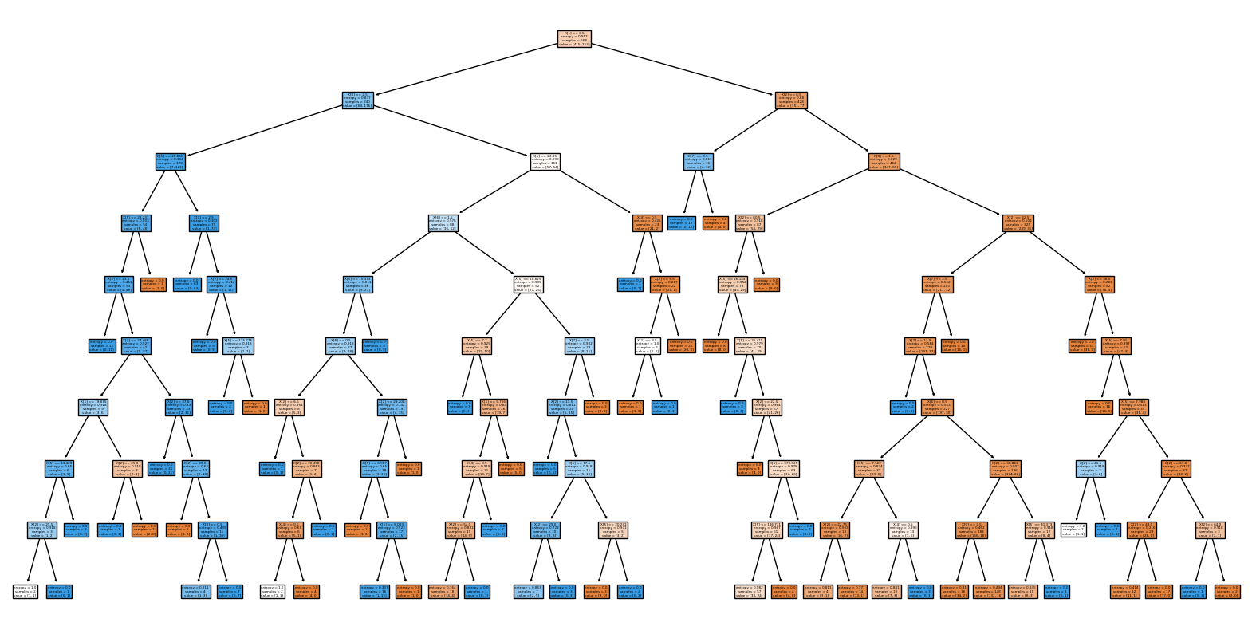
DECISION TREE BASED ON
Titanic - Machine Learning from Disaster

Slide 36
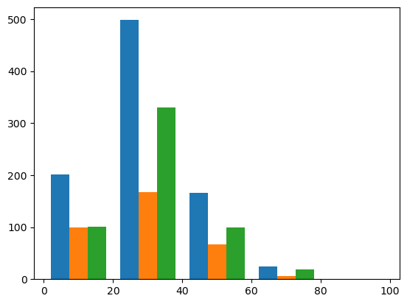
The below graph provides relation between age and survivability of the passenger

Slide 37
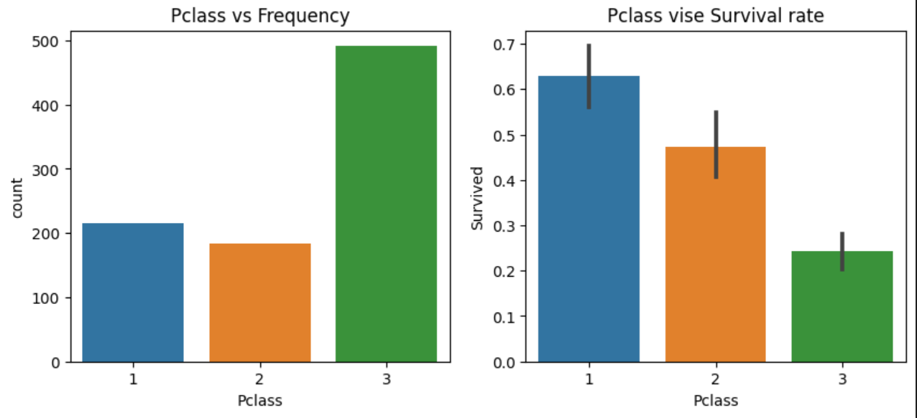
Relation btw Passenger class and survival rate

Slide 38
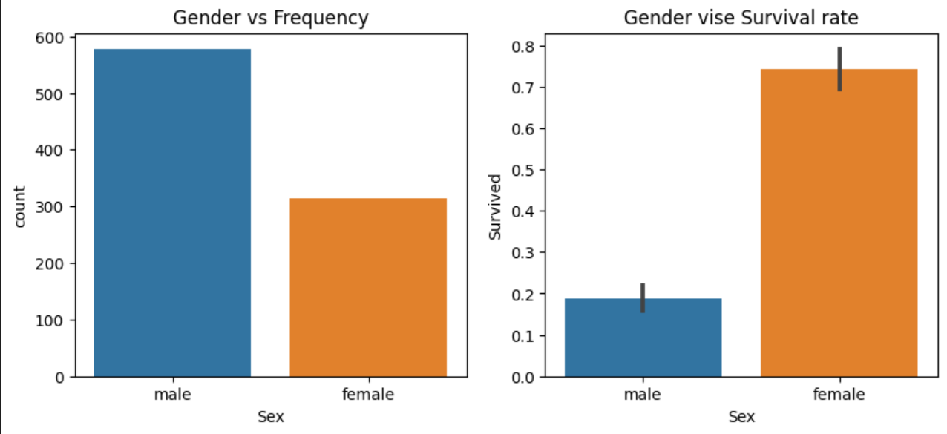
Gender vs Survival rate

Slide 39
Techniques Used
Linear Regression — 0.851123595505618
Gaussian Naive Bayes — 0.8876404494382022
Random Forest — 0.8707865168539326

Slide 40
Thank You

