Slide 1
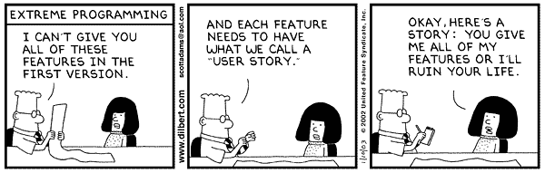
Visualization, Lecture
Volume Visualization,
Part 1

Slide 2
Overview: Lecture #3
Contents of Volume Visualization, Part 1:
  Introduction
    About Volume Data
    Overview of Techniques
  The VolVis Conceptual Framework
  Simple Methods
    slicing, cuberille

Slide 3
Volume Visualization
Introduction:
  VolVis = Visualization of Volume data
    Picture/image 3D→2D
    Projection (e.g., Maximum Intensity Projection-MIP), slicing, surface extraction, volume rendering, …
  Volume Data =
    3D −> 1D Data
    scalar data, 3D data space, space filling (dense-as opposed to sparse)
  User goals:
    to gain insight into 3D Data
    depends strongly on what user is interested in (focus + context)

Slide 4
Volume Data
Where does the data come from?
  Medical Applications
    Computer Tomography (CT)
    Magnet Resonance Imaging (MRI)
  Material testing/control
    Industry-CT
  Simulation
    Finite element methods (FEM)
    Computational fluid dynamics (CFD)
  And other sources

Slide 5
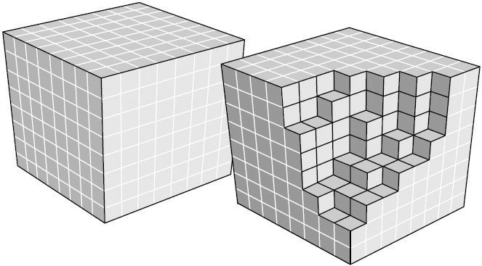
Grid data
Data is often in a 2D/3D grid of values
scattered uniform rectilinear structured unstructured

Slide 6
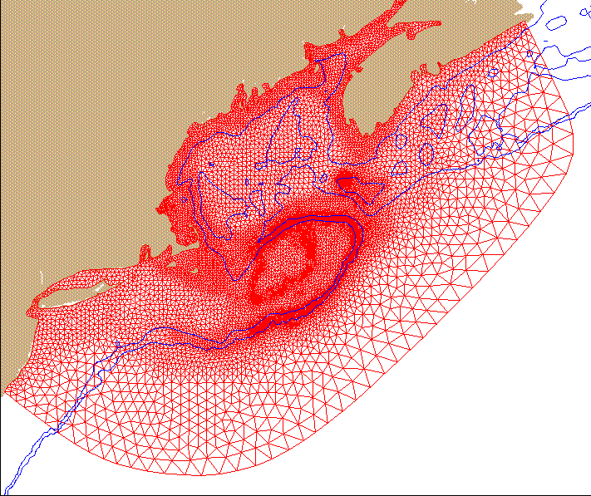
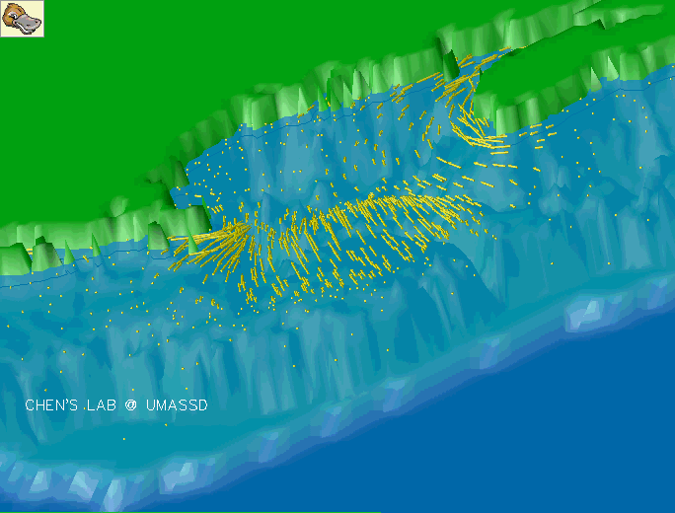
Grid data
Can be adapted to local data

Slide 7
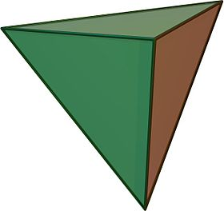
3D Data Space
How is the volume data organized?
  Cartesian, i.e., regular grids:
    CT/MR: often dx=dy<dz, e.g. 135 sclices (z) by 512² values in x & y
    Data enhancement: iso-stack-computation = interpolation of additional slices, so that dx=dy=dz −−> 512³ Voxel
    Data: Cells (Faces), Corners: Voxel
  Curvilinear grid i.e., unstructured:
    Data organized as Tetrahedra or Hexahedra
    Often: Conversion to Tetrahedra
Terminology
Tetrahedron. “A 3D primary cell that is a simplex with four triangular faces, six edges, and four vertices.” –the Visualization Toolkit (VTK)

Slide 8
Volume Visualization (VolVis) – Challenges
Challenges:
  rendering projection,
  so much information and so few pixels
  large data sets, e.g.,
  512x512x1024 voxels at 16 bit/voxel = 512 Mbytes
  Computational Speed,
  Interaction is very important, >10 frames per second (fps)

Slide 9
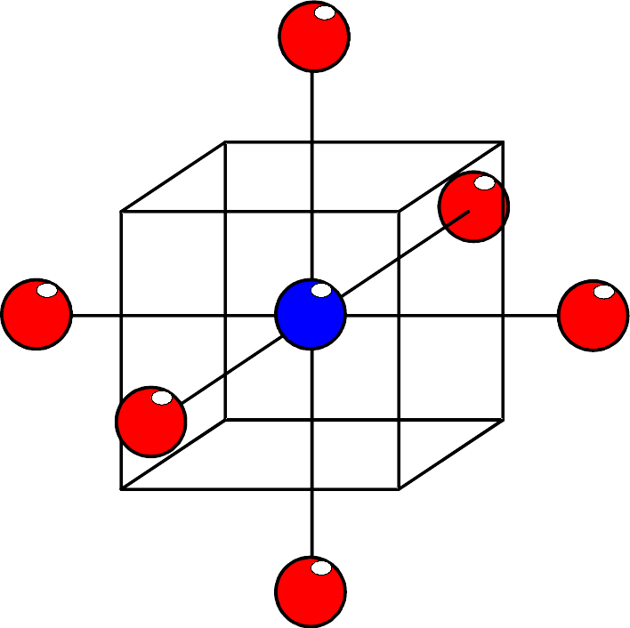
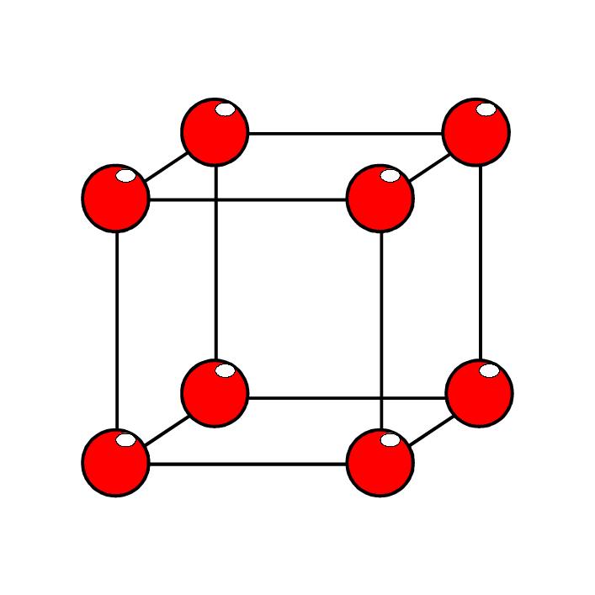
Voxels vs. Cells
Two ways to view the volume data:
  Data as a set of voxels
    voxel = short for
    volume element
    (recall: pixel = "picture element”)
    voxel = point sample in 3D
    not always interpolated
  Data as a set of cells
    cell = Cubic Primitive (3D)
    corners: 8 voxel
    value(s) in cell:
    are always interpolated

Slide 10
Interpolation
(More) Terminology:
Interpolate: ``Estimate a value of a function at a point, p, given known function values and points that bracket p.''
Nearest neighbor
Linear

Slide 11
Interpolation
Example
f(1)● ←d→ (p)● ←(D-d)→ ●f(2)
T(1)● ←d→ T(x)● ←(D-d)→ ●T(2)
100C● ←2→ T(?)● ←(10-2)→ ●200C
Nearest neighbor: T(?) = 100C
Linear:
T(?) = 100C(10-2)/10 + 200C(2/10)
120C = 100C(.8) + 200C(.2)

Slide 12
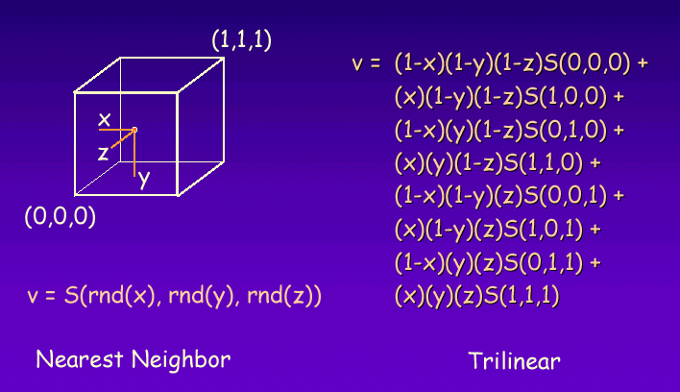
Interpolation

Slide 13
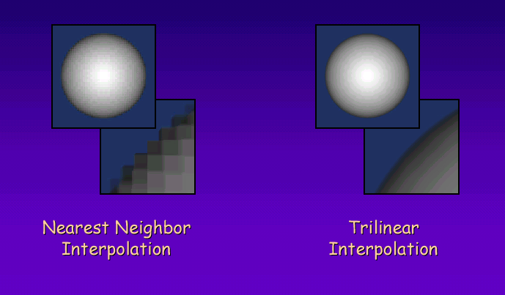
Interpolation – Influence

Slide 14
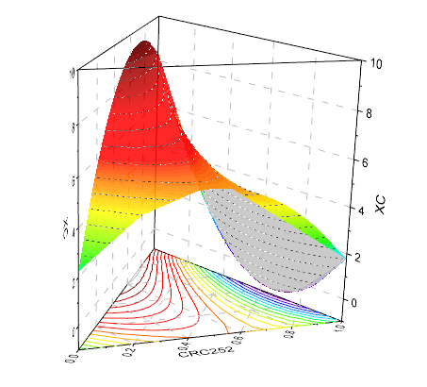
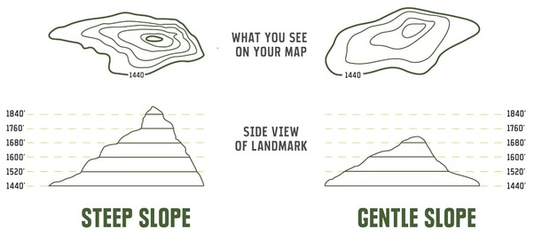
Isosurfaces
Level set : {(x) | f(x) = a}
The set of all points where the function equals some value
Isocontour surface made from the level set of a 2D scalar function

Slide 15
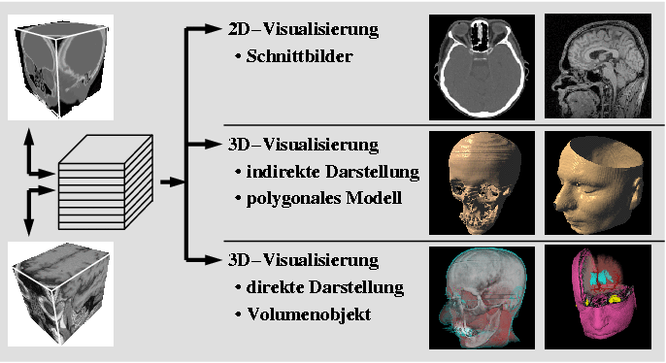
Isosurfaces
Isosurface surface made from the level set of a 3D scalar function

Slide 16
Conceptual VolVis Framework
Sampled Data
(Measurement)
Analytical Data
(Modeling)
iso-surfacing
Voxel space
(discrete)
Geometric Surface
(analytic)
voxelization
(direct) volume
rendering
surface
rendering
Pixel space
(discrete)

Slide 17
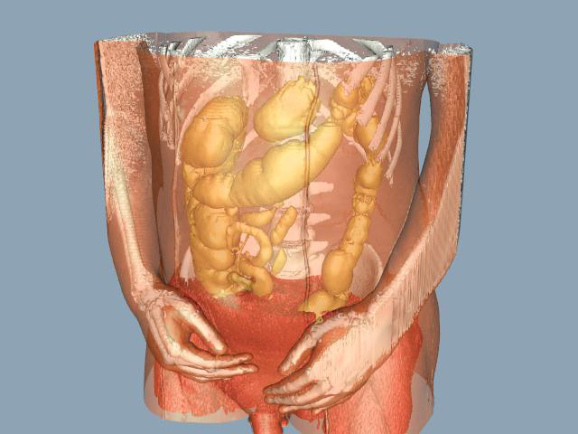
Conceptual VolVis Framework
Sampled Data
(Measured)
Analytical Data
(Modeling)
Example 1:
  CT measurement
  iso-stack compuation
  iso-surface
  computation
  (marching cubes)
  Surface rendering
  (OpenGL)
Voxel space
(discrete)
iso-surfacing
Geometr. Surface
(analytic)
voxelization
volume
rendering
surface
rendering
Pixel space
(discrete)

Slide 18
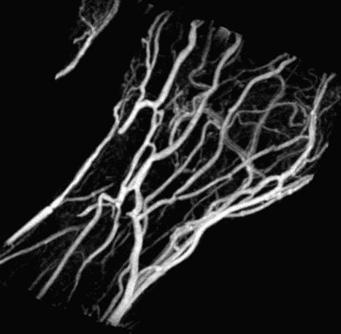
Conceptual VolVis Framework
Sampled Data
(Measured)
Analytical Data
(Modeling)
Example 2:
  MR Measurement
  iso-stack computation
  MIP (maximum
  intensity projection)
  Image: Vessels in Hand
Voxel space
(discrete)
iso-surfacing
Geometric. Surface
(analytic)
voxelization
volume
rendering
surface
rendering
Pixel space
(discrete)

Slide 19
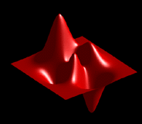
Conceptual VolVis Framework
Sampled Data
(Measurement)
Analytical Data
(Modeling)
Example 3:
  potential function
  ρ(x,y,z)
  iso-surface
  ρ(x,y,z)=ρ₀
  surface
  ray tracing
Voxel space
(discrete)
iso-surfacing
Geometr. Surface
(analytic)
voxelization
volume
rendering
surface
rendering
Pixel space
(discrete)

Slide 20
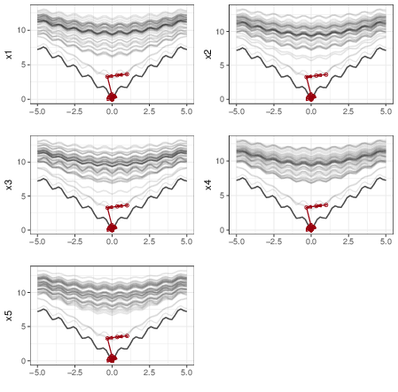
Conceptual VolVis Framework
Sampled Data
(Measurement)
Analytical Data
(Modeling)
Example 4:
  Optimization function ackley(x1,x2,…)
  Multi-D slicing
  2D line plotting
Voxel space
(discrete)
iso-surfacing
Geometr. Surface
(analytic)
voxelization
volume
rendering
surface
rendering
Pixel space
(discrete)
Torsney-Weir, et al. 2017

Slide 21
VolVis-Techniques – Overview
Indirect volume visualization:
Indirect: Compute isosurfaces, then render
slicing, MPR (multi-planar reconstruction)
marching cubes (marching tetrahedra)
Direct volume visualization:
Direct: project volume onto image plane
ray casting
shear-warp factorization
Splatting
3D texture mapping

Slide 22
Image-order vs. Object-order
Image-order:
  FOR every pixel DO: …
  Cost is related to size of image (measured in pixels)
  Example: VolVis technique-ray casting
Object-order:
  FOR every object (voxel) DO: …
  Cost is related to the number of objects (number of voxels)
  Example: VolVis technique-splatting

Slide 23
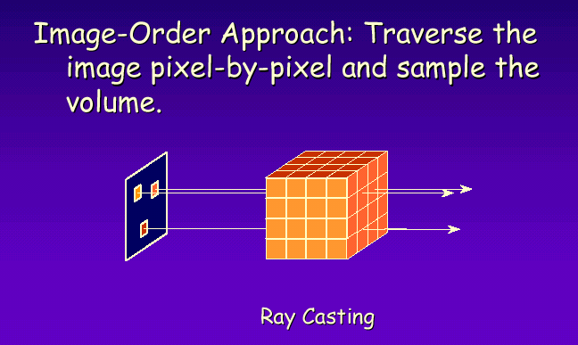
Image-order Approach

Slide 24
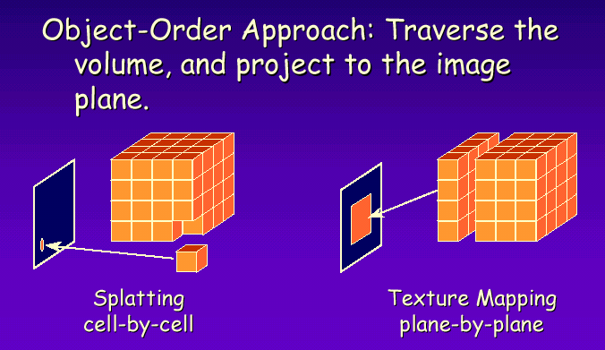
Object-order Approach

Slide 25
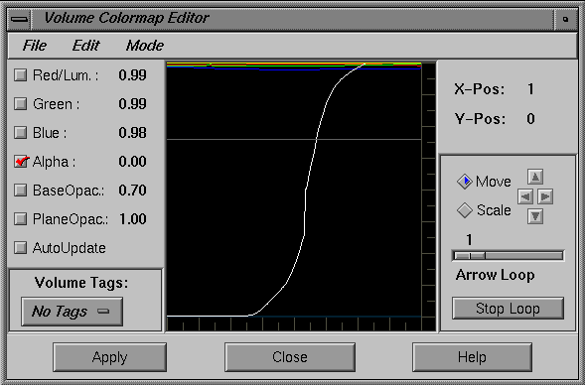
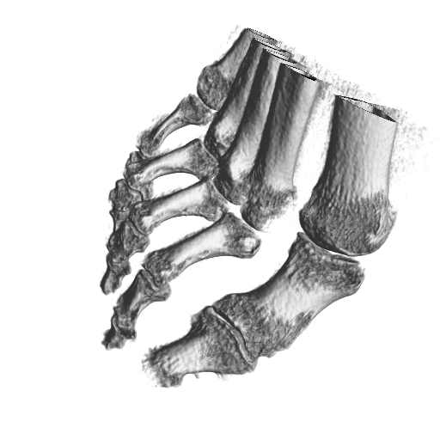
Transfer functions
Empowers user to select “structures”
Maps raw voxel value into presentable entities
Extract important features of the data set
Classification is non trivial
Data value
opacity

Slide 26
Transfer functions
Assign each scalar value a different color value
Assignment via transfer function T
  T :: scalarvalue -> colorvalue
Common choice for color representation: RGBA
Alpha value is very important, describes opacity
Code color values into a color lookup table
On-the-fly update of color LUT

Slide 27
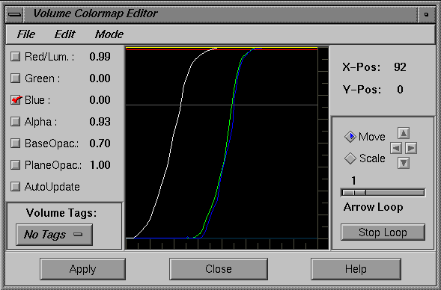
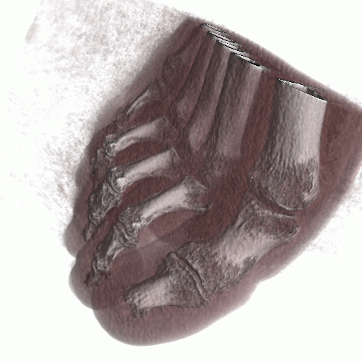
Transfer functions
Data value
opacity
Interaction is important

Slide 28
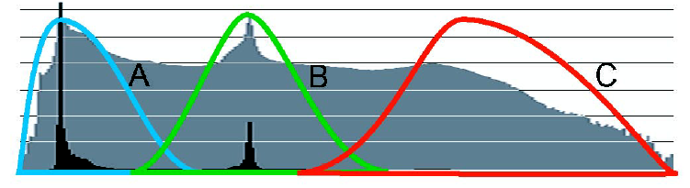
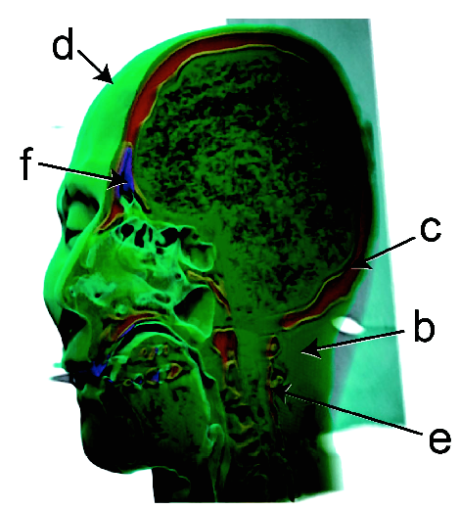
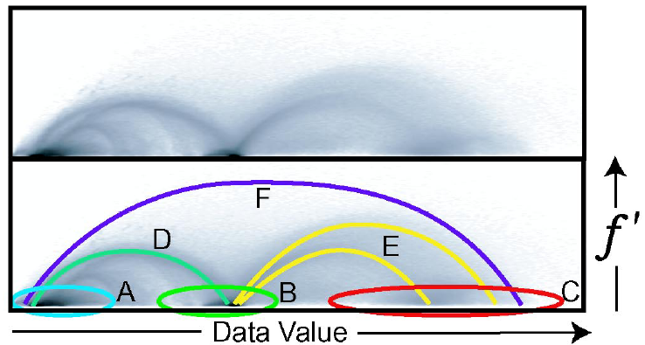
Transfer functions

Slide 29
Simple VolVis Methods
Slicing

Slide 30
Slicing
Slicing:
  Axis-aligned slices
  regular grids: simple
  no transfer function
  no color
  windowing:
  contrast adjustment/enhancement

Slide 31
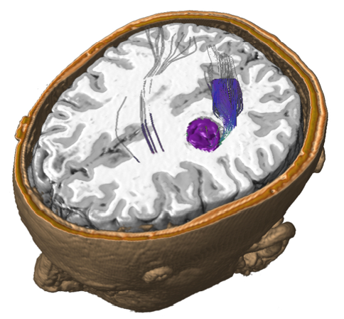
Slicing
Not so simple:
slicing through
all grids
interpolation
necessary
Slicing:
Combines well with
3D-Vis.

Slide 32
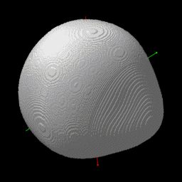
Slicing
Example: Analytical Data set

Slide 33
Summary
Data is usually given on a grid
Conceptual volvis framework is a pipeline from data to visualization
Indirect vs direct visualization
Transfer function maps data values to color

Slide 34
Further Reading and Acknowledgements
For more information, please see, Data Visualization: Principles and Practice, Chapter 10 Volume Visualization by A.C. Telea, AK Peters, 2008
We thank the following people for lecture material:
  Robert S. Laramee
  Michael Meißner
  Roger Crawfis (Ohio State Univ.)
  Hanspeter Pfister
  Meister E. Gröller
  Torsten Möller
  Dirk Bartz
  Markus Hadwiger
  Helwig Hauser

