Slide 1
Introduction to visualization
Thomas Torsney-Weir

Slide 2
Acknowledgements
Selective contributions from
Robert S. Laramee
Torsten Möller
Tamara Munzner
Raghu Machiraju
Hanspeter Pfister
Melanie Tory
Daniel Weiskopf

Slide 3
What is visualization?

Slide 4
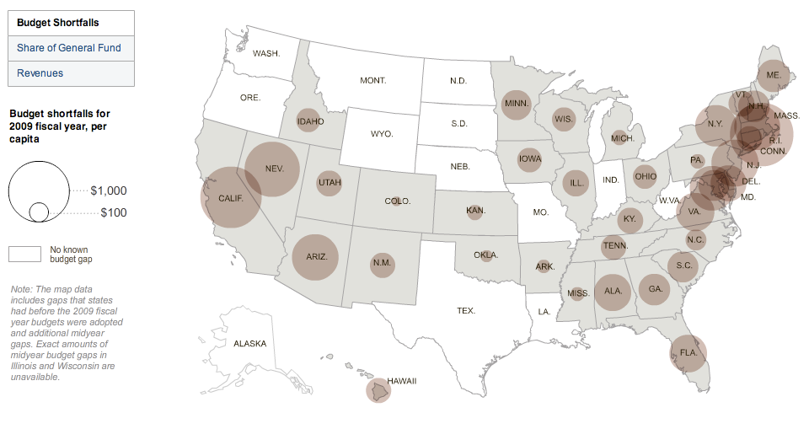
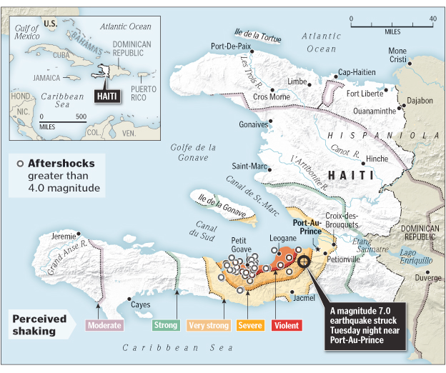

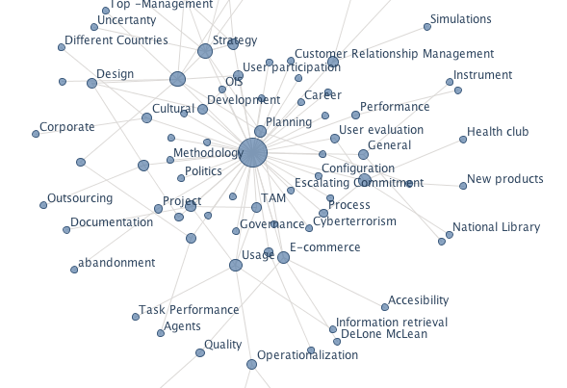
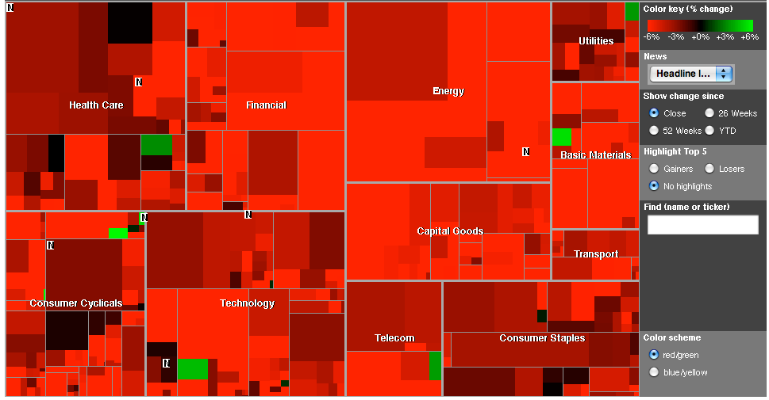
What is visualization?
convey information via visual representations
www.wordle.net

Slide 5
Definition
Computer-based visualization systems provide visual representations of datasets intended to help people carry out some task more effectively.
T. Munzner: Visualization Design and Analysis: Abstractions, Principles, and Methods, AK Peters, 2014

Slide 6
Definition
Computer-based visualization systems provide visual representations of datasets intended to help people carry out some task more effectively.
T. Munzner: Visualization Design and Analysis: Abstractions, Principles, and Methods, AK Peters, 2014

Slide 7
Definition
Computer-based visualization systems provide visual representations of datasets intended to help people carry out some task more effectively.
T. Munzner: Visualization Design and Analysis: Abstractions, Principles, and Methods, AK Peters, 2014

Slide 8
Definition
Computer-based visualization systems provide visual representations of datasets intended to help people carry out some task more effectively.
T. Munzner: Visualization Design and Analysis: Abstractions, Principles, and Methods, AK Peters, 2014

Slide 9
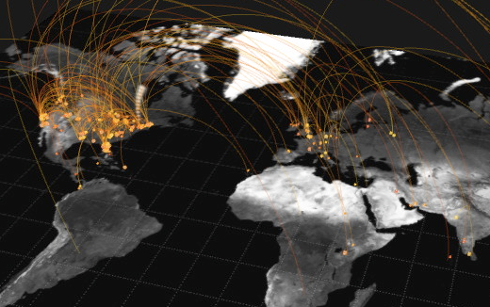
What is not visualization?
Data-driven art
https://vimeo.com/4587178

Slide 10
Beginnings of visualization

Slide 11
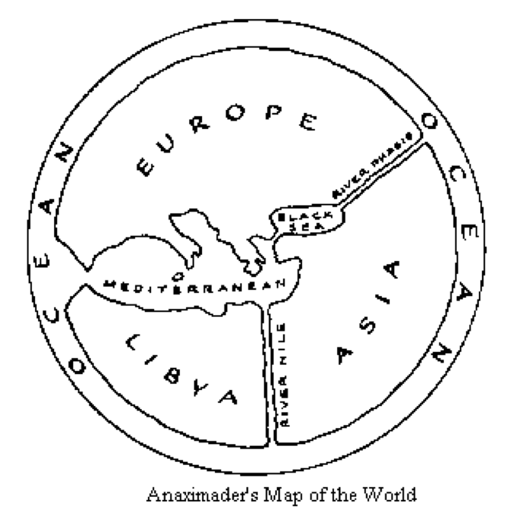
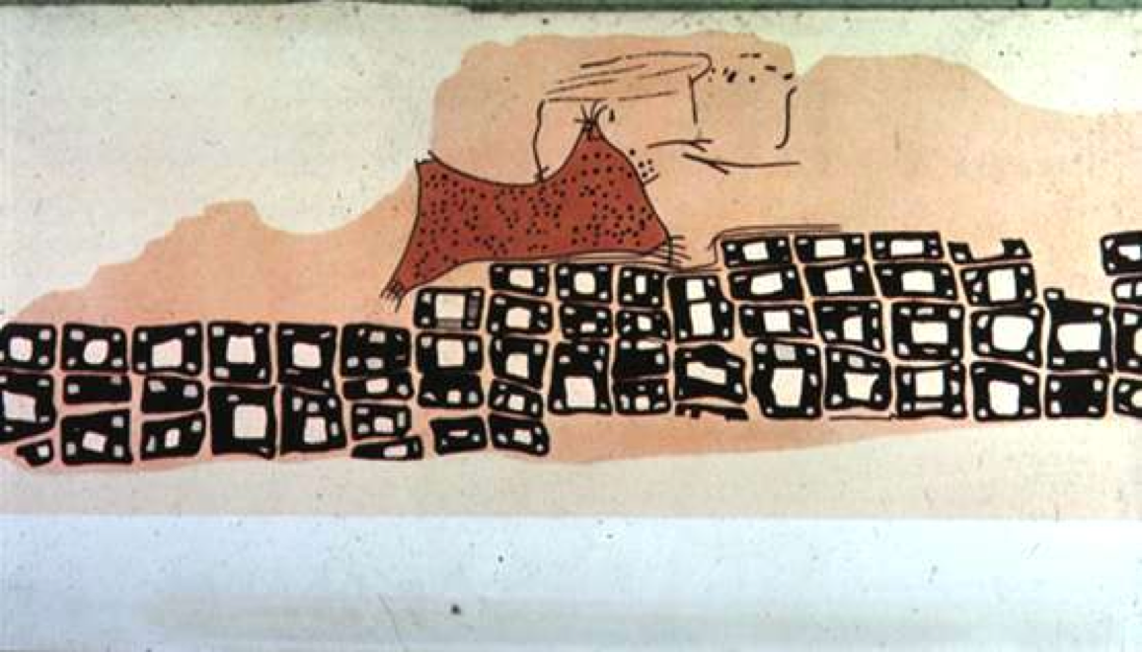
Maps
Konya town map, Turkey (~6200 BC)
Anaximander of Miletus, (~550 BC)
Milestones Project
http://www.math.yorku.ca/SCS/Gallery/milestone/

Slide 12
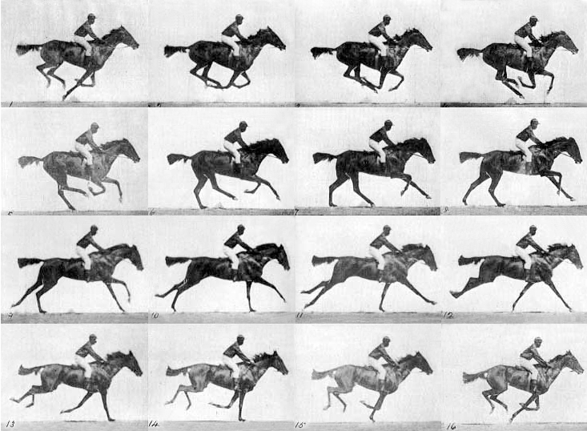
Solving arguments
E. J. Muybridge (1878)

Slide 13
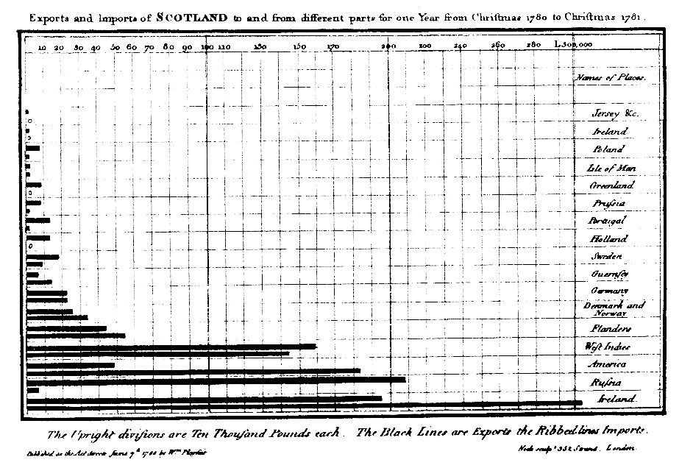
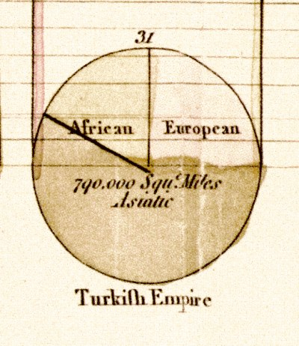
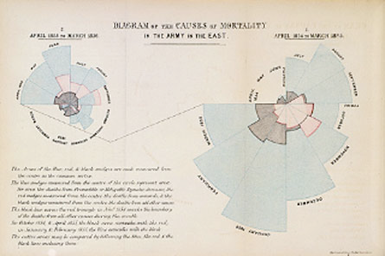
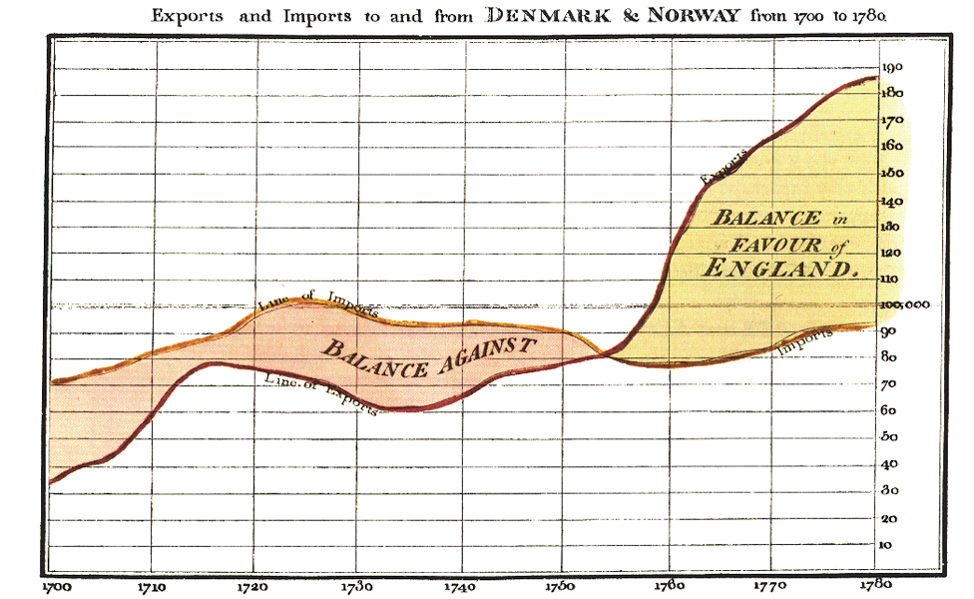
Abstract data
F. Nightingale (1856)
W. Playfair (1786)

Slide 14
Why visualization?

Slide 15
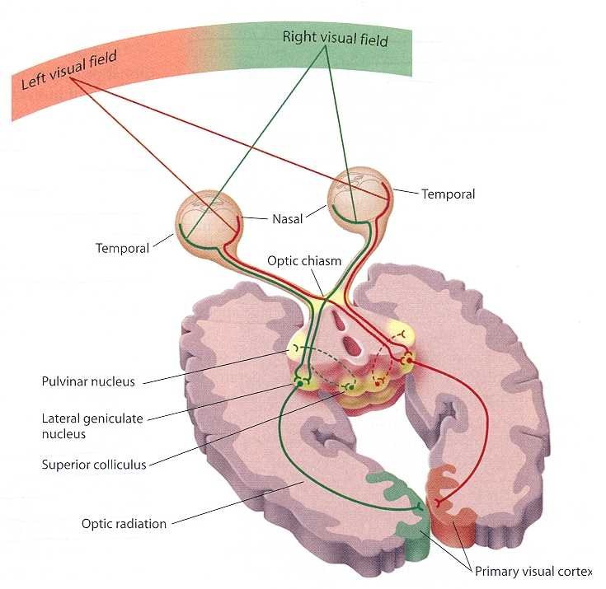
Visual cortex
Visualization exploits our powerful visual system
Several billion neurons devoted to analyzing visual information (30% cortex)
8% for touch, 3% for hearing (Discover, 1993, Ware, 2013)
Enables massively parallel processing of the visual field, i.e., incoming color, motion, texture, shapes etc.

Slide 16
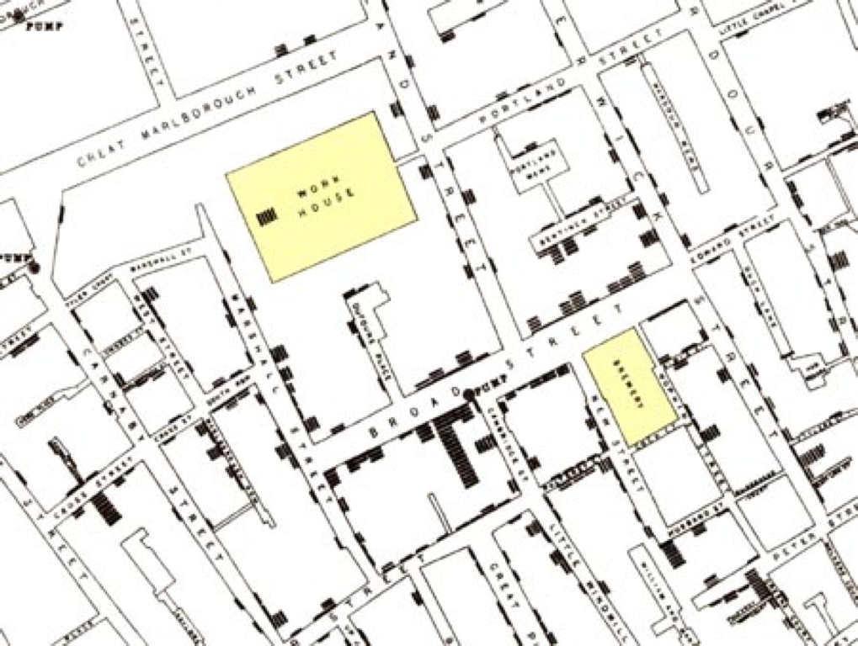

Discovery
John Snow (1854)

Slide 17
Interaction
NY times

Slide 18
Communication
NY times

Slide 19
Why visualization
Helps us think
Reduces load on working memory
Offloads cognition
Leverages power of human perception

Slide 20
Conclusion

Slide 21
Related fields
Analysis
Human
Graphics
Machine learning
Statistics
Signal/image processing
Geometry
Numerics
Psychology
Cognition
UI/UX
Graphic design
Computer graphics
Animation
Geometry processing
Virtual reality

Slide 22
Summary
factors for effective visualization
  data
  tasks
  users
People have been using visualization for centuries
Human visual perception is extremely powerful

Slide 23
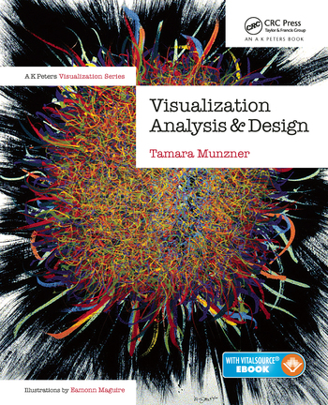
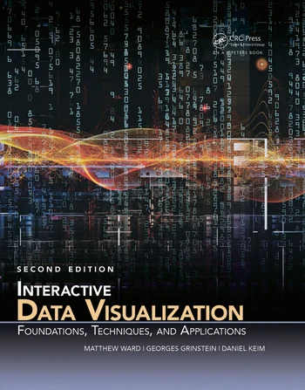
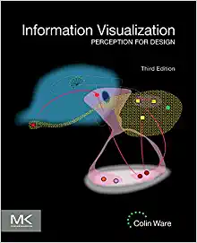
Some books
Visualization Analysis and Design by Tamara Munzner
Interactive Data Visualization: Foundations, Techniques, and Applications, Second Edition by Matthew O. Ward, Georges Grinstein, Daniel Keim
Information Visualization: Perception for Design by Colin Ware

