Slide 1
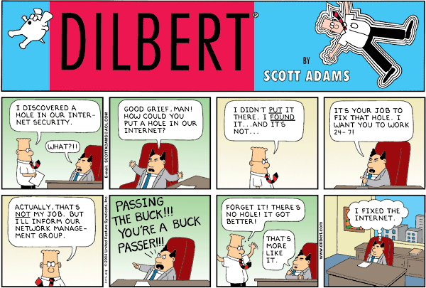
Volume visualization
Iso-Surface Extraction and Marching Cubes

Slide 2
Overview: Lecture #4
Contents of Volume Visualization, Part 1:
  Marching Cubes
    Iso-contours
    Iso-Surfaces
    The Marching Cubes (MC) Algorithm

Slide 3
Marching Cubes
Iso-Surfaces: Generation and Presentation

Slide 4
Surface Rendering
Terminology
Isosurface: “surface made from the level set of a 3D scalar function”
Isovalue: “The scalar value used to generate an isosurface.” The VTK
About Surface rendering:
  indirect volume visualization technique
  isosurfaces are computed from 3D volume data

Slide 5
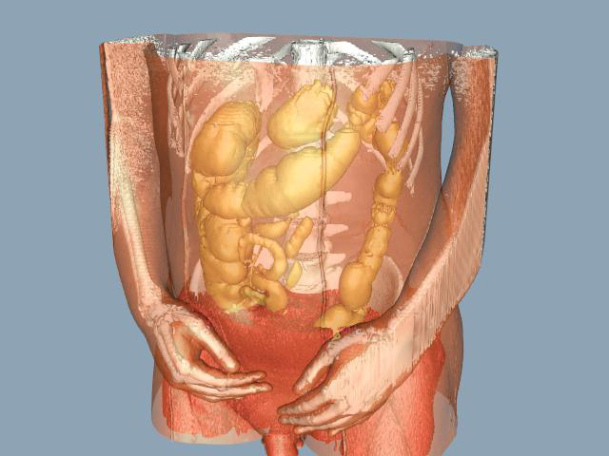
Conceptual VolVis Framework
Sampled Data
(Measured)
Analytical Data
(Modeling)
Example:
  CT measurement
  iso-stack compuation
  iso-surface
  computation
  (marching cubes)
  Surface rendering
  (OpenGL)
Voxel space
(discrete)
iso-surfacing
Geometr. Surface
(analytic)
voxelization
volume
rendering
surface
rendering
Pixel space
(discrete)

Slide 6
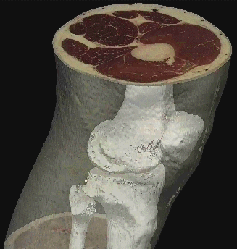
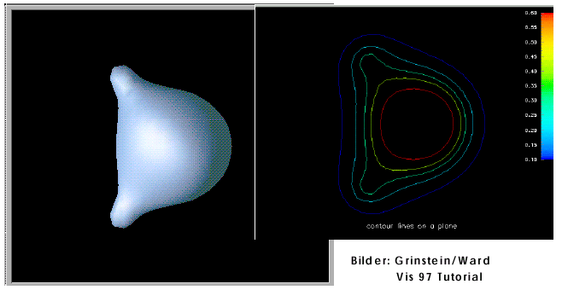
Iso-Surfaces
Indirect representation
Characteristics:
Meaningful isovalue,
Isovalue separates substances
Interest in boundary regions
Very selective (binary
choice/filter)
Uses traditional hardware
Shading gives a 3D
impression

Slide 7
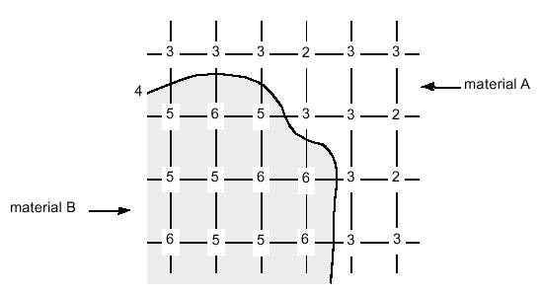
Planar Data and Iso-Contours
Iso-Contours:
isovalue f₀
Separate values > f₀
from values ≤ f₀
Can be approximated from given samples
Form/Position depends on reconstruction (interpolation)

Slide 8
https://www.youtube.com/watch?v=B_xk71YopsA

Slide 9
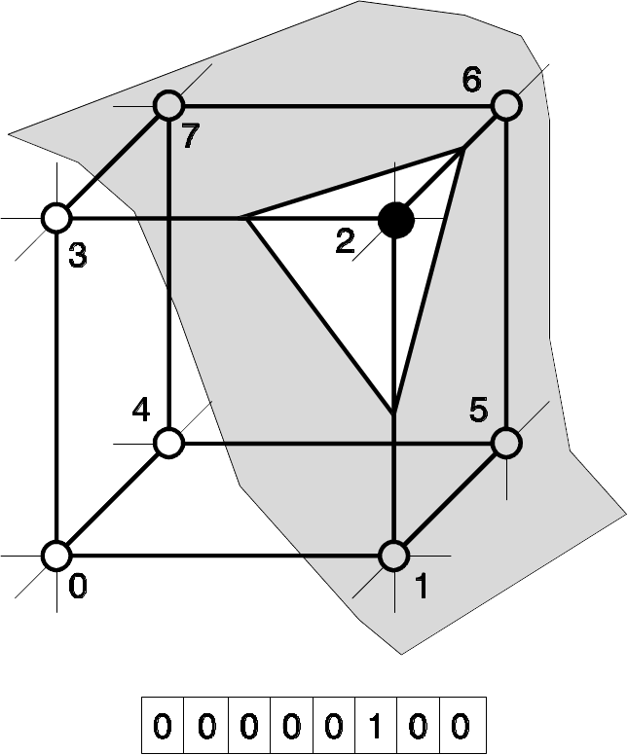
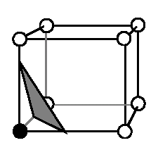
Approximating the Iso-Surface
Approach:
  Iso-surface cuts volume = each cell is searched
Idea:
  Divide the Iso-Surface into a per-volume cell representation
  Use triangles

Slide 10
Marching Cubes - Overview
Overview of MC algorithm
  Cell consists of 4(8) pixel (voxel) values:
  (i+[01], j+[01], k+[01])
1. Examine a cell
2. Classify each vertex as inside or outside
3. Build an index
4. Get edge list from table[index]
5. Interpolate the edge location
6. Compute gradients
7. Consider ambiguous cases
8. Go to next cell
‹#›

Slide 11
Marching Cubes – Step 1
Step 1: Consider a cell defined by eight data values
(i,j+1,k+1)
(i+1,j+1,k+1)
(i,j,k+1)
(i+1,j,k+1)
(i,j+1,k)
(i+1,j+1,k)
(i,j,k)
(i+1,j,k)

Slide 12
Marching Cubes – Step 2
Step 2: Classify each voxel according to whether it lies:
Outside the surface (value > isosurface value)
Inside the surface (value <= isosurface value)
10
10
iso = 9
5
5
10
8
isovalue =7
8
8
=inside
=outside

Slide 13
Marching Cubes Step 3
Step 3: Use the binary labeling of each voxel vertex to create an index
v8
v7
11110100
inside =1
v4
v3
outside=0
v5
v6
00110000
v1
v2
Index:
v1
v2
v3
v4
v5
v6
v7
v8

Slide 14
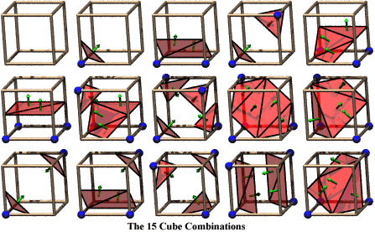
Marching Cubes – Step 4
Step 4: For a given index, access an array storing a list of edges
All 256 cases can be derived from 1+14=15 base cases due to symmetries

Slide 15
Marching Cubes – Step 4 continued
Step 4 cont.: Get edge list from lookup (case) table
  Example for
  Index = 10110001
  triangle 1 = e4,e7,e11
  triangle 2 = e1, e7, e4
  triangle 3 = e1, e6, e7
  triangle 4 = e1, e10, e6
e7
e11
e6
e4
e10
e1

Slide 16
Marching Cubes – Step 5
Step 5: For each triangle edge, find the vertex location along the edge using linear interpolation of the voxel values
i
x
i+1
=10
=0
T=5
T=8

Slide 17
Marching Cubes – Step 6
Step 6: Calculate the normal at each cube vertex (central differences)
G_{x} = V_{x+1,y,z} - V_{x-1,y,z}
G_{y} = V_{x,y+1,z} - V_{x,y-1,z}
G_{z} = V_{x,y,z+1} - V_{x,y,z-1}
Use linear interpolation to compute the polygon vertex normal (of the isosurface)

Slide 18
Marching Cubes – Step 7
Step 7: Consider ambiguous cases
Adjacent vertices: different states
Diagonal vertices: same state
Resolution: choose one case
(the right one)
or
or

Slide 19
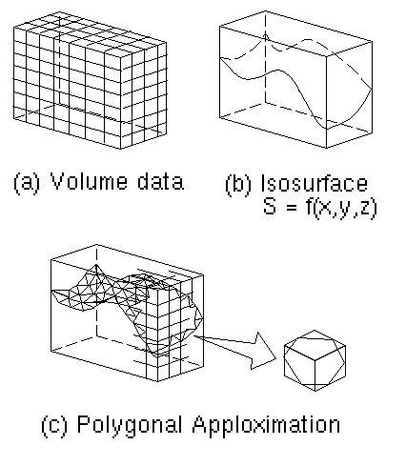
Marching Cubes - Summary
Summary
256 Cases
Reduce to 15 cases by symmetry
Ambiguity in certain cases
Causes holes if arbitrary choices are made
Up to 5 triangles per cube

Slide 20
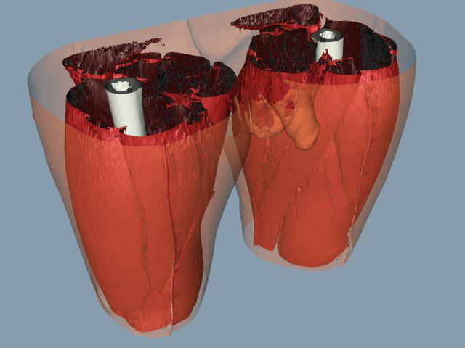
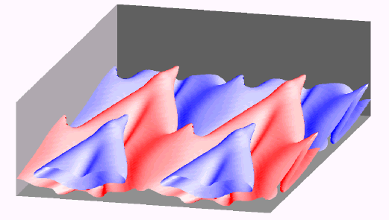
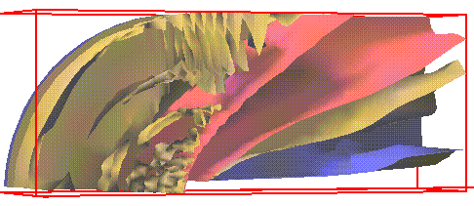
More Examples

Slide 21
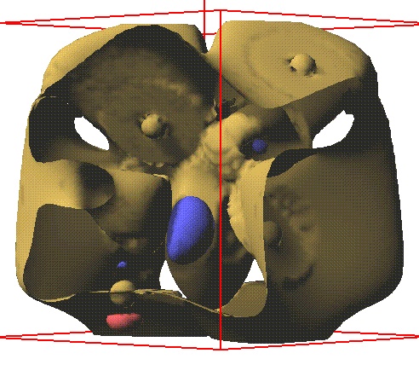
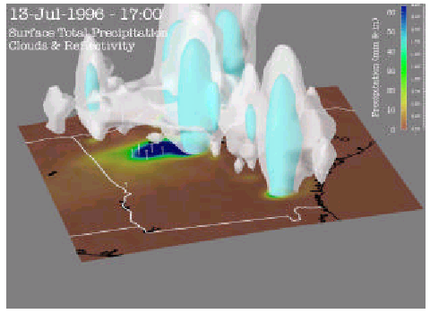
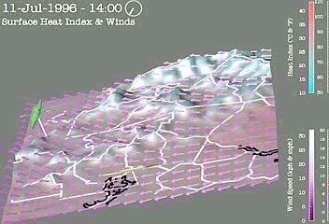
More Examples

Slide 22
Literature
Paper (more details):
W. Lorensen & H. Cline: “Marching Cubes: A High Resolution 3D Surface Construction Algorithm” in Proceedings of ACM SIGGRAPH ’87 = Computer Graphics, Vol. 21, No. 24, July 1987

Slide 23
Acknowledgments
For their contribution to the lecture material:
  Michael Meißner
  Roger Crawfis (Ohio State Univ.)
  Hanspeter Pfister
  Meister E. Gröller
  Torsten Möller
  Dirk Bartz
  Markus Hadwiger
  Helwig Hauser
  Daniel Weiskopf

