Slide 1
Introduction to flow visualization
Thomas Torsney-Weir

Slide 2


What is flow visualization?
A classic topic within scientific visualization
The depiction of vector quantities (as opposed to scalar quantities)
Applications include automotive simulation, aerodynamics, turbomachinery, meteorology, oceanography, medical visualization, sports
https://www.youtube.com/watch?v=A05n32Bl0aY

Slide 3
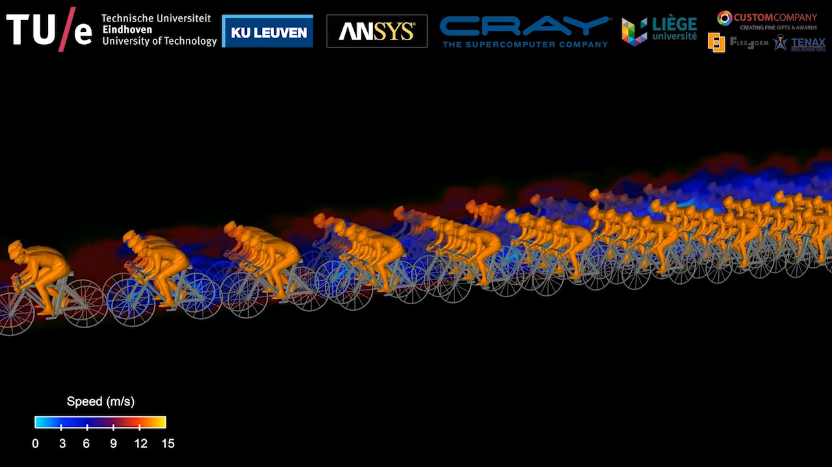
Example
https://www.youtube.com/watch?v=kZBh-fpv2sY

Slide 4
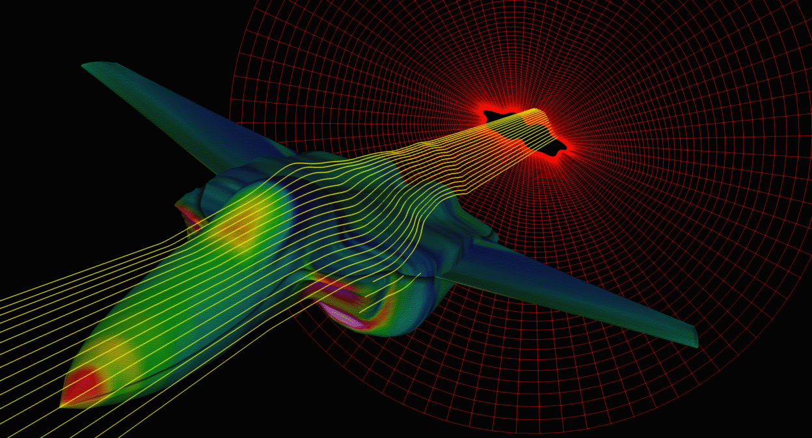
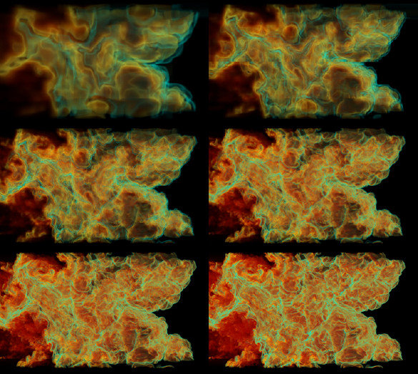
Origins of flow data
flow simulation
airplane- / ship- / car-design
weather simulation (air-, sea-flows)
medicine (blood flows, etc.)
Simulation data is given as a set of samples on a grid
Computational fluid dynamics (CFD)
flow measurement
wind tunnels, water channels
optical measurement techniques
Vectors are measure using instrumental equipment, e.g. optical methods like particle image velocimetry
flow models
differential equation systems (dynamic systems)
Vectors are provided by an analytic formula, wherever needed

Slide 5
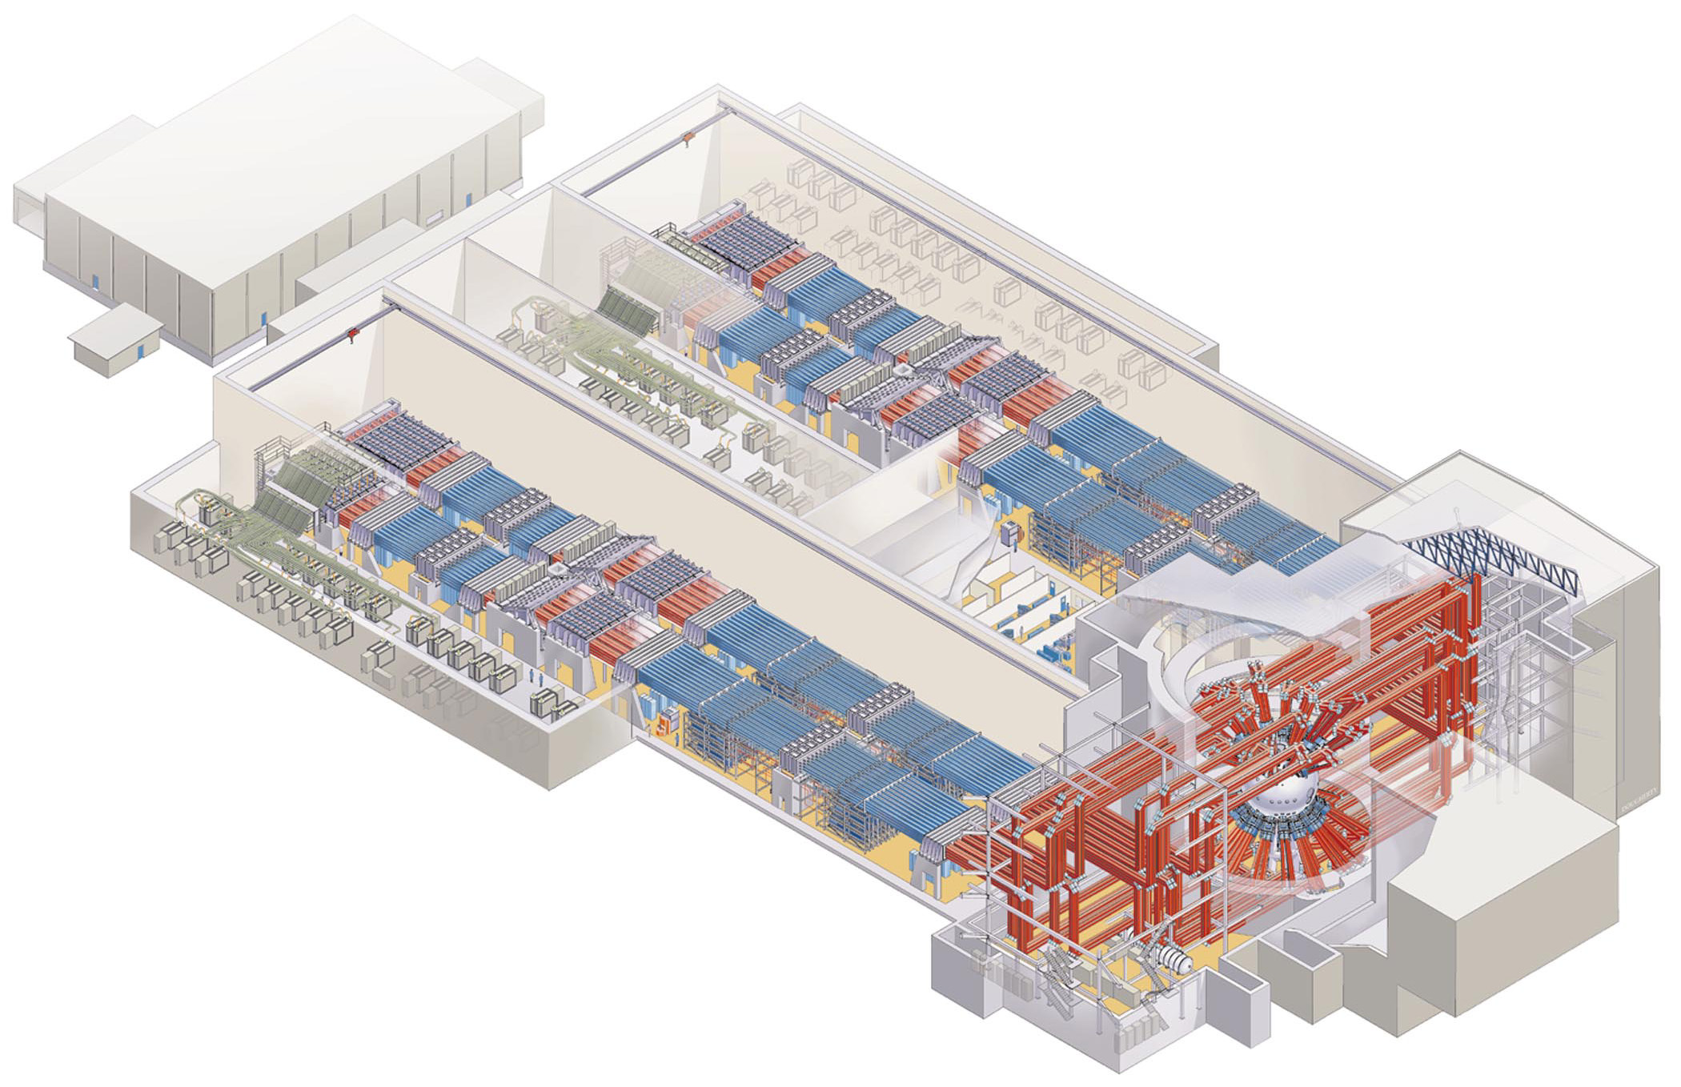
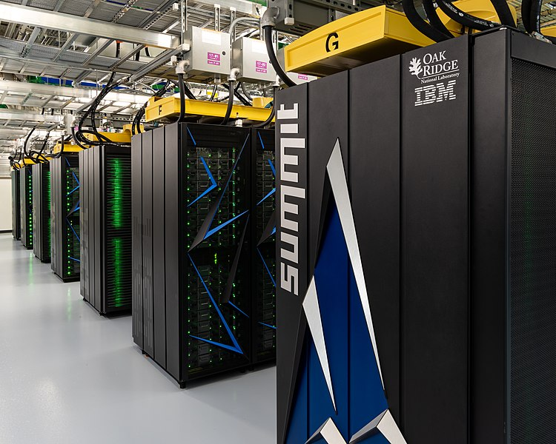
Computational fluid dynamics
We often visualize Computational Fluid Dynamics (CFD) simulation data
CFD is the discipline of predicting flow behavior, quantitatively
data is (often) the result of a simulation of flow through or around an object of interest
some characteristics of CFD data:
large, often gigabytes
unsteady, time-dependent
unstructured, adaptive resolution grids
smooth
Notes:
November 2019 is the fastest supercomputer in the world
148.6 petaFLOPS.[7] As of November 2019, the supercomputer is also the 3rd most energy efficient in the world with a measured power efficiency of 14.668 gigaFLOPS/watt.[8] Summit is the first supercomputer to reach exaop (a quintillion operations per second) speed, achieving 1.88 exaops during a genomic analysis and is expected to reach 3.3 exaops using mixed precision calculations.[9]

Slide 6
Tasks
Find eddies
How flows interfere with objects
Forces over time
Diffusion of one fluid into another

Slide 7
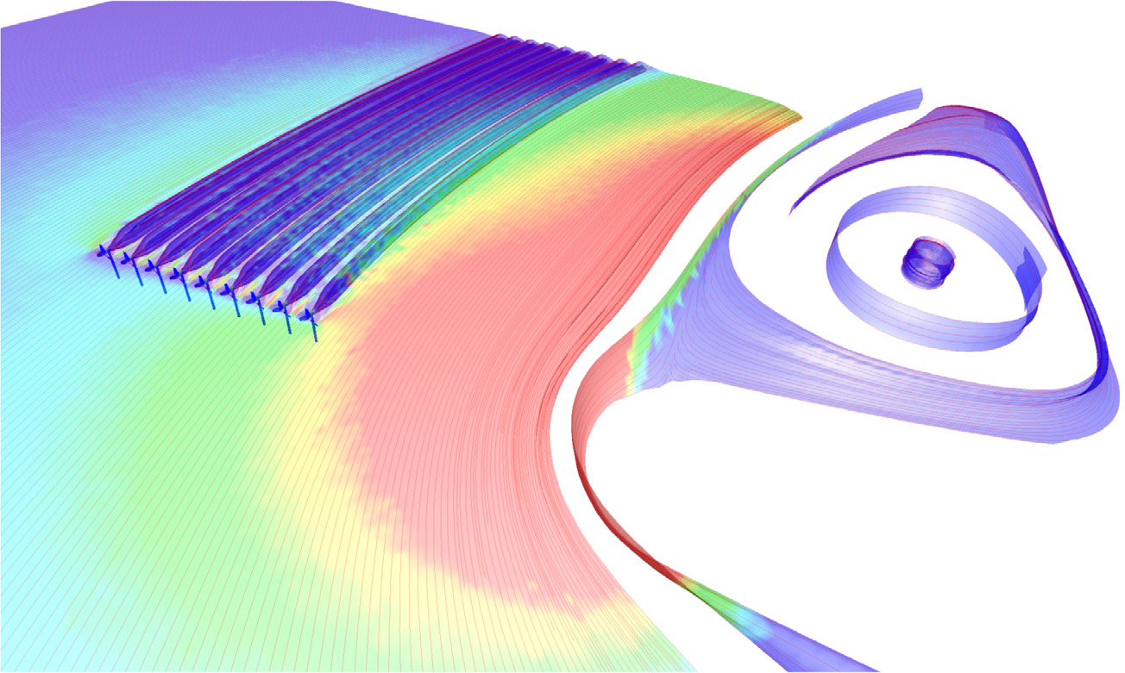
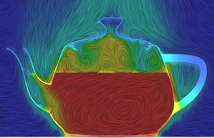
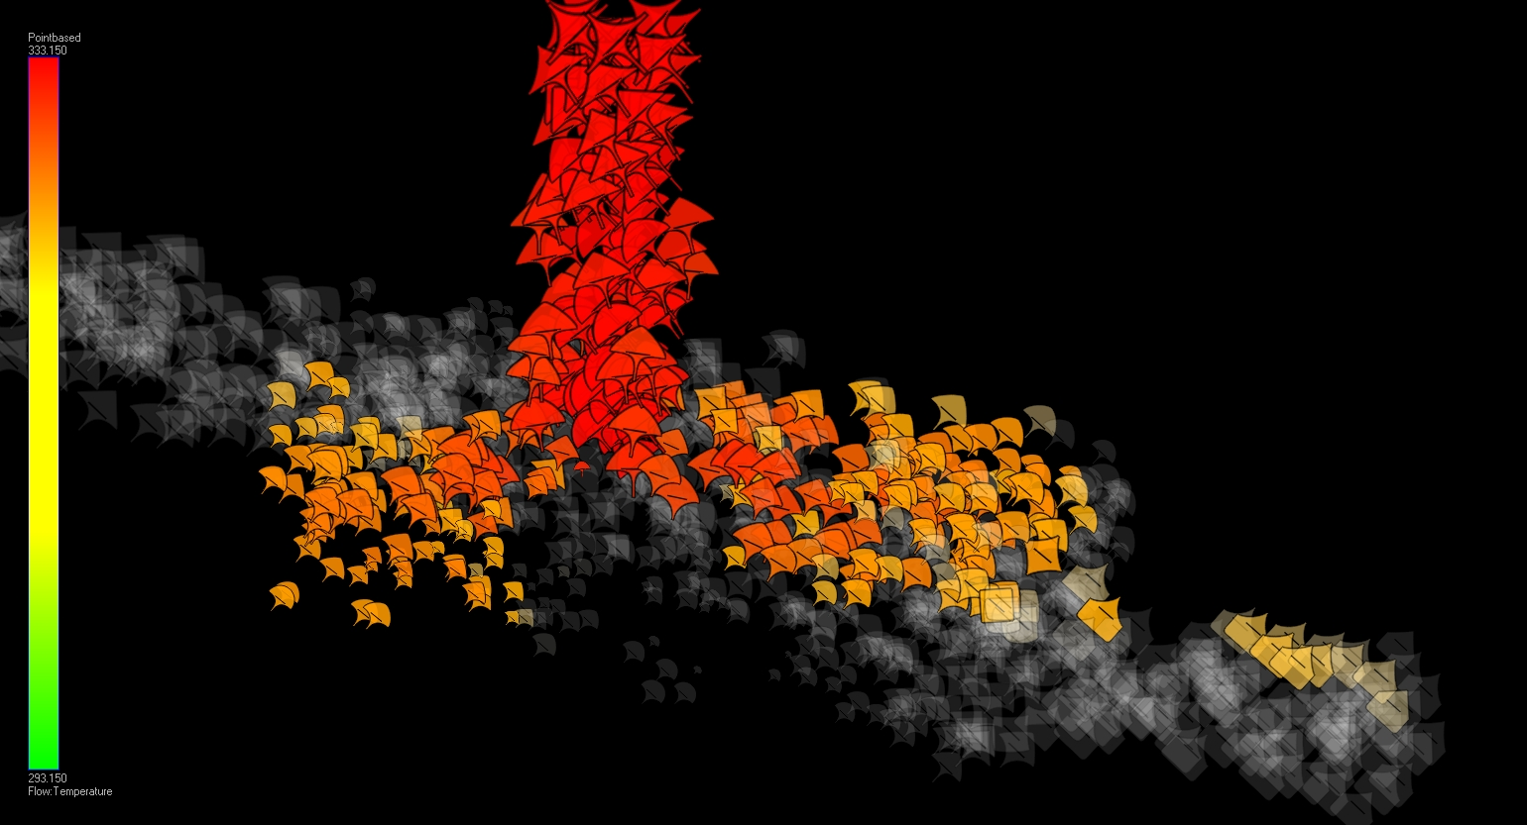
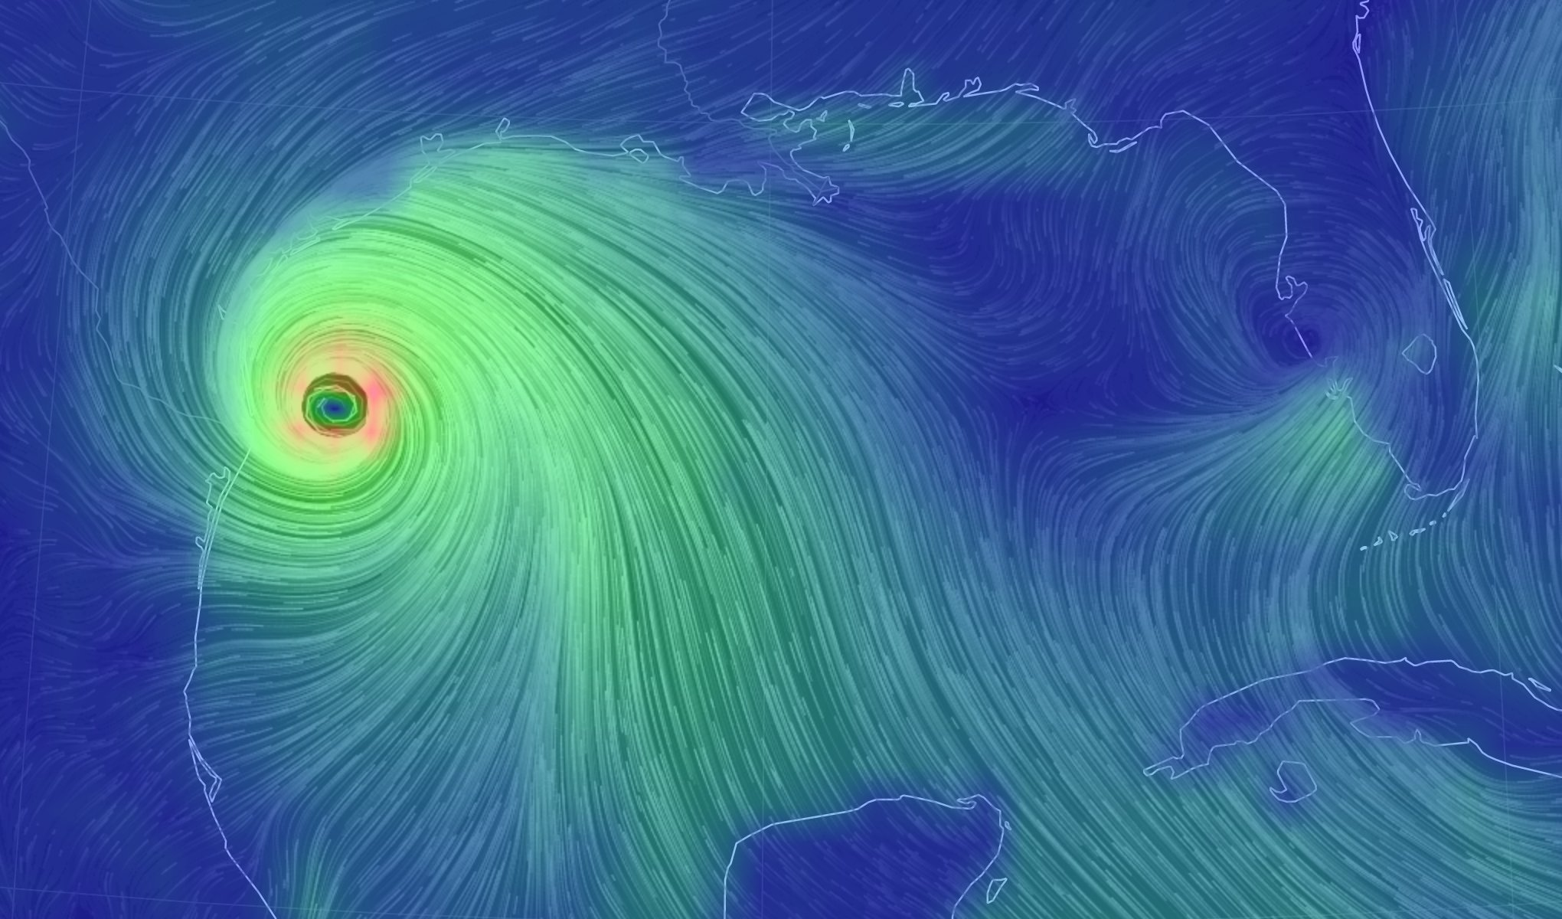
Tasks
Edmunds et al., “Aspects of Tidal Stream Turbine Modelling in the Natural Environment Using a Coupled BEM–CFD Model.”
https://blog.pointwise.com/2015/07/10/this-week-in-cfd-204/
http://ii.uib.no/vis_old/teaching/vis-project/2008-fall/lie/index.html
https://earth.nullschool.net/#current/wind/surface/level/

Slide 8
Challenges
effectively visualize both magnitude + direction, often simultaneously
large data sets
time-dependent data
What should be visualized? (data filtering/feature extraction)

Slide 9
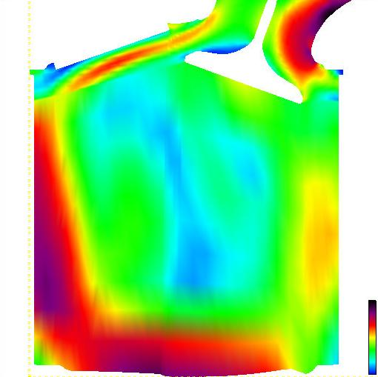
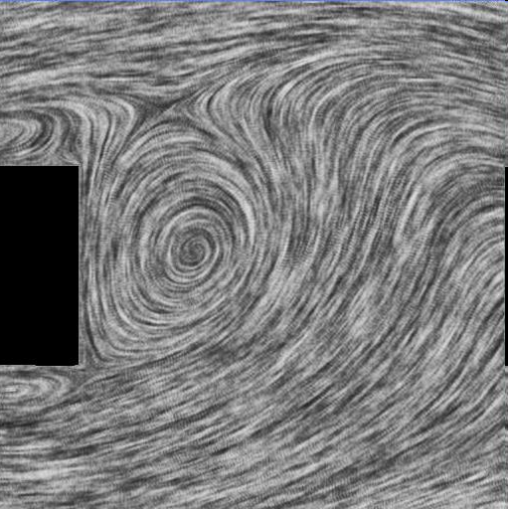
Challenges
Challenge: to effectively visualize both magnitude + direction often simultaneously
Magnitude only
Direction only

Slide 10
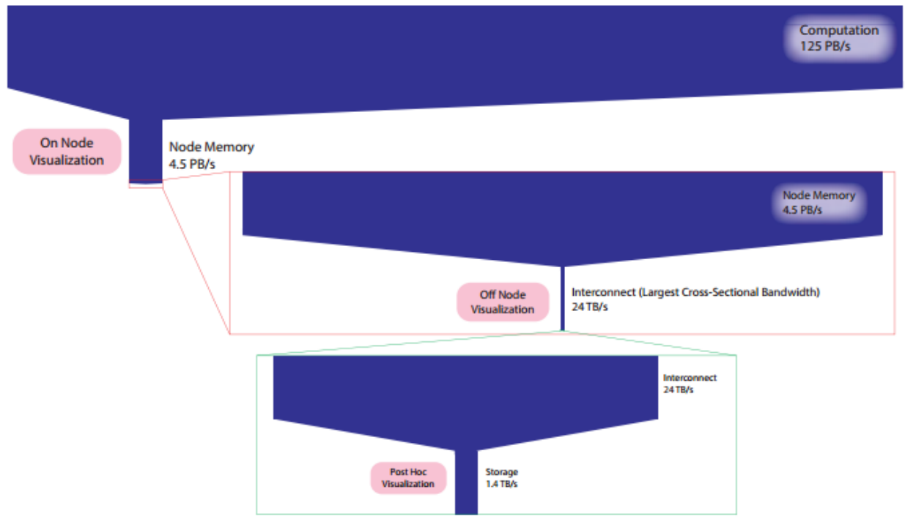
Large datasets
Simulations generating 4.5PB/s!
Bauer et al., “In Situ Methods, Infrastructures, and Applications on High Performance Computing Platforms.”

Slide 11
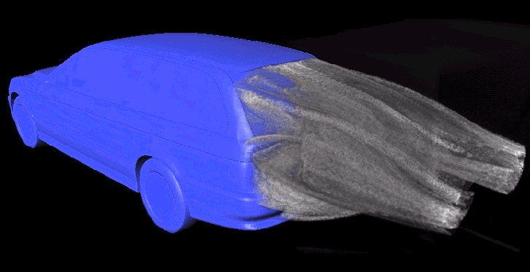
Examples
Bauer et al., “In Situ Methods, Infrastructures, and Applications on High Performance Computing Platforms.”

Slide 12
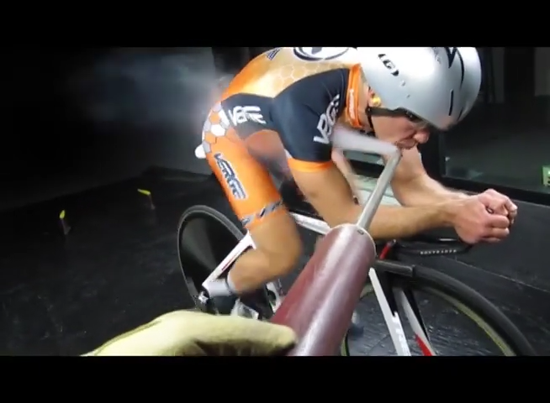
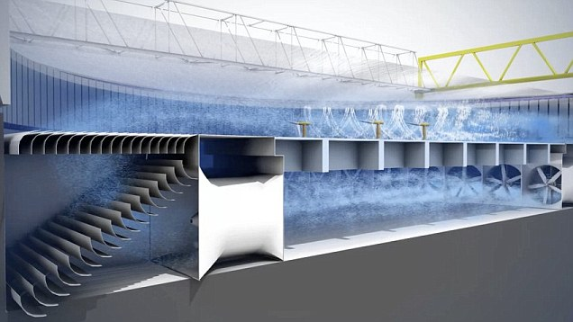
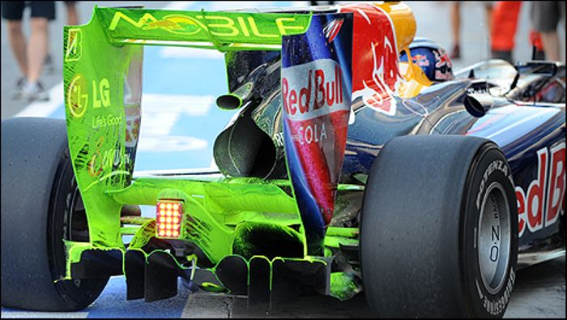
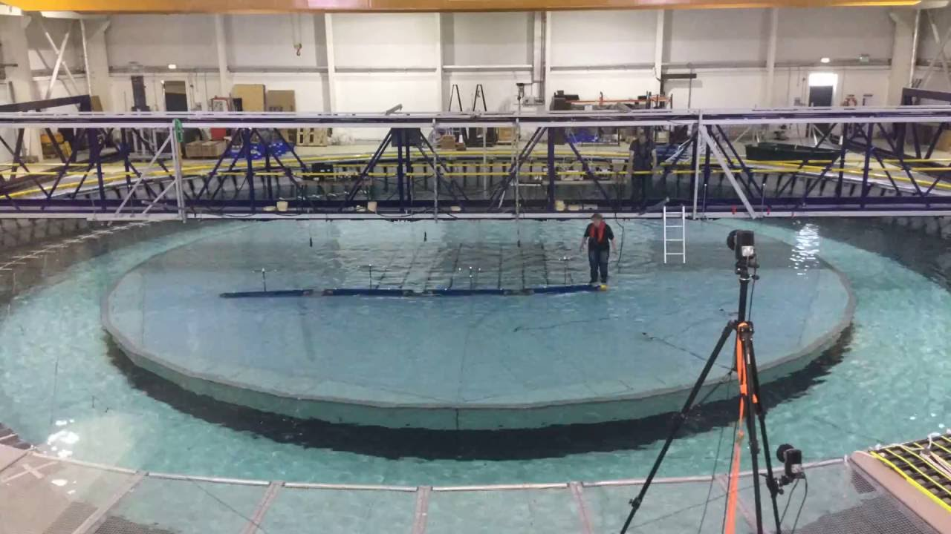
Why flow visualization?

Slide 13
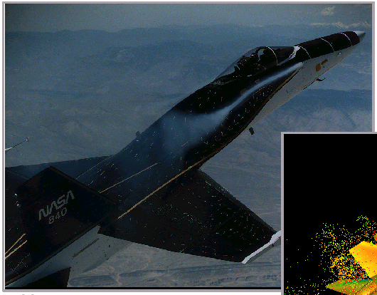
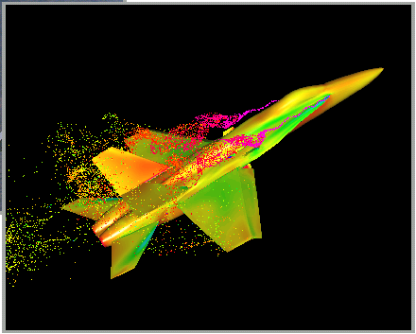
Why flow visualization?

Slide 14
Types of flow
Steady (time-independent) flows:
flow itself constant over time
v(x), e.g., laminar flows
simpler case for visualization
Time-dependent (unsteady) flows:
flow itself changes over time
v(x,t), e.g., turbulent flow
often has moving objects
more complex case

Slide 15
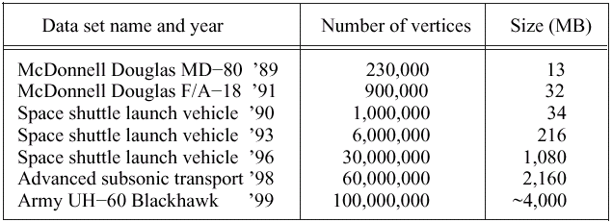
Steady state flow data

Slide 16
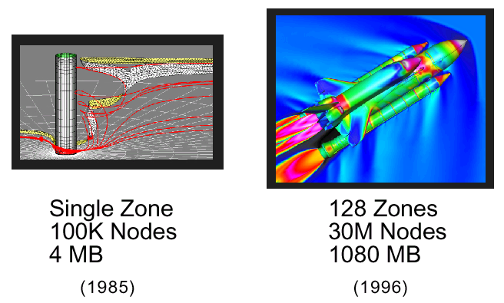
Steady state flow vis

Slide 17
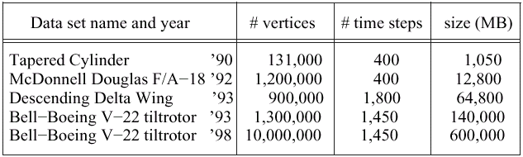
Unsteady flow data

Slide 18
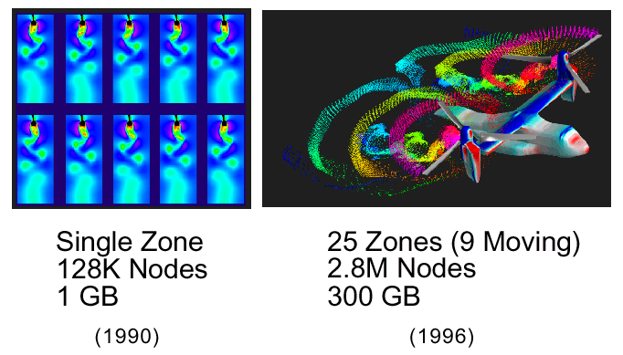
Unsteady flow data

Slide 19
Flow vis taxonomy
analogous to indirect (vs. direct) volume visualization
Direct flow visualization:
overview of current state of flow
visualization with vectors popular
arrows, icons, glyph techniques
Geometric flow visualization:
use of intermediate objects, e.g., after vector field integration over time
visualization of development over time
streamlines, stream surfaces

Slide 20
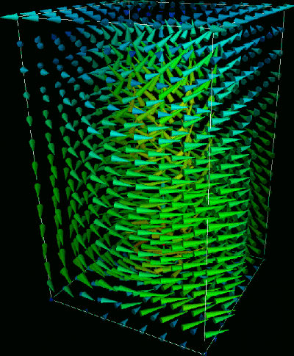
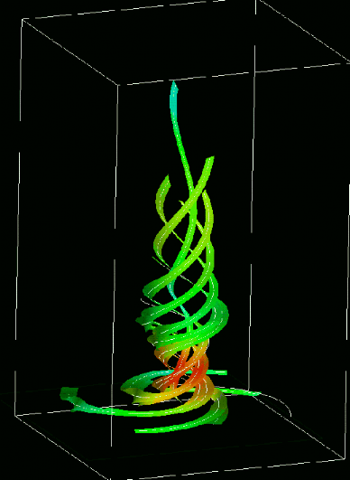
Direct vs geometric flow vis
Direct
Geometric

Slide 21
Flow vis classification
direct: overview of vector field, minimal computation, e.g. glyphs, color mapping
texture-based: covers domain with a convolved texture, e.g., Spot Noise, LIC, ISA, IBFV(S)
geometric: a discrete object(s) whose geometry reflects flow characteristics, e.g. streamlines
feature-based: both automatic and interactive feature-based techniques, e.g. flow topology

Slide 22
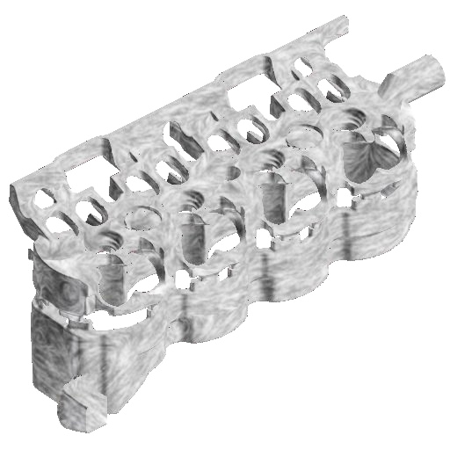
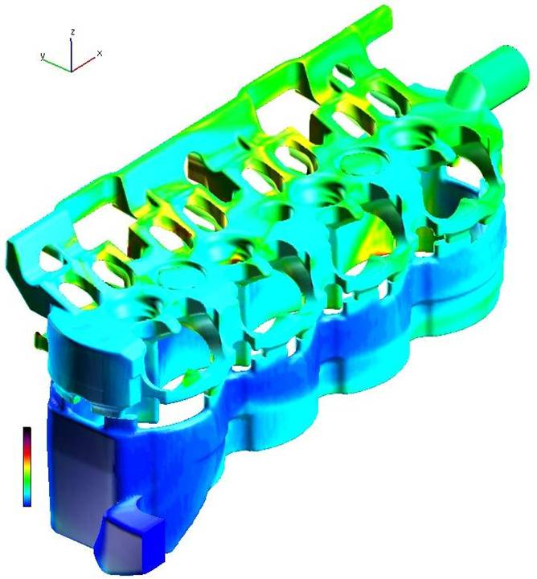
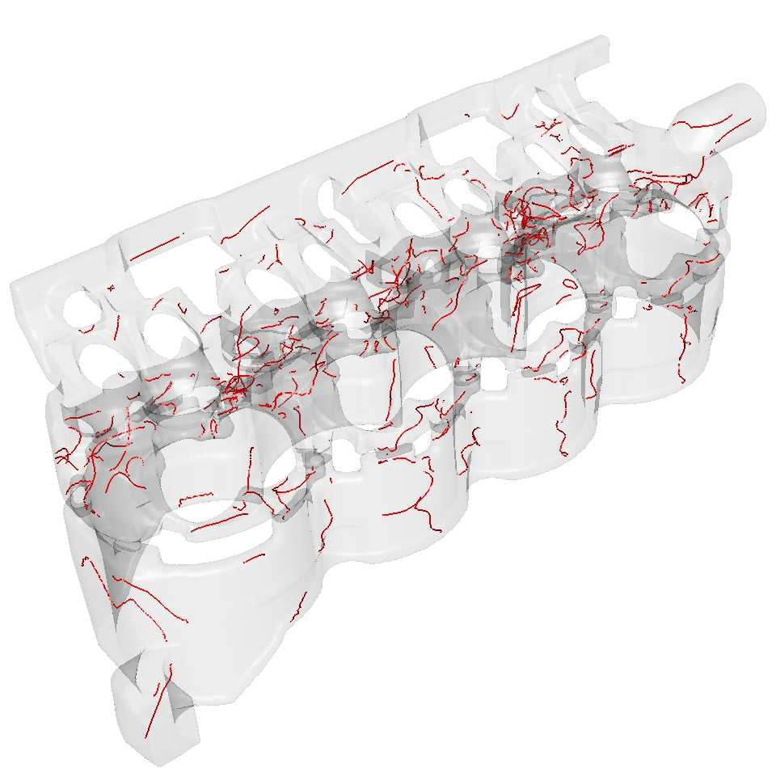
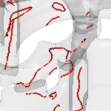
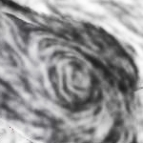
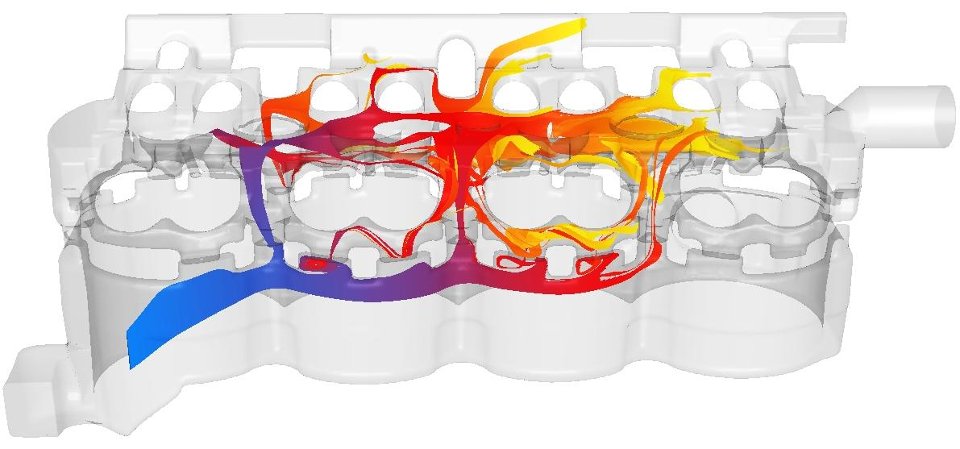
Further classification
Direct
Texture-based
Feature-based
Geometric

Slide 23
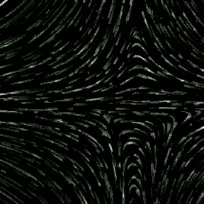
Dimensionality
Dimensions of visualization, not dataset
2D flow visualization
models, flow layers (2D section through 3D)
https://blog.pointwise.com/2015/07/10/this-week-in-cfd-204/

Slide 24
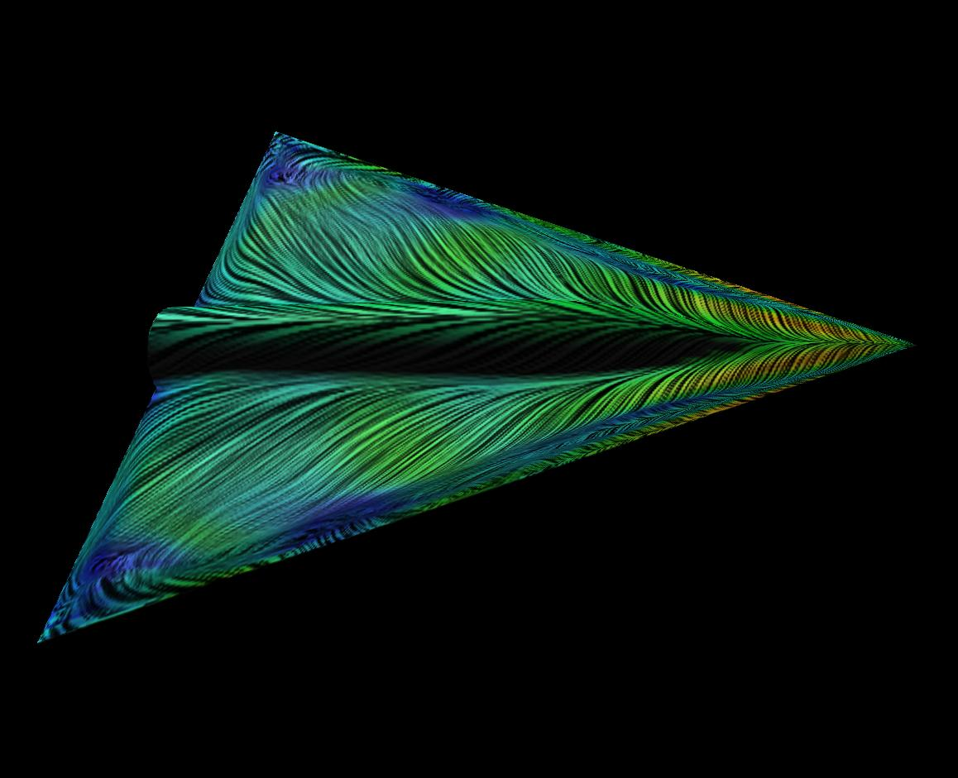
Dimensionality
Dimensions of visualization, not dataset
Visualization of flows on surfaces (2.5D)
3D flows around obstacles
boundary flows on surfaces (locally 2D)

Slide 25
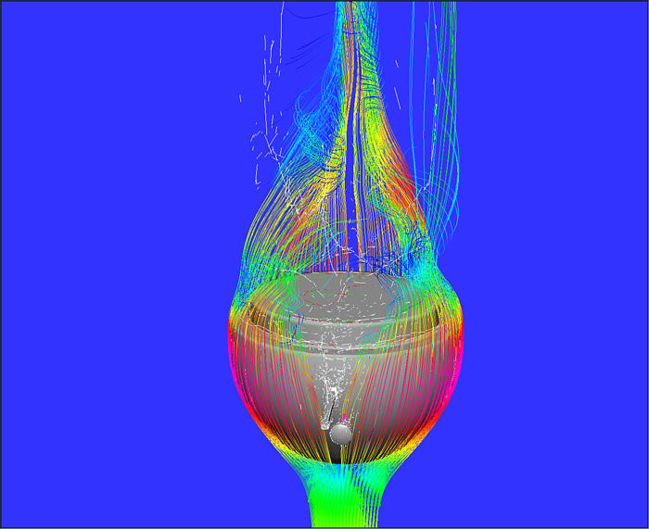
Dimensionality
Dimensions of visualization, not dataset
3D flow visualization
simulations, 3D models

Slide 26
Full example

Slide 27
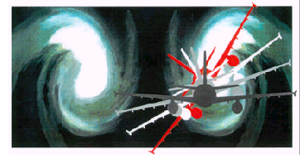
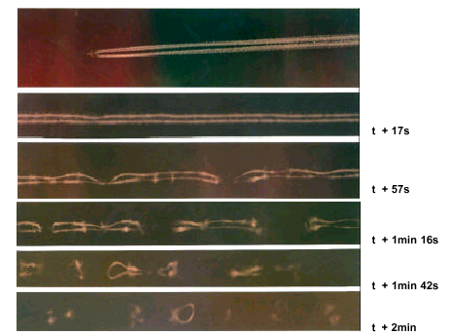
Airplane example
Problem: vortices behind airplanes

Slide 28
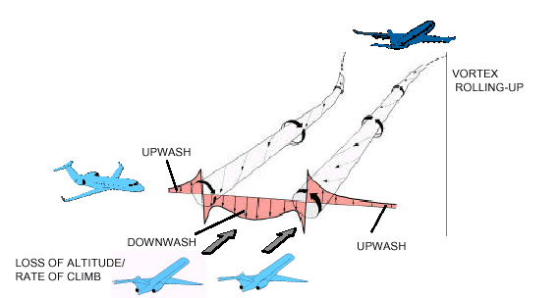
Airplane example
Vortices can be dangerous

Slide 29
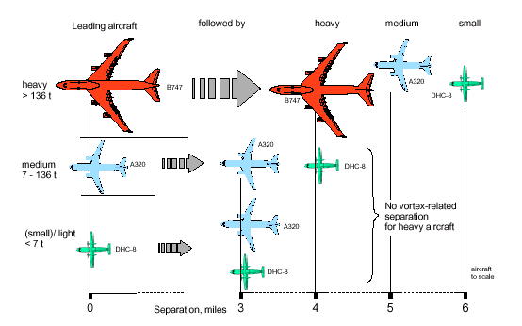
Airplane example
Planes need to keep distance

Slide 30
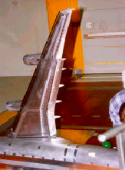
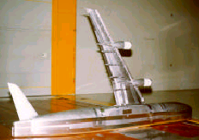
Airplane example
Run wind tunnel experiments

Slide 31
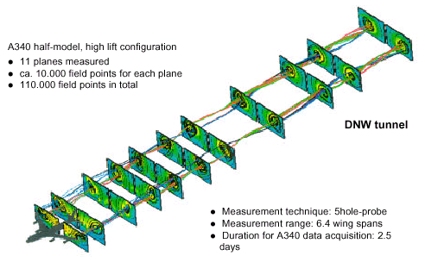
Airplane example
Visualization

Slide 32
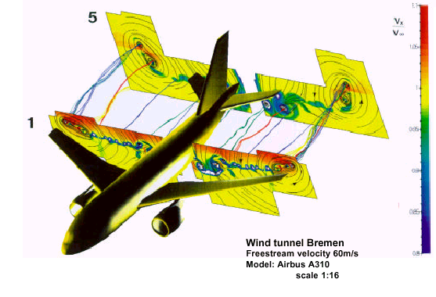
Airplane example

Slide 33
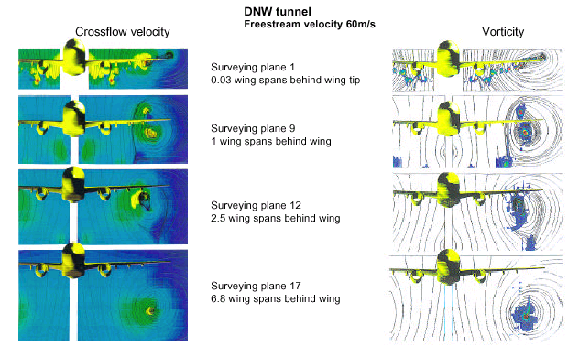
Airplane example

Slide 34
Conclusion

Slide 35
Summary
Data is a set of vectors in 3D + time
Visualization to see key aspects of flow
Steady vs unsteady flow
Direct vs geometric flow visualization

Slide 36
Reading/acknowledgements
Data Visualization: Principles and Practice, Chapter 6-Vector Visualization by A. Telea, AK Peters Ltd., 2008
Interactive Data Visualization: Foundations, Techniques, and Applications, Chapter 5-Visualization Techniques for Spatial Data, by M. Ward et al., AK Peters, Ltd., 2010
For material used in this lecture:
Robert S. Laramee
Hans-Georg Pagendarm
Roger Crawfis
Lloyd Treinish
David Kenwright
Terry Hewitt
Helwig Hauser

Slide 37
More videos
Introduction to Vector: https://www.youtube.com/watch?v=A05n32Bl0aY
Aerodynamics in British cycling: https://www.youtube.com/watch?v=BSnPqvsFpJM
CFD for pelotons: https://www.youtube.com/watch?v=kZBh-fpv2sY
Flow visualization through the years: https://www.youtube.com/watch?v=-GMg536L4PU

Slide 38
References
Edmunds, M., R. Malki, A. J. Williams, I. Masters, and T. N. Croft. “Aspects of Tidal Stream Turbine Modelling in the Natural Environment Using a Coupled BEM–CFD Model.” International Journal of Marine Energy 7 (September 1, 2014): 20–42. https://doi.org/10.1016/j.ijome.2014.07.001.
Bauer, A. C., H. Abbasi, J. Ahrens, H. Childs, B. Geveci, S. Klasky, K. Moreland, et al. “In Situ Methods, Infrastructures, and Applications on High Performance Computing Platforms.” Computer Graphics Forum 35, no. 3 (2016): 577–97. https://doi.org/10.1111/cgf.12930.

