Slide 1
Geometric flow visualization
Thomas Torsney-Weir

Slide 2
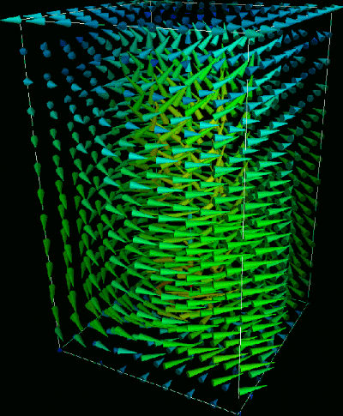
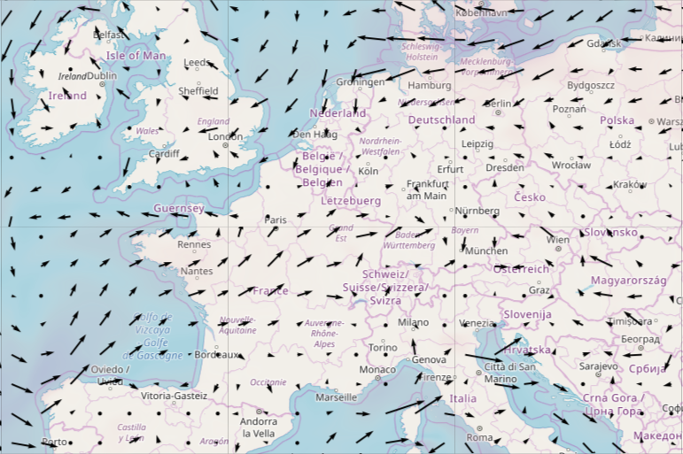
Direct flow visualization
User needs to mentally integrate the flow

Slide 3
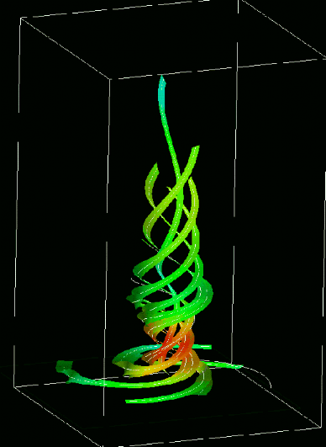
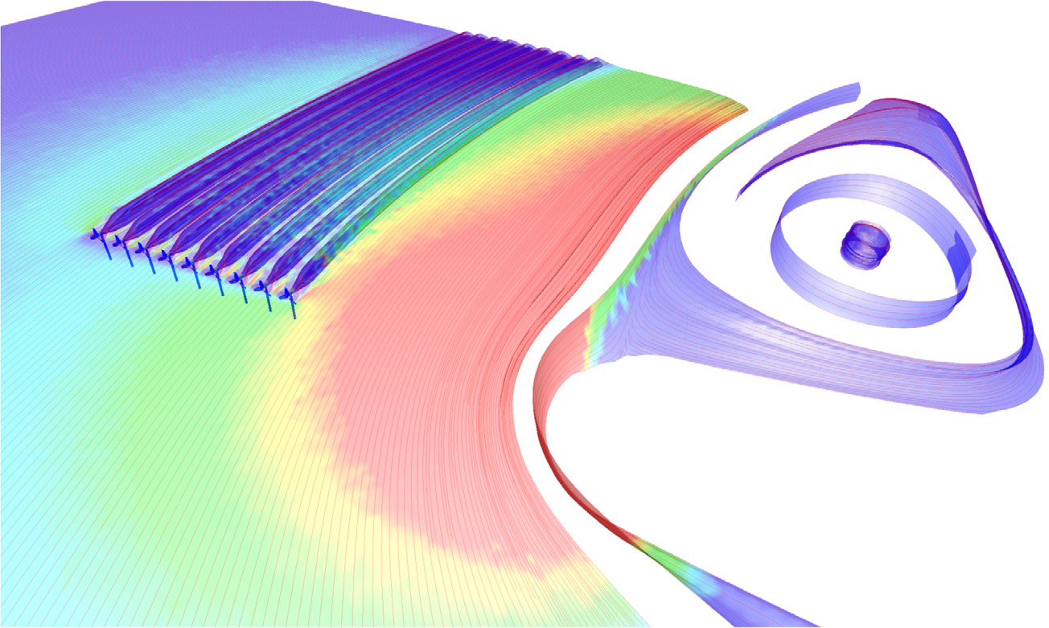
Geometric flow visualization
Visualization of the integrated flow
Edmunds et al., “Aspects of Tidal Stream Turbine Modelling in the Natural Environment Using a Coupled BEM–CFD Model.”

Slide 4
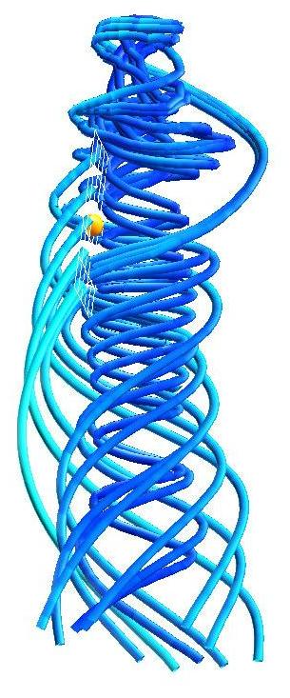
Pros and cons
Advantages:
Implementation : various easy-to-implement streamline tracing algorithms (integration)
Intuitive : interpretation is not difficult
Applicability : generally applicable to all vector fields, also in three-dimensions
Disadvantages:
Perception : too many lines can lead to clutter and visual complexity
Perception : depth is difficult to perceive, no well-defined normal vector
Seeding : optimal placement is very challenging (unsolved problem)

Slide 5
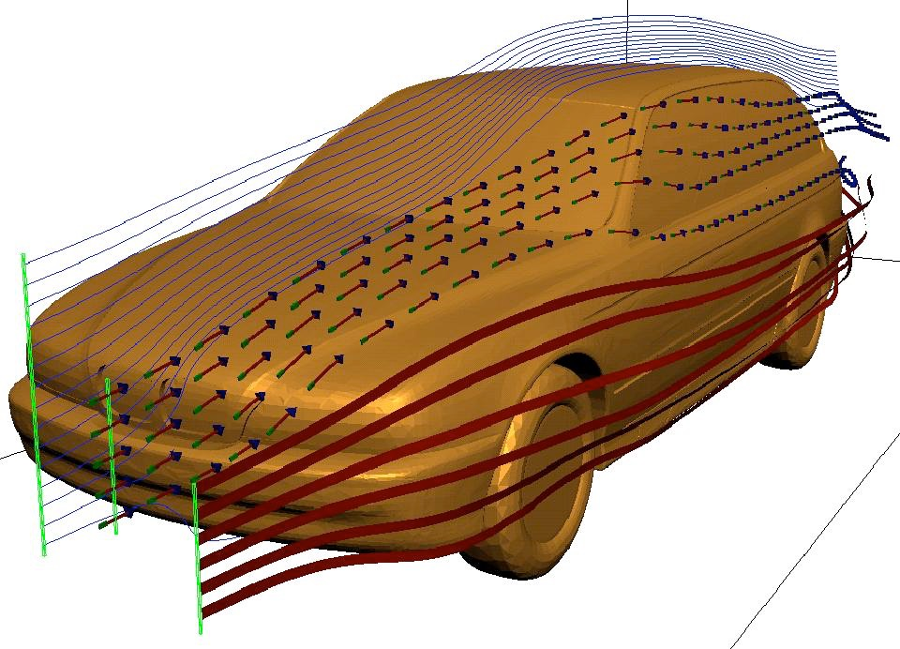
Creating geometry
Each mark is created by following the path of the flow
Steady-state flow : follow the path
Unsteady flow : depends on observation method

Slide 6
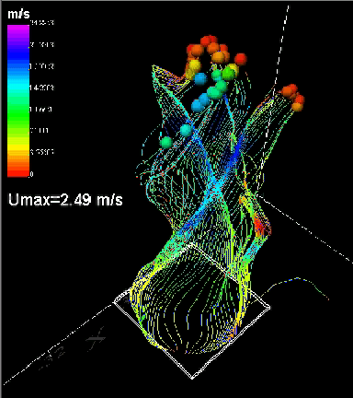
Steady-state flow
Based on particle motion
(Continuous) path becomes a mark to show on screen
Field lines : lines tangent to direction of flow

Slide 7
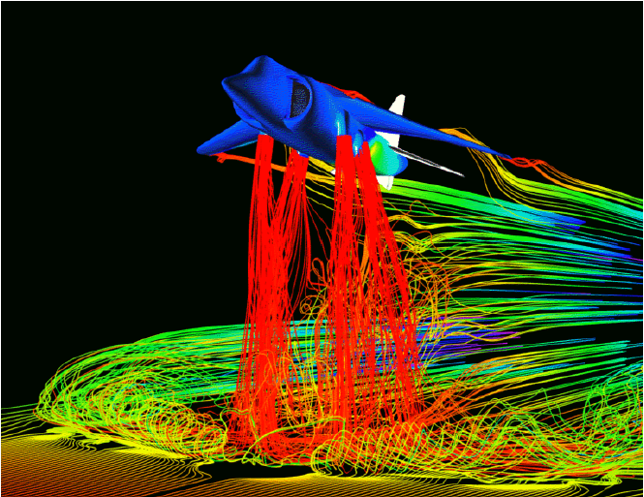
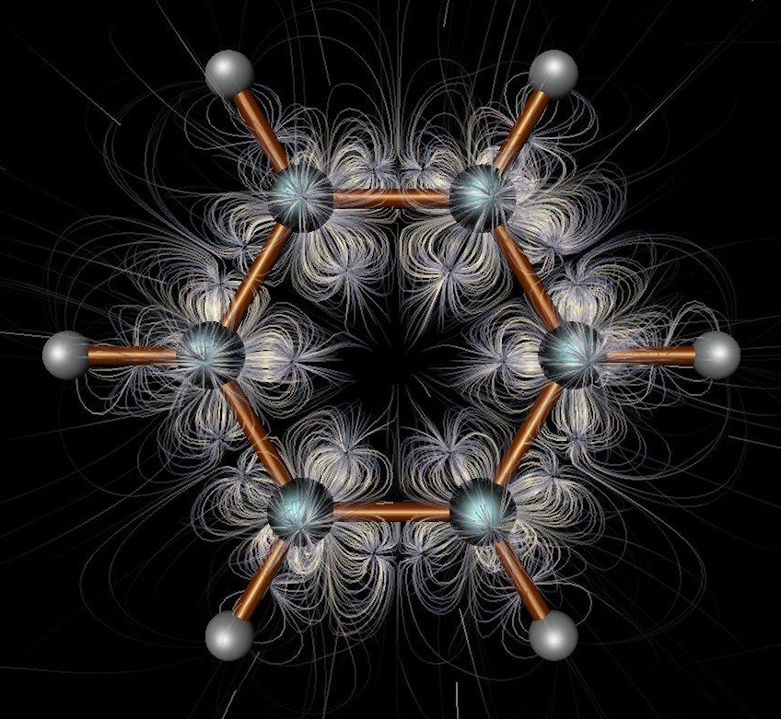
Steady-state flow
Color = velocity
Illumination helps 3D perception

Slide 8
Unsteady flow
Now we want to see 2 things:
  Direction of flow
  How flow changes over time
Where/when particles are introduced changes visualization
t₀
t₁
t₂
t₃
pathline
streakline
streamline for t₃

Slide 9
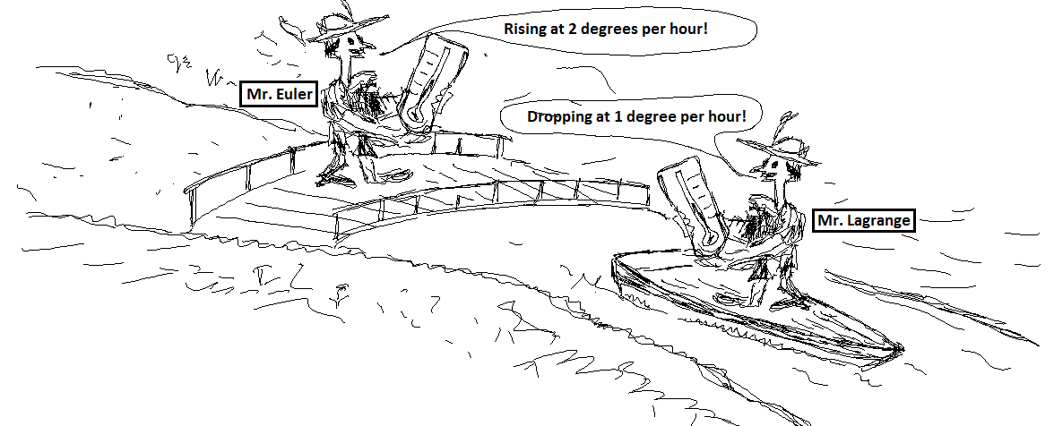
Flow obervation
Euler vs Langrange
http://www.flowillustrator.com/fluid-dynamics/basics/lagrangian-eulerian-viewpoints.php

Slide 10
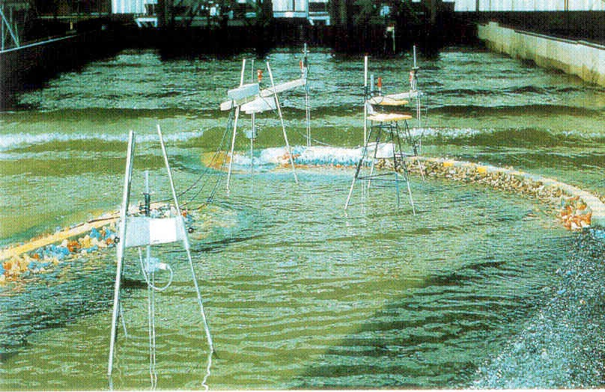
Flow observation
Lagrange
Euler

Slide 11
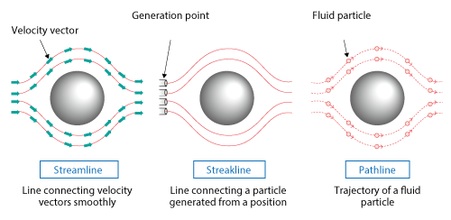
Flow visualization
Streamline: a curve that is everywhere tangent to the flow (release 1 massless particle)
Pathline: a curve that is everywhere tangent to an unsteady flow field (release 1 massless particle)
Streakline: a curve traced by the continues release of particles in unsteady flow from the same position in space (release infinitely many massless particles)
https://www.cradle-cfd.com/media/column/a147

Slide 12
Streamlines
Tangential to the vector field at fixed time t
Cannot intersect
t₀
t₁
t₂
t₃
streamline for t₀
streamline for t₁
streamline for t₂
streamline for t₃

Slide 13
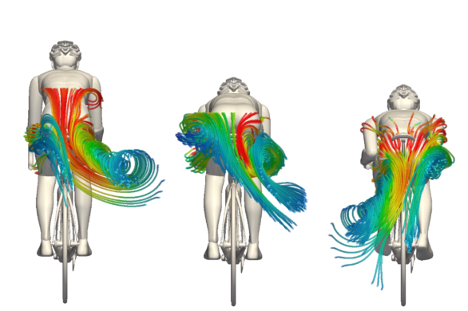
Streamlines
Edmunds et al., “Aspects of Tidal Stream Turbine Modelling in the Natural Environment Using a Coupled BEM–CFD Model.”
https://www.simscale.com/blog/2017/07/cycling-aerodynamics/

Slide 14
Streaklines
Trace of dye released into the flow at a fixed position
Cannot intersect
Looking “backwards in time”
t₀
t₁
t₂
t₃
streakline

Slide 15
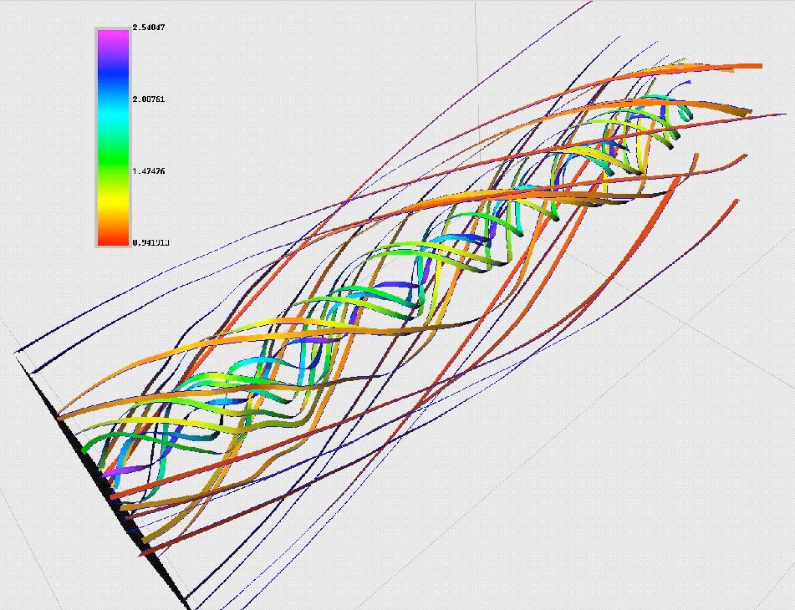
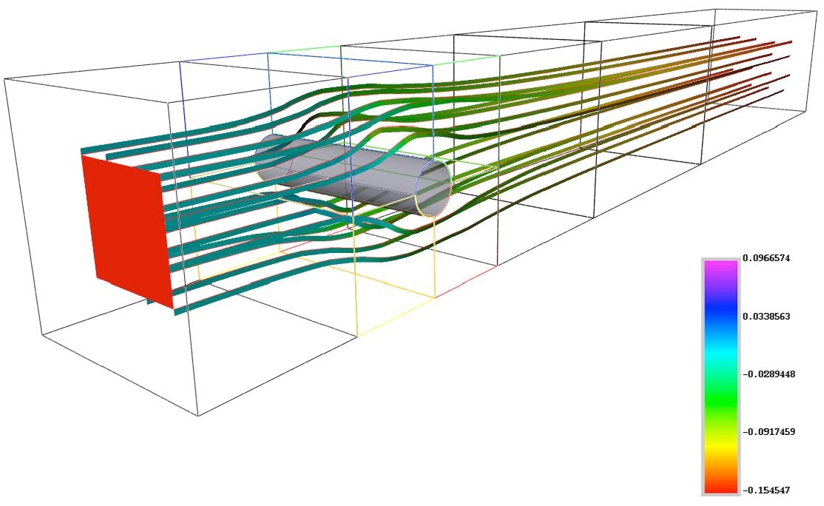
Streaklines

Slide 16
Pathlines
Trajectories of massless particles in the flow
Start particle at t₀, see where it goes
t₀
t₁
t₂
t₃
pathline

Slide 17
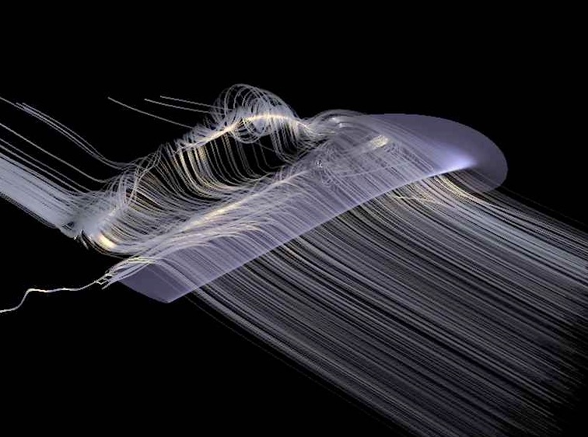
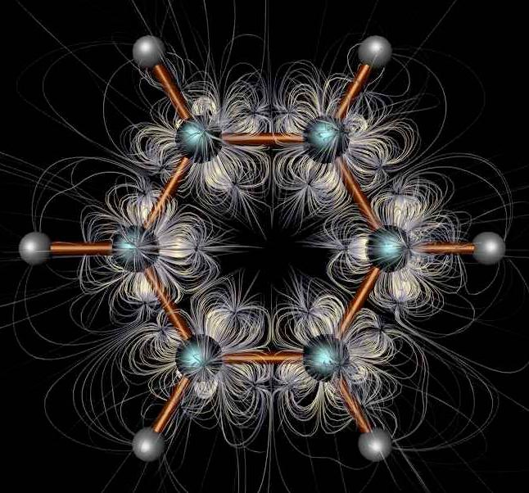
Pathlines

Slide 18
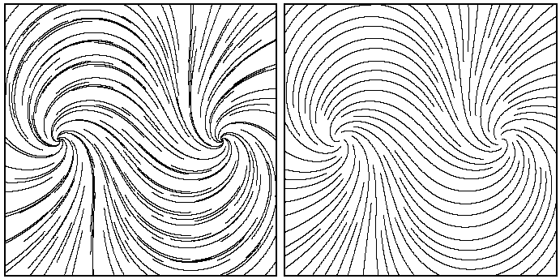
Considerations
Distribution of lines
Number of lines
Seeding
Regular grid
Regular spacing

Slide 19
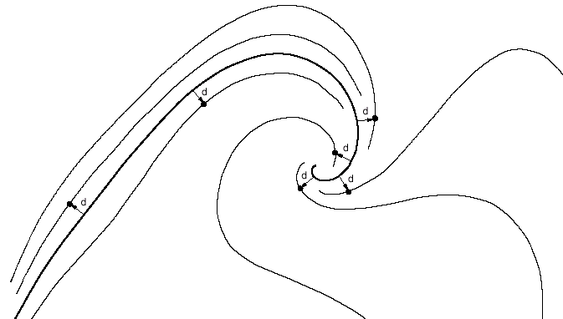
Regular spacing

Slide 20
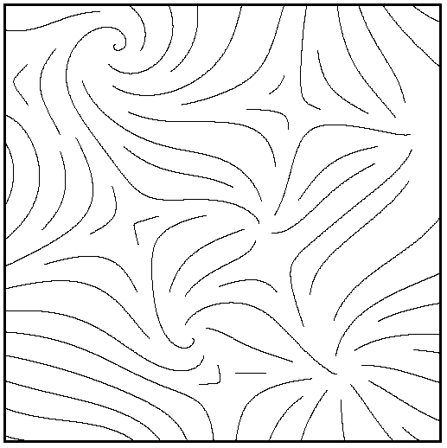
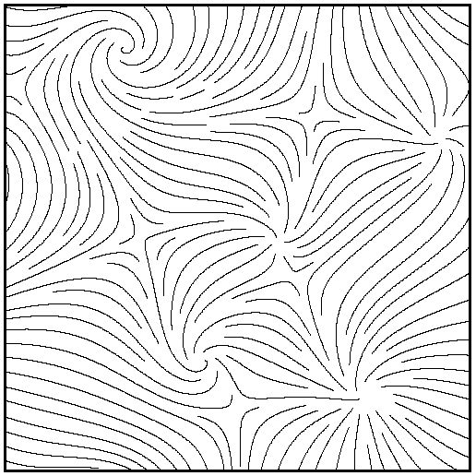
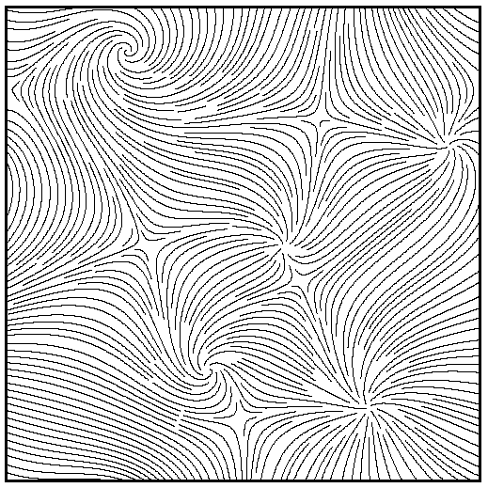
Number of lines
Variations of d_{sep} relative to image width:
6% 3% 1.5%

Slide 21
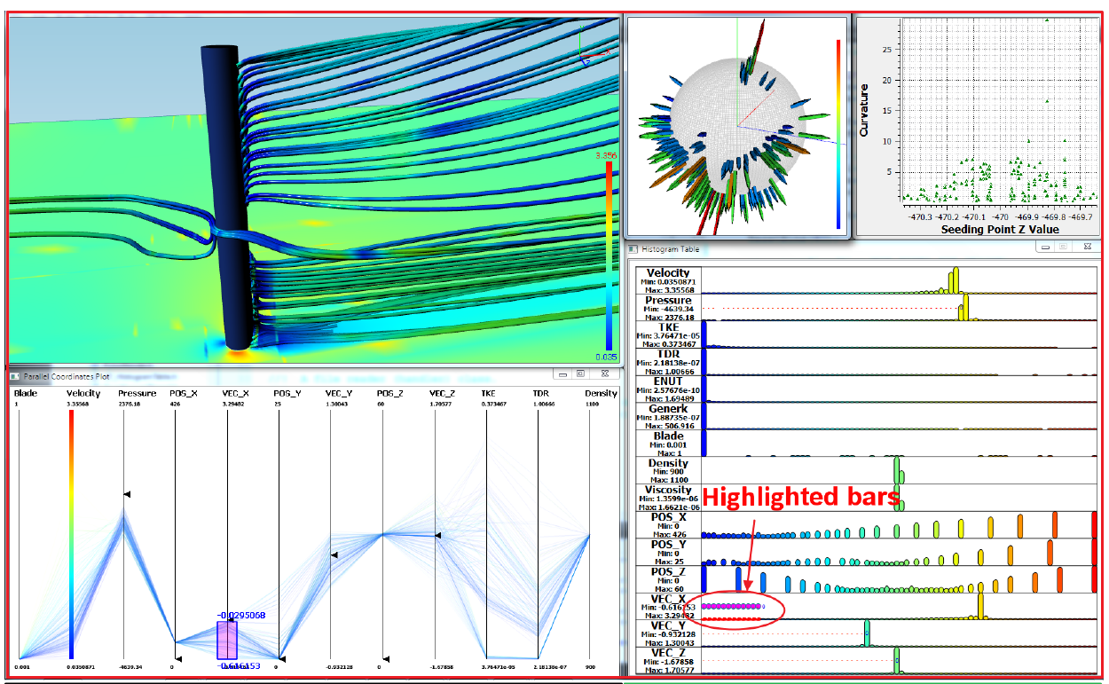
Seeding
Peng, Zhenmin, Zhao Geng, Michael Nicholas, Robert S. Laramee, Nick Croft, Rami Malki, Ian Masters, and Chuck Hansen. “Visualization of Flow Past a Marine Turbine: The Information-Assisted Search for Sustainable Energy.” Computing and Visualization in Science 16, no. 3 (June 1, 2013): 89–103. https://doi.org/10.1007/s00791-014-0229-4.

Slide 22
Other techniques

Slide 23
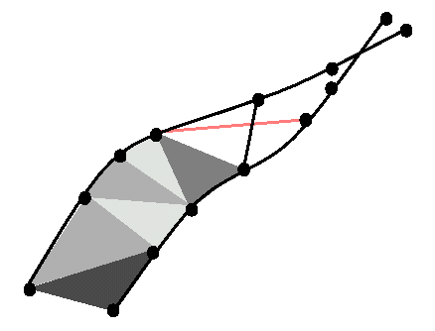
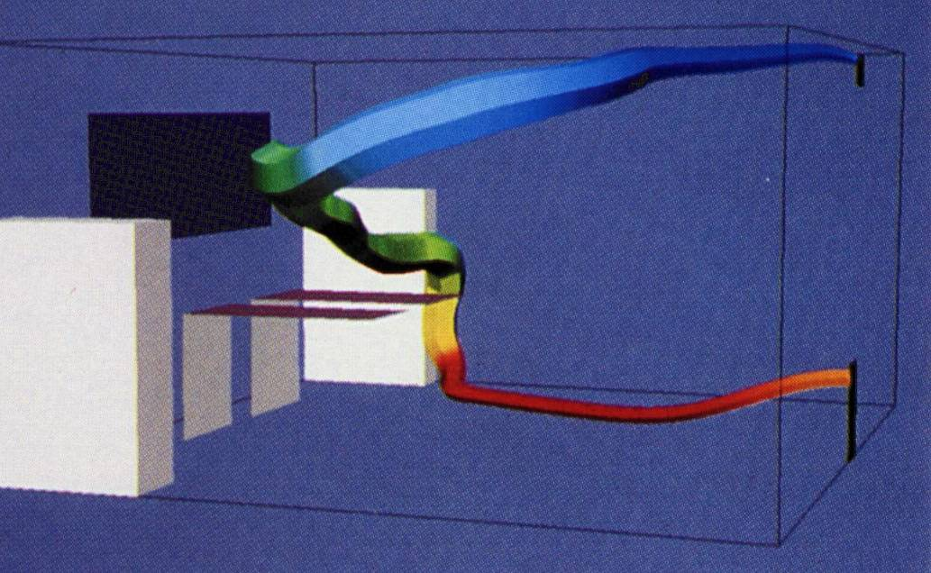
Ribbons and tubes
Can show rotation of vector field
Streamribbon : a ribbon (surface of fixed width) always tangent to the vector field -shows rotational properties of flow
Streamtube : shows convergence and divergence of flow

Slide 24
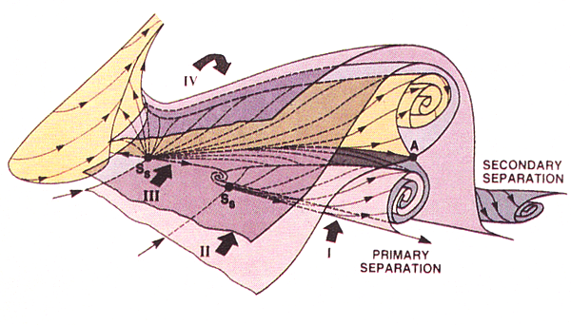
Stream surfaces
Stream surface : a surface that is everywhere tangent to flow
Stream surface : the union of stream lines seeded at all points of a curve (the seed curve)
Next higher dimensional equivalent to a streamline
Unsteady flow can be visualized with a path surface or streak surface
YING, SUSAN, LEWIS SCHIFF, and JOSEPH STEGER. “A Numerical Study of Three-Dimensional Separated Flow Past a Hemisphere Cylinder.” In 19th AIAA, Fluid Dynamics, Plasma Dynamics, and Lasers Conference. American Institute of Aeronautics and Astronautics. Accessed March 24, 2020. https://doi.org/10.2514/6.1987-1207.

Slide 25
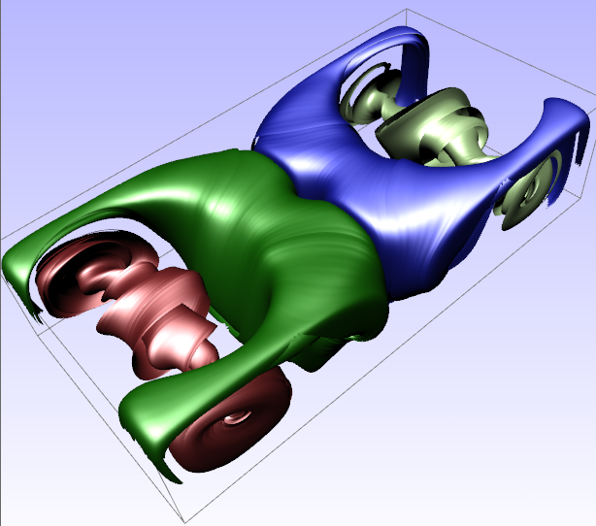
Stream surfaces
Motivation:
Separates (steady) flow: flow cannot cross surface (stream surfaces only)
Perception: Less visual clutter and complexity than many lines/curves
Perception: well-defined normal vectors make shading easy, improving depth perception
Rendering: surfaces provide more rendering options than lines: e.g., shading and texture-mapping etc.
Disadvantages:
Construction/Implementation: more complicated algorithms are required to construct integral surfaces
Occlusion: multiple surfaces hide one another
Placement: placement of surfaces is still an unsolved problem

Slide 26
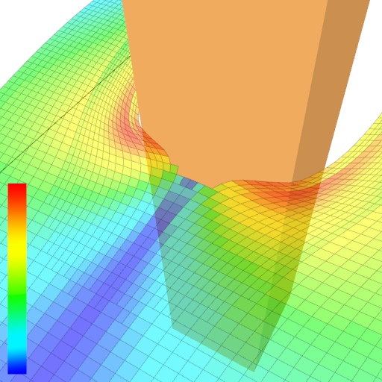
Splitting/merging
Surface may split when object boundary encountered
Separate portions computed independently
Terminating Conditions:
Critical Point (Zero Velocity)
Object Intersection
Leave Domain
Desired geodesic length reached

Slide 27
Conclusion

Slide 28
Summary
Geometric flow visualization visualizes the integrated flow field
Different viewpoints of flow:
  Eulerian
  Lagrangian
Standard techniques:
  streamlines
  pathlines
  Streaklines
Need to be careful w.r.t. placement and number of lines

Slide 29
Acknowledgements
Torsten Möller
Robert S. Laramee
Christoph Garth
Helwig Hauser
Daniel Weiskopf
Raghu Machiraju

Slide 30
References
B. Jobard & W. Lefer: “Creating Evenly-Spaced Streamlines of Arbitrary Density” in Proceedings of 8th Eurographics Workshop on Visualization in Scientific Computing, April 1997, pp. 45-55
Data Visualization: Principles and Practice, Chapter 6: Vector Visualization by A. Telea, AK Peters 2008
YING, SUSAN, LEWIS SCHIFF, and JOSEPH STEGER. “A Numerical Study of Three-Dimensional Separated Flow Past a Hemisphere Cylinder.” In 19th AIAA, Fluid Dynamics, Plasma Dynamics, and Lasers Conference. American Institute of Aeronautics and Astronautics. Accessed March 24, 2020. https://doi.org/10.2514/6.1987-1207.
Peng, Zhenmin, Zhao Geng, Michael Nicholas, Robert S. Laramee, Nick Croft, Rami Malki, Ian Masters, and Chuck Hansen. “Visualization of Flow Past a Marine Turbine: The Information-Assisted Search for Sustainable Energy.” Computing and Visualization in Science 16, no. 3 (June 1, 2013): 89–103. https://doi.org/10.1007/s00791-014-0229-4.

