Slide 1
Color
Thomas Torsney-Weir

Slide 2
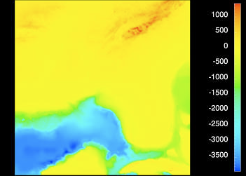
Importance of color
Rogowitz, B.E., and L.A. Treinish. “Data Visualization: The End of the Rainbow.” IEEE Spectrum 35, no. 12 (December 1998): 52–59. https://doi.org/10.1109/6.736450.

Slide 3
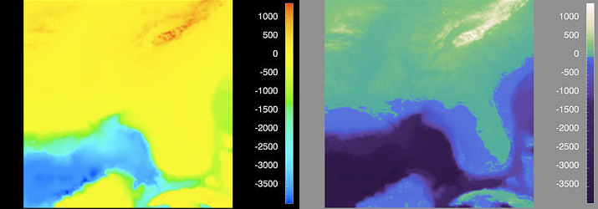
Importance of color
Rogowitz, B.E., and L.A. Treinish. “Data Visualization: The End of the Rainbow.” IEEE Spectrum 35, no. 12 (December 1998): 52–59. https://doi.org/10.1109/6.736450.

Slide 4
Importance of color
Color needs careful consideration
Additional visual channels
Draw attention
Aesthetic appeal

Slide 5
How color works

Slide 6
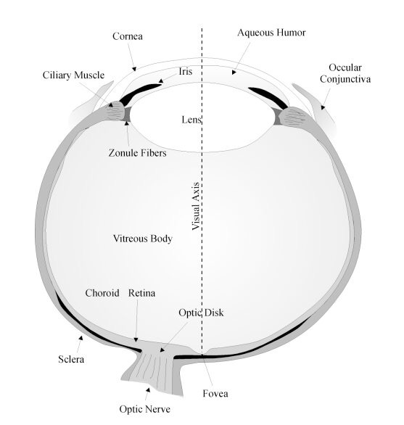
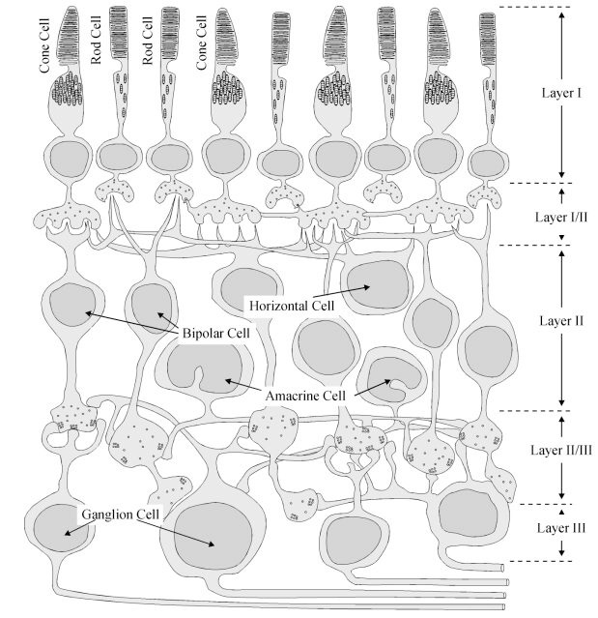
The eye

Slide 7
Retina detectors
Rods : monochrome sensor
  Important at low light
Cones : color sensors
Lots of specialized cells --- edge detection, corners, etc
Sensitive to contrast

Slide 8
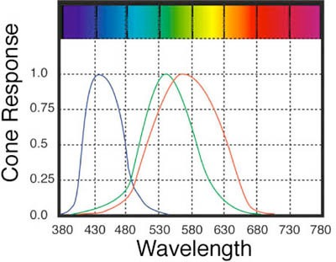
Cones
3 types of color sensors (S,M,L)
Works in bright light
Peak sensitivities located at approx. 430nm, 560nm, and 610nm for "average" observer.
Roughly equivalent to
blue, green, and red sensors

Slide 9
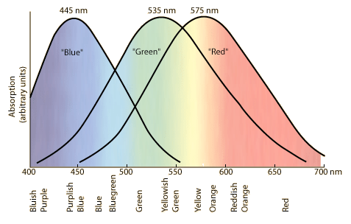
Cone response

Slide 10
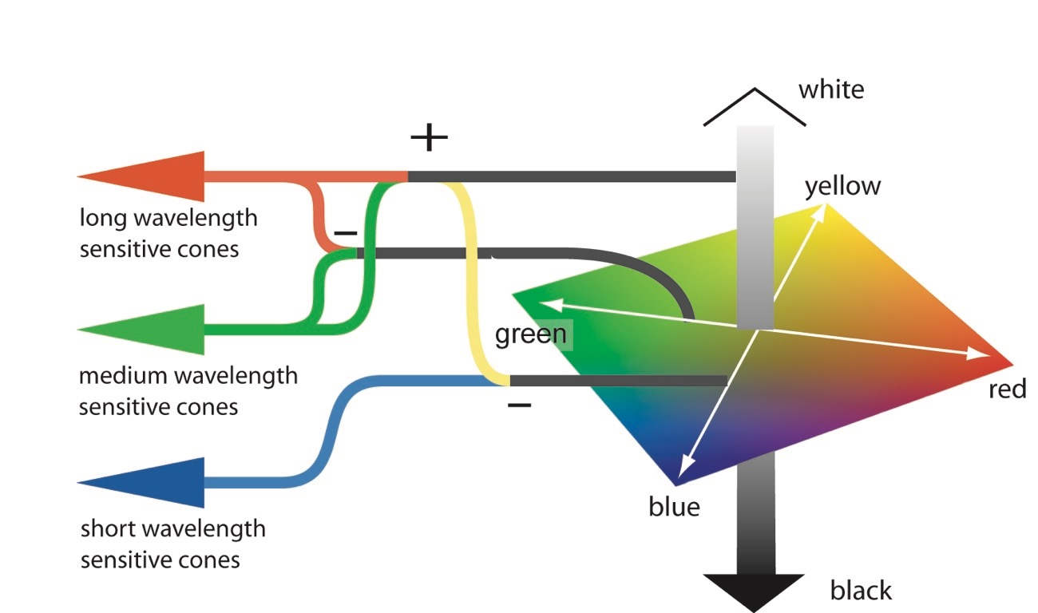
Color opponency
Ware, Colin. Information visualization: Perception for design 2004.

Slide 11


Slide 12
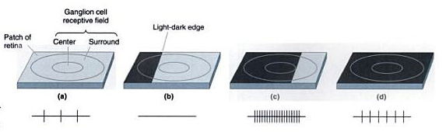
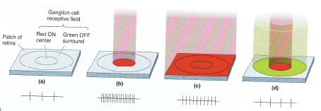
Color opponent cells
B&W:
Color:
Bear, Mark F., Barry W. Connors, and Michael A. Paradiso. Neuroscience: Exploring the Brain. Jones & Bartlett Learning, 2015.

Slide 13
Color models
“Space” is amount of each element
RGB : red, green, blue
HSL : hue, saturation, lightness
LAB : lightness, chroma
Saturation : “pureness” of color/distance from grey
Lightness : “brightness” of color/distance from black

Slide 14
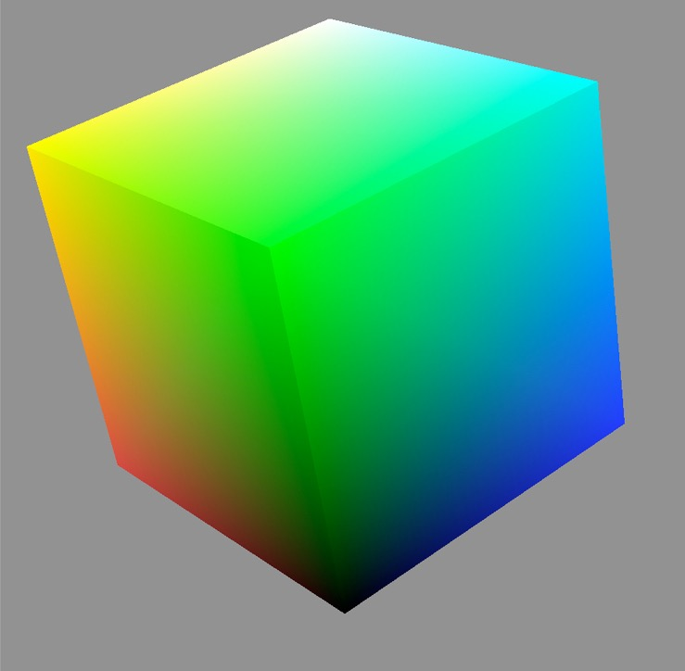
RGB color space
Additive system
Colors that can be represented by computer monitors
Not perceptually uniform
White
Cyan
Yellow
Green
Blue
Red
Black

Slide 15
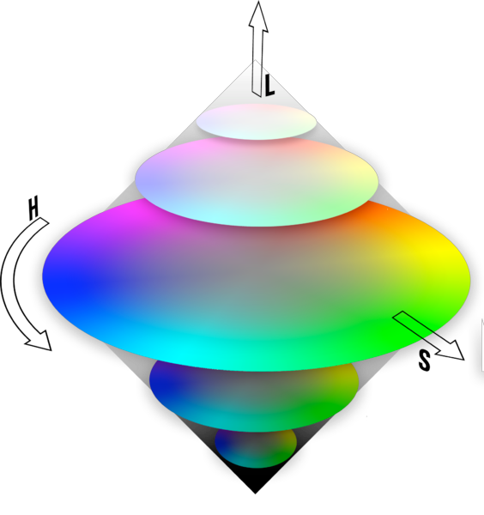
HSL color space
Hue : what people think of color
Saturation : purity, distance from grey
Lightness : from dark to light
Not perceptually uniform

Slide 16
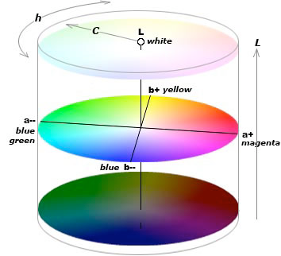
LAB color space
L : approximates human perception of lightness
a, b : approximate R/G and Y/B channels
a, b called chroma
Perceptually uniform

Slide 17
Applying color

Slide 18
Hue, luminance, saturation
Luminance
  How-much channel
  discriminability: ~2-4 bins
  contrast important
Saturation
  How-much channel
  discriminability: ~3 bins
Hue
  What channel
  discriminability: ~6-12

Slide 19
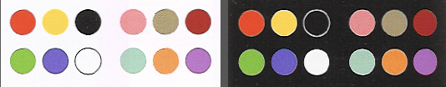
Categorical data
Limited distinguishability (8–14)
Best with hue
From Ware:

Slide 20
Ordinal/quantitative
Order these colors

Slide 21
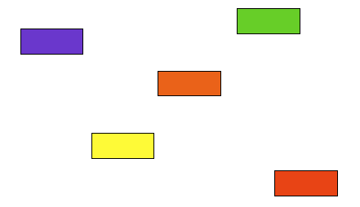
Ordinal/quantitative
Order these colors

Slide 22
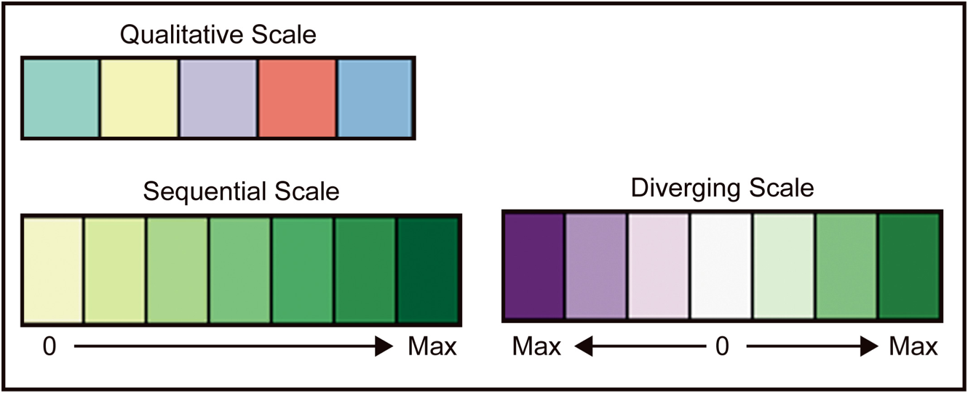
Brewer scales
Nominal
Ordinal

Slide 23
Drawing attention

Slide 24
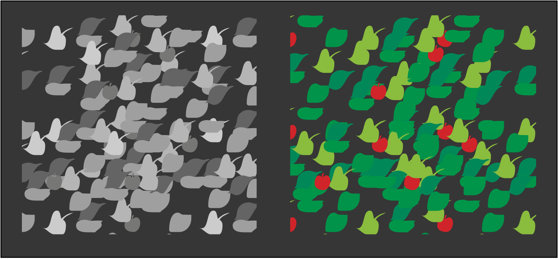
Highlight small items
Ware, Colin. Information visualization: Perception for design 2004.

Slide 25
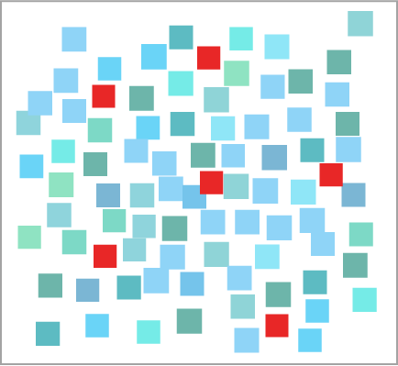
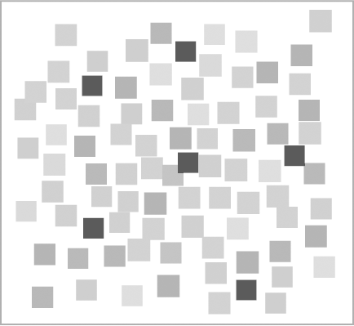
Highlight small items
Hue and lightness
Lightness only

Slide 26
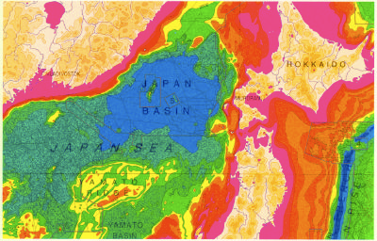

Need care with large areas

Slide 27
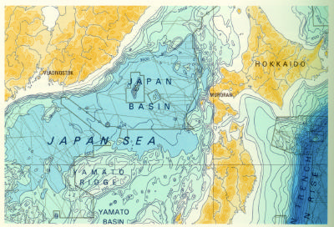

Need care with large areas

Slide 28
Aesthetics

Slide 29
Aesthetics
Don Norman: "Attractive things work better" (Norman, Don. The design of everyday things 1988.)
Color influences aesthetics (Ball, Victoria K. “The Aesthetics of Color: A Review of Fifty Years of Experimentation.” Journal of Aesthetics & Art Criticism 23, no. 4 (1965): 441–52. https://doi.org/10.2307/427666.)
Poorly designed color is confusing
  Creates visual clutter
  Misdirects attention

Slide 30
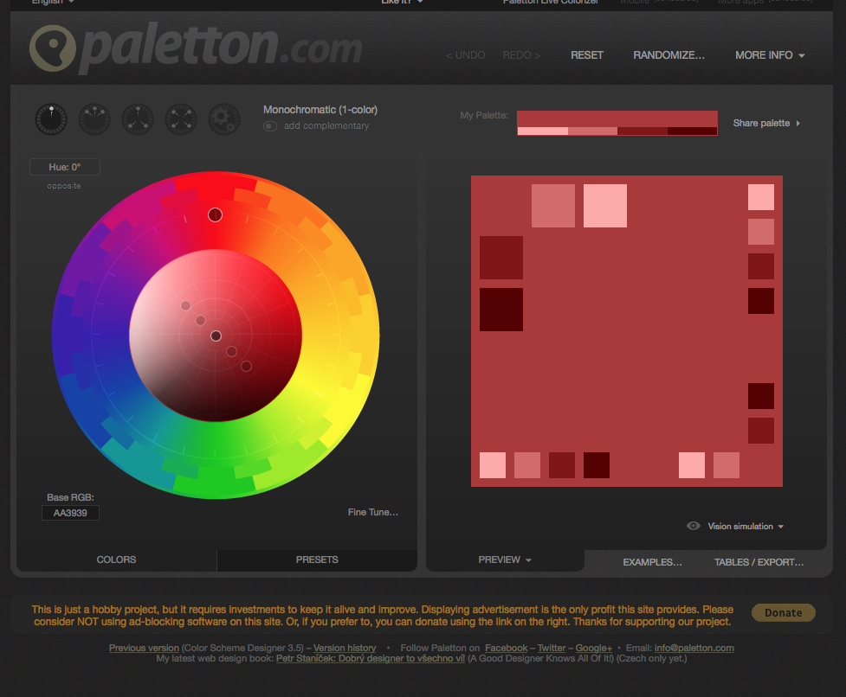
Finding good colors
Colorbrewer
Paletton

Slide 31
Considerations

Slide 32
Color blindness
Flaw in opponent processing
  Red-green common (deuteranope, protanope)
  Blue-yellow possible (tritanope -- most common)
  Luminance channel almost “normal”
8% of all men, 0.5% of all women
Effect is 2D color vision model
  Flatten color space
  Can be simulated (Brettel et. al.)
  http://colorfilter.wickline.org
  http://www.colblindor.com/coblis-color-blindness-simulator/

Slide 33
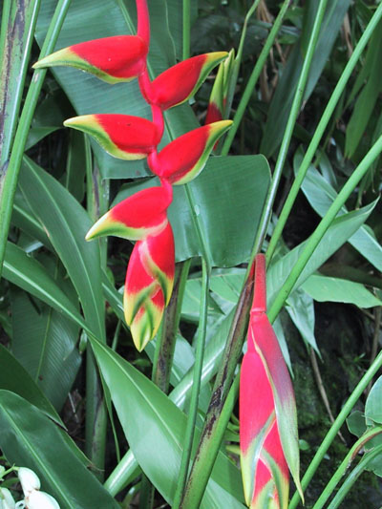
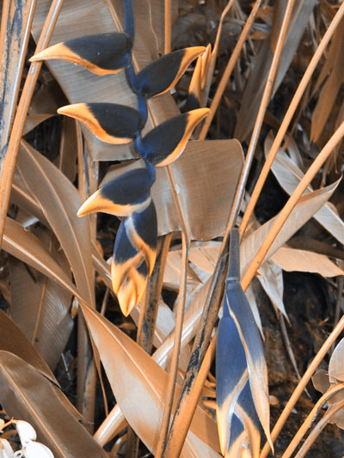
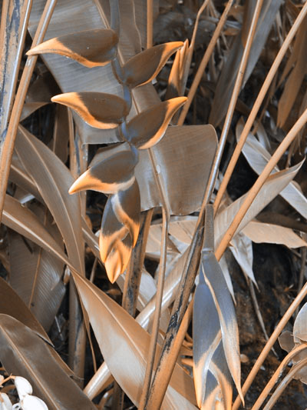
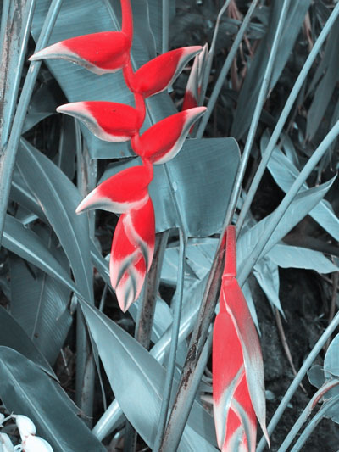
Color blindness
Protanope
Deuteranope
Tritanope
No L cones
No M cones
No S cones
Red / green
deficiencies
Blue / Yellow
deficiency

Slide 34
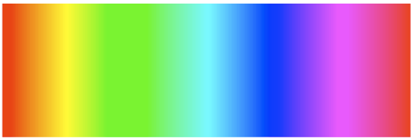

Rainbow color map
Hue is used to show ordinal data
Not perceptually linear: Equal steps in the continuous range are not perceived as equal steps
Colors are a learned order
Not good for colorblind people

Slide 35
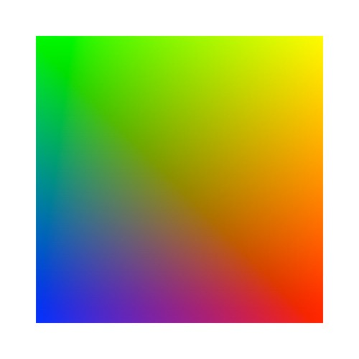
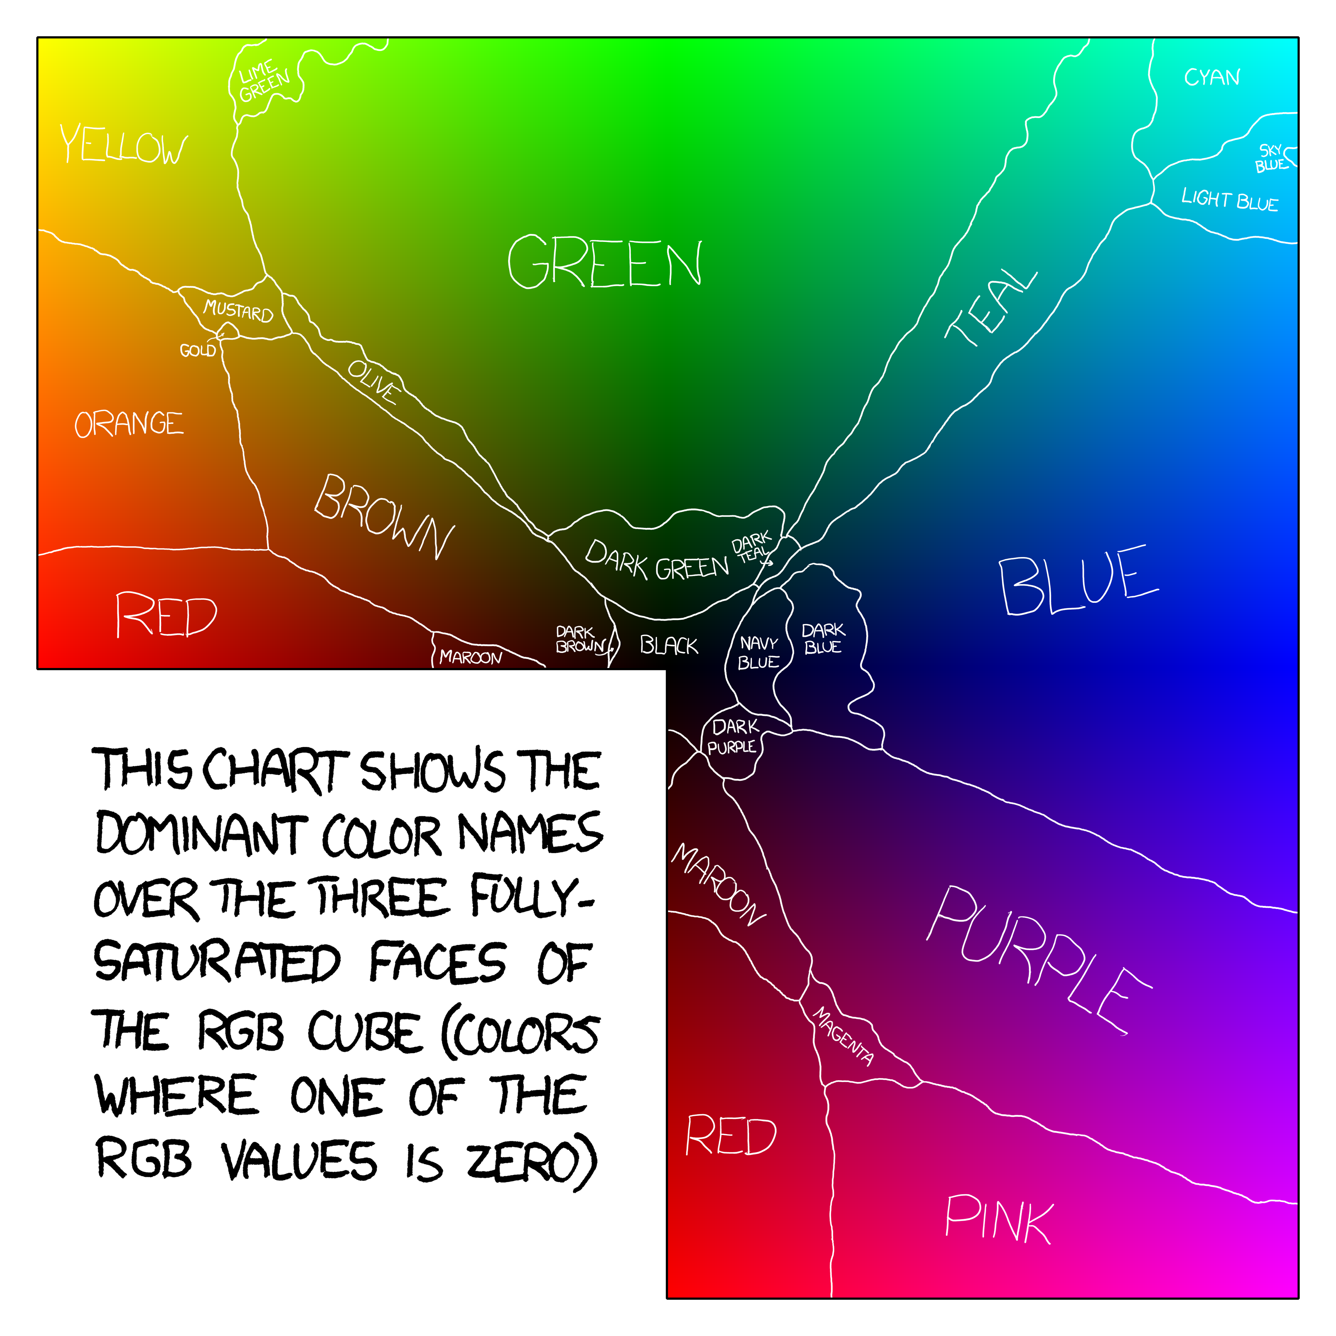
Rainbow color map
Visually segmented
https://blog.xkcd.com/2010/05/03/color-survey-results/

Slide 36
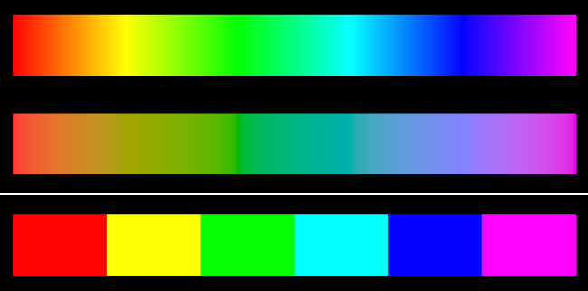
Rainbow color map
Solution — isoluminant rainbow
Solution — discretize colormap

Slide 37
Conclusion

Slide 38
Key points
Balance aesthetics with perceptual issues
Hue for categories (<8!)
Saturation for numbers
Use colorbrewer!

Slide 39
Futher reading
Harrower, Mark A., and Cynthia A. Brewer. "ColorBrewer.Org: An Online Tool for Selecting Color Schemes for Maps," The Cartographic Journal. 2003.
Ware, Colin. Information visualization: Perception for design 2004.
Borland, David, and Russell M. Taylor Ii. "Rainbow Color Map (Still) Considered Harmful," IEEE Computer Graphics and Applications. 2007.
Ware, Colin, Terece L. Turton, Roxana Bujack, Francesca Samsel, Piyush Shrivastava, and David H. Rogers. "Measuring and Modeling the Feature Detection Threshold Functions of Colormaps," IEEE Transactions on Visualization and Computer Graphics. 2019.
Smart, Stephen, Keke Wu, and Danielle Albers Szafir. "Color Crafting: Automating the Construction of Designer Quality Color Ramps," IEEE Transactions on Visualization and Computer Graphics. 2020.

