Slide 1
Infovis: networks and trees
Thomas Torsney-Weir

Slide 2
Last time
we talked about viewing tablular data
Information visualization is mapping abstract dimensions to spatial/visual
Care needed to choose spatial mappings
Single views form foundation of more elaborate visualizations

Slide 3
Other data types
Networks and trees
Fields
Geometry

Slide 4
Networks and trees

Slide 5
Low-level Tasks
identify nodes
determine connections
find paths
determine cliques

Slide 6
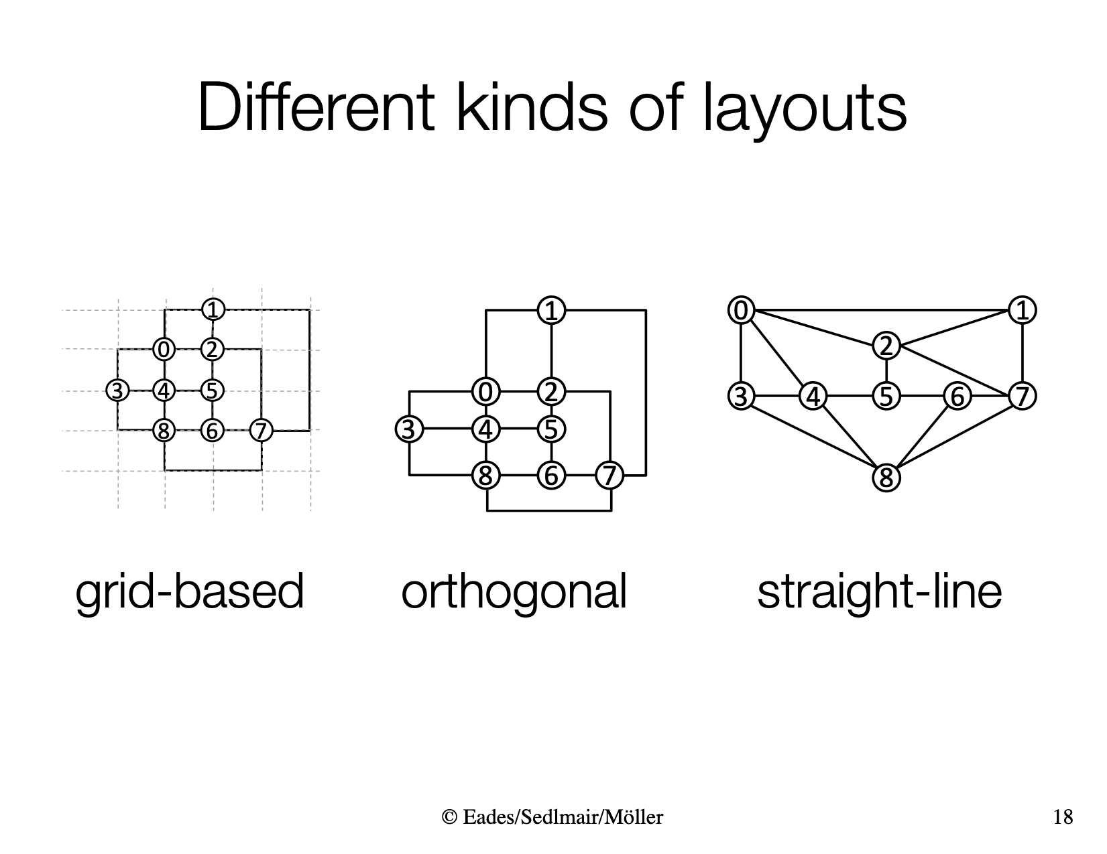
Node-link diagrams

Slide 7
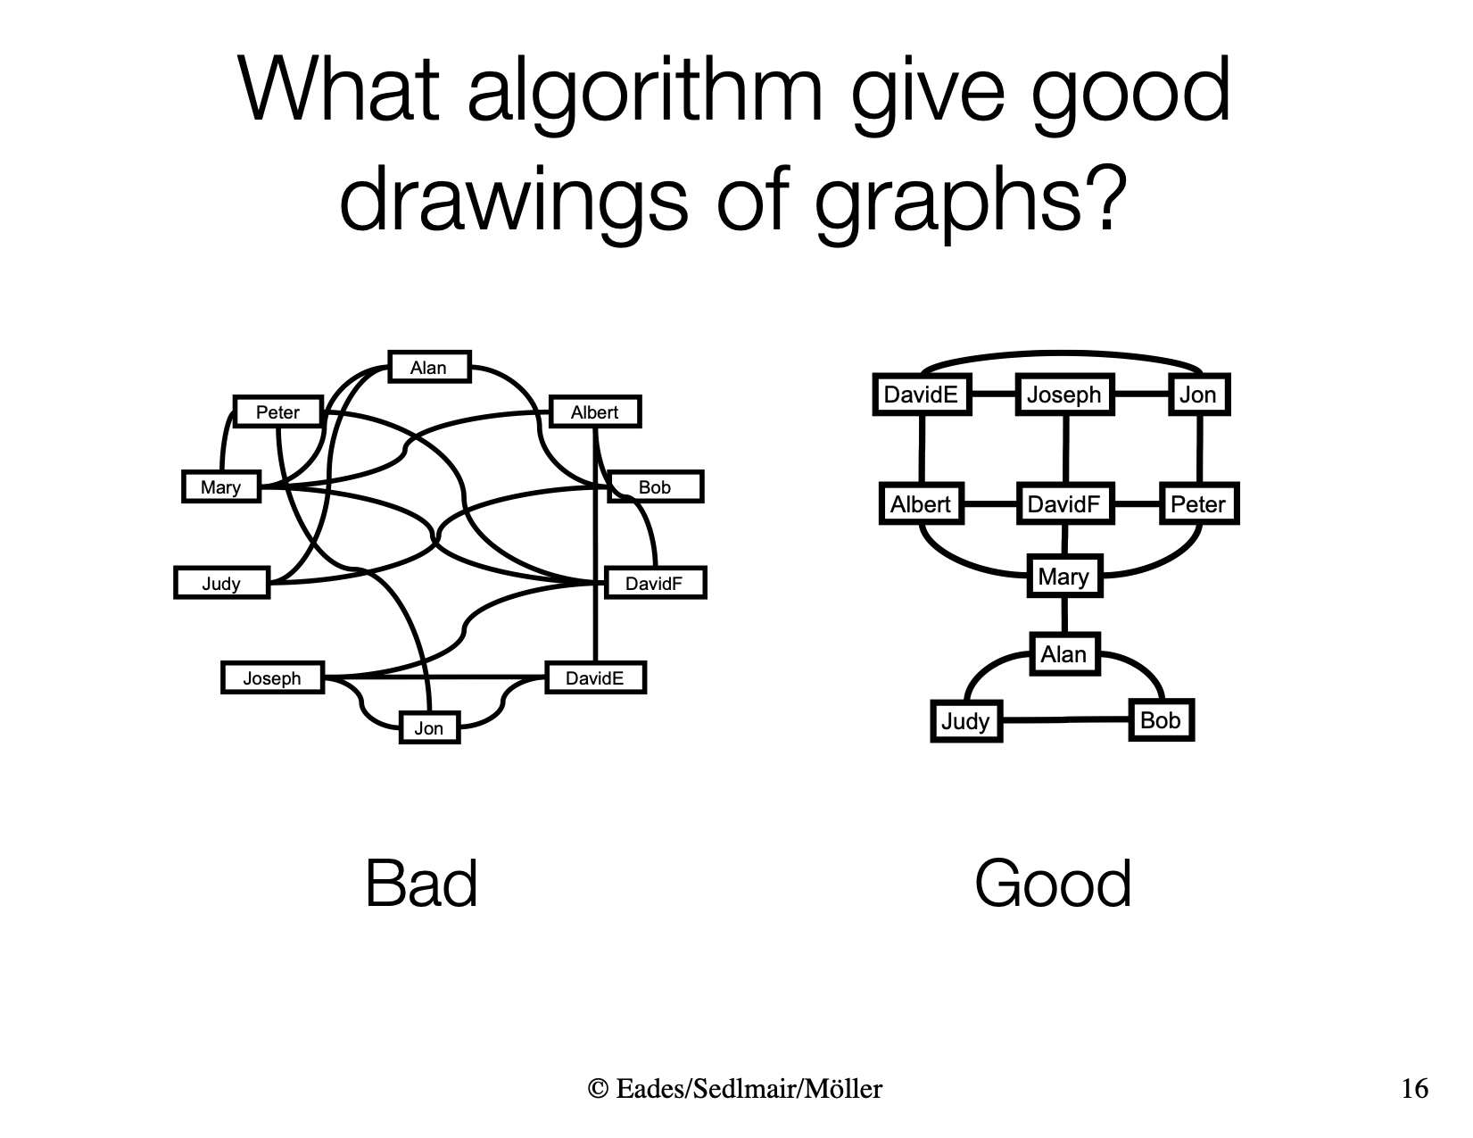
Algorithms
Algorithm to draw graphs nicely
few edge crossings
nodes well-separated
minimize bends
Nice
Not nice
Purchase, Helen. "Which aesthetic has the greatest effect on human understanding?" Graph Drawing. 1997.

Slide 8
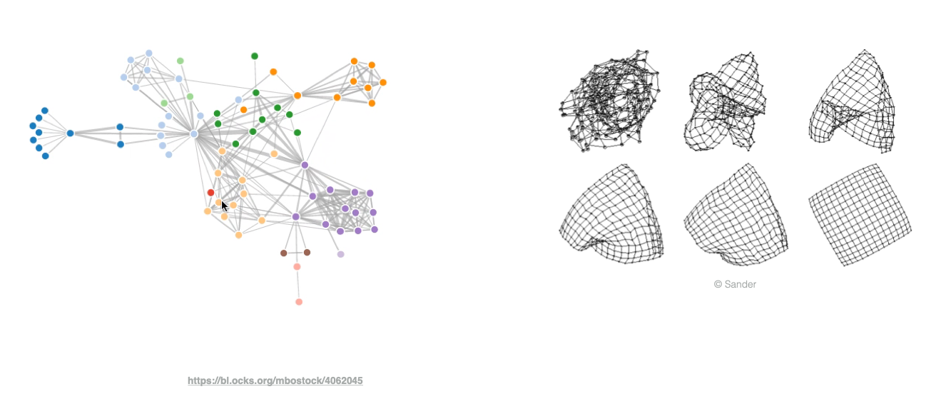
Force directed layouts

Slide 12
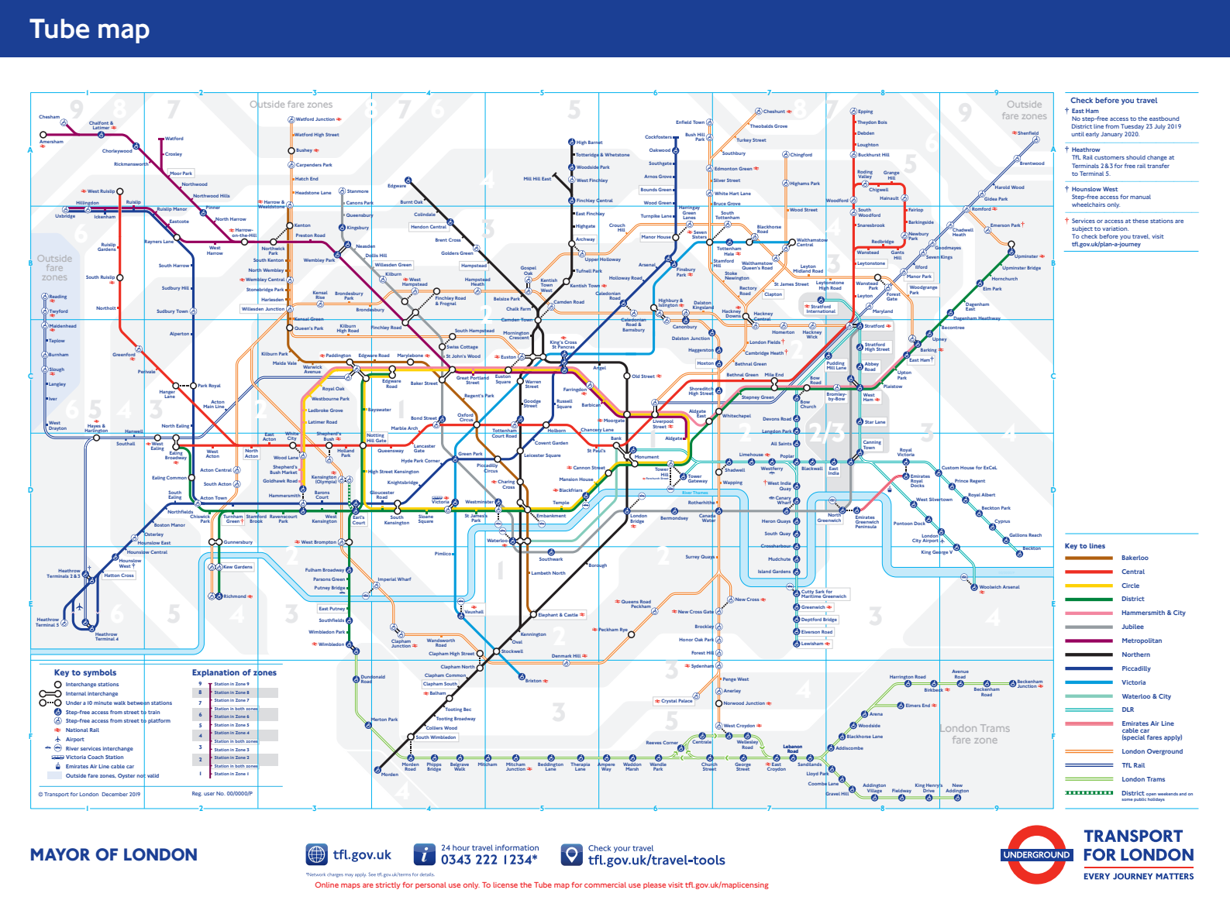

Slide 13
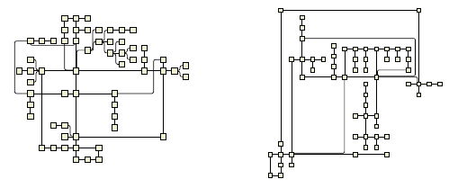
HOLA
HOLA
yFiles
Kieffer, Steve, Tim Dwyer, Kim Marriott, and Michael Wybrow. "HOLA: Human-like Orthogonal Network Layout," IEEE Transactions on Visualization and Computer Graphics. 2016.

Slide 14
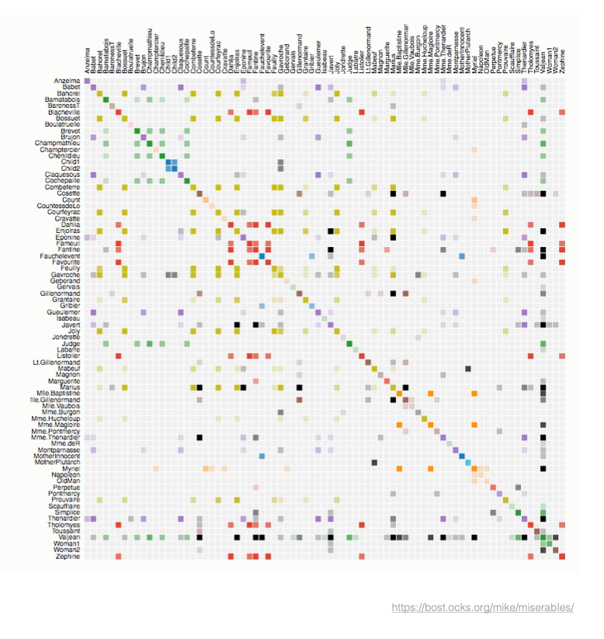
Adjacency matrix

Slide 15
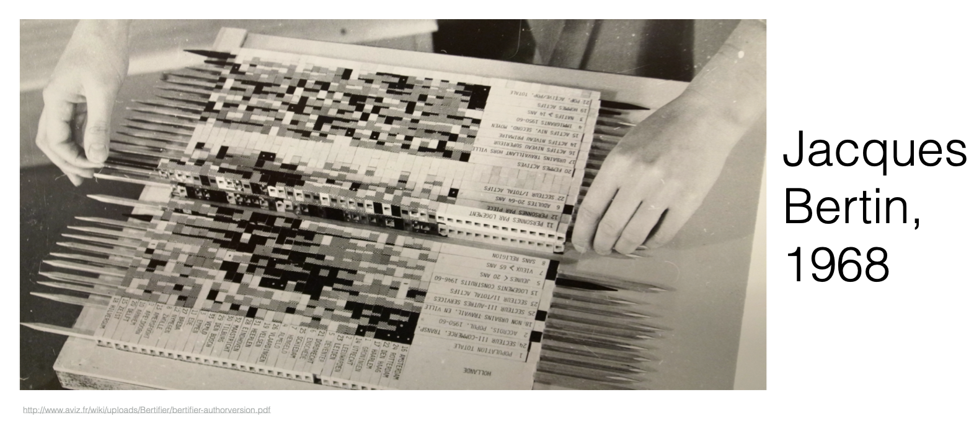
Physical reordering

Slide 16
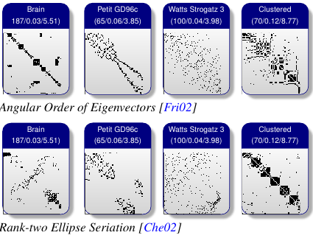
Algorithmic reordering
Behrisch, Michael, Benjamin Bach, Nathalie Henry Riche, Tobias Schreck, and Jean-Daniel Fekete. “Matrix Reordering Methods for Table and Network Visualization.” Computer Graphics Forum 35, no. 3 (2016): 693–716. https://doi.org/10.1111/cgf.12935.

Slide 17
Hierarchical data
trees
file system browsers
venn diagrams
treemaps

Slide 18
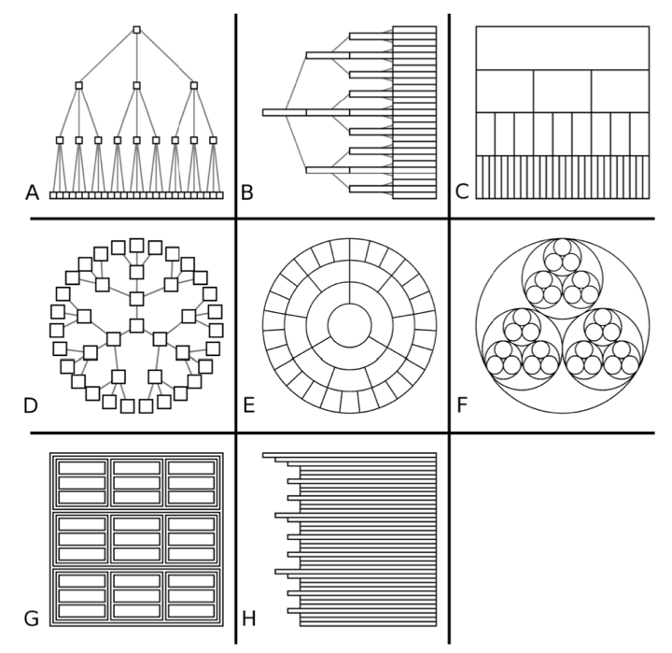
Trees
McGuffin, Michael J, and Jean-Marc Robert. "Quantifying the Space-Efficiency of 2D Graphical Representations of Trees," Information Visualization. 2010.

Slide 19
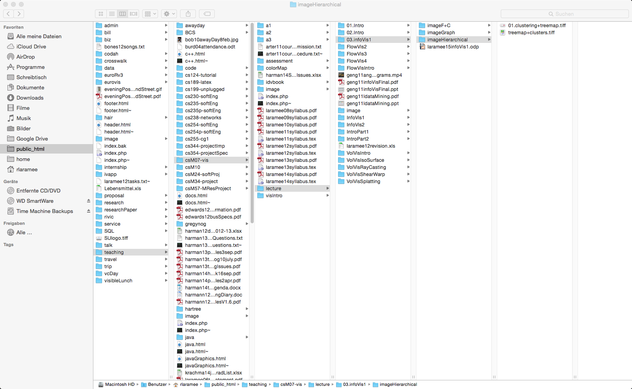
File system browser

Slide 20
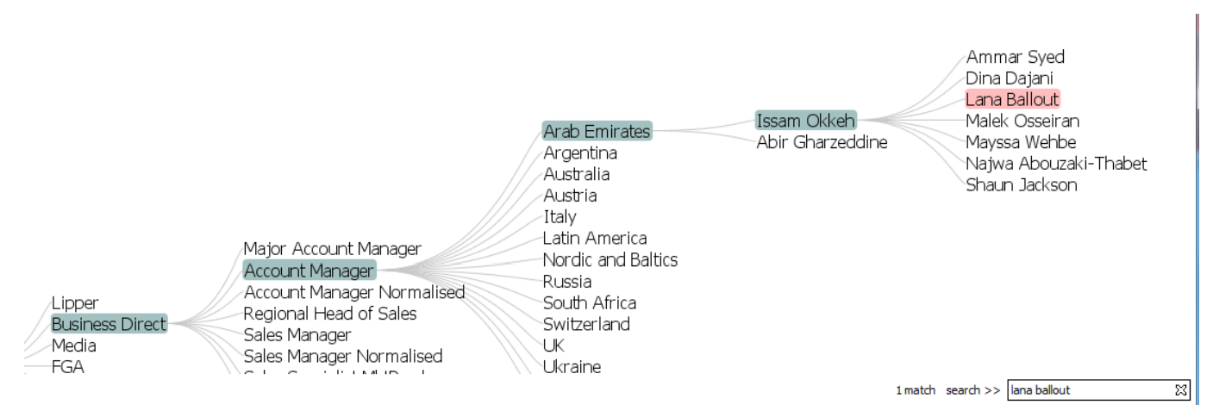
File system browser
Geng, Zhao, Robert S. Laramee, Fernando Loizides, and George Buchanan. “Visual Analysis of Document Triage Data.” In Proceedings of the International Conference on Imaging Theory and Applications and International Conference on Information Visualization Theory and Applications, 1:151–63. Algrave, Portugal, 2011. https://doi.org/10.5220/0003320401510163.

Slide 21
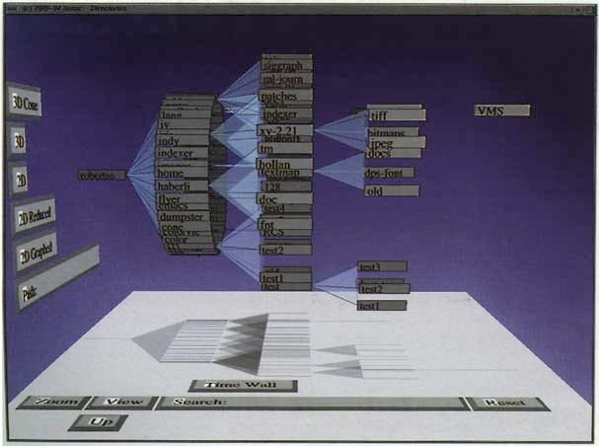
Cone tree
Robertson, George G., Jock D. Mackinlay, and Stuart K. Card. "Cone Trees: Animated 3D visualizations of hierarchical information," Proceedings of the SIGCHI Conference on Human Factors in Computing Systems. 1991.

Slide 22
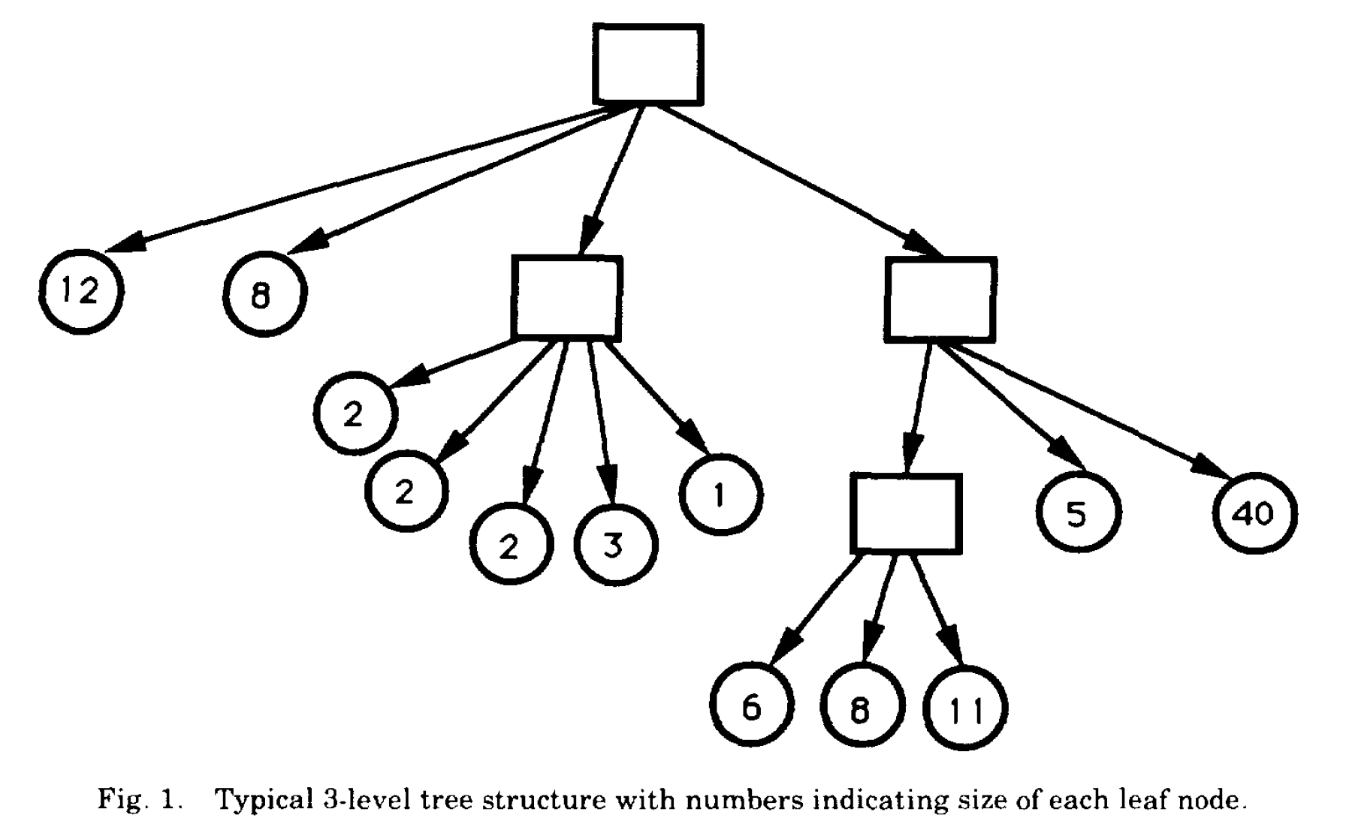
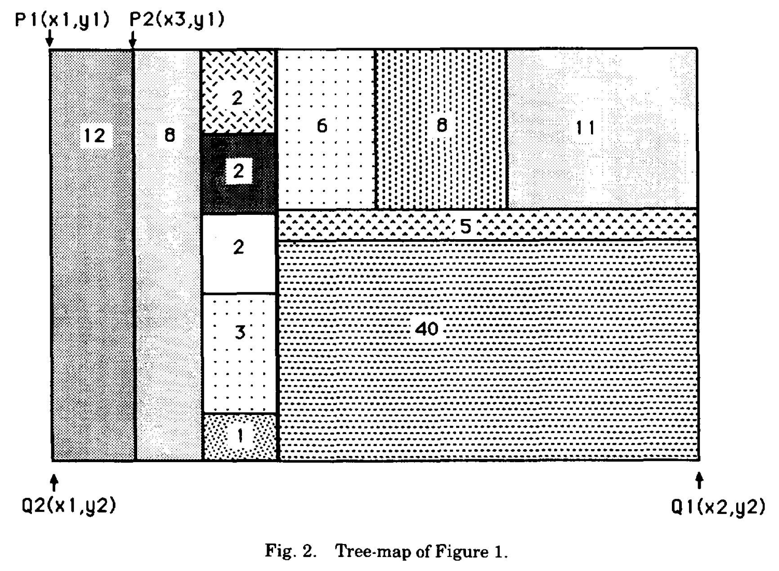
Treemaps
Johnson, Brian, and Ben Shneiderman. "Tree-Maps: A space-filling approach to the visualization of hierarchical information structures," Proceedings of the 2nd conference on Visualization '91. 1991.

Slide 23
Treemaps
Johnson, Brian, and Ben Shneiderman. "Tree-Maps: A space-filling approach to the visualization of hierarchical information structures," Proceedings of the 2nd conference on Visualization '91. 1991.

Slide 24
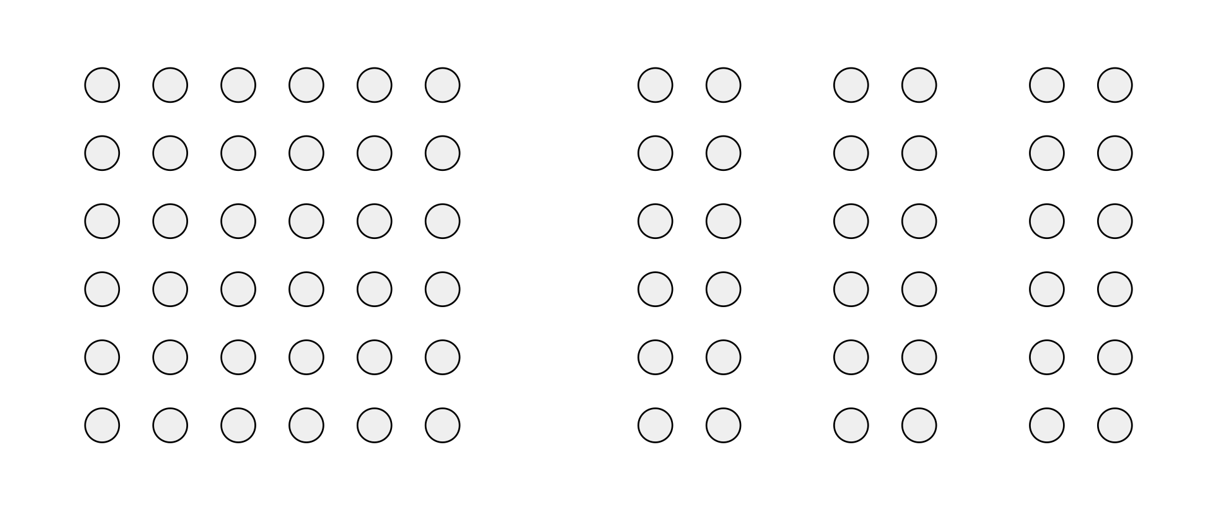
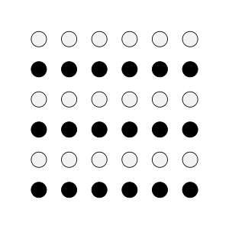

Gestalt principles
Grouping
Similarity
Closure
http://www.scholarpedia.org/article/Gestalt_principles

Slide 25
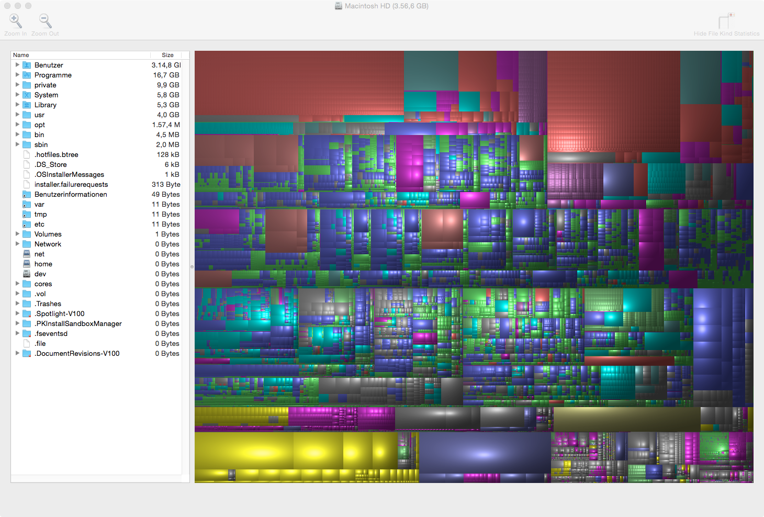

Slide 26
Semantic hierarchy
Data may be in a semantic hierarchy
e.g. home prices
Home type
Neighborhood
Year
Home price
Flat
Semi
Det
Ter
...
...
...
...
Bexley
Brent
...
...
...

Slide 27
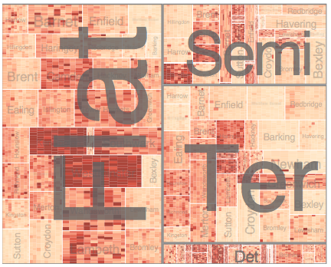
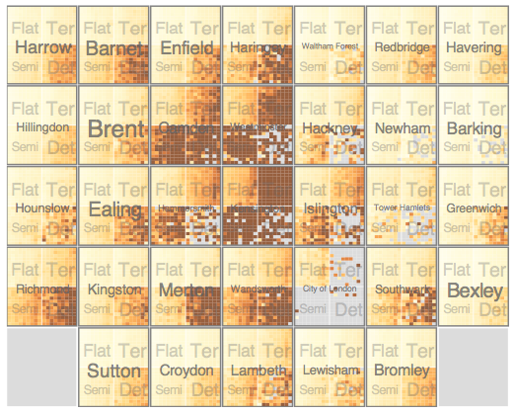
HiVE
Home type first
Neighborhood first
Slingsby, Aidan, Jason Dykes, and Jo Wood. “Configuring Hierarchical Layouts to Address Research Questions.” IEEE Transactions on Visualization and Computer Graphics 15, no. 6 (November 2009): 977–84. https://doi.org/10.1109/TVCG.2009.128.

Slide 28
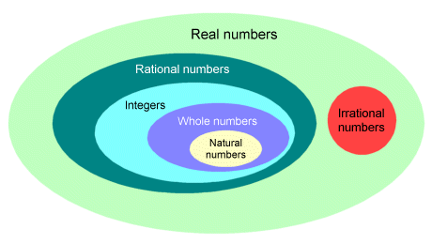
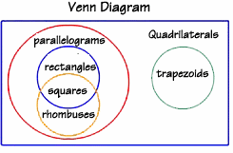
Venn diagram
http://www.technologyuk.net/mathematics/about_numbers/real_numbers.shtml

Slide 29
Conclusion

Slide 30
Summary
Node-link diagrams should minimize edge crossings and curved edges
Adjacency matrix needs interactive reordering to show patterns
Treemaps are a compact representation of trees
Data may be semantically hierarchical

