Slide 1
Users, tasks, data
Thomas Torsney-Weir

Slide 2
Overview

Slide 3
Last time
factors for effective visualization
  data
  tasks
  users
People have been using visualization for centuries
Human visual perception is extremely powerful

Slide 4
Designing an effective visualization
Today: scenario
  Users
  Tasks
  Data
Next time: rendering
  Visualization pipeline
  Visual elements

Slide 5
Why not just data?
Users : Visual literacy, etc
Tasks : Hypotheses, interactions, etc
Data : Information we want to examine

Slide 6
Users

Slide 7
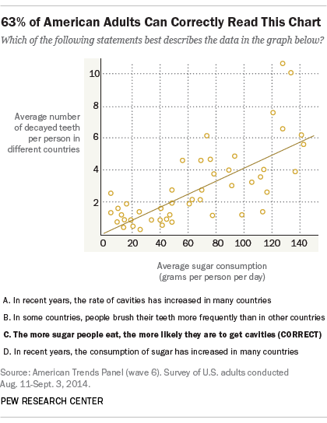
User considerations
Visualization literacy
Color blindness
Patience
  Development
  Evaluation
Training considerations
https://www.pewresearch.org/fact-tank/2015/09/16/the-art-and-science-of-the-scatterplot/

Slide 8
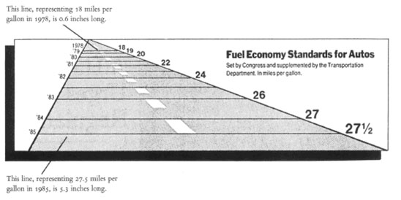
The lie factor
(size of effect in graphic)/(size of effect in data)
Tufte, E. The Visual Display of Quantitative Information. Graphics press, 1983.

Slide 9
The lie factor
Tufte, E. The Visual Display of Quantitative Information. Graphics press, 1983.

Slide 10
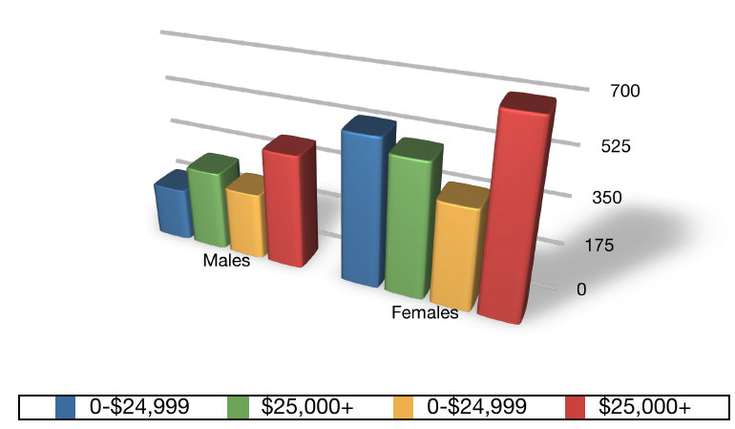
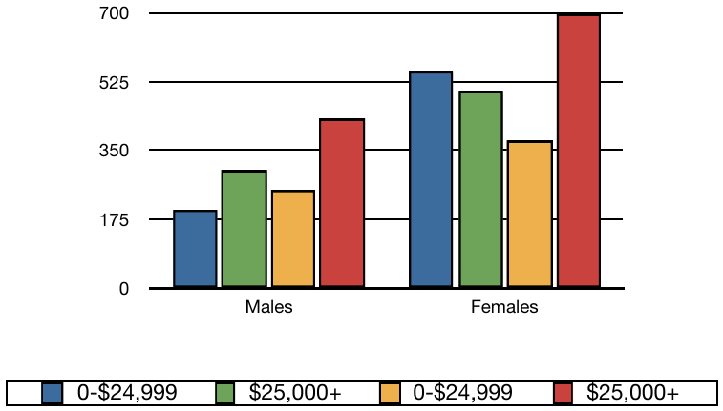
Data-ink ratio
Data-ink : the ink used to show data
Data-ink ratio : data-ink / total ink used
bad
good
vs
Pfister/Möller

Slide 11
Tasks

Slide 12
What are tasks?
For what purpose is a particular visualization effective?
Often described abstractly
Abstracting tasks allows us to compare across domains
  "constrast patients in the ICU after one month vs first week"
  "see if the treated tissues differ from untreated"
  compare values between 2 groups

Slide 13
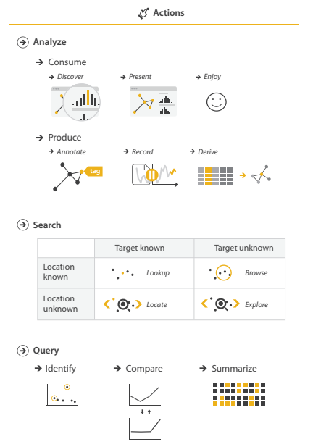
Types of tasks
High level : Cure cancer
Mid-level : Identify most influential factors
Low level : Click on line, band select key points
Munzner, T. Visualization Analysis & Design. CRC press, 2014.

Slide 14

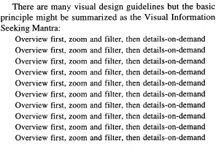
Shneiderman's mantra
Overview first, zoom and filter, details on demand
Shneiderman, B. "The eyes have it: A task by data type taxonomy for information visualizations," Proceedings 1996 IEEE Symposium on Visual Languages. 1996.

Slide 15
Data

Slide 16
What is data?
Data is just information
Semantics : real-world meaning of data
Type : Storage type in computer
e.g. height can be int, double, or a Tuple{int,int}

Slide 17
Attributes
Visualizations are based on data attributes
Quantitative : Continuous numbers (10cm, 75kg, etc)
Ordinal : Categories with order (small, medium, large, eggs in a box)
Nominal : Categories with no order (male, female, apples, oranges, etc)

Slide 18
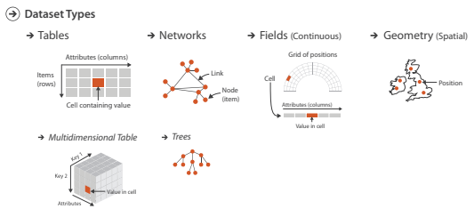
Dataset
Collection of attributes
Munzner, T. Visualization Analysis & Design. CRC press, 2014.

Slide 19
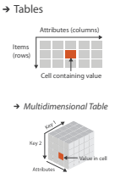
Tabular data
Likely most common
Attributes in columns
Data “item” is a row

Slide 20
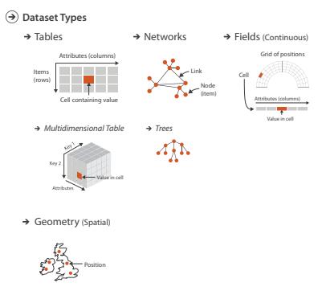
Networks
Nodes have attributes
Edges have attributes
Often represented as 2 tables

Slide 21
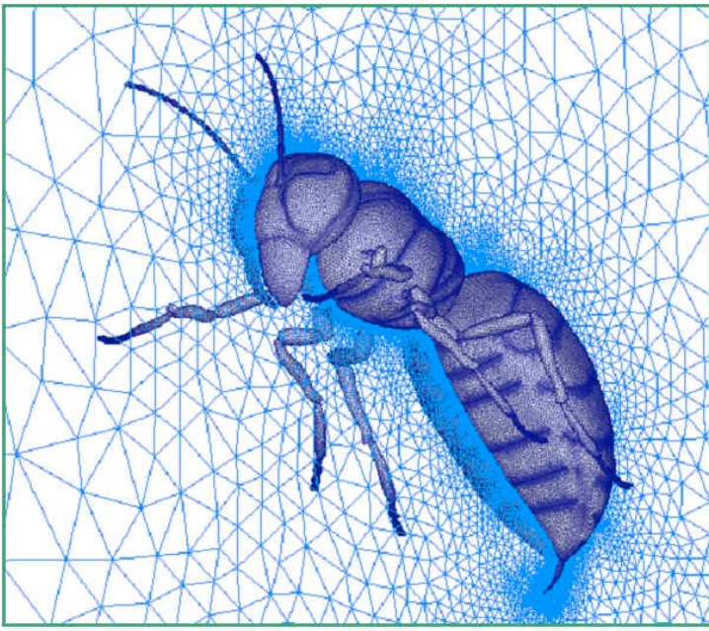
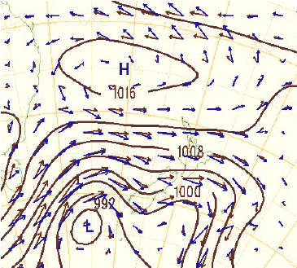
Fields (continuous)
Common in volume & flow visualization
Grids can be many types

Slide 22
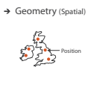
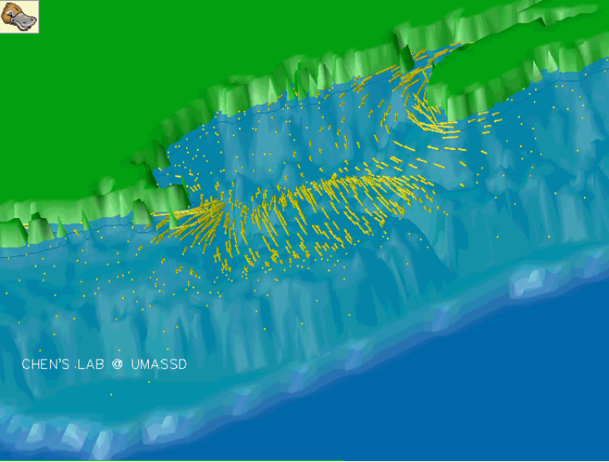
Geometry
Location
Distance
Areas of effect

Slide 23
What about text?
Text is unstructured data
Examples of encoding into attributes
  Word counts (aka bag of words)
  N-grams
  word2vec

Slide 24
Conclusion

Slide 25
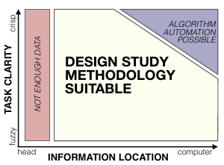
When to use visualization
Sedlmair, Michael, Miriah Meyer, and Tamara Munzner. "Design study methodology: Reflections from the trenches and the stacks," IEEE Transactions on Visualization and Computer Graphics. 2012.

Slide 26
Summary
Shneiderman's mantra is a good starting point for design
Humans are diverse like snowflakes
Task abstractions allow us to compare across domains
Data has both semantics and type
Identifying attributes is key to understanding data

