Slide 1
Visualization process
Thomas Torsney-Weir

Slide 2
Designing an effective visualization
Last time: scenario
  Users
  Tasks
  Data
Today: rendering
  Visual elements
  Visualization pipeline

Slide 3
Designing an effective visualization
Last time: scenario
  Users
  Tasks
  Data
Today: rendering
  Visual elements
  Visualization pipeline

Slide 4
Visual encodings

Slide 5
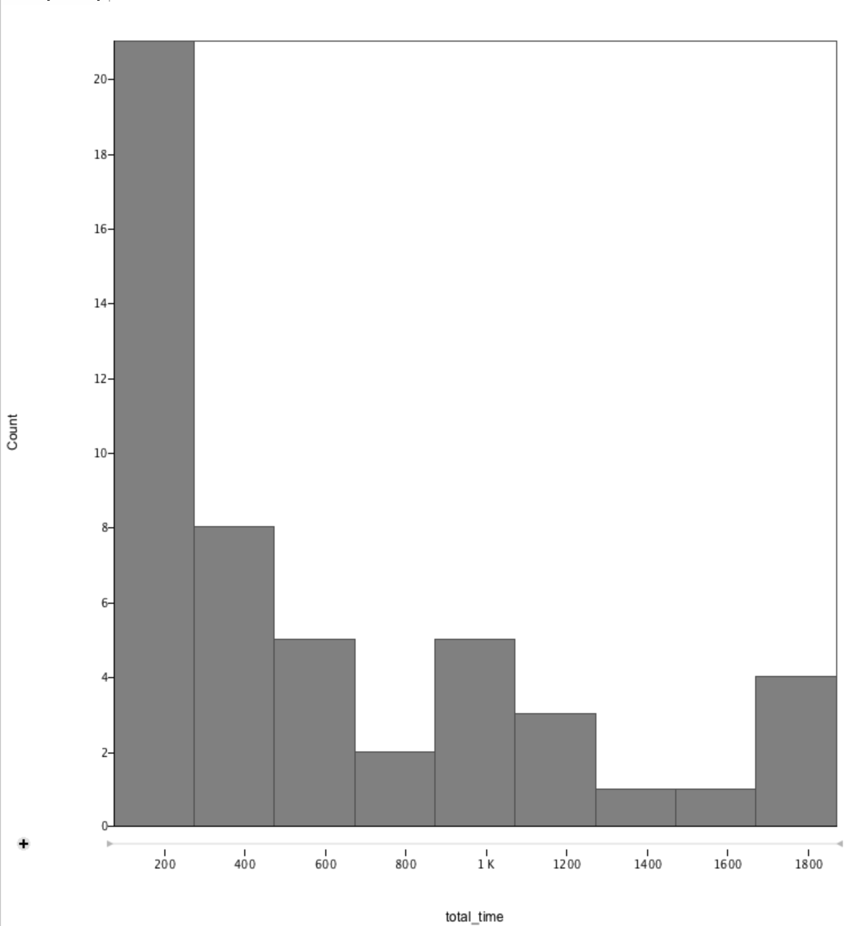
Elements of a visualization

Slide 7
Rectangle
Line
color
Width
Height
y-position
Text
x-position

Slide 8
What are visual encodings?
Mappings between data and graphical elements
Separated into
  Marks : graphical primitives
  Channels : attributes of marks

Slide 9
Mark: Area
Height: bin size
x-position: bin name

Slide 10

Marks and channels
Jacques Bertin
French cartographer [1918-2010]
Semiology of Graphics [1967]
Image perceived as a set of signs
Sender encodes information in signs
Receiver decodes information from signs

Slide 11
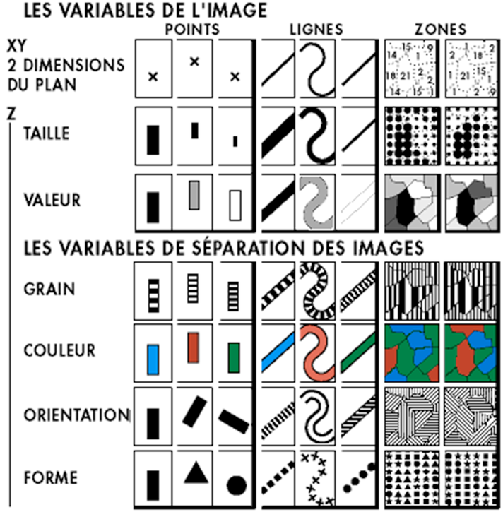
Channel types
Marks
Position
Size
(Grey)Value
Texture
Color
Orientation
Shape
Channels
Bertin, J. Semiology of graphics, ESRI press, 1967.

Slide 12
What vs how much channels
What
Where / how much

Slide 13
What vs how much channels
What: categorical
Shape
Spatial region
Color (hue)
How much: ordered
Length
Area
Volume
Tilt
Color (lightness)

Slide 14
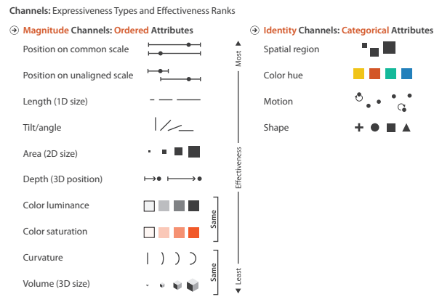
Effective visual encodings
Munzner, T. Visualization Analysis & Design. CRC press, 2014.

Slide 15
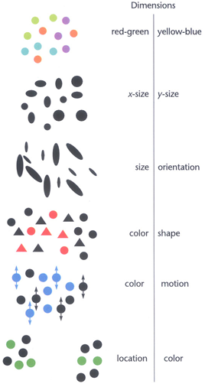
Separable channels
Integral
Integral: two or more encodings perceived holistically
Separable: separate judgements about each graphical dimension
Many exceptions!
Separable
Ware, C. Information Visualization: Perception for Design. Morgan Kaufmann, 2012.

Slide 16
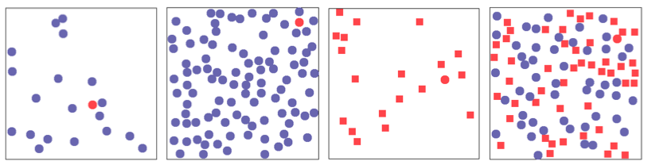
Popout
Parallel visual attention

Slide 17
Popout
Parallel visual attention

Slide 18
Popout
Parallel visual attention

Slide 19
Popout
Parallel visual attention

Slide 20
Visualization pipeline

Slide 21
Overview
Data is produced or acquired
Data acquisition
Data is prepared (or preprocessed)
Data enhancement
Data is mapped to
geometric primitives
Visualization mapping
Data is transformed
into images
Rendering (3D or 2D)

Slide 22
Step 1: get data
Data is generated
(or acquired)
Data acquisition
Data is produced and archived. This is what everyone is good at.
Measurement, e.g., CT, MRI
Written down, scanned in as text
User Input, into databases or spreadsheets
Simulation, e.g., Computational Fluid Dynamics Simulation (CFD).
Modeling, e.g., Computer Aided Design (CAD), dynamical systems
Videos or images are recorded

Slide 23
Step 2: just what we need
Data enhancement
Data is prepared
(or “preprocessed”)
Data enhancement = Data preparation/preprocessing
Filtering, e.g. smoothing (noise filtering)
Errors are discovered and corrected
Missing values may be handled
Resampling or modify grid representation
Derive new data, e.g., gradients
Data interpolation

Slide 24
Step 3: what goes where
Visualization mapping
Data is mapped to
geometry
Visualization mapping results in Data being visible
Data is represented by geometric primitives: points, lines, triangles, polygons, cubes, tetrahedra, of varying size, shape, color, transparency
Compute isosurface
Compute glyphs or icons
Compute graph layout
Compute voxel attributes: color, transparency, …

Slide 25
Step 4: draw!
Rendering (3D/2D)
Data becomes an
image(s)
Rendering involves representation with Computer Graphics (CG)
Projection (3D → 2D)
Visibility calculation
Shading
Compositing (accumulate transparency and color values)
Animation

Slide 26
Conclusion

Slide 27
Summary
Visualizations are broken down into marks (elements) and channels (parameters)
Data is linked to these channels
A lot of care needed to choose which and how many channels to use
Visualization pipeline helps organize software/notebooks

