Slide 1
Infovis: Single views
Thomas Torsney-Weir

Slide 2
Overview
Context
Challenges
Single view examples

Slide 3
Context

Slide 4
Infovis vs Scivis
Abstract Data
n-dimensional
Very important:
  visual metaphor
  user interaction
  exploration, analysis (visual analytics),
  presentation
Spatial data
1, 2- or 3-dimensional,
time-dependent
Very important:
  3D rendering
  fast rendering
  analysis, exploration, presentation

Slide 5
Two important goals
An intuitive visual metaphor:
How can abstract information be represented visually?
How can high-dimensional data be depicted?
2D or 3D visualization?
How can we position or place the data in space?
Integration of Focus and Context?
A proper interaction scheme:
Modification of visual parameters and metaphors
Change of focus

Slide 6
Special challenges
Often large amounts of data. How to do visualization and:
selection of data subsets
aggregation of data
extraction of meta data
Extended data structures, complex data inter-dependencies
deep hierarchies, large graphs,
multi-modal data
different kinds of inter-dependencies, i.e., relationships
pattern finding capabilities are very important

Slide 7
Dealing with large amounts of data
Subsampling/Subsetting techniques
sampling
querying
Segmentation techniques
segmentation: separation into subsets
Aggregation techniques
aggregation:
sum, count, minimum, maximum, average...
frequency-based techniques

Slide 8
Single views

Slide 9
Characteristics
Data : often tabular
Users : general public, inexperienced
Tasks : exploration, supplementary figures

Slide 10
Scatterplot
2-3 variables, one ellipse per data item

Slide 11
Scatterplot matrix
With details on demand

Slide 12
3D scatterplot matrix

Slide 13
Stacked bar chart

Slide 14
Stacked area chart

Slide 15
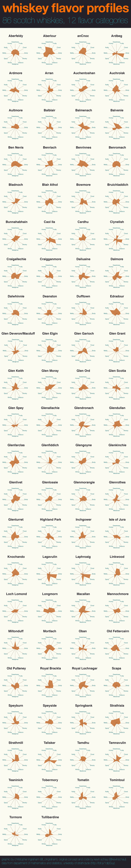
Star glyphs
https://www.reddit.com/r/Infographics/comments/1ueveb/whiskey_flavor_profiles_86_scotch_whiskies_12/

Slide 16
Parallel coordinates
layout: n parallel axes
one axis per data-attribute
axes scaled to min/max-interval
Inselberg, Alfred. “The Plane with Parallel Coordinates.” The Visual Computer 1, no. 2 (August 1985): 69–91. https://doi.org/10.1007/BF01898350.

Slide 17
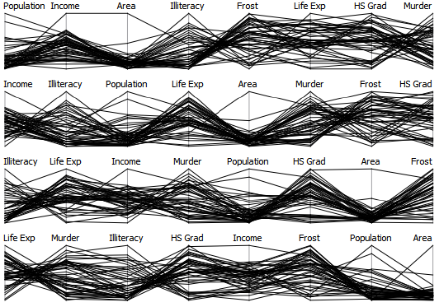
Challenge: Axis ordering
Heinrich, Julian, and Daniel Weiskopf. “State of the Art of Parallel Coordinates,” 2013. http://dx.doi.org/10.2312/conf/EG2013/stars/095-116.

Slide 18
Challenge: overlapping lines

Slide 19
Color and brushing

Slide 20
Glyphs
Iconic representation of multiple attributes
Methods:
  Rugby glyphs
  Vector glyphs
  Chernoff faces
  Star glyphs

Slide 21
Sample glyph
10 dimensions

Slide 22
Glyphs for visualizing rugby events

Slide 24
Glyphs for rugby events
Chung, David HS, Philip A. Legg, Matthew L. Parry, Rhodri Bown, Iwan W. Griffiths, Robert S. Laramee, and Min Chen. “Glyph Sorting: Interactive Visualization for Multi-Dimensional Data:” Information Visualization, November 29, 2013. https://doi.org/10.1177/1473871613511959.

Slide 25
Vector glyphs
Vector glyphs for visualization of fluid flow
7 variates visualized:
  Position (x,y,z)
  velocity(x,y,z)
  magnitude
Peng, Zhenmin, Zhao Geng, Michael Nicholas, Robert S. Laramee, Nick Croft, Rami Malki, Ian Masters, and Chuck Hansen. “Visualization of Flow Past a Marine Turbine: The Information-Assisted Search for Sustainable Energy.” Computing and Visualization in Science 16, no. 3 (June 1, 2013): 89–103. https://doi.org/10.1007/s00791-014-0229-4.

Slide 26
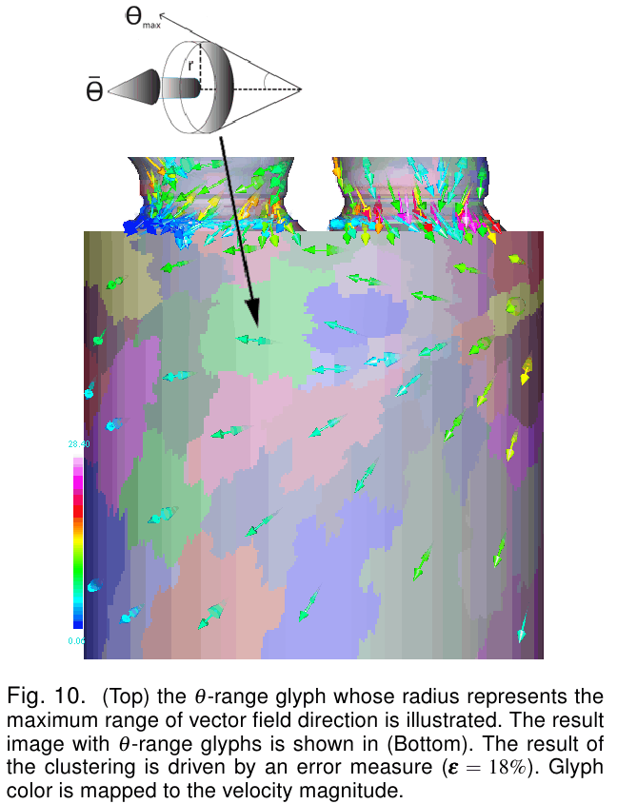
Range glyphs
Theta-Range glyphs for visualization of fluid flow
8 variates visualized:
  Position (x,y,z)
  Velocity (x,y,z)
  Magnitude,
  Angle range

Slide 27
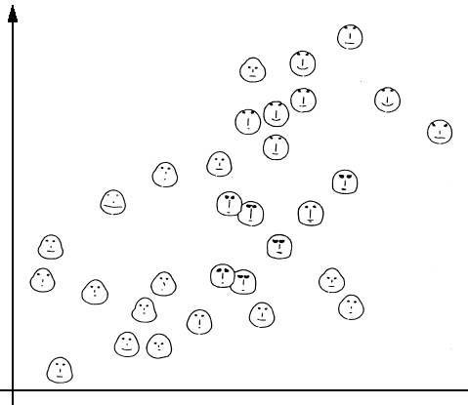
Chernoff faces
Orginally used for 8-variate fossil specimens
Head shape/curvature + size
Mouth length + curvature
Nose length + curvature
Eyes shape + size
color
x,y position
Chernoff, Herman. “The Use of Faces to Represent Points in K-Dimensional Space Graphically.” Journal of the American Statistical Association 68, no. 342 (June 1, 1973): 361–68. https://doi.org/10.1080/01621459.1973.10482434.

Slide 28
Chernoff faces
Do not use these
Humans are designed around facial recognition
Dimensions of face are not seperable

Slide 29
Conclusion

Slide 30
Summary
Often using tabular data
Information visualization is mapping abstract dimensions to spatial/visual
Care needed to choose spatial mappings
Single views form foundation of more elaborate visualizations

