Slide 1
Infovis: multiple views
Thomas Torsney-Weir

Slide 2
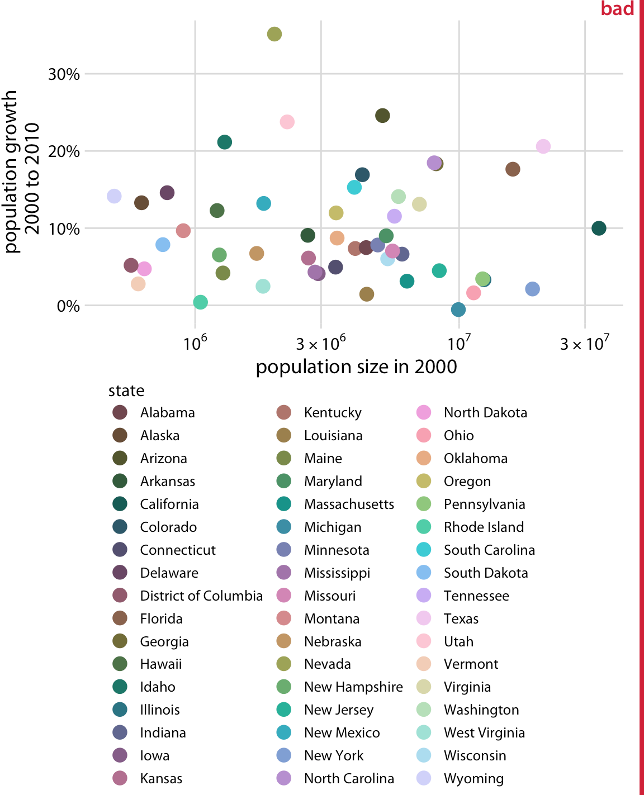
Too many attributes

Slide 3
What to do?
split data into multiple sections
visualize each part separately
link these together with interaction (coordinated multiple linked views) Wang Baldonado, Michelle Q., Allison Woodruff, and Allan Kuchinsky. "Guidelines for using multiple views in information visualization," Proceedings of the working conference on Advanced visual interfaces. 2000.

Slide 4
Improvise
Weaver, Chris. “Building Highly-Coordinated Visualizations in Improvise.” In IEEE Symposium on Information Visualization, 159–166. Institute of Electrical & Electronics Engineers (IEEE), 2004. https://doi.org/10.1109/infvis.2004.12.

Slide 5
Advantages
eyes over memory: two simultaneous views have a lower cognitive load than remembering previous views
Each visualization can use just a few visual encodings
Different encodings can lead to different insights

Slide 6
Splitting views

Slide 7
Coordinated multiple linked views
Multiple (different) aspects of a dataset linked together through interaction
small multiples
focus + context
multiple views

Slide 8
Splitting data
Subset items
Subset attributes
Both!
Clustering

Slide 9
Small multiples
Same visualization different data
Only has to learn to “read” one plot type
Often used for time varying data

Slide 10

Space vs time
Used as an alternative to video

Slide 11
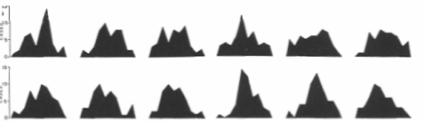
Small multiples
Side by side easier than temporal

Slide 12
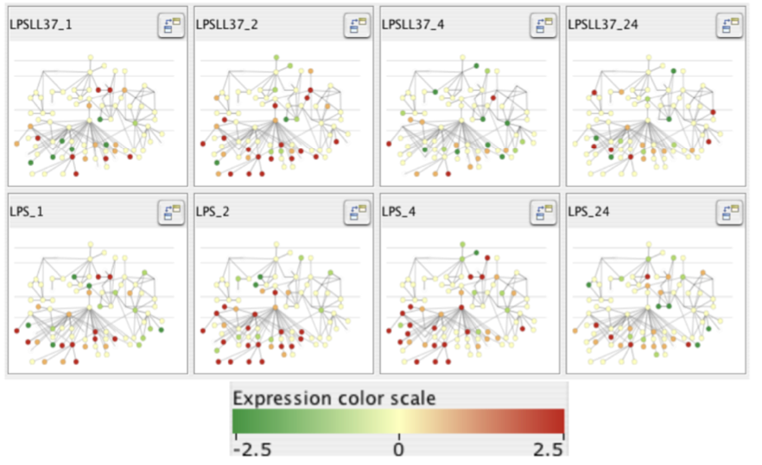
Cerebral
Barsky, Aaron, Tamara Munzner, Jennifer Gardy, and Robert Kincaid. “Cerebral: Visualizing Multiple Experimental Conditions on a Graph with Biological Context.” IEEE Transactions on Visualization and Computer Graphics 14, no. 6 (2008): 1253–1260. https://doi.org/10.1109/TVCG.2008.117.

Slide 13
Focus + context
2 primary views of data
  Overview (context)
  Detail (focus)
Zooming metaphor is often used

Slide 14
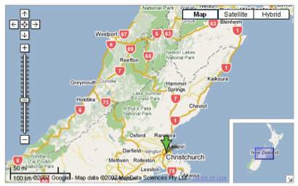
Maps!

Slide 15
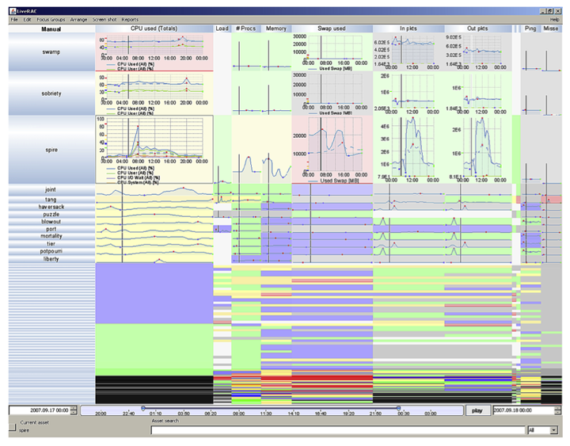
Semantic zoom
Automatically determine visual encoding based on space
McLachlan, Peter, Tamara Munzner, Eleftherios Koutsofios, and Stephen North. “LiveRAC: Interactive Visual Exploration of System Management Time-Series Data.” In Proceeding of the Twenty-Sixth Annual SIGCHI Conference on Human Factors in Computing Systems, 1483–1492. ACM, 2008. http://portal.acm.org/citation.cfm?id=1357286.

Slide 16
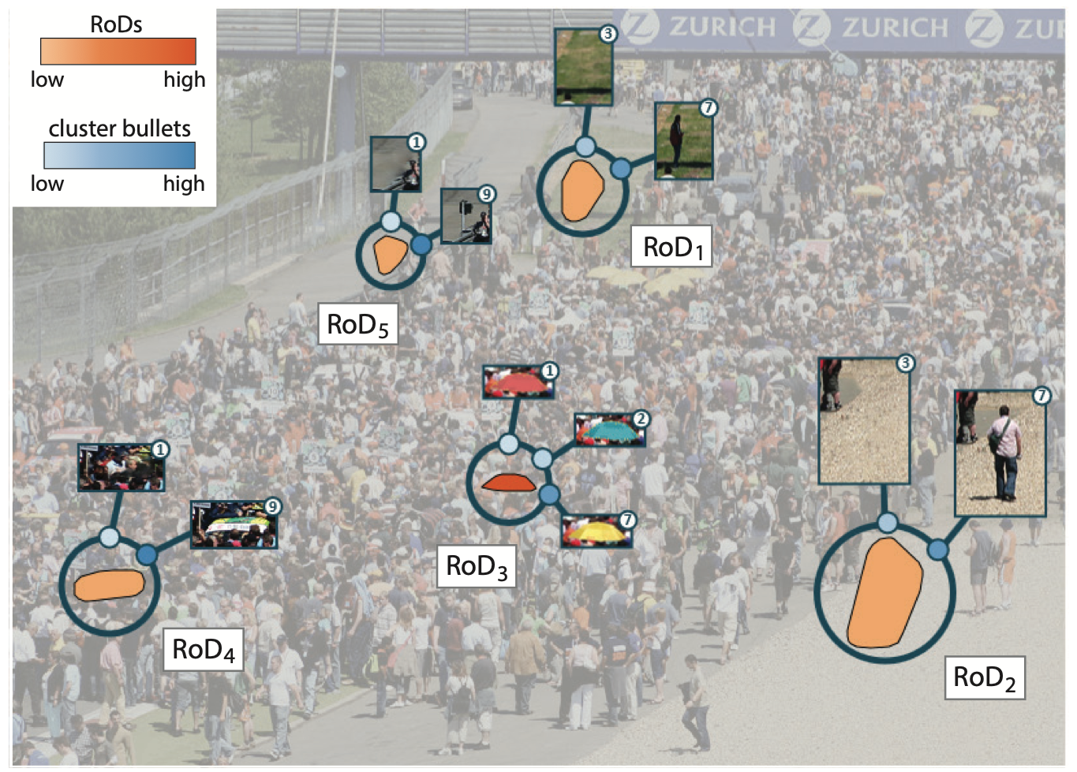
VAICo
Schmidt, Johanna, M. Eduard Groller, and Stefan Bruckner. “VAICo: Visual Analysis for Image Comparison.” IEEE Transactions on Visualization and Computer Graphics 19, no. 12 (December 2013): 2090–2099. https://doi.org/10.1109/tvcg.2013.213.

Slide 17
Multiple views
Each subset of data is given a unique view
“Best” view can be chosen for task/data
Views are linked with interaction

Slide 18
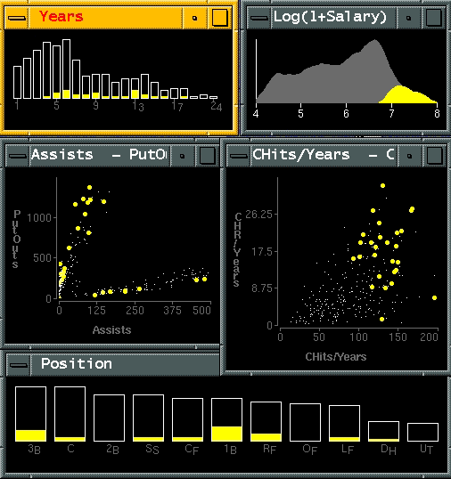
Exploratory data visualizer
Wills, Graham J. “Visual Exploration of Large Structured Datasets.” In New Techniques and Trends in Statistics, 237--246. IOS press, 1995.

Slide 19
Exploratory data visualizer
how long
in majors
select high
salaries
avg career
HRs vs avg
career hits
(batting ability)
avg assists vs
avg putouts
(fielding ability)
distribution
of positions
played
Wills, Graham J. “Visual Exploration of Large Structured Datasets.” In New Techniques and Trends in Statistics, 237--246. IOS press, 1995.

Slide 20
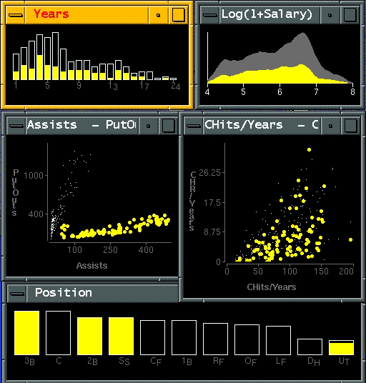
Exploratory data visualizer
Wills, Graham J. “Visual Exploration of Large Structured Datasets.” In New Techniques and Trends in Statistics, 237--246. IOS press, 1995.

Slide 21
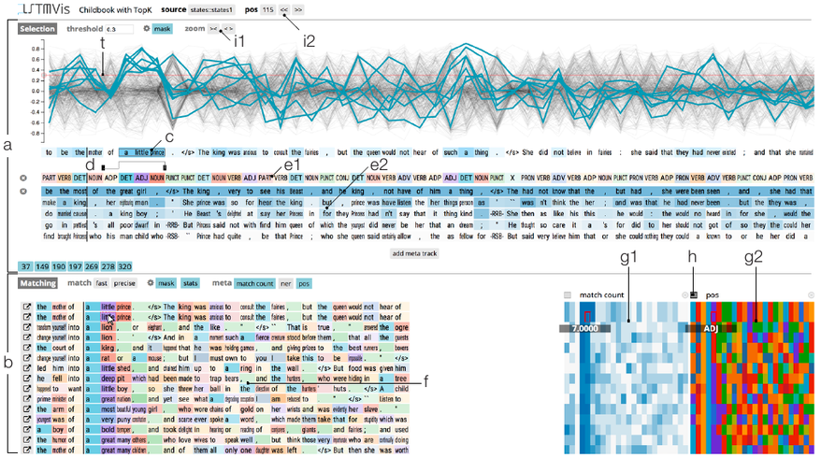
LSTMvis
Strobelt, Hendrik, Sebastian Gehrmann, Hanspeter Pfister, and Alexander M. Rush. “LSTMVis: A Tool for Visual Analysis of Hidden State Dynamics in Recurrent Neural Networks.” IEEE Transactions on Visualization and Computer Graphics 24, no. 1 (January 2018): 667–76. https://doi.org/10.1109/TVCG.2017.2744158.

Slide 22
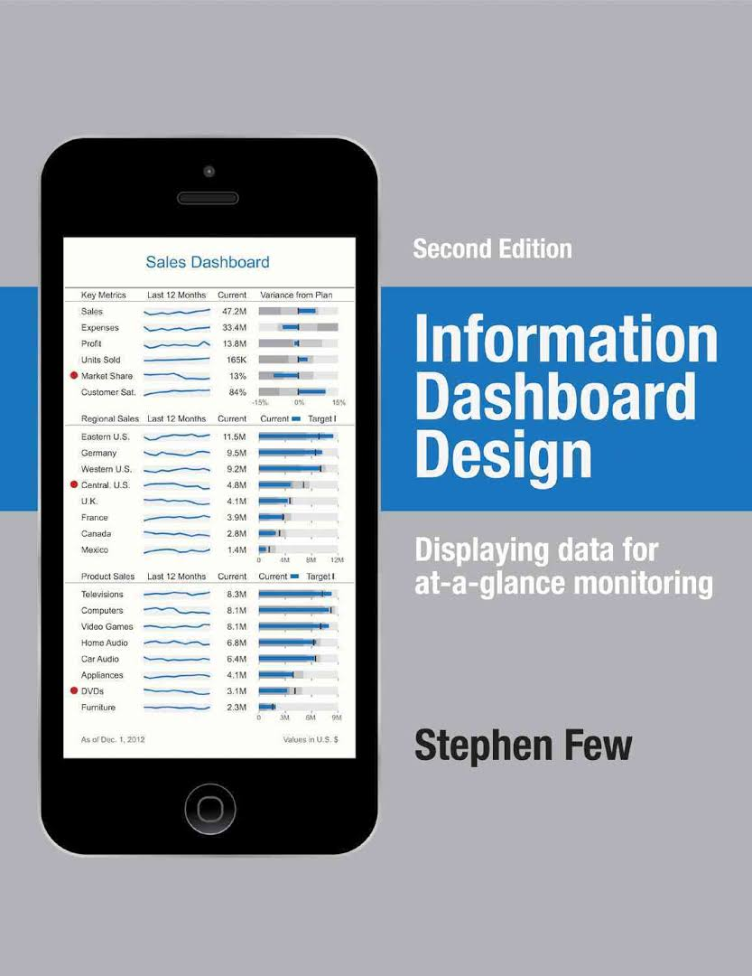
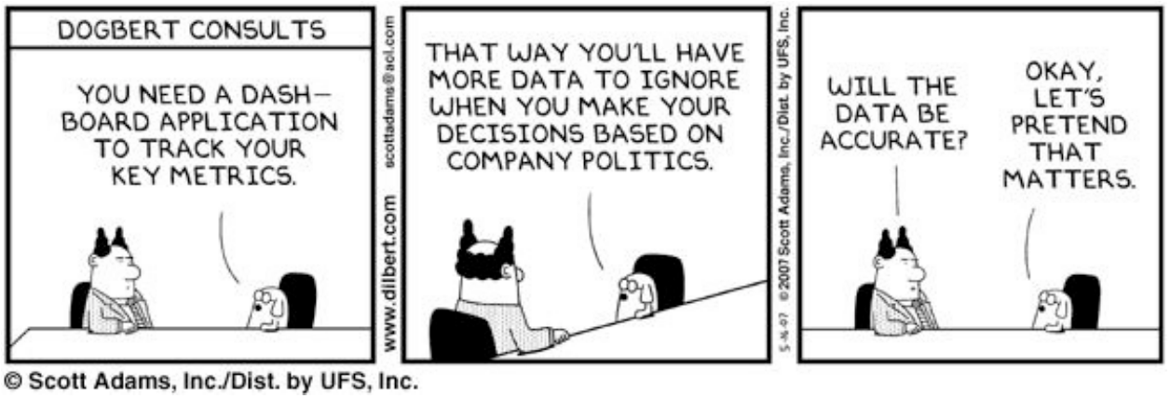
Information dashboard design

Slide 23
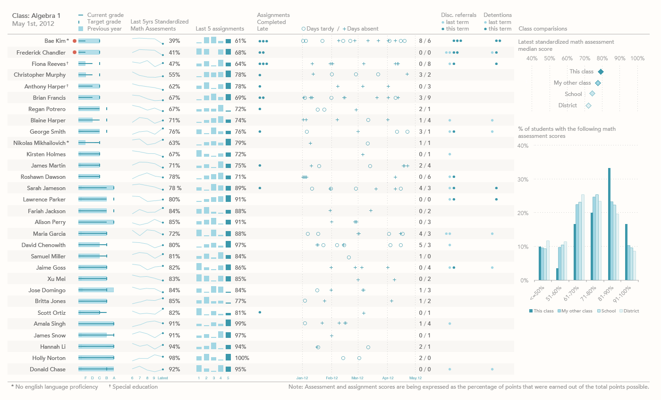
Dashboard design
https://www.perceptualedge.com/blog/?p=1374

Slide 24
Interaction

Slide 25
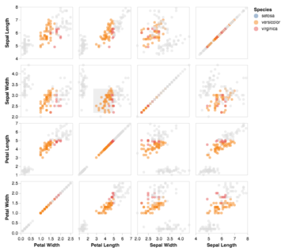
Linked brushing
Demo: https://vega.github.io/vega/examples/brushing-scatter-plots/

Slide 26
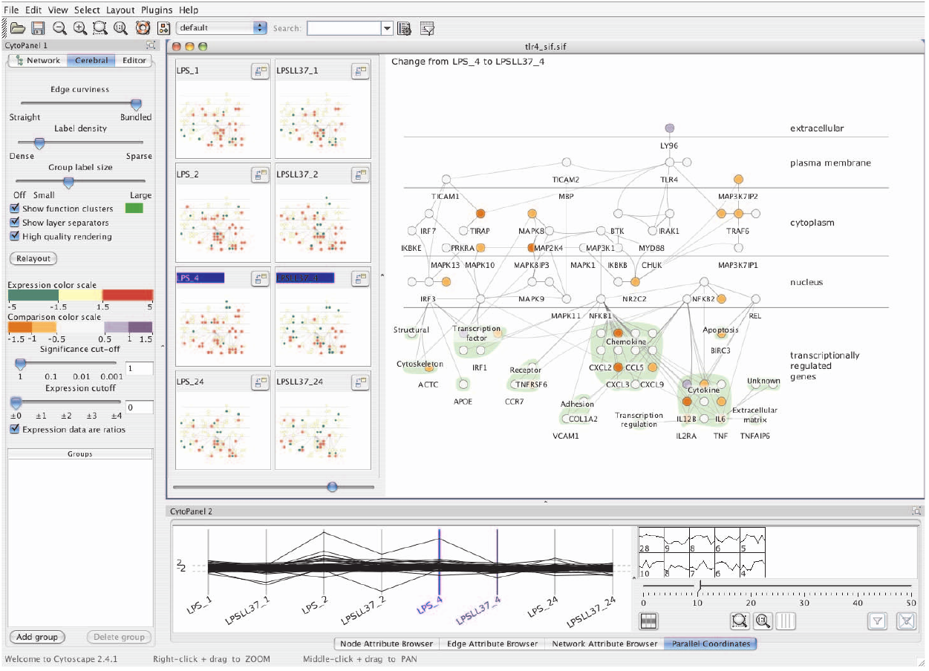
Linked comparison
Barsky, Aaron, Tamara Munzner, Jennifer Gardy, and Robert Kincaid. “Cerebral: Visualizing Multiple Experimental Conditions on a Graph with Biological Context.” IEEE Transactions on Visualization and Computer Graphics 14, no. 6 (2008): 1253–1260. https://doi.org/10.1109/TVCG.2008.117.

Slide 27
Conclusion

Slide 28
Summary
eyes over memory
Splitting views is very powerful
Interaction is key

