Slide 1
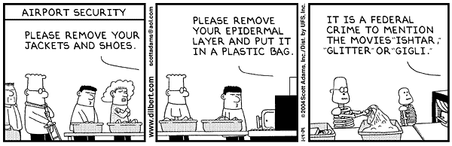
Visualization, Lecture
Volume Visualization
Part 2
Direct Volume Visualization

Slide 2
Overview: Current Lecture
Contents of Current Lecture:
  introduction to direct volume visualization
  ray functions
  ray casting
  compositing

Slide 3
Direct Volume Visualization
Overview:
  No intermediate representation
  “Real 3D”
  Integration of so much information: difficult
  Object-order vs. image-order rendering
  Various techniques (ray casting, shear-warp, texture mapping, etc.)
  Various rendering techniques (compositing, MIP, first-hit, average, etc.)

Slide 4
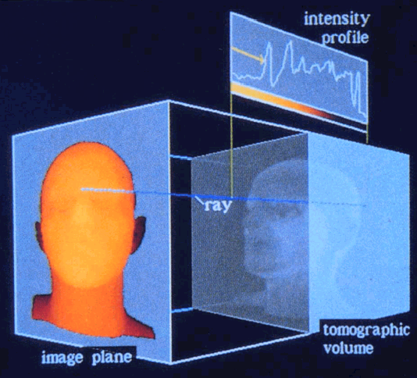
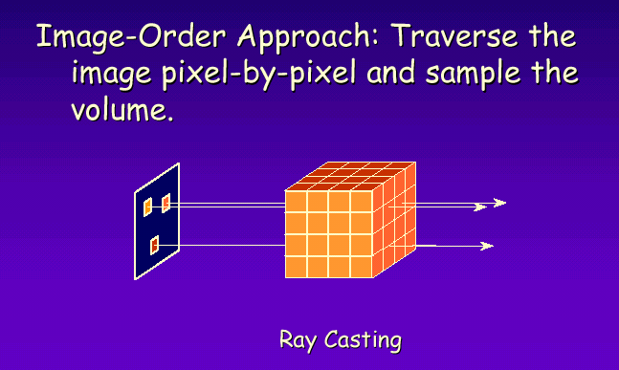
Direct Volume Visualization
Terminology:
Ray Casting: the value of each pixel in the image is determined by sending a ray through the pixel into the scene (image order volume rendering)

Slide 5
Rendering Techniques: Ray Functions
Scalar
Values
Ray Functions
Overview:
MIP
(Maximum Intensity Projection)
Compositing
X-Ray
First Hit
Ray functions produce an intensity profile.
Max Intensity
Accumulate
Average
First
Depth (into volume)

Slide 6
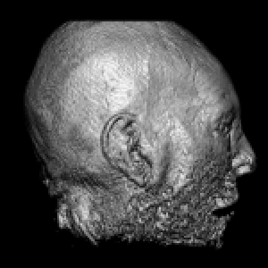
First Hit: Iso-surface Extraction
Scalar Values
First
Depth
First Hit Ray Function: Extracts iso-surfaces (again), done by Tuy&Tuy ’84

Slide 7
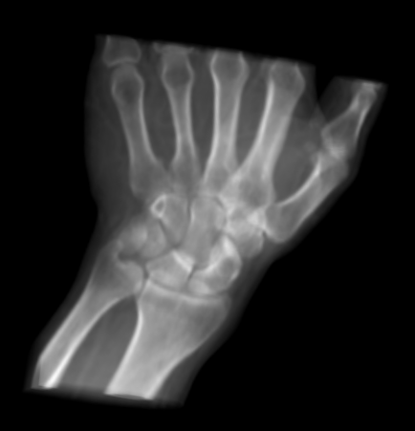
Average: Like X-Rays
Scalar Field
Average
Depth
Average Ray Function: Produces basically an X-ray picture

Slide 8
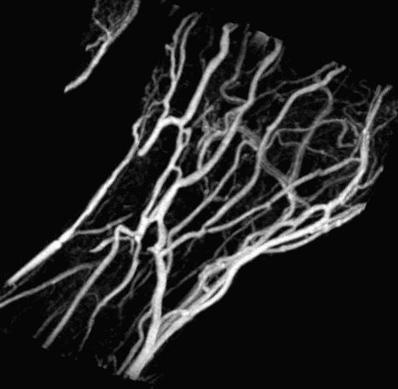
MIP: maximum-intensity projection
Scalar Values
MaxIntensity
Depth
Max Ray Function: Maximum Intensity Projection (MIP) used for Magnetic Resonance Angiogram (MRA)

Slide 9
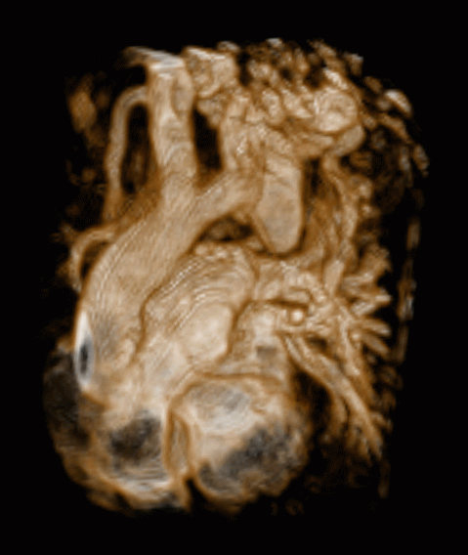
Compositing: Semi-transparency
Scalar values
Accumulate
Depth
Accumulate: Make transparent layers visible.
Levoy ‘88

Slide 10
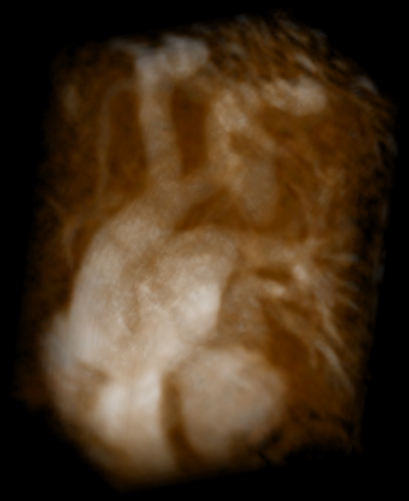
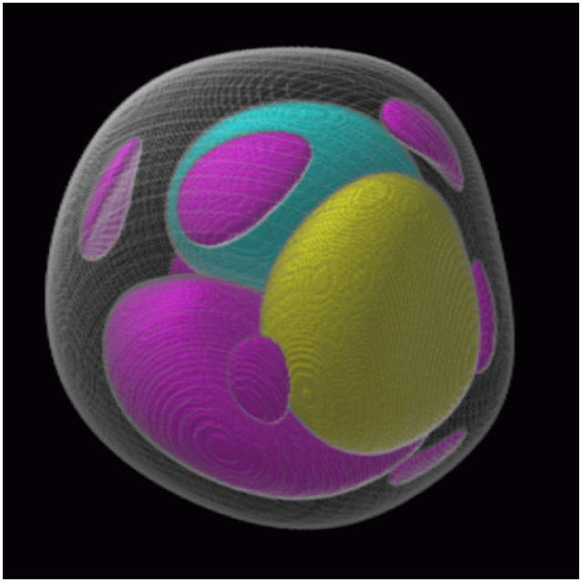
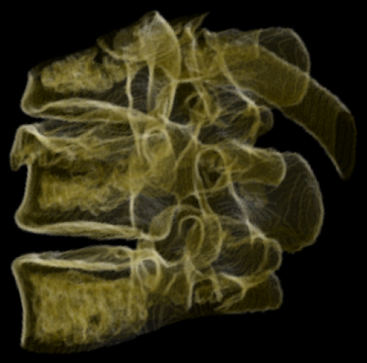
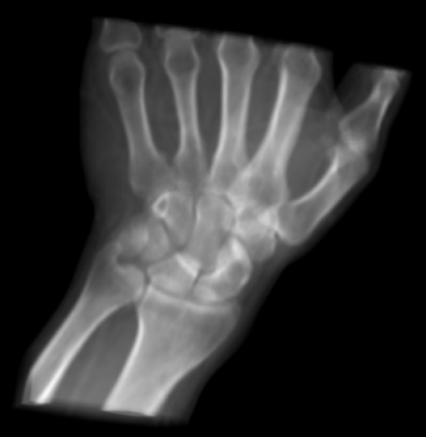
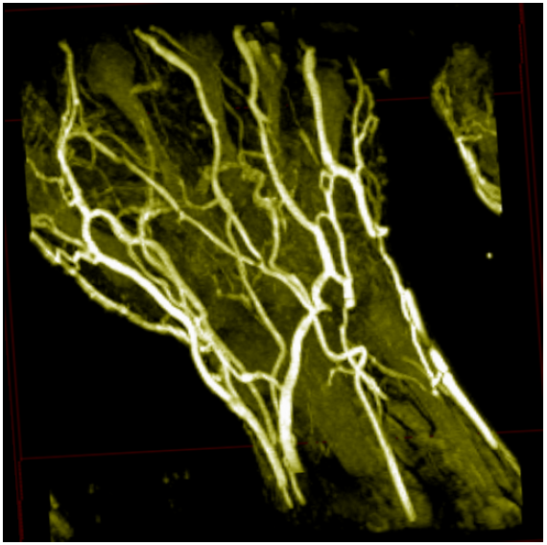
Combining Ray Functions
DVR
Some Possibilities:
α-compositing
shaded surface display
maximum-intensity projection
x-ray simulation
contour rendering
SSD
MIP

Slide 11
The Ray Casting Pipeline
Classical
Image-Order Method

Slide 12
Ray Tracing vs. Ray Casting
Ray Tracing: image generation method
In volume rendering: only primary light scattering −−> thus Ray Casting
Classical image-order method
Ray tracing: radiate object surface or slices
Ray casting: no objects, just scalar (e.g. density) values in 3D
Theory: consider all density values
Practice: traverse volume slice by slice
Interpolation necessary per slice

Slide 13
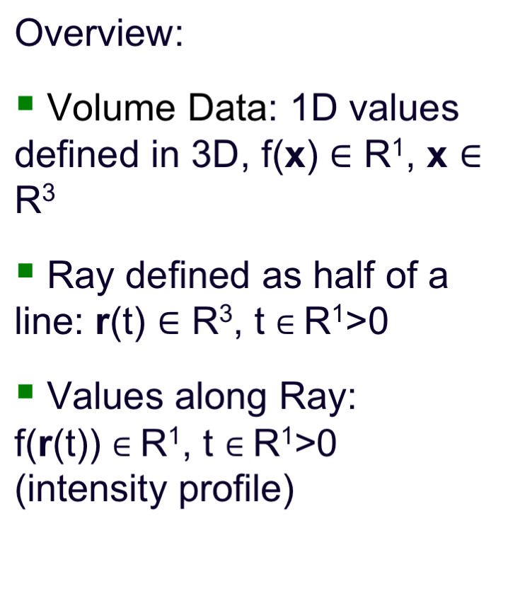
Ray Through Volume Data

Slide 14
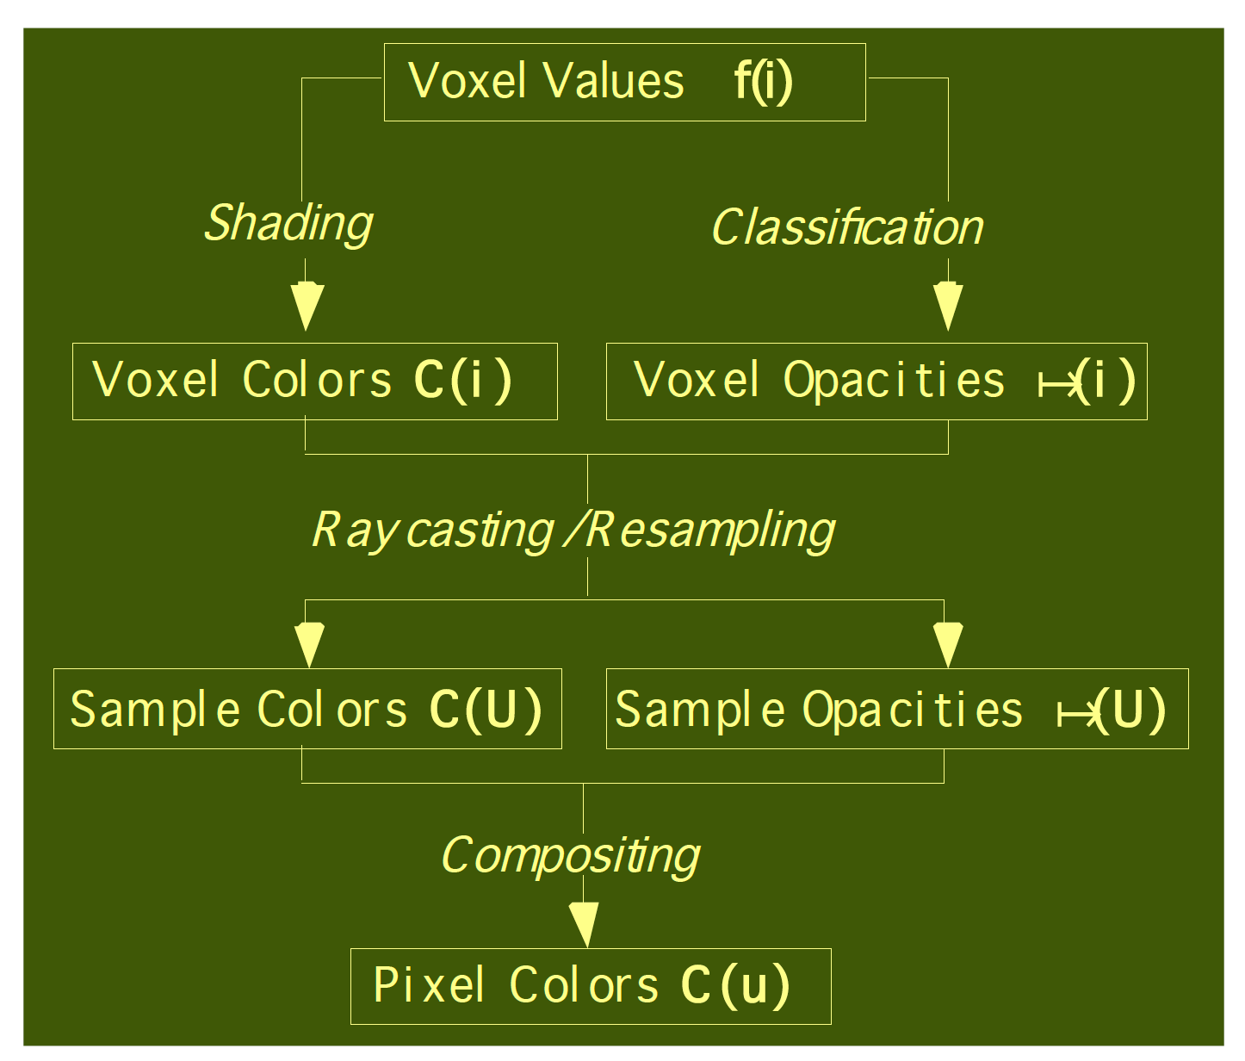
The Ray Casting Pipeline
Levoy ’88:
1. set color and alpha (using transfer function)
2. Ray casting,
interpolation
3. Compositing

Slide 15
The Ray Casting Pipeline
Levoy ’88:
1. set color and alpha (using transfer function)
2. Ray casting,
interpolation
3. Compositing

Slide 16
The Ray Casting Pipeline
Levoy ’88:
1. set color and alpha (using transfer function)
2. Ray casting,
interpolation
3. Compositing

Slide 17
The Ray Casting Pipeline
Levoy ’88:
1. set color and alpha (using transfer function)
2. Ray casting,
interpolation
3. Compositing

Slide 18
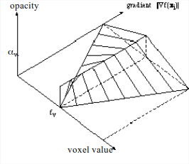
1. Shading and Classification of Voxel Values
voxel shading according to transfer function
  diffuse shading (Phong), gradient used to derive normals
  voxel classification, f(i)→α(i):
  according to gradients
  emphasizes transitions/boundaries

Slide 19
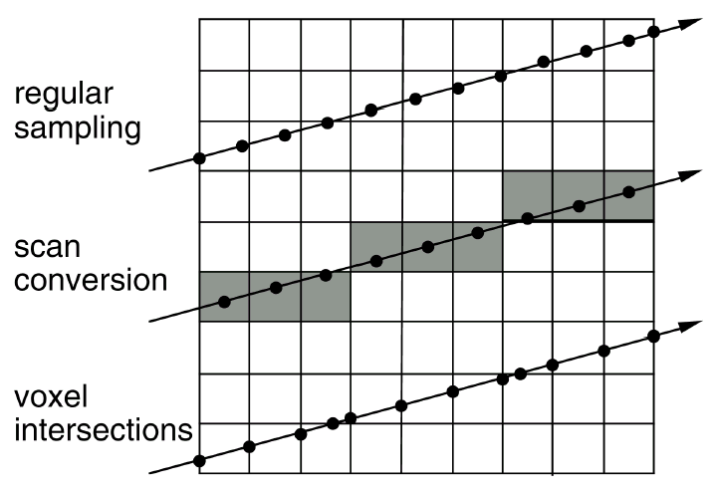
2. Ray traversal – Three Approaches

Slide 20
2. Ray traversal – Three Approaches
Need to interpolate

Slide 21
2. Ray traversal – Three Approaches
Nearest neighbor

Slide 22
2. Ray traversal – Three Approaches
Faster interpolation

Slide 23
2. Ray Traversal, Interpolation
Voxel-based vs. cell-based ray traversal
Tri-linear (interpolotion within the cell)
vs. Bi-linear (interpolation along cell edges)
Tri-linear:
  first 4* in z-Direction (Quadratic interpolation),
  then 2* in y-Direction (Linear interpolation),
  then 1* in x-Direction (value interpolation)

Slide 24
3. Compositing
Terminology
compositing: the sample-by-sample accumulation of color and opacity values along a ray as it traverses volume data. –bob
kernel: (a.k.a. convolution kernel a.k.a. convolution filter) “one or two dimensional images that are used for computing the weighted average of pixel images” –The OpenGL Programming Guide

Slide 25
3. Compositing: F2B vs. B2F
Back-to-Front (B2F):
  c = c(1- α(iΔs)) + C(iΔs)
  α = α(1 - α(iΔs)) + α(iΔs)
Front-to-Back (F2B):
  c = C(iΔs) α (iΔs) (1- α) + c
  α = α(iΔs)(1 - α) + α
c = current color
α = opacity (inverse of transparency)
i = sample index
s = sample
Δs = distance between samples
C = color at sample

Slide 26
Compositing: F2B vs. B2F
F2B: a ray can be stopped once opacity approaches 1.0 -early ray termination.
B2F: a generalization of the Painter’s algorithm –less frequently used.

Slide 27
Volumetric Ray Integration
color
opacity
1.0
object (color, opacity)

Slide 28
Raycasting
volumetric compositing
color
opacity
1.0
object (color, opacity)

Slide 29
Raycasting
Interpolation
kernel
volumetric compositing
color
opacity
1.0
object (color, opacity)

Slide 30
Raycasting
Interpolation
kernel
volumetric compositing
color c = c _{s} α_{s}(1 - α) + c
opacity α = α _{s} (1 - α) + α
1.0
object (color, opacity)

Slide 31
Raycasting
volumetric compositing
color
opacity
1.0
object (color, opacity)

Slide 32
Raycasting
volumetric compositing
color
opacity
1.0
object (color, opacity)

Slide 33
Raycasting
volumetric compositing
color
opacity
1.0
object (color, opacity)

Slide 34
Raycasting
volumetric compositing
color
opacity
1.0
object (color, opacity)

Slide 35
Raycasting
volumetric compositing
color
opacity
object (color, opacity)

Slide 36
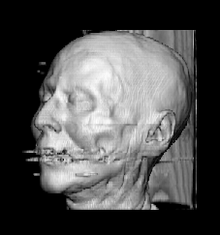
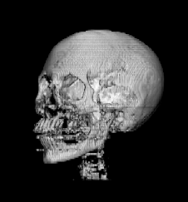
Ray Casting – Examples
Different transfer functions (quasi-surface rend.),
256 x 256 x 113 CT data

Slide 37
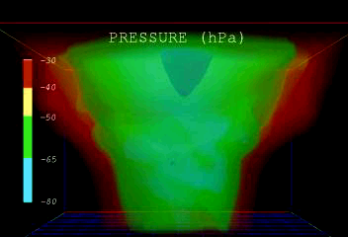
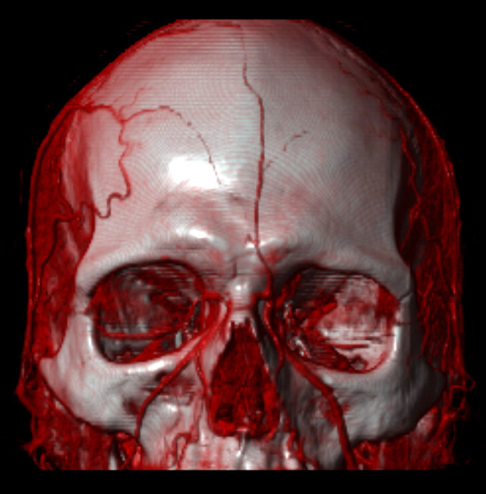
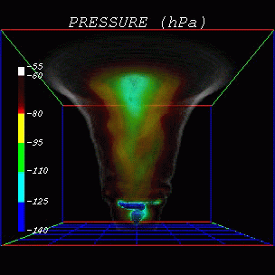
Ray Casting – More Examples
Tornado Viz:
Head data:

Slide 38
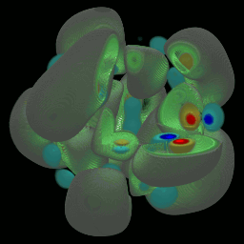
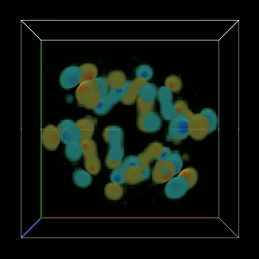
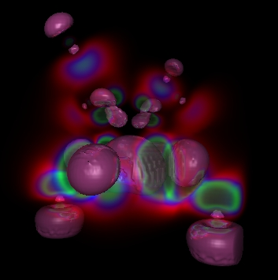
Ray Casting – more Examples
Molecular
data:

Slide 39
Literature
Paper (more details):
Marc Levoy: “Display of Surfaces from Volume Data” in IEEE Computer Graphics & Applications, Vol. 8, No. 3, June 1988
For more, see also
Data Visualization, Principles and Practice, Chapter 10 Volume Visualization, by A. Telea, AK Peters, 2008

Slide 40
Acknowledgements
We thank:
  Robert S. Laramee
  Nelson Max (LLNL), Marc Levoy (Stanford)
  Hans-Georg Pagendarm (DLR, Göttingen)
  Lloyd Treinish (IBM)
  Roberto Scopigno,
  Claudio Montani (CNR, Pisa)
  Roger Crawfis (Ohio State Univ.)
  Michael Meißner (GRIS, Tübingen)
  M. Eduard Gröller
  Torsten Möller
  Roberto Scopigno,
  Claudio Montani (CNR, Pisa)
  Hans-Georg Pagendarm (DLR, Göttingen)
  Michael Meißner (GRIS, Tübingen)
  Torsten Möller
  M. Eduard Gröller
  Helwig Hauser

