Slide 1
Transfer functions/classification
Thomas Torsney-Weir

Slide 2
Purpose
Data is just a set of scalar values
Transfer function maps raw voxel value to presentable entities
  Assign each scalar value to a color
  Exploration important --- want fast on-the-fly updates

Slide 3
Data classification (CT example)
Hounsfield units (HU) for CT data sets
Describes x-ray attenuation, i.e., density of material
12-bit CT-measurements
Range of values from -1024 to +3071 HU
Typical values:
  Air: -1024
  Fat: -100 to -20
  Water: 0
  Soft tissue such as muscle: +20 to +80
  Bone: > +500
For visualization, 12 bits are often reduced to 8 bits by windowing (loss of dynamic range)

Slide 4
Classification
Empowers user to select "structures"
Extract important features of the data set
Classification is non trivial
Histogram can be a useful hint
Often interactive manipulation of transfer functions needed

Slide 5
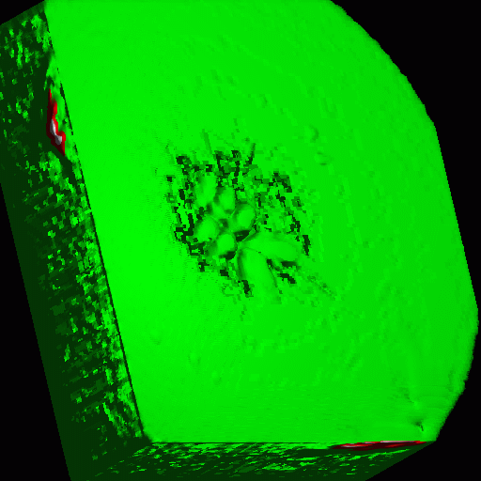
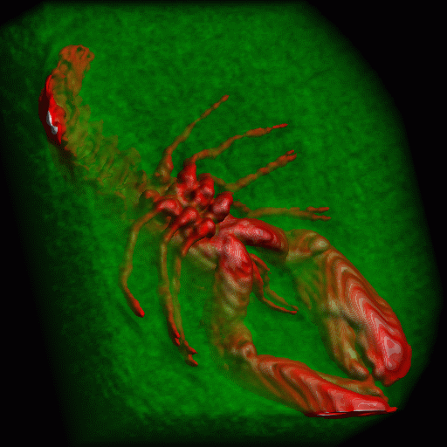
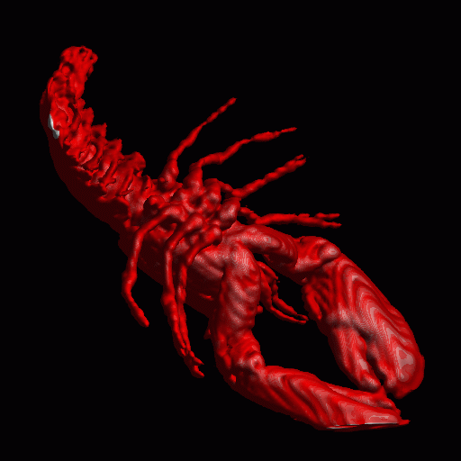
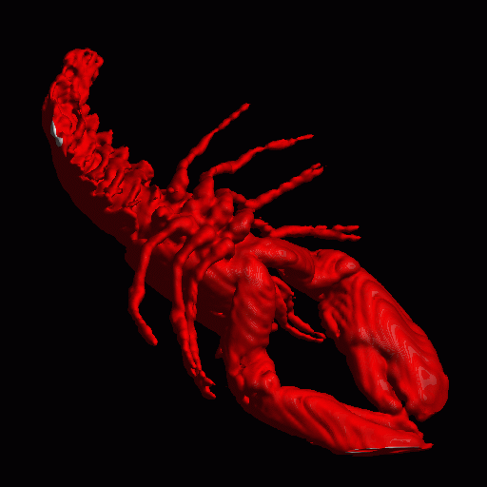
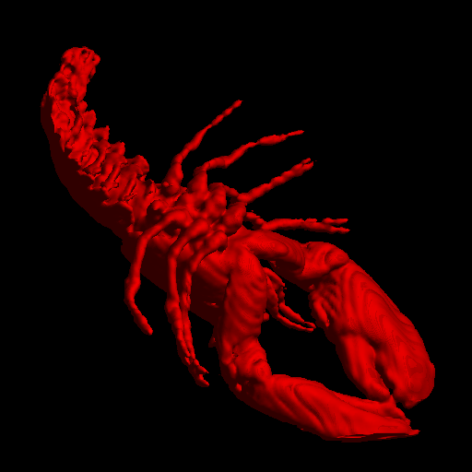

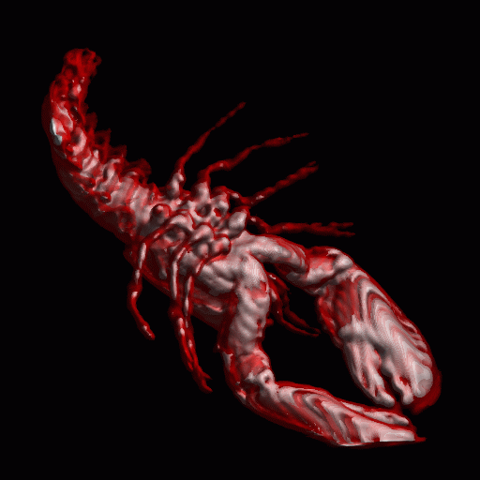
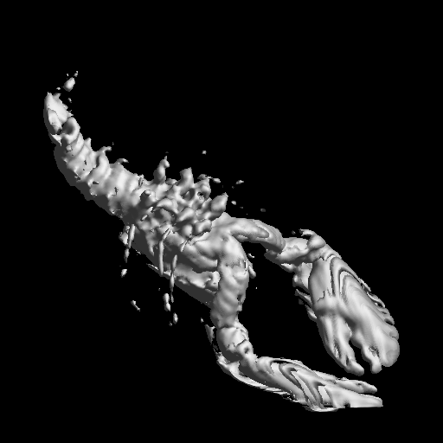
Classification

Slide 6
Transfer functions

Slide 7
Techniques
Simplest: 1D transfer function
2D transfer function
Multi-d transfer functions
Principled exploration
Segmentation

Slide 8
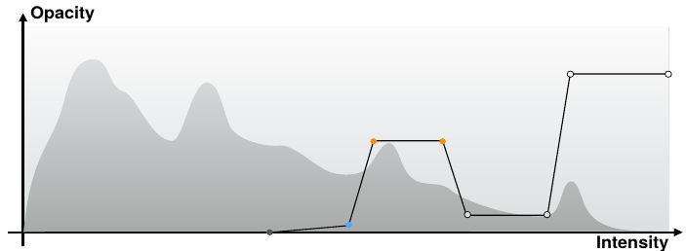
1D transfer functions
X-axis: Data values
Ljung et al., “State of the Art in Transfer Functions for Direct Volume Rendering.”

Slide 9
1D transfer functions
Y-axis: opacity
Ljung et al., “State of the Art in Transfer Functions for Direct Volume Rendering.”

Slide 10
1D transfer functions
Points: defined color/opacity
Ljung et al., “State of the Art in Transfer Functions for Direct Volume Rendering.”

Slide 11
1D transfer functions
Linear interpolation of color/opacity
Ljung et al., “State of the Art in Transfer Functions for Direct Volume Rendering.”

Slide 12
Histograms
Inuition for key values in the dataset
constituents’ distributions
histogram
air
fat
tissue
bone
CT number
%
material assignment
air
fat
tissue
bone
CT

Slide 13
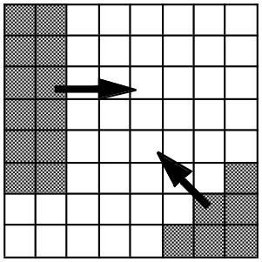
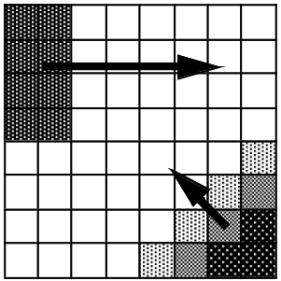
2D transfer functions
Usually interested in regions of "change"
High opacity highlights features
2D transfer function determines color/alpha based on value and gradient magnitude

Slide 14
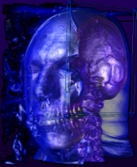
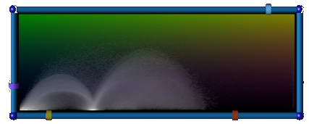
2D transfer functions
second derivative
emphasis
gradient
magnitude
boundary
surface
scalar value

Slide 15
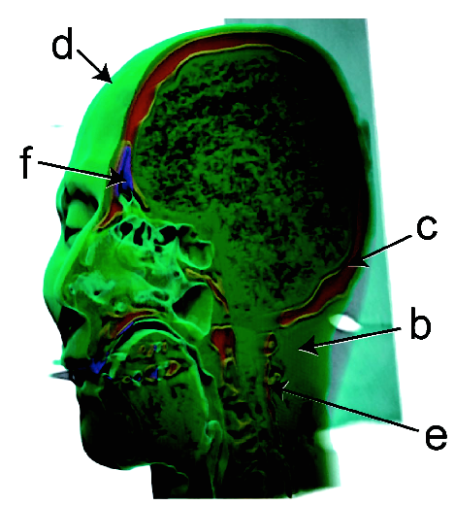
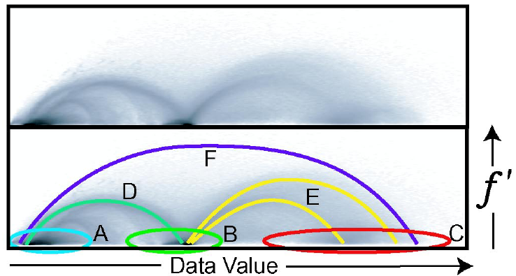
2D transfer functions

Slide 16
Multidimensional transfer functions
Problem: How to identify boundary regions/surfaces
Approach: 2D/3D/nD transfer functions, depending on
  Scalar value, magnitude of the gradient
  Second derivative along the gradient direction
  Multi-valued fields
  Derived (statistical values)

Slide 17
Principled exploration
Notes:
So, just to give you an idea of their workflow before Tuner, here’s a simplified version. This example has 2 parameters, alpha 1 and alpha 2. What they would do is pick a parameter setting they thought would work and run a segmentation and then look at the result. What they really wants to see is the continuous function underlying this. Then they can reason about the effects of the parameters.

Slide 18
Principled exploration
Lots of possibilities what to do?
Use the computer for what it’s good at
Sample offline
Visual interface to explore possibilities

Slide 19
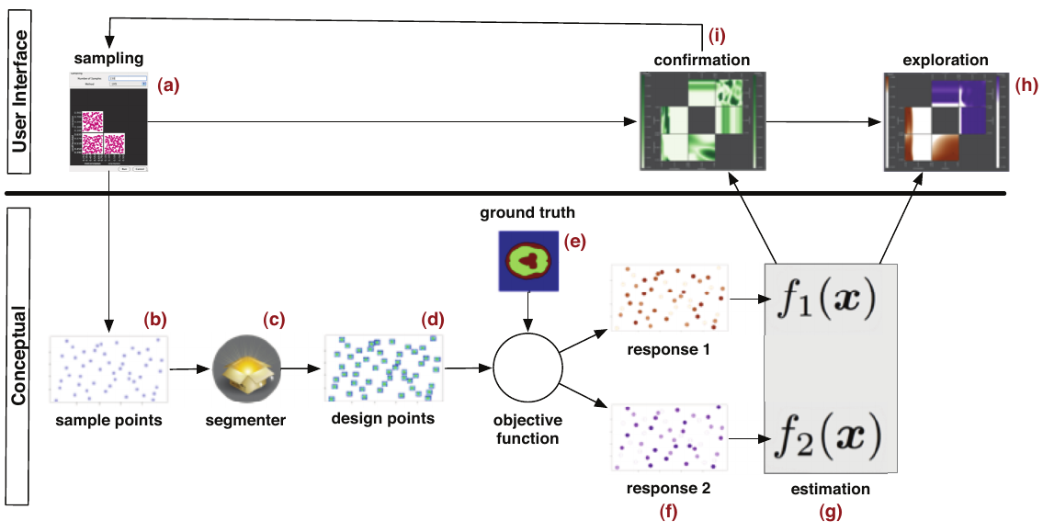
Principled exploration
Torsney-Weir et al., “Tuner: Principled Parameter Finding for Image Segmentation Algorithms Using Visual Response Surface Exploration.”

Slide 20
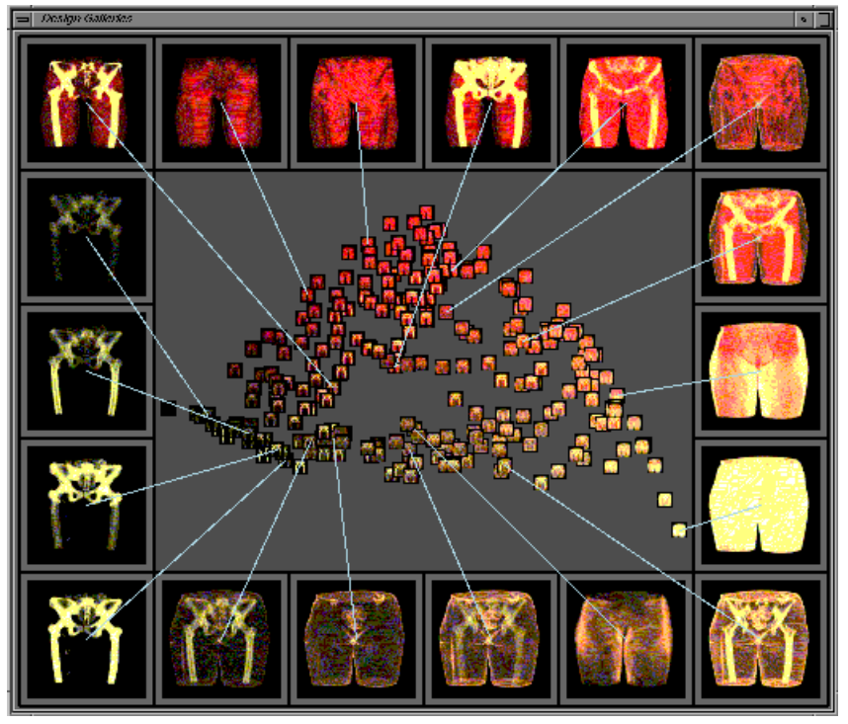
Principled exploration
Marks et al., “Design Galleries: A General Approach to Setting Parameters for Computer Graphics and Animation.”

Slide 21
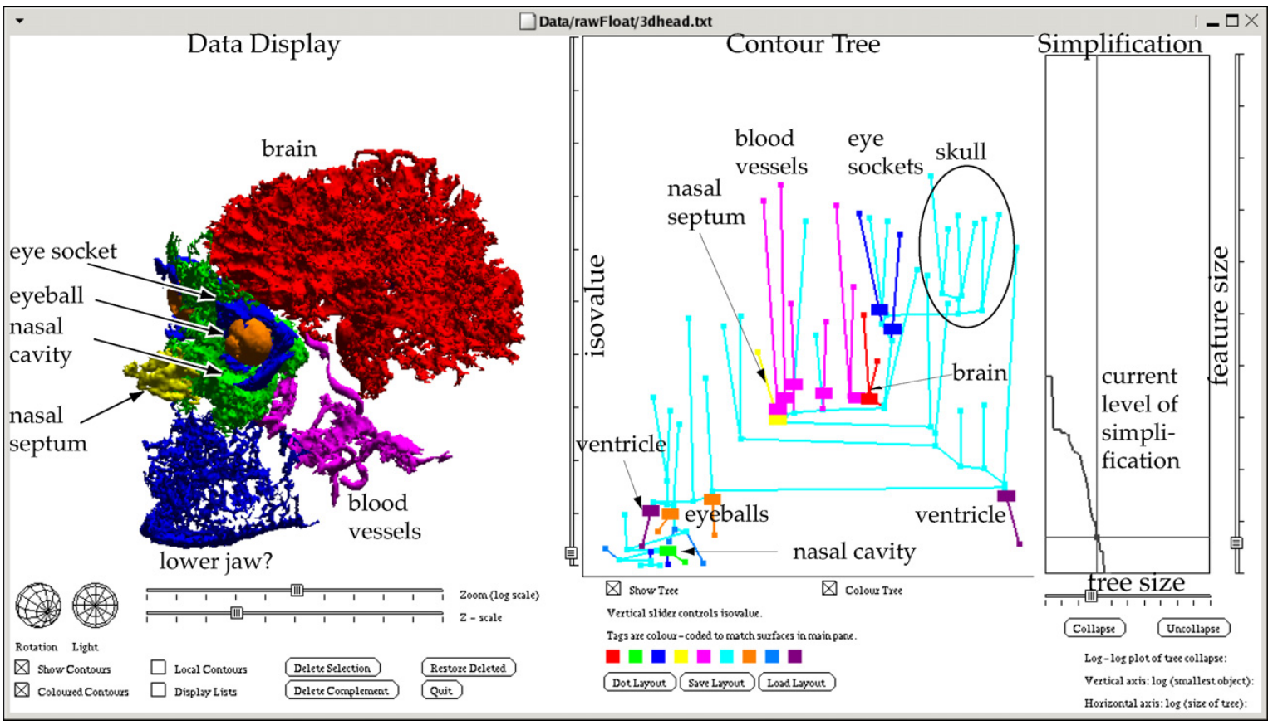
Contour trees
Hamish Carr at al., Flexible isosurfaces: Simplifying and displaying scalar topology using the contour tree, Computational Geometry, Volume 43, Issue 1, 2010,

Slide 22
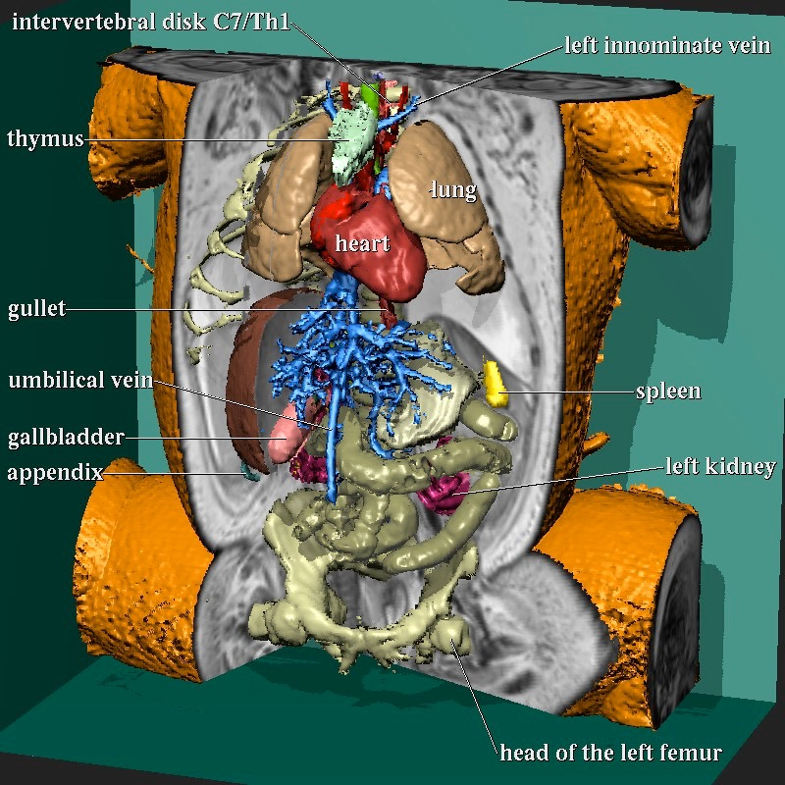
Segmentation
Different features with same value
Label each voxel with a type
Transfer function maps type to color/alpha

Slide 23
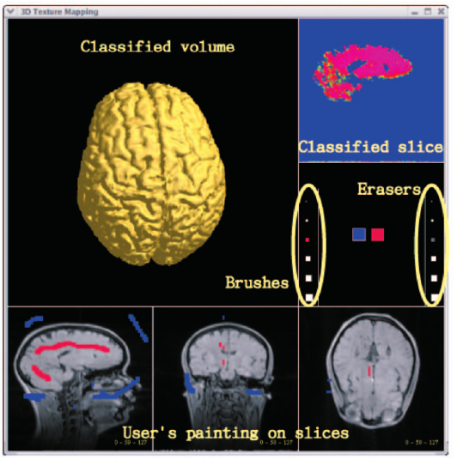
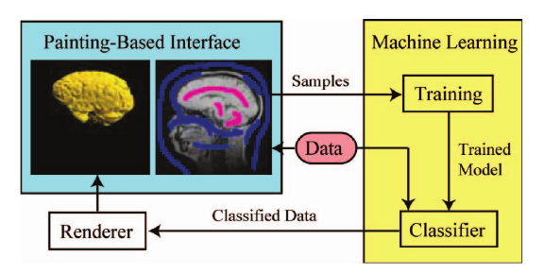
Segmentation
Tzeng, Lum, and Ma, “An Intelligent System Approach to Higher-Dimensional Classification of Volume Data.”
Notes:
For scalar data, the sample point
data includes the scalar value of the voxel, gradient
magnitude, the scalar values of its neighbors (up, down,
left, right, front, and back), the position of this voxel, and an
output value that indicates membership into a material
class. For color data, the sample point data includes the R,
G, B values of the voxel, values of its neighbors, and
position.

Slide 24
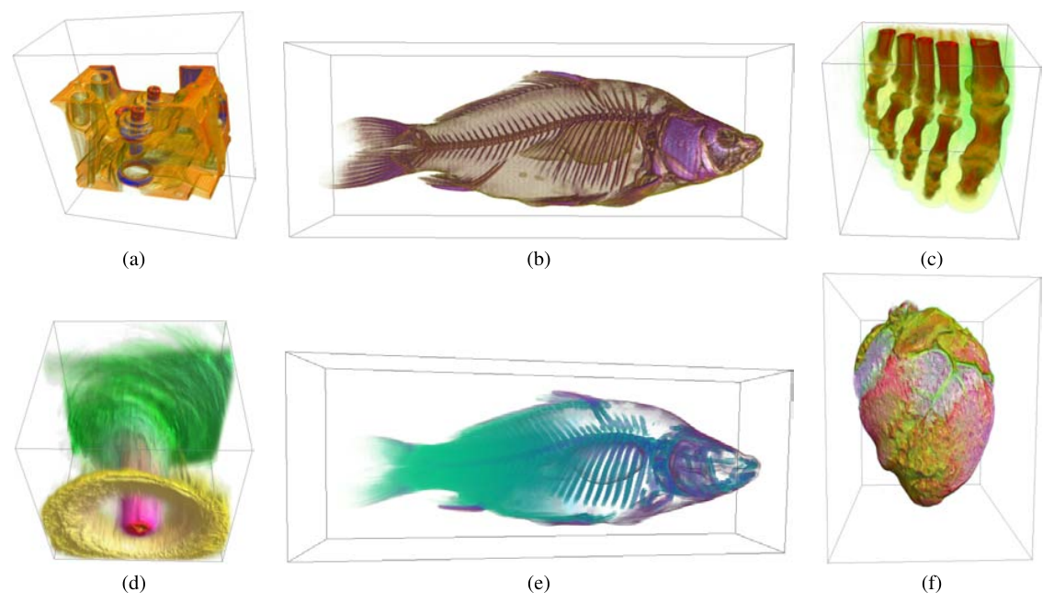
Unsupervised segmentation
Pinto and Freitas, Design of Multi-Dimensional Transfer Functions Using Dimensional Reduction.
Notes:
Figure 3: Visualizations obtained using Kohonen maps — (a) engine data set and (b) carp data set, both using scalar and
derivative values (gradient magnitude and directional second derivative) as voxel signature; (c) foot data set, using statistical
signatures (mean scalar value, standard deviation, cubic root of the third-order statistical moment); and (e) carp data set,
using the normalized z coordinate of the voxels and same three statistical signatures, thus composing a four-dimensional voxel
signature (z axis is horizontally represented) — and Spherical maps — (d) hurricane data set at the 24th time step, using wind
speed, pressure and temperature as voxel signature; and (f) sheep heart data set, using the same statistical signatures as (c).

Slide 25
Conclusion

Slide 26
Summary
Histograms give intuition about interesting values
Gradient in data value to find transitions
Transfer functions require exploration
Segmentation is powerful but more investigation needed

Slide 27
Further reading
Survey paper
Ljung, Patric, Jens Krüger, Eduard Groller, Markus Hadwiger, Charles D. Hansen, and Anders Ynnerman. “State of the Art in Transfer Functions for Direct Volume Rendering.” Computer Graphics Forum 35, no. 3 (2016): 669–91. https://doi.org/10.1111/cgf.12934.
Pinto, Francisco de Moura, and Carla M. D. S. Freitas. Design of Multi-Dimensional Transfer Functions Using Dimensional Reduction. The Eurographics Association, 2007. http://dx.doi.org/10.2312/VisSym/EuroVis07/131-138.
Marks, Joe, Brad Andalman, Paul A. Beardsley, William Freeman, Sarah Gibson, Jessica Hodgins, Thomas Kang, et al. “Design Galleries: A General Approach to Setting Parameters for Computer Graphics and Animation.” In Proceedings of SIGGRAPH 97, 389–400. Annual Conference Series. ACM, 1997. https://doi.org/10.1145/258734.258887.
Torsney-Weir, Thomas, Ahmed Saad, Torsten Möller, Britta Weber, Hans-Christian Hege, Jean-Marc Verbavatz, and Steven Bergner. “Tuner: Principled Parameter Finding for Image Segmentation Algorithms Using Visual Response Surface Exploration.” IEEE Transactions on Visualization and Computer Graphics 17, no. 12 (November 2011): 1892–1901.
Carr, Hamish, Jack Snoeyink, and Michiel van de Panne. “Flexible Isosurfaces: Simplifying and Displaying Scalar Topology Using the Contour Tree.” Computational Geometry, Special Issue on the 14th Annual Fall Workshop, 43, no. 1 (January 1, 2010): 42–58. https://doi.org/10.1016/j.comgeo.2006.05.009.
Tzeng, F.-Y., E.B. Lum, and K.-L. Ma. “An Intelligent System Approach to Higher-Dimensional Classification of Volume Data.” IEEE Transactions on Visualization and Computer Graphics 11, no. 3 (May 2005): 273–84. https://doi.org/10.1109/TVCG.2005.38.

