Slide 1
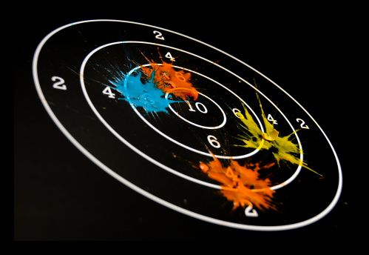
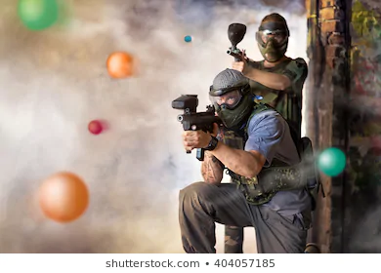
Visualization, Lecture
Volume Visualization:
Splatting

Slide 2
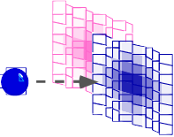
Splatting
Instead of asking which data samples contribute to a pixel value, ask, to which pixel values does a data sample contribute?
  Ray casting: pixel value computed from multiple data samples
  Splatting: multiple pixel values (partially) computed from a single data sample
Overview:
  object-order (FOR each voxel DO …)
  high-quality
  Needs to be parallelized
Idea: contribute every voxel to the image
  projection from voxel: splat
  composite in image space

Slide 3
Why?
Marching cubes and DVR need grids
  Marching cubes for isosurfacing
  DVR for transfer function
Some data are point clouds
Generating the mesh can be difficult
Storing the mesh can be costly

Slide 4
Splatting and Reconstruction – Premise
Premise:
  before measurement: original distribution ϕ: R³→R
1
0
0
1
2
3
4
5

Slide 5
Splatting and Reconstruction – Premise
Premise:
  before measurement: original distribution ϕ: R³→R
  measurement = sampling: samples
  f = ϕ ⋅ comb_{3D}
1
0
0
1
2
3
4
5

Slide 6
Splatting and Reconstruction – Basics
Basic concepts, idea:
  before measurement: original distribution ϕ: R³→R
  measurement = sampling: samples f = ϕ ⋅ comb_{3D}
  intermediate goal: 3D-Reconstruction g = f ∗ h
1
0
0
1
2
3
4
5

Slide 7
Splatting and Reconstruction – Basics
Basic concepts, idea:
  before measurement: original distribution ϕ: R³→R
  measurement = sampling: samples f = ϕ ⋅ comb_{3D}
  intermediate goal: 3D-Reconstruction g = f ∗ h
1
0
0
1
2
3
4
5

Slide 8
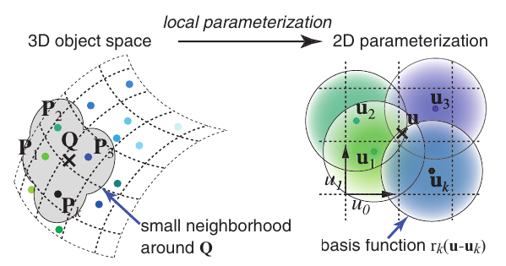
Splatting and Reconstruction – Basics
Basic concepts, idea:
  intermediate goal: 3D-Reconstruction g = f ∗ h
  h is the kernel or basis function
Zwicker, Matthias, Hanspeter Pfister, Jeroen van Baar, and Markus Gross. “Surface Splatting.” In Proceedings of the 28th Annual Conference on Computer Graphics and Interactive Techniques, 371–378. SIGGRAPH ’01. New York, NY, USA: Association for Computing Machinery, 2001. https://doi.org/10.1145/383259.383300.
Notes:
Basis function usually holds color information (post-transfer function)

Slide 9
Splatting and Reconstruction – Basics
Basic concepts, idea:
  intermediate goal: 3D-Reconstruction g = f ∗ h
  h is the kernel or basis function
  Computes the function (for each pixel)
Zwicker, Matthias, Hanspeter Pfister, Jeroen van Baar, and Markus Gross. “Surface Splatting.” In Proceedings of the 28th Annual Conference on Computer Graphics and Interactive Techniques, 371–378. SIGGRAPH ’01. New York, NY, USA: Association for Computing Machinery, 2001. https://doi.org/10.1145/383259.383300.

Slide 10
Splatting and Reconstruction – Basics
Basic concepts, idea:
  intermediate goal: 3D-Reconstruction g = f ∗ h
  h is the kernel or basis function
  Computes the function (for each pixel)
Final pixel value
Zwicker, Matthias, Hanspeter Pfister, Jeroen van Baar, and Markus Gross. “Surface Splatting.” In Proceedings of the 28th Annual Conference on Computer Graphics and Interactive Techniques, 371–378. SIGGRAPH ’01. New York, NY, USA: Association for Computing Machinery, 2001. https://doi.org/10.1145/383259.383300.

Slide 11
Splatting and Reconstruction – Basics
Basic concepts, idea:
  intermediate goal: 3D-Reconstruction g = f ∗ h
  h is the kernel or basis function
  Computes the function (for each pixel)
Number of basis functions
(number of samples)
Zwicker, Matthias, Hanspeter Pfister, Jeroen van Baar, and Markus Gross. “Surface Splatting.” In Proceedings of the 28th Annual Conference on Computer Graphics and Interactive Techniques, 371–378. SIGGRAPH ’01. New York, NY, USA: Association for Computing Machinery, 2001. https://doi.org/10.1145/383259.383300.

Slide 12
Splatting and Reconstruction – Basics
Basic concepts, idea:
  intermediate goal: 3D-Reconstruction g = f ∗ h
  h is the kernel or basis function
  Computes the function (for each pixel)
Effect of sample on pixel
Zwicker, Matthias, Hanspeter Pfister, Jeroen van Baar, and Markus Gross. “Surface Splatting.” In Proceedings of the 28th Annual Conference on Computer Graphics and Interactive Techniques, 371–378. SIGGRAPH ’01. New York, NY, USA: Association for Computing Machinery, 2001. https://doi.org/10.1145/383259.383300.

Slide 13
Splatting
Project each sample (voxel) from the volume into the image plane
splat
image

Slide 14
Splatting

Slide 15
Splatting
Discretization via 2D splats
from the original 3D kernel
The 3D rotationally symmetric filter kernel is integrated to produce a 2D filter kernel
3D filter kernel
Integrate along one dimension
2D filter kernel

Slide 16
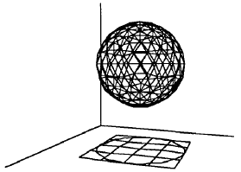
Splatting
Draw each voxel as a cloud of points (footprint) that spreads the voxel contribution across multiple pixels
Footprint: splatted (integrated) kernel
Approximate the 3D kernel h(x,y,z) extent by a sphere

Slide 17
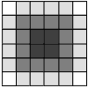




Splatting
Larger footprint increases blurring and used for high pixel-to-voxel ratio
Footprint geometry
  Orthographic projection: footprint is independent of the view point
  Perspective projection: footprint is elliptical
Pre-integration of footprint
For perspective projection: additional computation of the orientation of the ellipse

Slide 18
Splatting
Volume = field of 3D interpolation kernels
  One kernel at each grid voxel
Each kernel leaves a 2D footprint on screen
Weighted footprints accumulate into image
voxel kernels
screen footprints = splats
screen

Slide 19
Splatting
Volume = field of 3D interpolation kernels
  One kernel at each grid voxel
Each kernel leaves a 2D footprint on screen
Weighted footprints accumulate into image
voxel kernels
screen footprints = splats
screen

Slide 20
Splatting
Volume = field of 3D interpolation kernels
  One kernel at each grid voxel
Each kernel leaves a 2D footprint on screen
Weighted footprints accumulate into image
voxel kernels
screen footprints = splats
screen

Slide 21
Splatting
Voxel kernels are added within sheets
Sheets are composited front-to-back
Sheets = volume slices most perpendicular to the image plane
(analogously to stack of slices)
volume slices
volume slices
z
y
x
image plane at 30°
image plane at 70°

Slide 22
Splatting
Core algorithm for splatting
Volume
  Represented by voxels
  Slicing
Image plane:
  Sheet buffer
  Compositing buffer
volume slices
sheet buffer
image plane
compositing buffer

Slide 23
Splatting
Add voxel kernels within first sheet
volume slices
sheet buffer
image plane
compositing buffer

Slide 24
Splatting
Transfer to compositing buffer
volume slices
sheet buffer
image plane
compositing buffer

Slide 25
Splatting
Add voxel kernels within second sheet
volume slices
sheet buffer
image plane
compositing buffer

Slide 26
Splatting
Composite sheet with compositing buffer
volume slices
sheet buffer
image plane
compositing buffer

Slide 27
Splatting
Add voxel kernels within third sheet
volume slices
sheet buffer
image plane
compositing buffer

Slide 28
Splatting
Composite sheet with compositing buffer
volume slices
sheet buffer
image plane
compositing buffer

Slide 29
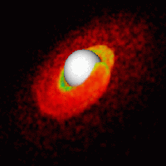
Splatting
Simple extension to volume data without grids
  Scattered data with kernels
  Example: SPH (smooth particle hydrodynamics)
  Needs sorting of sample points

Slide 30
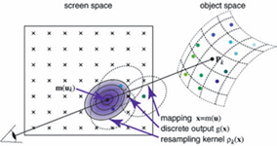
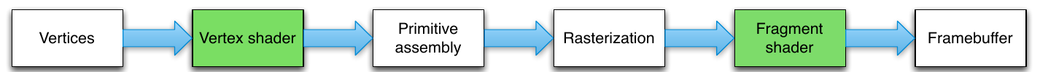
Acceleration
Splat hits region?
GPU pipeline

Slide 31
Acceleration
Filter influential samples
Render splat
GPU pipeline

Slide 32
Splatting – Conclusion
Pros:
  high-quality
  easy to parallelize
  Works for unstructured data
  perspective projection possible
  adaptive rendering possible
Cons:
  DVR is usually faster
  yields somewhat blurry images (in original)

Slide 33
Splatting vs Ray Casting
Splatting:
Object-order: FOR each voxel (x,y,z) DO
  sample volume at (x,y,z) using filter kernel
  project reconstruction result to x-y image plane (leaving footprint)
FOR each pixel (x,y) DO:
    composite (color, opacity) result of all footprints
Ray Casting:
Image-order: FOR each pixel (x,y) DO
  cast ray into volume
  FOR each sample point along ray (x,y,z)
    Sample volume at (x,y,z) using filter kernel
    composite (color, opacity) in image space at pixel (x,y)

Slide 34
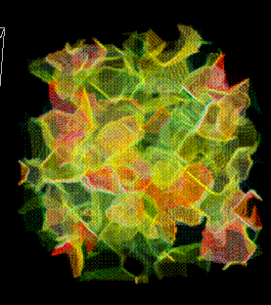
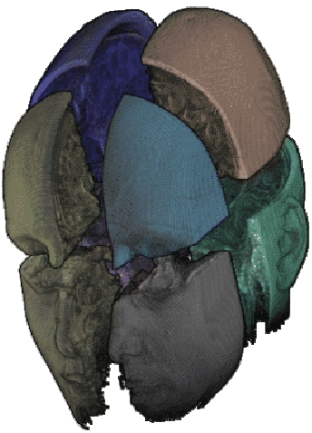
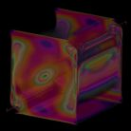
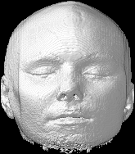
Splatting – Images

Slide 35
Further Reading
For more details, please see,
Data Visualization, Principles and Practice, Chapter 9, Image Visualization, by A Telea, AK Peters 2008
And
Footprint Evaluation for Volume Rendering, by Lee Westover, in ACM Computer Graphics Volume 24, Number 4, August 1990, pages, 367-376

Slide 36
Acknowledgements
We thank the following people for the lecture material:
  Robert S. Laramee
  Roberto Scopigno, Claudio Montani
  Peggy Li
  Roger Crawfis
  Hanspeter Pfister
  Philippe Lacroute
  Lukas Mroz
  Meister E. Gröller
  Torsten Möller
  Helwig Hauser
  Daniel Weiskopf

