Slide 1
Glyphs and arrows
Thomas Torsney-Weir

Slide 2
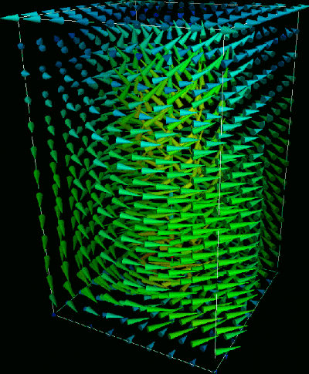
What is direct flow visualization?
Direct flow visualization : encode the flow information at each voxel
Techniques: Arrows and glyphs
Mentally integrate arrows to see flow
Human as feature detector
Frequently used

Slide 3
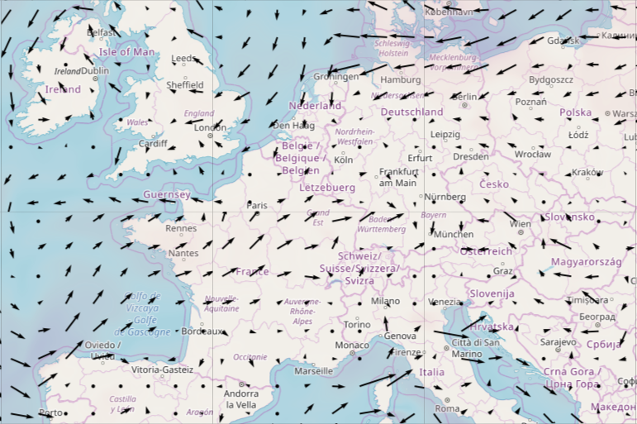
Tasks
Visualizing local features of dataset
Vector itself
Vorticity
Addl data: temperature, pressure, etc.

Slide 4
Technique: Arrows

Slide 5
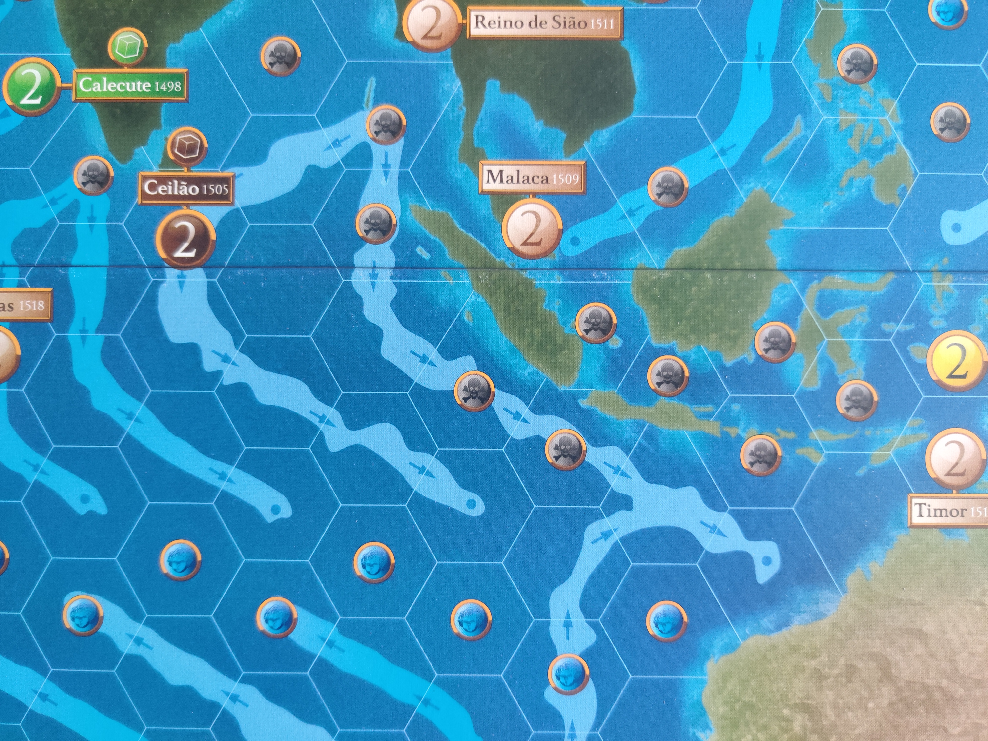
Arrows
Easy to understand encoding
2D: works well
3D: numerous issues
Poor result if magnitude or velocity changes rapidly
Time component missing

Slide 6
Arrows in 2D
Very commonly used
Angle = direction
Magnitude: length vs color

Slide 7
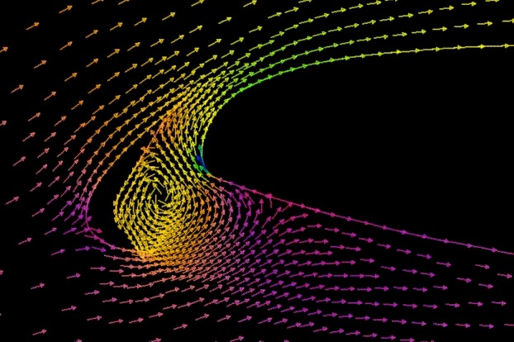
Length occlusion
Arrows can interfere with each other

Slide 8
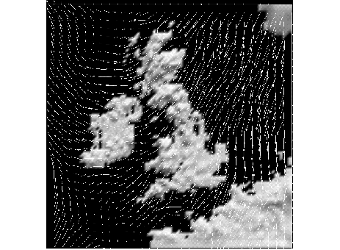
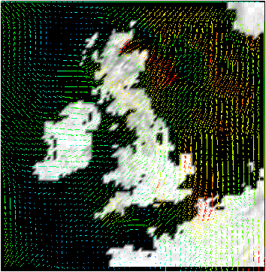
Scaled vs color coded

Slide 9
Arrows in 3D
Issues:
  Occlusion
  Perspecive ambiguity
Solution: show subset

Slide 10
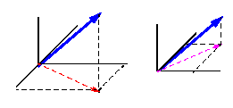
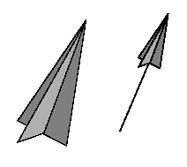
Perspective ambiguity
Perspective shortening
1D objects generally difficult to grasp in 3D
3D arrows help slightly

Slide 11
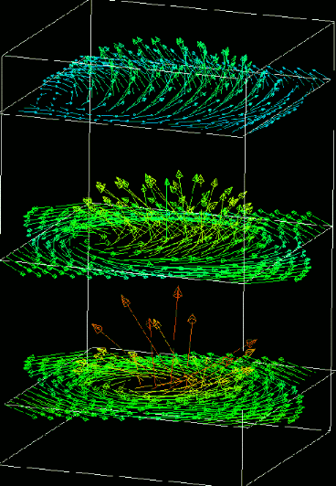
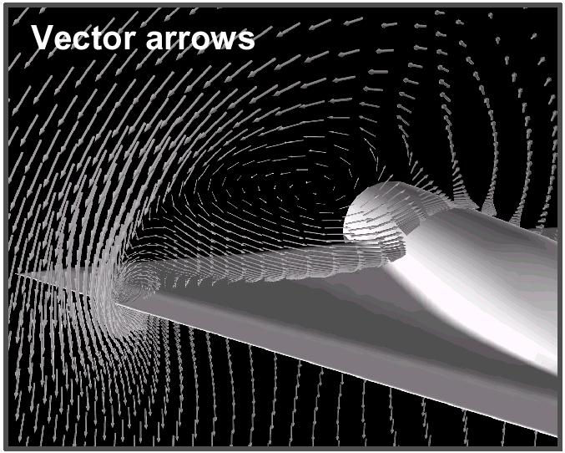
Addressing clutter
Arrows in layers

Slide 12
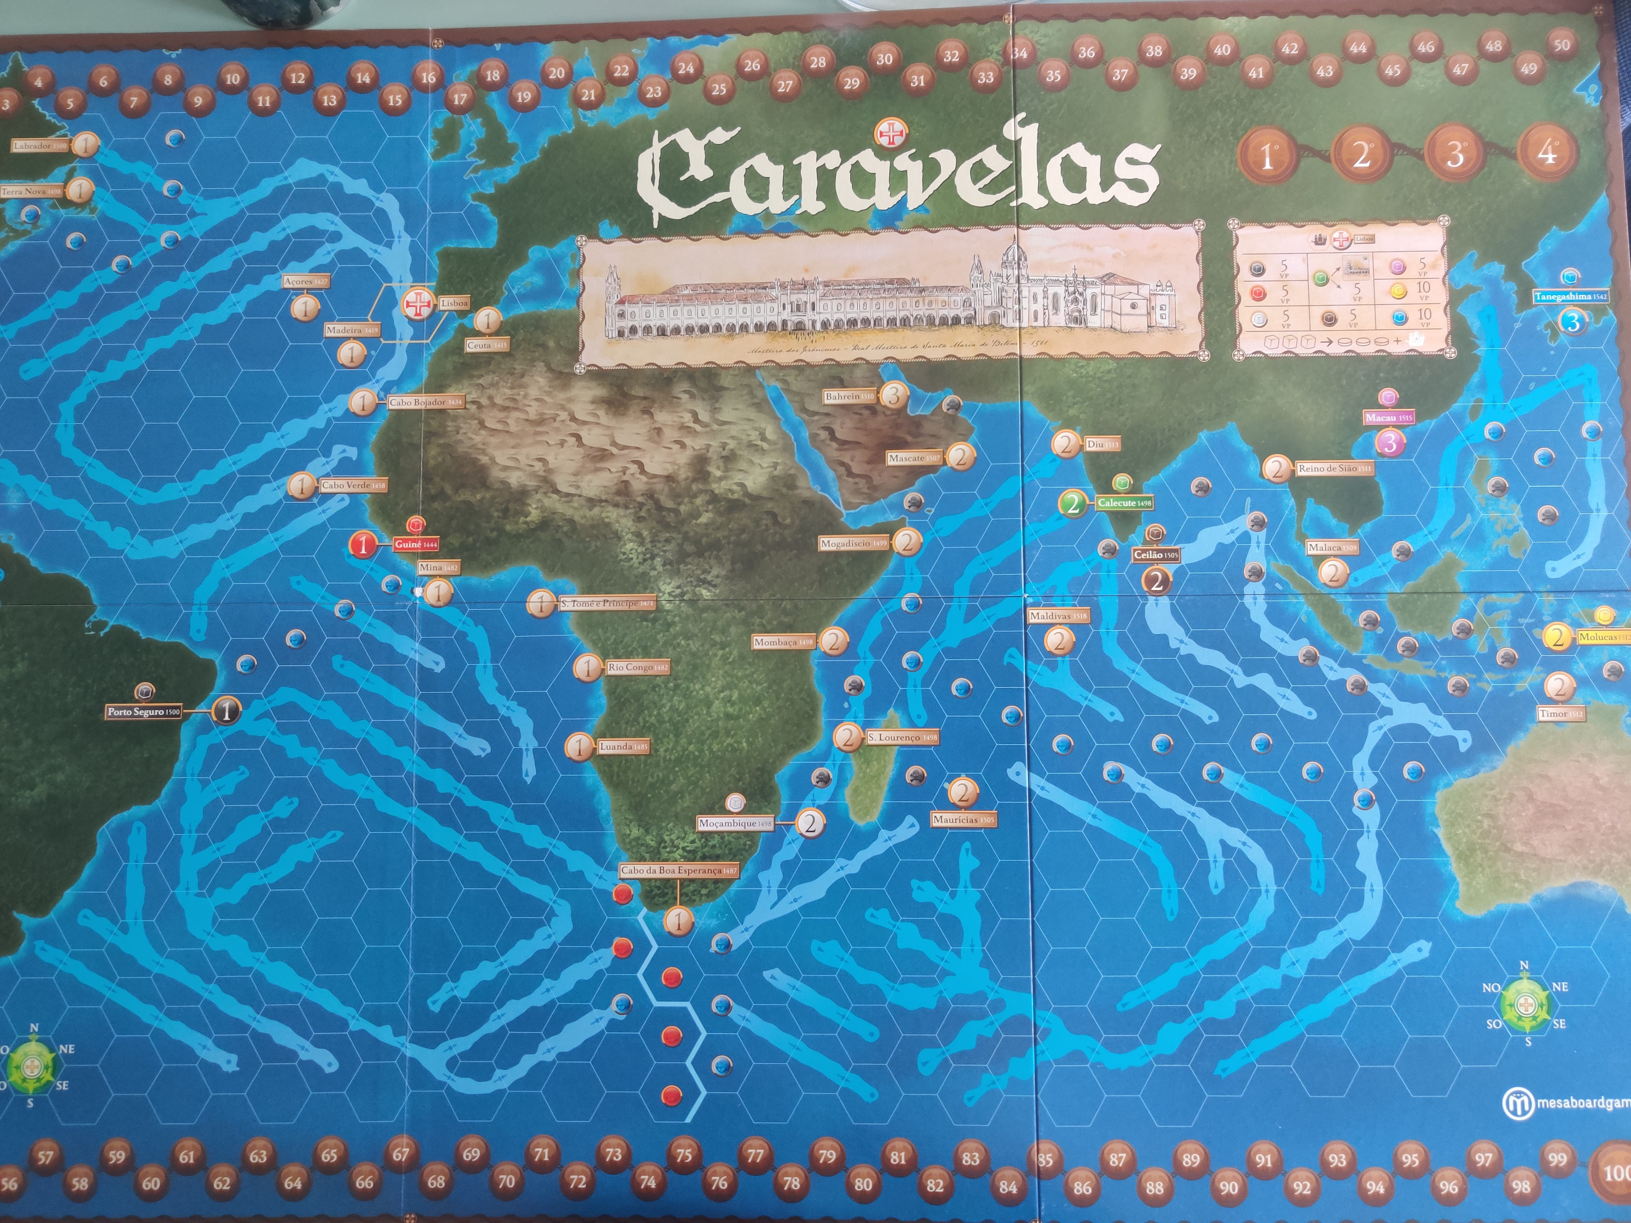
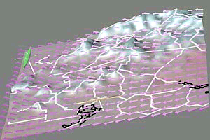
Addressing clutter
Combine with other techniques

Slide 13
Technique: glyphs

Slide 14
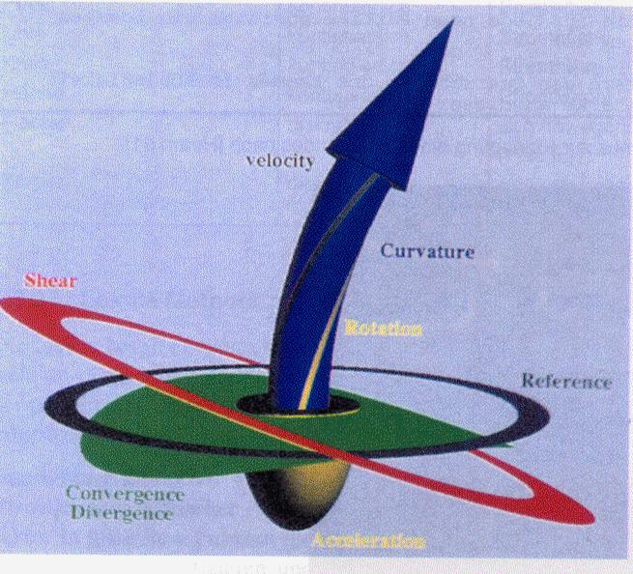
Glyphs
More information per voxel
Often modifications of familiar arrow shape
Addl features:
  Curvature
  Rotation
  Shear
  Divergence
  Acceleration
  etc

Slide 15
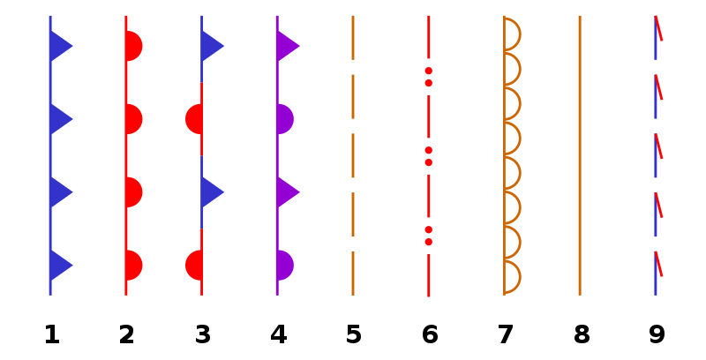
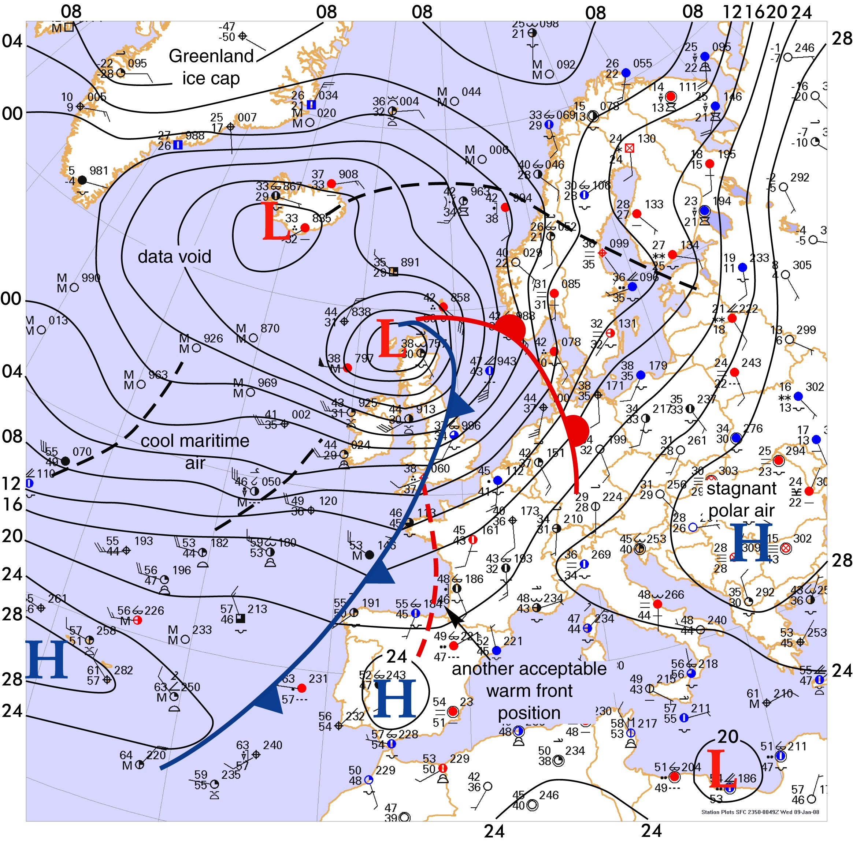
Weather maps
cold front
warm front
stationary front
occluded front
surface trough
squall line
dry line
tropical wave
trowal

Slide 16
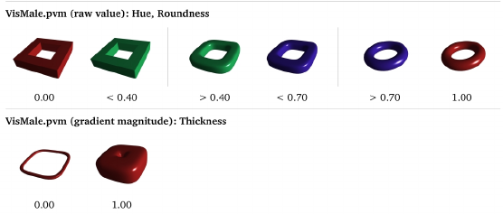
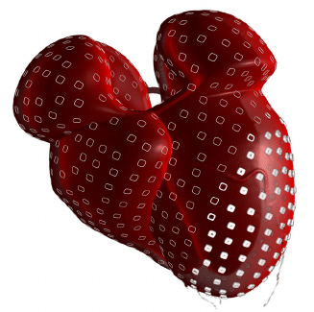
Medical applications
Hue = value
Thickness = gradient magnitude
Ropinski, Timo, Michael Specht, Jennis Meyer-Spradow, Klaus Hinrichs, and Bernhard Preim. “Surface Glyphs for Visualizing Multimodal Volume Data,” 3--12, 2007.

Slide 17

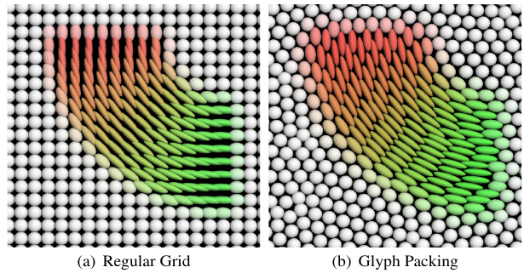
Physics
Kindlmann, Gordon, and Carl-fredrik Westin. “Diffusion Tensor Visualization with Glyph Packing.” IEEE Transactions on Visualization and Computer Graphics 12, no. 5 (September 2006): 1329–36. https://doi.org/10.1109/TVCG.2006.134.

Slide 18
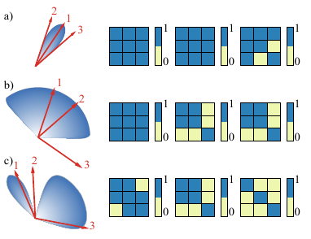
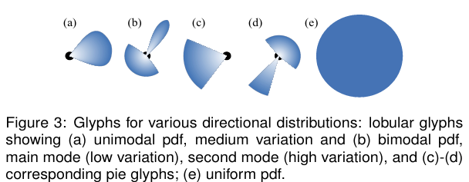
Flow ensembles
Jarema, Mihaela, Ismail Demir, Johannes Kehrer, and Rüdiger Westermann. “Comparative Visual Analysis of Vector Field Ensembles.” In 2015 IEEE Conference on Visual Analytics Science and Technology (VAST), 81–88, 2015. https://doi.org/10.1109/VAST.2015.7347634.

Slide 19
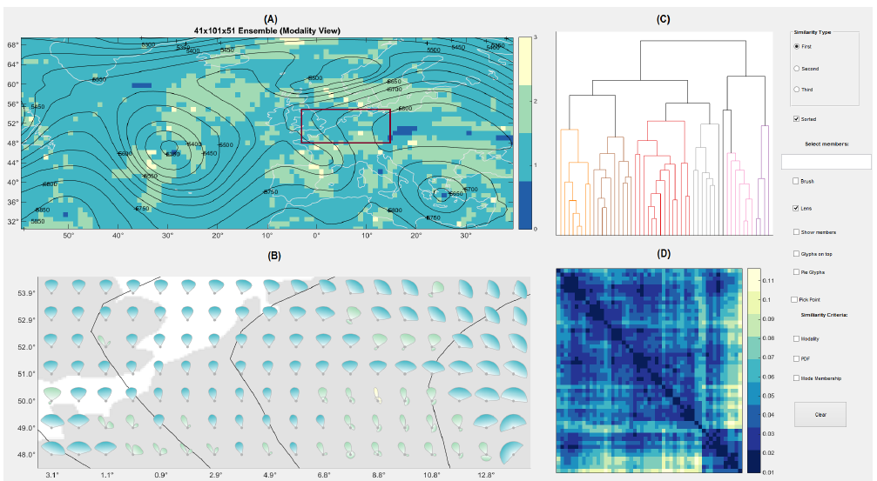
Flow ensembles

Slide 20
Conclusion

Slide 21
Summary
Direct flow visualization : encode the flow information at each voxel
Arrows in 2D: simple and effective
Arrows in 3D: need to handle occulsion
Glyphs:

Slide 22
Acknowledgements
Robert S. Laramee
Torsten Möller
Bruno Jobard
Malte Zöckler
Georg Fischel
Frits H. Post
Roger Crawfis
Helwig Hauser

Slide 23
Additional reading
B. Jobard & W. Lefer: “Creating Evenly-Spaced Streamlines of Arbitrary Density” in Proceedings of 8th Eurographics Workshop on Visualization in Scientific Computing, April 1997, pp. 45-55
Data Visualization: Principles and Practice, Chapter 6: Vector Visualization by A. Telea, AK Peters 2008
Ropinski, Timo, Michael Specht, Jennis Meyer-Spradow, Klaus Hinrichs, and Bernhard Preim. “Surface Glyphs for Visualizing Multimodal Volume Data,” 3--12, 2007.
Kindlmann, Gordon, and Carl-fredrik Westin. “Diffusion Tensor Visualization with Glyph Packing.” IEEE Transactions on Visualization and Computer Graphics 12, no. 5 (September 2006): 1329–36. https://doi.org/10.1109/TVCG.2006.134.
Jarema, Mihaela, Ismail Demir, Johannes Kehrer, and Rüdiger Westermann. “Comparative Visual Analysis of Vector Field Ensembles.” In 2015 IEEE Conference on Visual Analytics Science and Technology (VAST), 81–88, 2015. https://doi.org/10.1109/VAST.2015.7347634.

