Slide 1
Integration
Thomas Torsney-Weir

Slide 2
Streamline
Streamline: a curve that is everywhere tangent to the flow

Slide 3
Streamline
Streamline: a curve that is everywhere tangent to the flow

Slide 4
Streamline
Streamline: a curve that is everywhere tangent to the flow

Slide 5
Streamline creation

Slide 6
Streamline creation
2
1
0
0
1
2
3
4

Slide 7
Streamline creation
2
1
0
0
1
2
3
4

Slide 8
Streamline creation
2
1
0
0
1
2
3
4

Slide 9
Streamline creation
2
1
0
0
1
2
3
4

Slide 10
Streamline creation
2
1
0
0
1
2
3
4

Slide 11
Streamline creation
2
1
0
0
1
2
3
4

Slide 12
Streamline creation
2
1
0
0
1
2
3
4

Slide 13
Mathematics
Position at time step i
Vector at position
2
1
0
0
1
2
3
4

Slide 14
Position at time 0
Position at time step i
Vector at position
2
1
0
0
1
2
3
4

Slide 15
Position at time 1
Position at time step i
Vector at position
2
1
0
0
1
2
3
4

Slide 16
Position at time 2
Position at time step i
Vector at position
2
1
0
0
1
2
3
4

Slide 17
Position at time i
2
1
0
0
1
2
3
4

Slide 18
Position at time i
2
1
0
0
1
2
3
4

Slide 19
How does this make a line?
A line is just this at every i from 0 to T (the end)
2
1
0
0
1
2
3
4

Slide 20
Discrete to continuous
Computers are discrete
Continous version is the correct version of the streamline
Euler integration
Discrete:
Fixed, small, number
Continuous:
Infinitesimally small

Slide 21
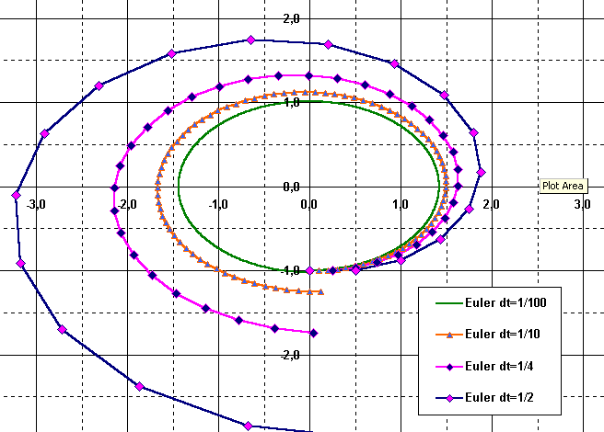
Issues with Euler

Slide 22
Integration methods
Analytical
Euler
Runge-Kutte

Slide 23
Runge-Kutte to the rescue!
Actually a family of methods
Developed around 1900
Idea is to cut the curve arc shorter
RK-2 and RK-4 most popular

Slide 24
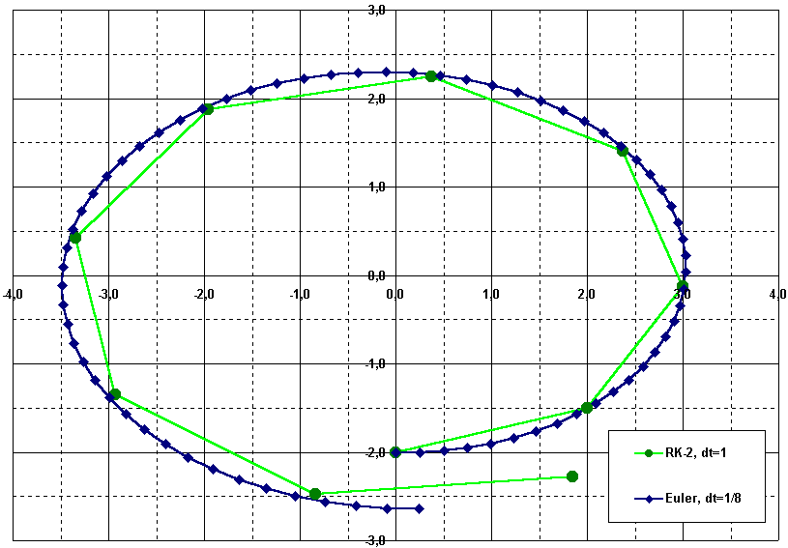
Runge-Kutte to the rescue!
9 steps (RK-2) vs 72 (Euler)

Slide 25
Runge-Kutte 2
Do half an Euler step
Evaluate the flow vector there
Use it at the original point
Average the 2 vectors

Slide 26
Runge-Kutte 2
Seed point s₀ = ( 0 , -2 )^{T};
current flow vector v(s₀) = ( 2 , 0 )^{T};
preview vector v(s₀+v(s₀)·du / 2) = (2,0.5)^{T};
du = 1
2
1
0
0
1
2
3
4

Slide 27
Runge-Kutte 2
Seed point s₁ = ( 2 , -1.5 )^{T};
current flow vector v(s₁) = ( 1.5 , 1 )^{T};
preview vector v(s₁+v(s₁)·du/ 2) = (1,1.4)^{T};
du = 1
2
1
0
0
1
2
3
4

Slide 28
Runge-Kutte 4
Even better: fourth order RK:
  four vectors a, b, c, d
  one step is a convex combination:
  s_{i+1} = s_{i} + (a + 2·b + 2·c + d)/6
  vectors:
      a = du·v(s_{i}) … original vector
      b = du·v(s_{i}+a/2) … RK-2 vector
      c = du·v(s_{i}+b/2) … use RK-2 …
      d = du·v(s_{i}+c) … and again

Slide 29
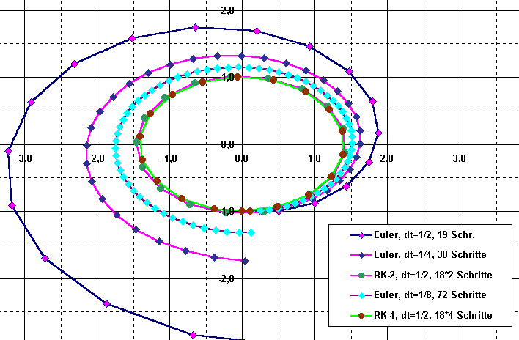
RK-4 only for complex flows

Slide 30
Unsteady flow visualization
Streamline: a curve that is everywhere tangent to the flow (release 1 massless particle)
Pathline: a curve that is everywhere tangent to an unsteady flow field (release 1 massless particle)
Streakline: a curve traced by the continues release of particles in unsteady flow from the same position in space (release infinitely many massless particles)
Pick an s₀
Find all pathlines that pass through that point
Get the end points of each of these lines at time T
Connect all the points from step 3

Slide 31
Unsteady flow visualization
Streamline: a curve that is everywhere tangent to the flow (release 1 massless particle)
Pathline: a curve that is everywhere tangent to an unsteady flow field (release 1 massless particle)
Streakline: a curve traced by the continues release of particles in unsteady flow from the same position in space (release infinitely many massless particles)
Pick an s₀
Find all pathlines that pass through that point
Get the end points of each of these lines at time T
Connect all the points from step 3

Slide 32
Conclusion

Slide 33
Summary
analytic determination of streamlines usually not possible
Euler: simple, imprecise, esp. with small dt
RK: more accurate in higher orders
Other lines are integrations over time/space

Slide 34
Acknowledgements
Robert S. Laramee
Torsten Möller
Bruno Jobard
Malte Zöckler
Georg Fischel
Frits H. Post
Roger Crawfis
Helwig Hauser

