Slide 1
Additional techniques
Thomas Torsney-Weir

Slide 2
The story so far
Direct flow visualiation - glyphs
Indirect flow visualization - streamlines, pathlines, streaklines
What else is there?

Slide 3
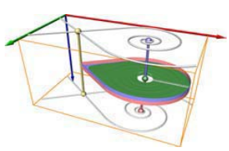
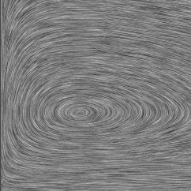
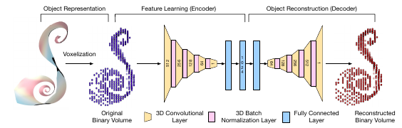
Other techniques
Line integral convolution (LIC) - textures
Feature-based flow visualization
Topology-based flow visualization

Slide 4
Line integral convolution

Slide 5
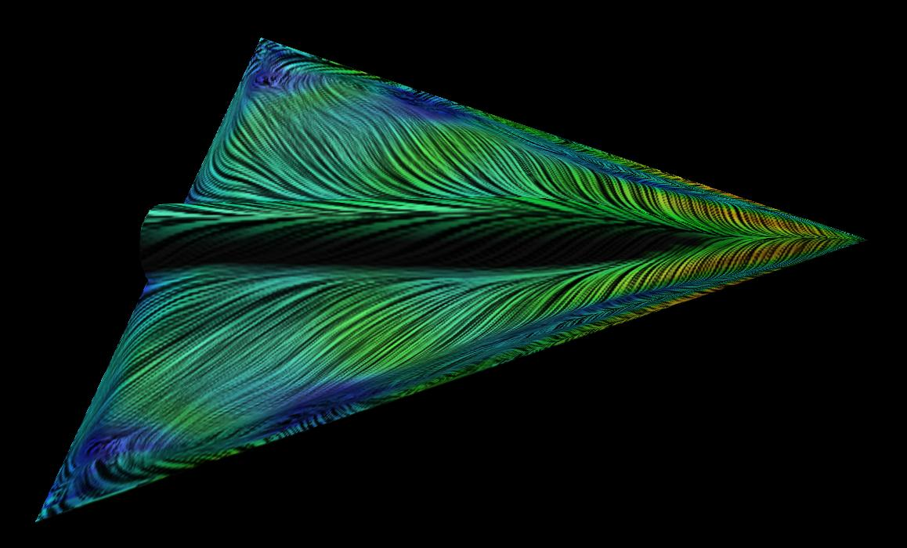
Line integral convolution
Useful for getting a general overview of the flow
Convolution of white noise and a smoothing filter
Streaks from streamlines through noise

Slide 6
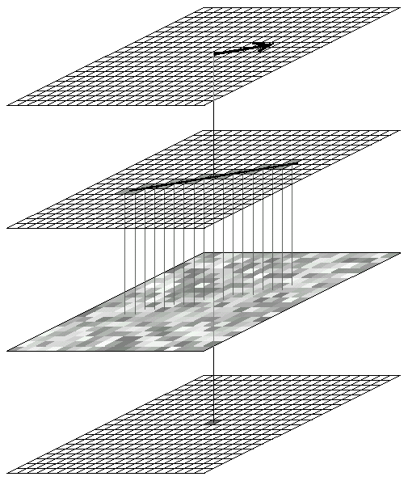
How?
Flow Data
Inputs:
flow data (v(x))
white noise (n(x))
filter (h(t)) --- Gaussian is popular choice
Algorithm for output image lic(x):
For each pixel location x:
s_x(s) <- find streamline through x
lic(x) <- 0
For u = 0 to L // length of line
lic(x) += n(s_x(u)) * h(u)
Integration
Streamline
(DDA)
Convolution
with
White Noise
results in
LIC Texel

Slide 7
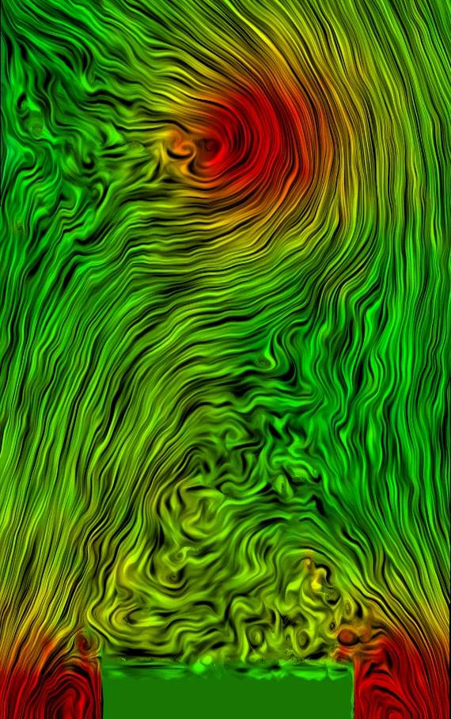
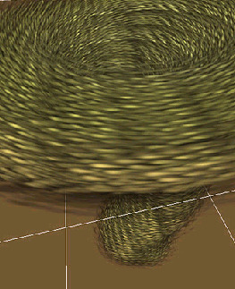
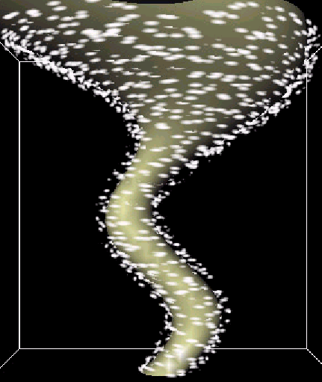
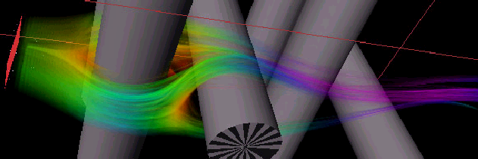
Alternatives to LIC
spot noise
Spot noise
Textured splats
Particle systems (weather maps)
Flow volumes
textured splats
motion
blurred
particles
flow volume

Slide 8
Feature-based flow visualization

Slide 9
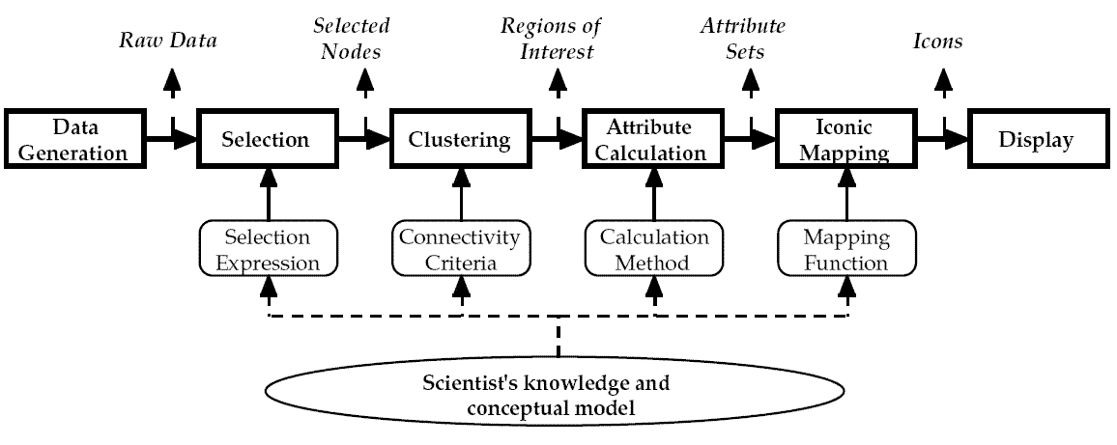
Feature-based flow visualization
Feature : a prominent or distinctive aspect, quality, or characteristic of the flow field
Identify what are "interesting" features for the user
Design an algorithm to identify/extract these features
Show them to the user
Profit!

Slide 10
Motivation
data reduction : original data set is represented with important features
perception : visualization of 3D and 4D flow is problematic in the absence of feature-based techniques
new insight : "new" characteristics of flow can be observed
technical advantages : less memory consumption, faster interaction and rendering
Good when you have clear idea of what to show

Slide 11
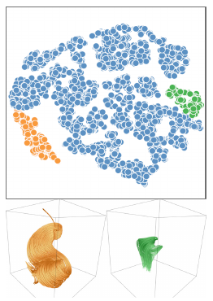
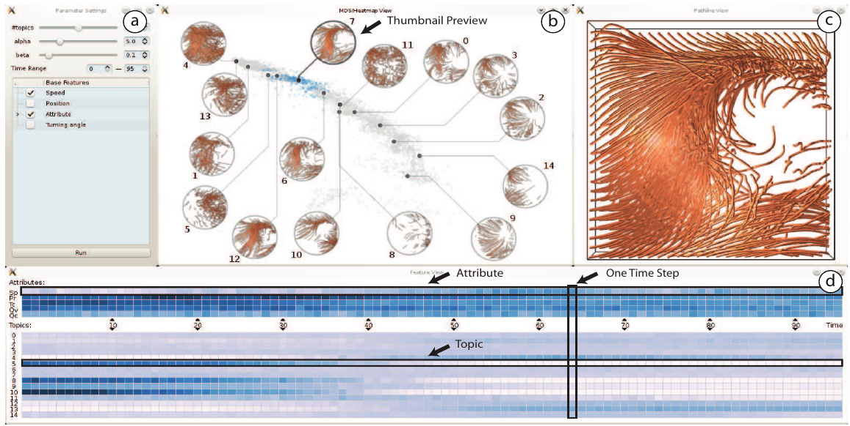
Examples
Han, Jun, Jun Tao, and Chaoli Wang. “FlowNet: A Deep Learning Framework for Clustering and Selection of Streamlines and Stream Surfaces.” IEEE Transactions on Visualization and Computer Graphics, 2018, 1–1. https://doi.org/10.1109/TVCG.2018.2880207.
Hong, Fan, Chufan Lai, Hanqi Guo, Enya Shen, Xiaoru Yuan, and Sikun Li. “FLDA: Latent Dirichlet Allocation Based Unsteady Flow Analysis.” IEEE Transactions on Visualization and Computer Graphics 20, no. 12 (December 2014): 2545–54. https://doi.org/10.1109/TVCG.2014.2346416.

Slide 12
Topology-based flow visualization

Slide 13
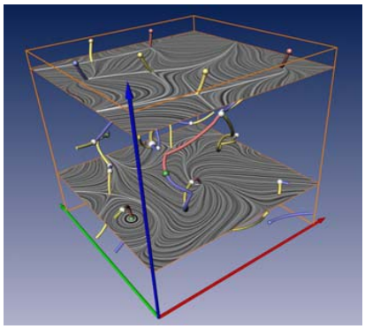
Introduction
Topological data analysis : Focuses on extracting critical points and how they relate to each other
Critical points : (Usually) locations of a function where gradient is 0
Singularities : Areas where the flow velocity is zero – e.g. sources, sinks
Connectivity (topology) between the singularies is analyzed
Topology of a vector field can be called "skeleton" of the flow
Good for feature tracking
Theisel, H., T. Weinkauf, H.-C. Hege, and H.-P. Seidel. “Stream Line and Path Line Oriented Topology for 2D Time-Dependent Vector Fields.” In IEEE Visualization 2004, 321–28, 2004. https://doi.org/10.1109/VISUAL.2004.99.

Slide 14
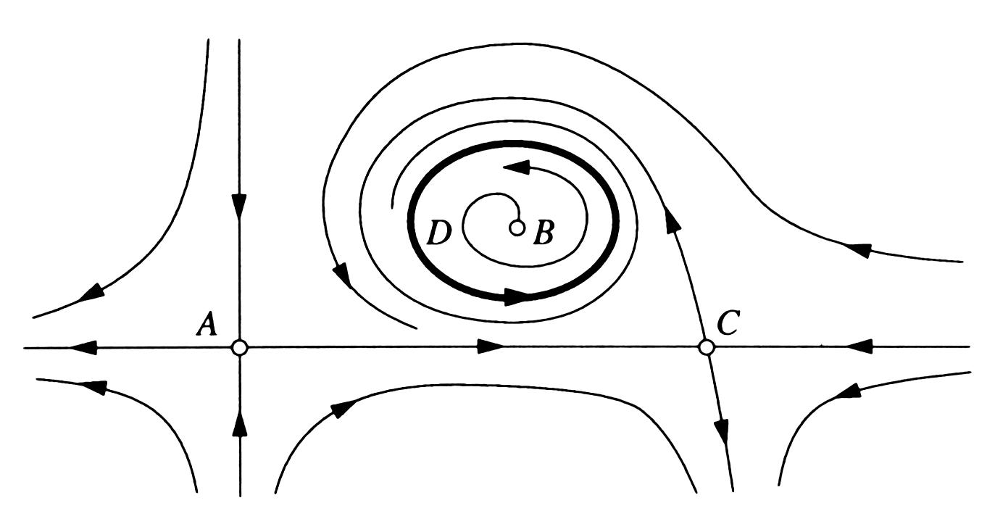
Flow topology
Critical points (v(x) = 0)
Cycles (s_x(t+T) = s_x(t))
Connections between these
Separatrices : streamlines connecting critcal points

Slide 15
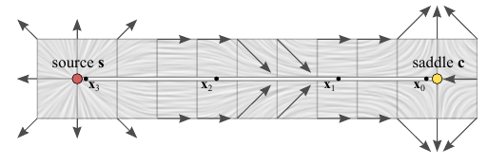
Flow topology
Critical points (v(x) = 0)
Cycles (s_x(t+T) = s_x(t))
Connections between these
Separatrices : streamlines connecting critcal points
Hullin, Matthias, Reinhard Klein, Thomas Schultz, and Holger Theisel. “Finite Time Steady Vector Field Topology - Theoretical Foundation and 3D Case.” The Eurographics Association, 2017. https://doi.org/10.2312/vmv.20171264.

Slide 16
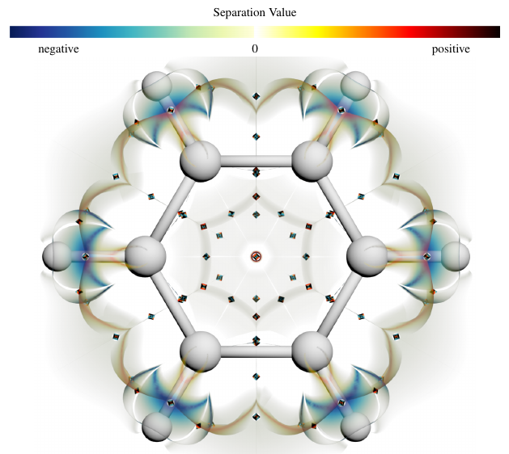
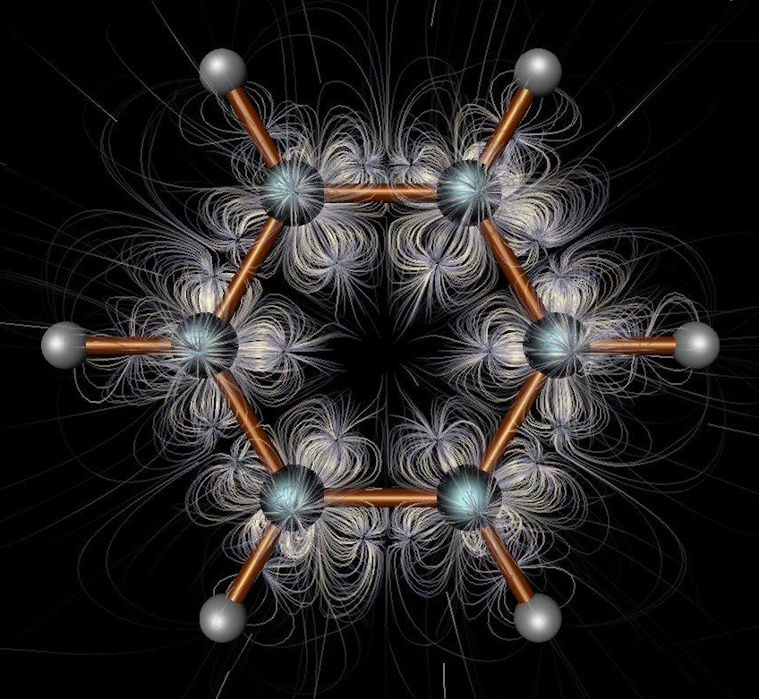
Example
vs
Hullin, Matthias, Reinhard Klein, Thomas Schultz, and Holger Theisel. “Finite Time Steady Vector Field Topology - Theoretical Foundation and 3D Case.” The Eurographics Association, 2017. https://doi.org/10.2312/vmv.20171264.

Slide 17
Conclusion

Slide 18
Summary
LIC – overview, easy to understand
Feature-based – when you know what you’re looking for
Topology – hybrid method, good for feature tracking

Slide 19
Reading
Hullin, Matthias, Reinhard Klein, Thomas Schultz, and Holger Theisel. “Finite Time Steady Vector Field Topology - Theoretical Foundation and 3D Case.” The Eurographics Association, 2017. https://doi.org/10.2312/vmv.20171264.
Han, Jun, Jun Tao, and Chaoli Wang. “FlowNet: A Deep Learning Framework for Clustering and Selection of Streamlines and Stream Surfaces.” IEEE Transactions on Visualization and Computer Graphics, 2018, 1–1. https://doi.org/10.1109/TVCG.2018.2880207.
Hong, Fan, Chufan Lai, Hanqi Guo, Enya Shen, Xiaoru Yuan, and Sikun Li. “FLDA: Latent Dirichlet Allocation Based Unsteady Flow Analysis.” IEEE Transactions on Visualization and Computer Graphics 20, no. 12 (December 2014): 2545–54. https://doi.org/10.1109/TVCG.2014.2346416.
Theisel, H., T. Weinkauf, H.-C. Hege, and H.-P. Seidel. “Stream Line and Path Line Oriented Topology for 2D Time-Dependent Vector Fields.” In IEEE Visualization 2004, 321–28, 2004. https://doi.org/10.1109/VISUAL.2004.99.
Laramee, Robert S., Helwig Hauser, Lingxiao Zhao, and Frits H. Post. “Topology-Based Flow Visualization, The State of the Art.” In Topology-Based Methods in Visualization, edited by Helwig Hauser, Hans Hagen, and Holger Theisel, 1–19. Mathematics and Visualization. Berlin, Heidelberg: Springer, 2007. https://doi.org/10.1007/978-3-540-70823-0_1.

