Slide 1

Distributed Databases

Slide 2
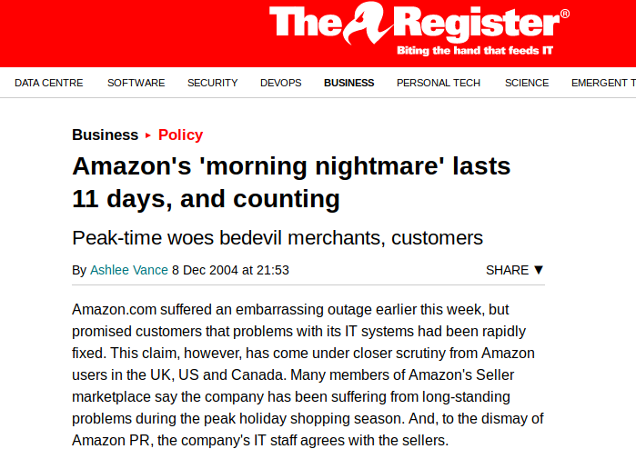
Amazon

Slide 3
Distributed Databases
Full distributed database support implies that a single application should be able to operate transparently on data that is:
a) spread across a variety of different databases,
b) managed by a variety of different DBMSs,
c) running on a variety of different machines,
d) supported by a variety of different operating systems,
e) connected by a variety of different networks.

Slide 4
The problem
New York
Paris
Communications Network
London
Munich
The complete database for any user is the logical join of all databases

Slide 5
Advantages
More closely models “real world”
Data kept closest to where it is most commonly used

Slide 6
Fundamental Principle
To the user, a distributed system should look exactly like a non-distributed system

Slide 7
Objectives
Local autonomy
No reliance on a single site
Continuous operation
Local independence
Fragmentation independence
Replication independence

Slide 8
Local Autonomy
All operations at a given site are controlled by that site.
Site X should not rely on site Y for successful operation.
Integrity, security physical storage.
Actually autonomous to maximum extent possible.

Slide 9
No Central Site
Cannot rely on master central site.
Might be bottleneck.
Central site down all sites stop working (single point of failure).

Slide 10
Continuous Operation
Greater reliability.
Probability that system is up and running at any given moment.
Greater availability.
Probability that system is running continuously throughout a specified period.

Slide 11
Location Independence
Users should not need to know where any given piece of data is physically stored.
Should be able to imagine that all data is at own site.
Simplifies application programming.
Allows for data migration to respond to evolving need.

Slide 12
Fragmentation Independence
Fragmentation exists where a given relation can be fragmented into different parts, with each part stored at a different location, whilst users are unaware of this. (Location Independence).
Restrictions or nonloss decomposition.

Slide 13
Replication Independence
A given relation can be replicated at different sites many times.
Better performance.
Better availibility.
NOTE: update propagation problem

Slide 14
Problems 1. Query processing
Optimisation needs to be performed globally before being performed locally
Slowest communication rates up to 2,000,000 times slower than fastest.

Slide 15
Problem 2. Catalogue management
Where to store catalogue?
Total catalogue stored at single site.
2) Catalogue replicated at each site.
3) Catalogue partitioned. Part of catalogue held at each site. Total catalogue is logical join of parts.
4) Combination of 1 and 3.

Slide 16
Problem 3. Update propagation
If data is duplicated then an update on one copy must be propagated to all copies. If one is currently unavailable then update fails!
Solution
One copy of each replicated object is designated primary copy. Remainder are all secondary copies.
Primary copies of different objects are held at different sites.
Update is considered complete when primary copy updated.. Site holding primary copy is responsible for updating secondary copies. (must be done before commit if ACID is to be preserved.)

Slide 17
Problem 4. Recovery
Based on two-phase commit.
Coordinator function must not be assigned to a single site. Each site must be coordinator and co-operator.
The co-ordinator must communicate with every participant, increasing overheads.
If site Y is a participant then it must do as it is told by site X (commit or rollback).

Slide 18
Problem 5. Concurrency
Requests to test, set and release locks become messages (increasing overheads).
Solution usually follows primary copy protocols as shown in previous slide.
Can lead to global deadlock, which no individual site can detect. Solution involves joining individual wait-for graphs into single graph

Slide 19

Amazon
Atomicity
Consistency
Isolation
Durability
Relaxed this requirement
DynamoDB
Giuseppe DeCandia, Deniz Hastorun, Madan Jampani, Gunavardhan Kakulapati, Avinash Lakshman, Alex Pilchin, Swaminathan Sivasubramanian, Peter Vosshall, and Werner Vogels. 2007. Dynamo: amazon's highly available key-value store. SIGOPS Oper. Syst. Rev. 41, 6 (October 2007), 205-220. DOI: https://doi.org/10.1145/1323293.1294281

