Slide 1

Database Security

Slide 2

Introduction
Security is different to Integrity
Security = protecting data from unauthorised users.
= making sure people are allowed to do something.
Integrity = protecting data from authorised users.
= making sure the thing someone is trying to do is correct.
In both cases constraints are necessary.
These must be specified in some suitable language, stored in the system, and the system must monitor operations to ensure constraints are enforced.

Slide 3
Aspects of Security
Legal, social and ethical – is the user allowed access.
Physical controls - Is the terminal locked?
Policy questions – who decides who is allowed access?
Operational – if passwords are used how is their integrity enforced?
Operating system support – is main memory erased when no longer needed? What about the recovery log?
DBMS – our main concern.

Slide 4
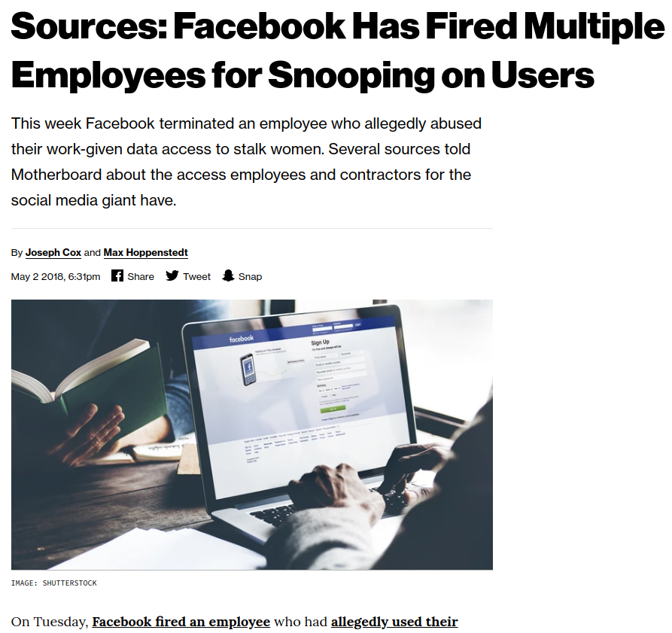
Aspects of Security
Legal, social and ethical – is the user allowed access.
https://www.vice.com/en_us/article/bjp9zv/facebook-employees-look-at-user-data

Slide 5
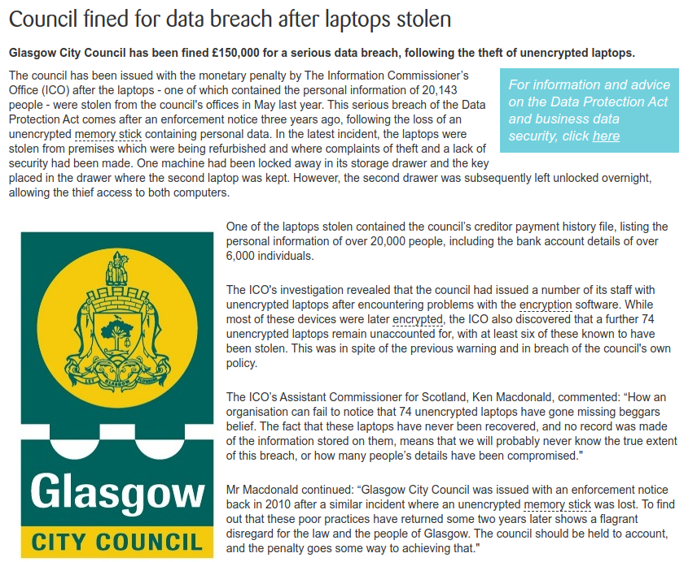
Aspects of Security
Physical controls - Is the terminal locked?
https://www.getsafeonline.org/news/council-fined-for-data-breach-after-laptops-stolen/

Slide 6
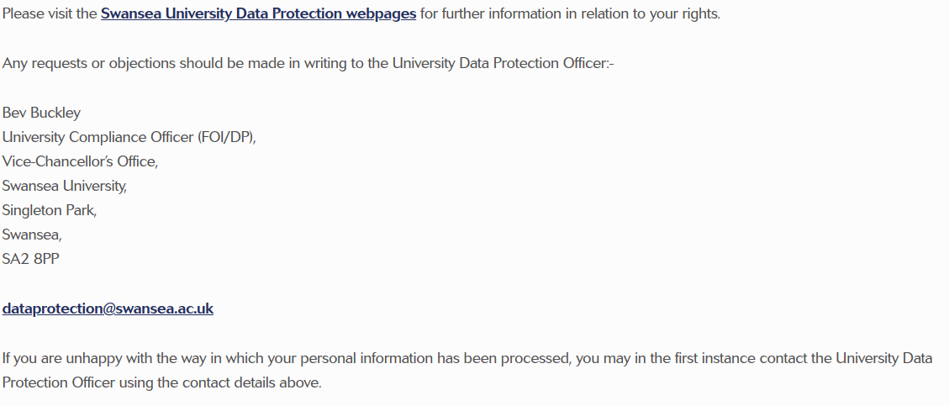
Aspects of Security
Policy questions – who decides who is allowed access?
https://www.swansea.ac.uk/business-and-industry/newsletter/privacy-policy/

Slide 7

Aspects of Security
Operational – if passwords are used how is their integrity enforced?
https://xkcd.com/936/

Slide 8
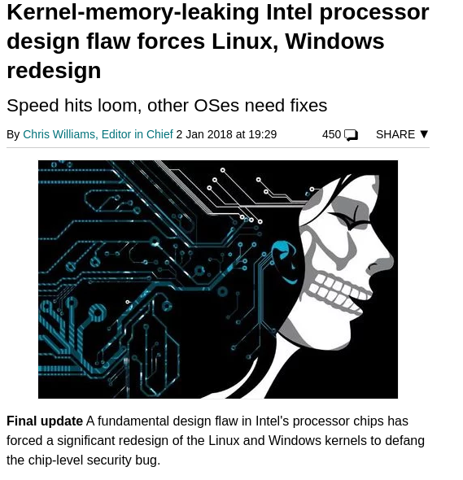
Aspects of Security
Operating system support – is main memory erased when no longer needed? What about the recovery log?
https://www.theregister.co.uk/2018/01/02/intel_cpu_design_flaw/

Slide 9
Two approaches
Discretionary control.
Each user is given rights over certain objects for certain operations.
Mandatory control.
Each user and each object is given a level, and typically cannot access anything above that level.
Not in MySQL

Slide 10
System Must be Informed
Since the decision as to ‘who can do what’ is policy, it is outside the DBMS’s control. DBMS can only enforce decisions when they are made.
Constraints must be declared using an appropriate language, and saved in the catalogue.
There must be a means of checking requests against constraints.
The system must be able to recognise the source of a request.
(note: a single id may be given to several users)

Slide 11
Discretionary Control - Language
We need a language in which we can express constraints.
NOTE: It is easier to state what is allowed than to state what is forbidden. Therefore we are expressing authorities, rather than constraints.
Example:
GRANT <priviledge list>
ON <relvar name>
TO <user id list>
NOTE: “all” can be used as a legal id.
More:https://dev.mysql.com/doc/refman/5.7/en/grant.html

Slide 12
Language
e.g.
GRANT SELECT, DELETE
ON S
TO Jim, Fred, Mary

Slide 13
Privileges
SELECT
INSERT
DELETE
UPDATE
ALL
NOTE: Often queries will touch other unexpected other objects (e.g. views)
One can also grant privileges to create, drop, rename etc, etc.

Slide 14
Not Authorised?
What happens when authority is not allowed for an enquiry?
Suggestions:
Send error message. Careful not to be too explicit!
Lock terminal?
Terminate program?
Keep a log of all requests?...or maybe just refused requests?

Slide 15
Mandatory Control
Each data object has a level.
Each user has a level.
Then
a) User x can retrieve object y only if level x >= level y. (Simple security property)
b) User x can update object y only if x = y. (Star property)
Why?

Slide 16
Implementation
Each tuple must have an extra attribute containing its level.
Anything written by user level x has that value automatically.
S# | SNAME | STATUS | CITY | LEVEL
S1 | Smith | 20 | London | 2
S2 | Jones | 10 | Paris | 3
S3 | Blake | 30 | Paris | 2
S4 | Clark | 20 | London | 4
s5 | Adams | 30 | Athens | 3

Slide 17
Implementation
User U3 = level 3
User U2 = level 2
Retrieve all from Tablename
U3 sees four tuples.
U2 sees two tuples.

Slide 18
Request Modification
S where city = “London”
Becomes
S where city = “London” and level <= user level;
Again must be invisible to user.

Slide 19
Problems?
Looking at the relvar again:
User U3 will be able to see four tuples.
Will be unaware that supplier S4 exists.
So following request seems reasonable:
Insert into S tuple {s# = s4,
Sname = Baker,
Status = 25,
City = Rome,
};

Slide 20
Problems?
This will need to become:
Insert into S tuple {s# = s4,
Sname = Baker,
Status = 25,
City = Rome,
Level = 3
};
Note that implicitly the primary key now is a composite key of S# and level.
Depending upon the user level each of users U1, U2, U3 and U4 will see completely different views of the data.

