Slide 1
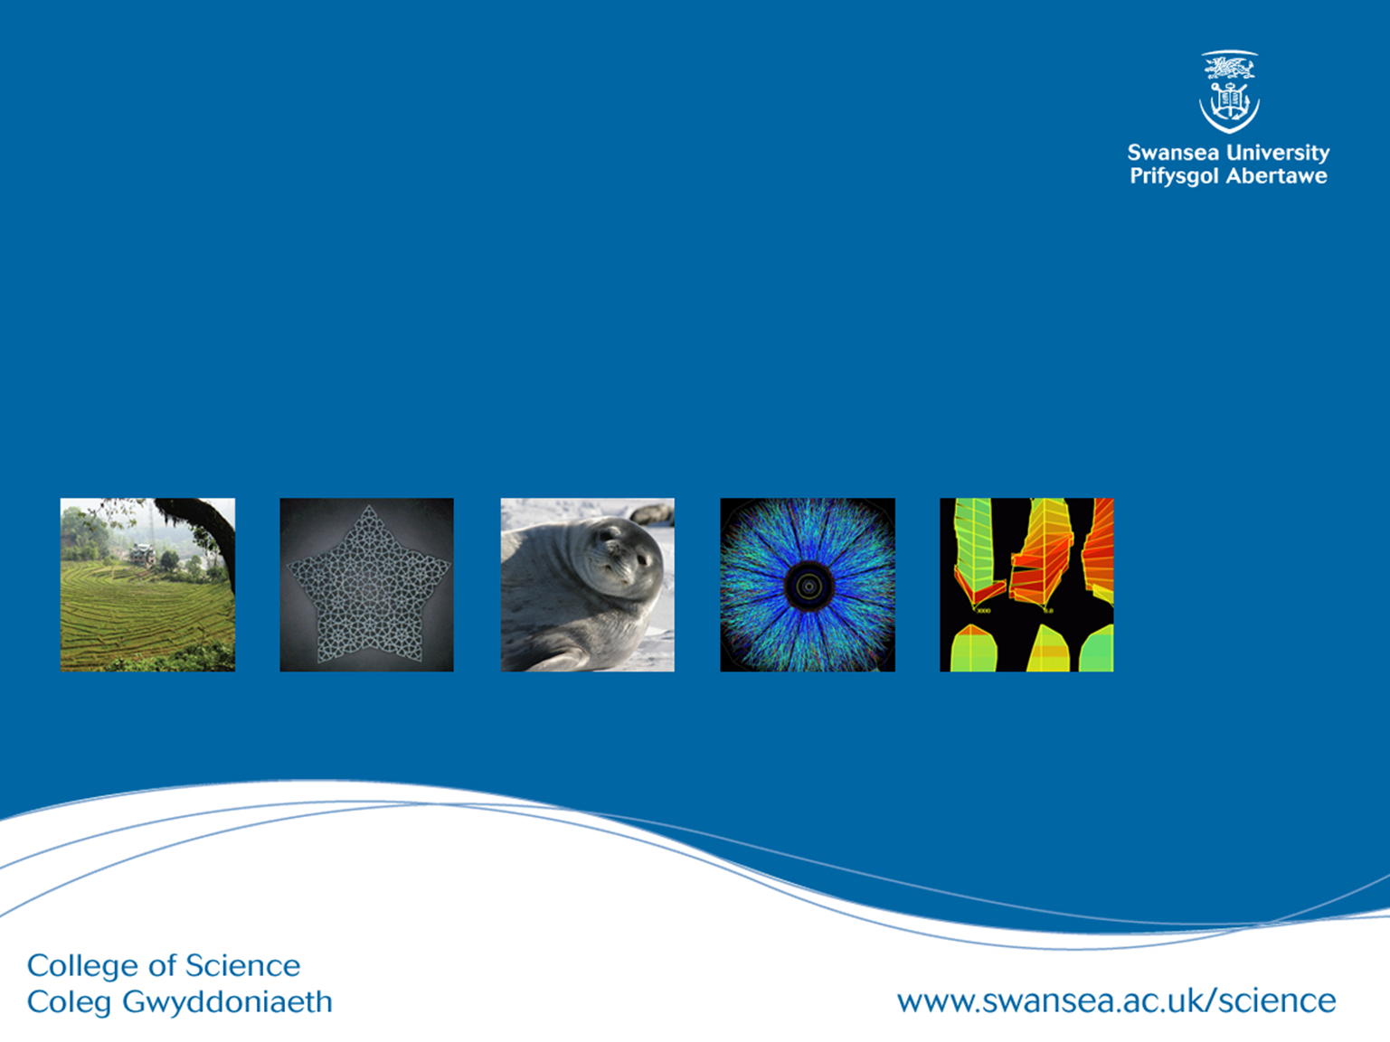
Object Oriented Databases

Slide 2


Object Oriented Databases
Attributes
Membership
Inheritance
Operations
Collections
Difficult in RDBMS
https://www.tutorialspoint.com/uml/images/uml_class_diagram.jpg

Slide 3
Complex data types
Need to store drawings, images etc.
Difficult to express queries in Relational Model
e.g. does a particular rectangle overlap another?

Slide 4
Solutions
Object-relational mapping (ORM)
Specialized datatypes (e.g. JSON column type)
Object-oriented database
Today

Slide 5
Advantage
A Dept tuple.
Many Emp tuples exist, each with a foreign key referencing the primary key attribute of Dept.
Instead imagine a Dept object which contains lots of Emps, and “knows” how to hire/fire employees, can specialize (subclass) departments

Slide 6
Disadvantage
Applications (Object-Oriented) are specialised. Databases are general.
Easy to ask an O-O database “Who works in marketing”?
Dificult to ask “List departments that employ women”

Slide 7
Application areas
Computer-aided design
Physics
Bioinformatics
Defense
Good for storing large objects

Slide 8
Object Oriented Database Concepts
In a programming language an object is transient.
In a database an object is persistent, and can be retrieved, referenced and used by other programs.

Slide 9
Object Oriented Database Concepts
Objects in database have state and behaviour.
Objects tend to have arbitrarily complex structure.
Objects will have a system-generated unique identity (cf: primary key).
Relationships between objects are typically implemented by the objects holding references to each other’s id.

Slide 10
Object Structure
The state (current value) of a complex object can be constructed from other objects or values by using type constructors.
Let O = (i, c, v) be an object.
i is an OID.
c is a type constructor (how to construct the object).
V = current state or value.

Slide 11
Example Objects
o1 = (i1, atom, 10M)
o2 = (i2, atom, Marketing)
o3 = (i3, atom, Lopez)
o4 = (i4, atom, Cheng)
o5 = (i5, set, {o3,o4})
o6 = (i6, tuple, <Dname:i2, Budget:i1>)

Slide 12
Basic Type Constructors
Atom
Tuple
Set
List
Bag
Array

Slide 13
Type Constructors
c = atom - v is an atomic value from the domain of basic values supported by the system.
c = set - v is a set of OIDs representing objects of the same type.
t = tuple – v is a tuple of the form <a1:i1, a2:i2…an:in>, where each aj is an attribute name and each ij is an OID

Slide 14
Lists, Bags and Sets
List is similar to set, except that lists are ordered.
Array is similar to a list but is typically of fixed size.
Bag is similar to set except that bags can contain duplicates.

Slide 15
Object Identity (OID)
The link between objects
Unique.
System-generated.
Usually not visible to external users.
Must be immutable (cannot change).
Only used once for one object. Even if that object is deleted its OID should not be reissued.
More usual to assign a long integer and store OIDs in a hash table.

Slide 16
Object Identity (OID)
Some systems based OID on location (undesirable). If an object moved location a pointer would refer to its new location.
Original (pure) OO systems demanded that everything has an OID. The integer 50 for example could be assigned two OIDs, one representing something’s weight in kilos and the other representing something’s age. Tends to create too many OIDs.
Most modern systems allow for representation of objects and values. Values become attributes, stored within objects. Not visible outside object (encapsulation).

Slide 17
Graph Representation
Root
Node
Atom
Tuple

Slide 18
Object Behaviour
The behaviour of an object is defined by the operations that can be applied to it externally.
The internal structure is hidden (encapsulation) and can only be modified by using methods whose signature is visible externally.
Most operations that update an object’s state are encapsulated. This means that integrity constraints are programmed into the objects methods, rather than predefined in a database schema. (ODMG 2.0 allows some constraints to be specified directly)

Slide 19
Inheritance
Typically a type can be named as a subtype of an existing type.
Subtypes inherit all state and behaviour from (all) their supertypes (can be restricted in supertype) and only define local differences.

Slide 20
Multiple Inheritance
Can cause problems.
Some implementations allow multiple inheritance, some do not allow, some force renaming.
a
a overridden
a overridden
Reference to a

Slide 21
Summary
Designed for storing objects directly
Can handle complex datatypes
OID provides linking between objects

