Slide 1
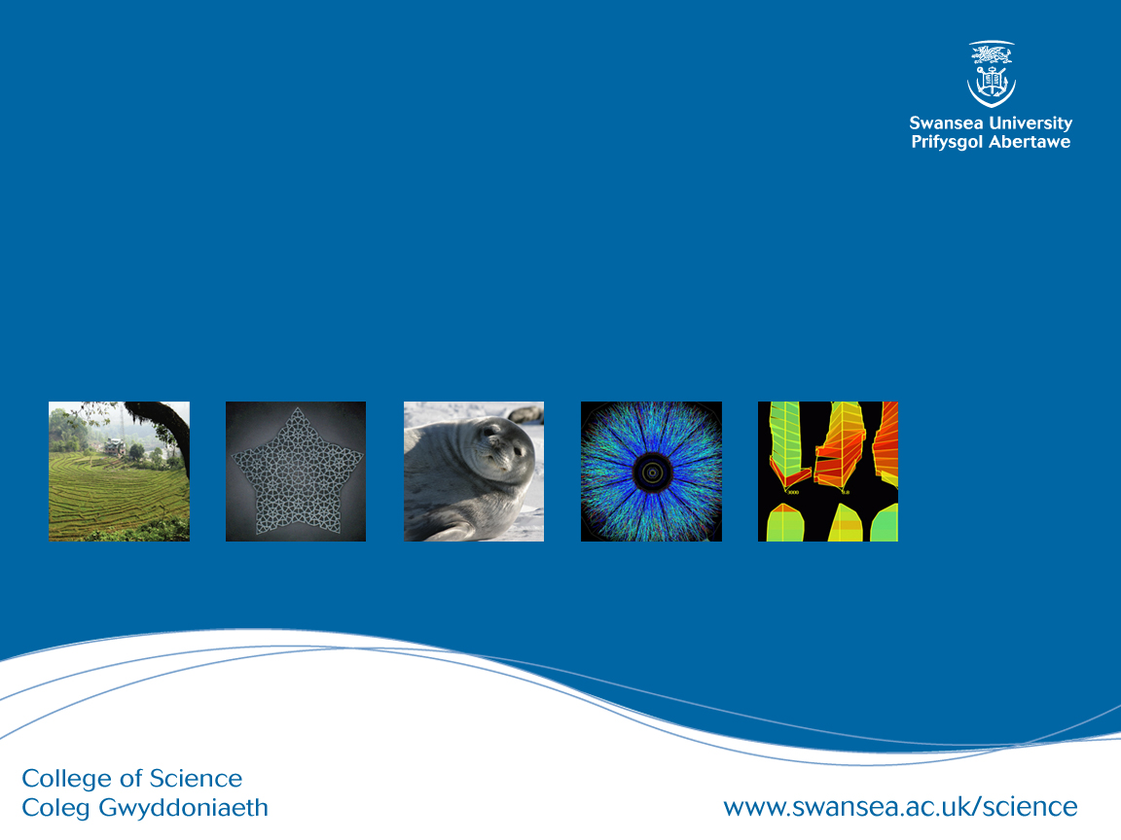
CSCM59 Relational and Object Oriented Databases

Slide 2

Dr. T. Torsney-Weir (Tom)
t.d.torsney-weir@swansea.ac.uk
CoFo 416

Slide 3
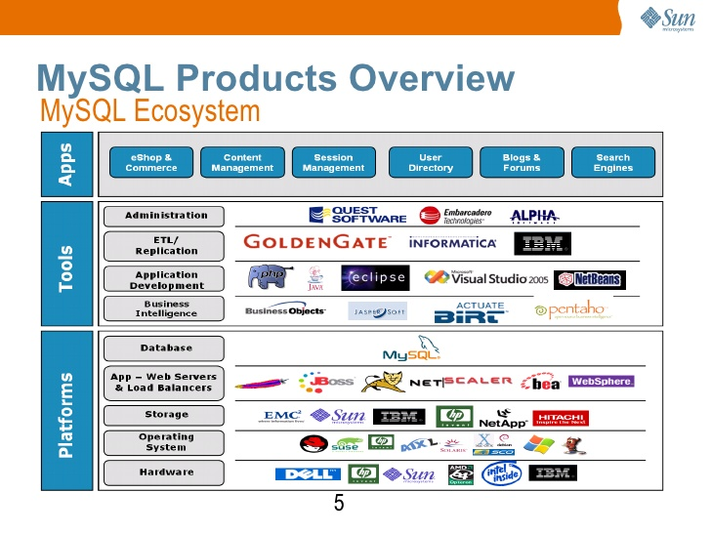
https://www.slideshare.net/chauhantushar/introduction-to-mysql

Slide 4
Database System
A computerised record-keeping system.
Consists of the data, hardware, software (DBMS), and users.
Users = programmers, end-users, Database Administrator (DBA).
DBA is responsible for administering the database according to instructions given by the Data Administrator (DA).
Databases are integrated, and shared (usually).
Store persistent data = entities + relationships.
Transactions.
Data independence.
Each row is a true proposition from which other true propositions may be inferred.

Slide 5
What do we want to do with data?
Add files.
Remove files.
Add data.
Retrieve data.
Alter data.
Remove data.

Slide 6
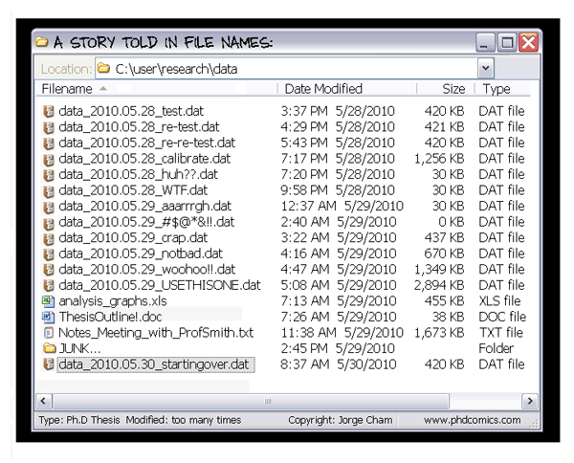
Integrated
A collection of separate files with redundancy removed (as far as possible).
http://phdcomics.com/comics.php?f=1323

Slide 7
Shared
Several different users, each with different requirements and interests.
Each user sharing the database sees a subset of the data.
Each user has a different view of the database.
Sometimes, different users view different data simultaneously (concurrency).
Notes:
I was here! 1/10/18
<number>

Slide 8
Software
End-users
DBMS
Physical data stored

Slide 9
Users
Application programmers.
Users.
DBA

Slide 10
Entity/Relationship diagram
Suppliers
SJ
Projects
SP
SPJ
PJ
EJ
MJ
Warehouses
Parts
Employees
SL
WP
PP
WL
ED
WE
Locations
Departments
LD

Slide 11
Entity – Relationship
Relationship is a part of the data!!!!!
Not all relationships binary.
Smith supplies monkey wrenches to Manhattan project
Smith supplies monkey wrenches.
Monkey wrenches are used in the Manhattan project.
The Manhattan project is supplied by Smith.
B + C + D ¬=> A

Slide 12
Database advantages
Data is shared
Redundancy reduced
Avoid inconsistency (sort of)
Supports transitions
Maintains integrity
Enforce security
Enforce standards

Slide 13
Database models
Relational
Inverted list
Hierarchic
Network
Object
Notes:
13

