Slide 1
SQL tutorial

Slide 2
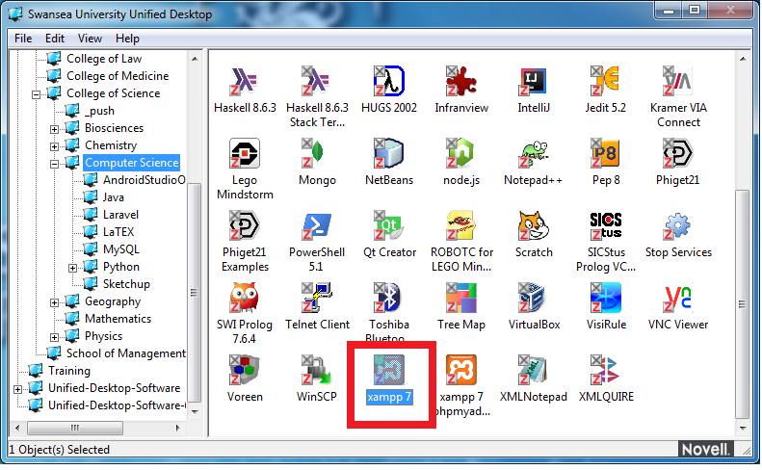
Starting mysql

Slide 3
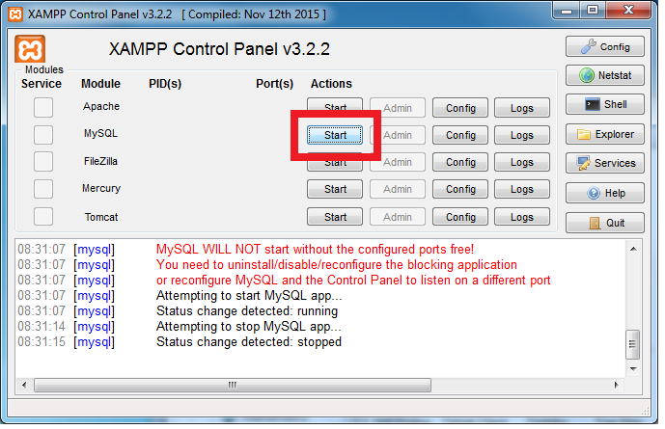
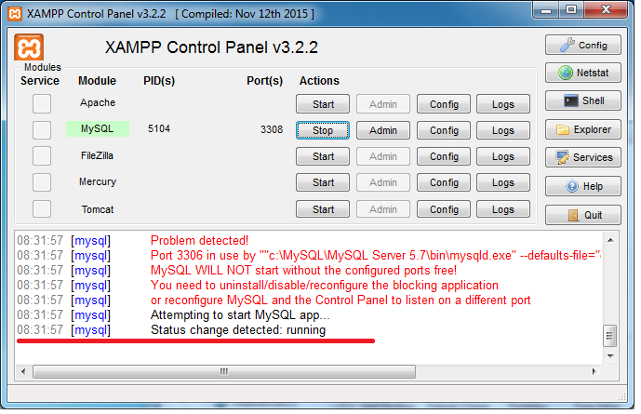

Slide 4
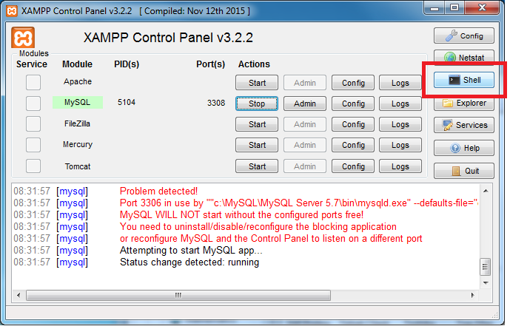
Starting mysql

Slide 5
What is SQL?
Practical implementation of the relational algebra
Developed at IBM in the 70s
Became standard language for relational databases in 80s
Each DBMS implements slightly different extensions (boo)

Slide 6
Creating the database
CREATE DATABASE finance;
USE finance;

Slide 7
Data structure

Slide 8
Creating tables
CREATE TABLE <table name> (
<column name> <data type> <constraints>,
<column name> <data type> <constraints>,
...
<column name> <data type> <constraints>,
PRIMARY KEY (<column name>),
FOREIGN KEY (<column name>) REFERENCES <foreign table>(<foreign col>)
);

Slide 9
Data types
see https://dev.mysql.com/doc/refman/8.0/en/data-types.html for more
BOOLEAN: true/false
INTEGER: integers
DECIMAL: exact fixed point number --- good for money
DOUBLE: 64 bit floating point numbers
DATE: a date
DATETIME: a date plus time --- good for creation/modification times
CHAR(n): fixed length character string
VARCHAR(n): variable length character string
TEXT: strings of text
BLOB: binary storage

Slide 10
Constraints
NOT NULL: not empty --- note: empty string is considered not empty!
UNIQUE: all values must be unique
AUTO_INCREMENT: default value is next highest integer
DEFAULT: default value if none specified
PRIMARY KEY: combines not null and unique
FOREIGN KEY: forces column to contain values in linked table

Slide 11
Creating tables
CREATE TABLE bonds (
bond_id INTEGER AUTO_INCREMENT,
company TEXT NOT NULL,
interest_rate DOUBLE NOT NULL,
PRIMARY KEY (bond_id)
);

Slide 12
Creating tables
CREATE TABLE portfolio (
entry_id INTEGER AUTO_INCREMENT,
bond_id INTEGER NOT NULL,
purchase_date DATE NOT NULL,
sell_date DATE,
amount DECIMAL NOT NULL,
PRIMARY KEY (entry_id),
FOREIGN KEY (bond_id) REFERENCES bonds(bond_id)
);

Slide 13
Altering tables
Adding columns
ALTER TABLE <table name>
ADD <column name> <data type> <constraints>;

Slide 14
Altering tables
Removing columns
ALTER TABLE <table name>
DROP COLUMN <column name>;

Slide 15
Dropping tables
DROP TABLE <table name>;

Slide 16
Data manipulation

Slide 17
Inserting data
INSERT INTO <table name>
(<column1>, <column2>, ..., <columnN>)
VALUES
(<value1>, <value2>, ..., <valueN>);

Slide 18
Inserting data
INSERT INTO bonds (company, interest_rate) VALUES ('apple', 1.2);
INSERT INTO bonds (company, interest_rate) VALUES ('msft', 0.9);
INSERT INTO bonds (company, interest_rate) VALUES ('tableau', 4.6);
INSERT INTO bonds (company, interest_rate) VALUES ('ibm', 2.3);
INSERT INTO portfolio (bond_id, purchase_date, amount) VALUES (1, '2019-09-01', 1000.0);
INSERT INTO portfolio (bond_id, purchase_date, amount) VALUES (2, '2019-09-11', 500.0);
INSERT INTO portfolio (bond_id, purchase_date, amount) VALUES (3, '2019-08-27', 5000.0);
INSERT INTO portfolio (bond_id, purchase_date, amount) VALUES (4, '2019-05-01', 1100.0);

Slide 19
Altering data
UPDATE <table name>
set <column name1> = <value1>,
<column name2> = <value2>
where <condition>;

Slide 20
Altering data
UPDATE bonds
SET interest_rate = 3.5
WHERE bond_id = 1;

Slide 21
Deleting data
DELETE FROM <table name>
WHERE <condition>;

Slide 22
Deleting data
DELETE from bonds
WHERE bond_id=1000;

Slide 23
Data selection

Slide 24
Simple selection
SELECT <column name1>, <column name2>, ..., <column nameN>
FROM <table name>;

Slide 25
Simple selection
SELECT company, interest_rate
FROM bonds;

Slide 26
Selection with restriction
SELECT <column name1>, <column name2>, ..., <column nameN>
FROM <table name>
WHERE <condition>;

Slide 27
Selection with restriction
SELECT company, interest_rate
FROM bonds
WHERE interest_rate > 1.0;

Slide 28
Conditions
boolean conditions: =, <>, >, >=, <, <=
combining terms: AND, OR
missing values: IS NULL, IS NOT NULL
within a subquery: IN, NOT IN

Slide 29
Sorting data
SELECT <column name1>, <column name2>, ..., <column nameN>
FROM <table name>
ORDER BY <column name>;

Slide 30
Sorting data
SELECT *
FROM bonds
ORDER BY interest_rate;

Slide 31
Joining tables
SELECT <table name1>.<column name1>, ...
FROM <table name1>, <table name2>, ...
WHERE <condition>;

Slide 32
Joining tables
SELECT *
FROM bonds, portfolio
WHERE bonds.bond_id=portfolio.bond_id;

Slide 33
Aliasing tables
It can be annoying to have to type a long table name over and over again
What if you want to specify a table more than once?
You can alias tables in the JOIN clause: <table name> AS <alias>
SELECT *
FROM bonds AS b, portfolio AS p
WHERE b.bond_id=p.bond_id;

Slide 34
Aggregating data
SELECT <column name2>, <aggregate function>(<column name1>)
FROM <table name>
WHERE <condition>
GROUP BY <column name2>;

Slide 35
Aggregating data
SELECT AVG(interest_rate)
FROM bonds;

Slide 36
Aggregate functions
SUM: adds everything up
AVG: takes the average
MIN: minimum value
MAX: maximum value
COUNT: number of rows
Different SQL implementations will have more than these!

Slide 37
Filtering by aggregate
You can't place aggregate functions in WHERE clauses
Instead put them in HAVING clauses
SELECT <column name2>, <aggregate function>(<column name1>)
FROM <table name>
WHERE <condition>
GROUP BY <column name2>
HAVING <aggregate function>(<column name1>);

Slide 38
Filtering by aggregate
SELECT b.company
FROM bonds b, portfolio p
WHERE b.bond_id=p.bond_id
GROUP BY p.purchase_date
HAVING SUM(p.amount) > 1000;

