Slide 1
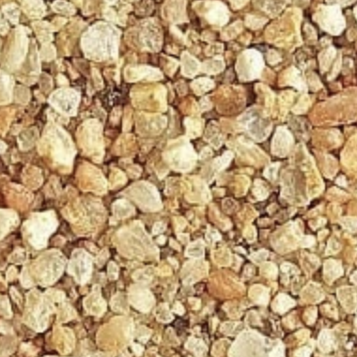
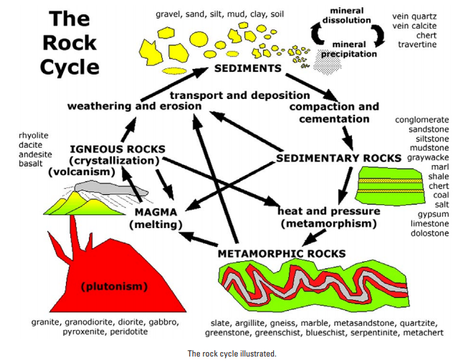
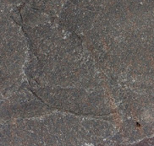
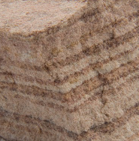
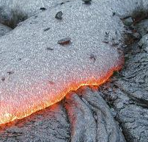
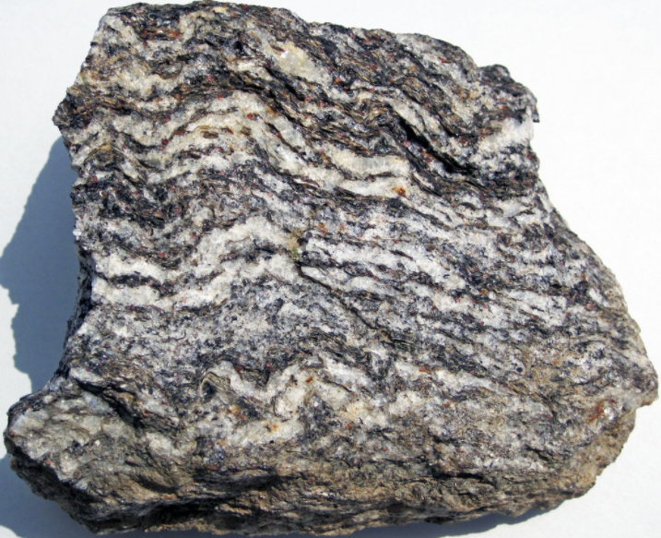
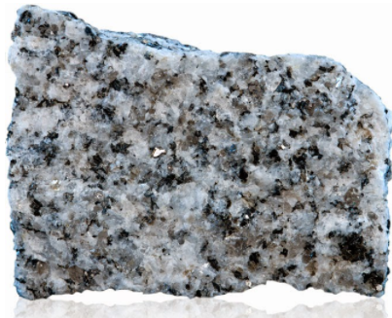

Slide 2
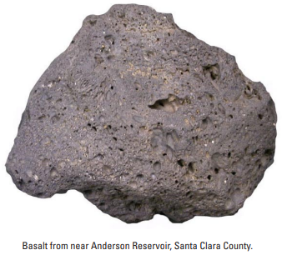
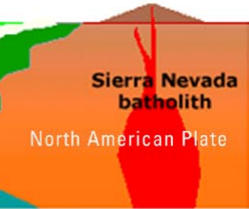
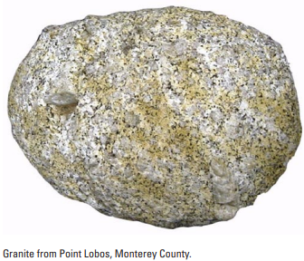
Igneous Rocks are formed by cooling and crystallization of molten rock
Extrusive rocks are erupted Intrusive rocks cool below the surface
Ex: Basalt Ex: Granite

Slide 3
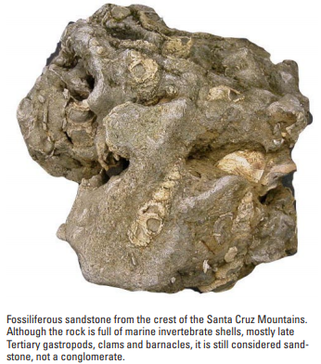
Sedimentary Rocks are formed by compaction and lithification of sediments
Ex: Sandstone
Characteristics to observe:
Grain size
Type/origin of sediments
Fossils
Layering

Slide 4
Metamorphic rocks are formed by applying heat and pressure to a rock (of any type)
Ex: Gneiss
Granite
Intrusive Igneous
Gneiss
Foliated Metamorphic
Heat
&
Pressure

