Slide 1
Test if expression
False
True
If block

Slide 2
Test if expression
False
True
If block
else block

Slide 3
Test if expression
False
True
Test if expression
False
if block
True
else if block
else block

Slide 4
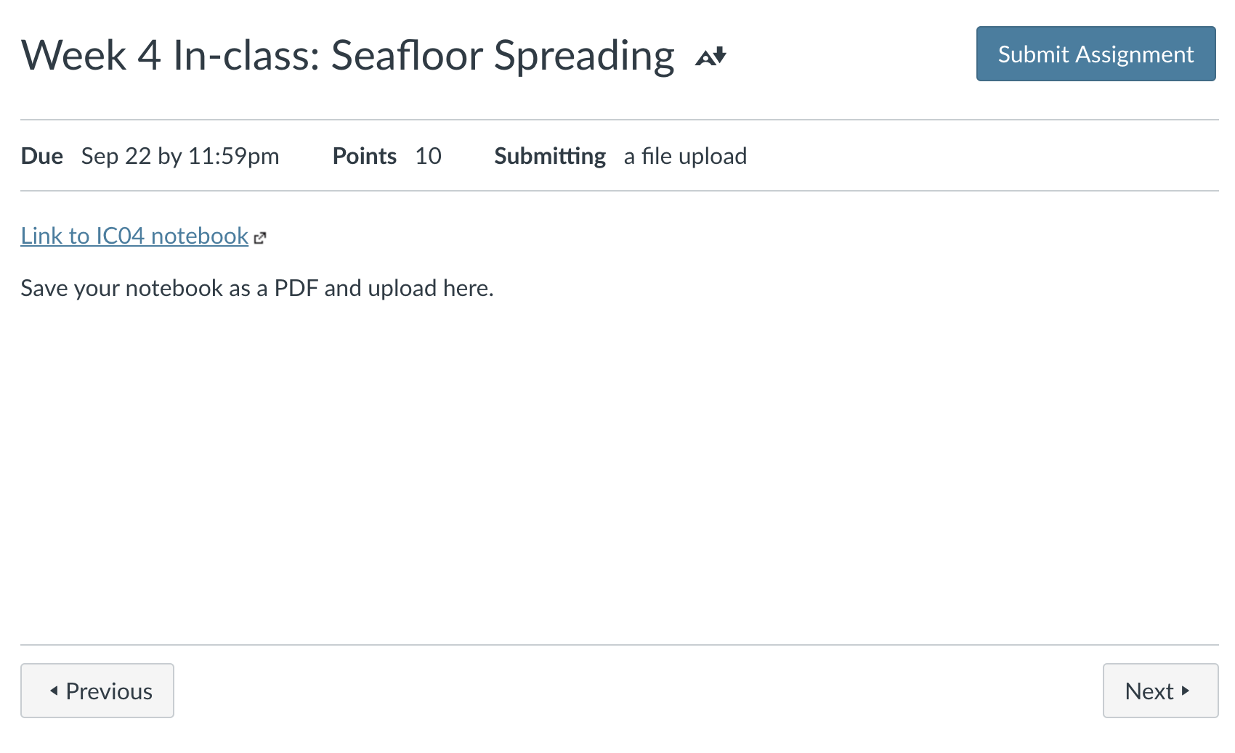

Slide 5
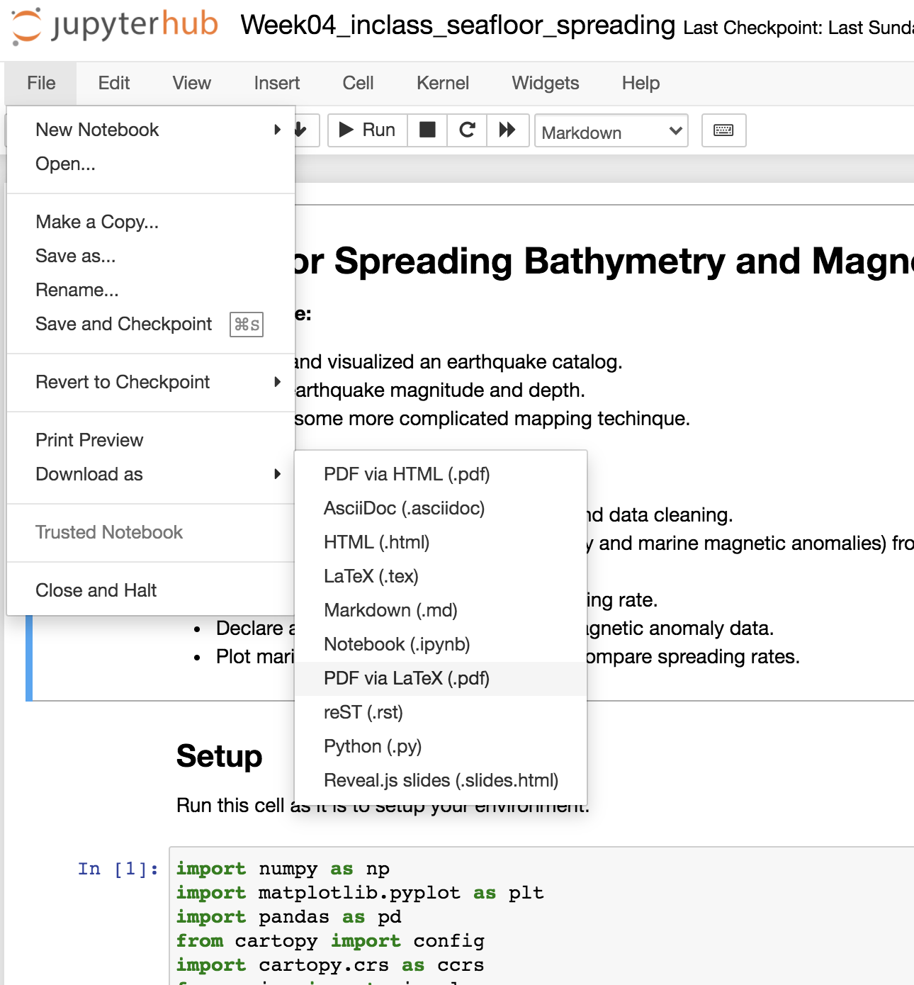

Slide 6
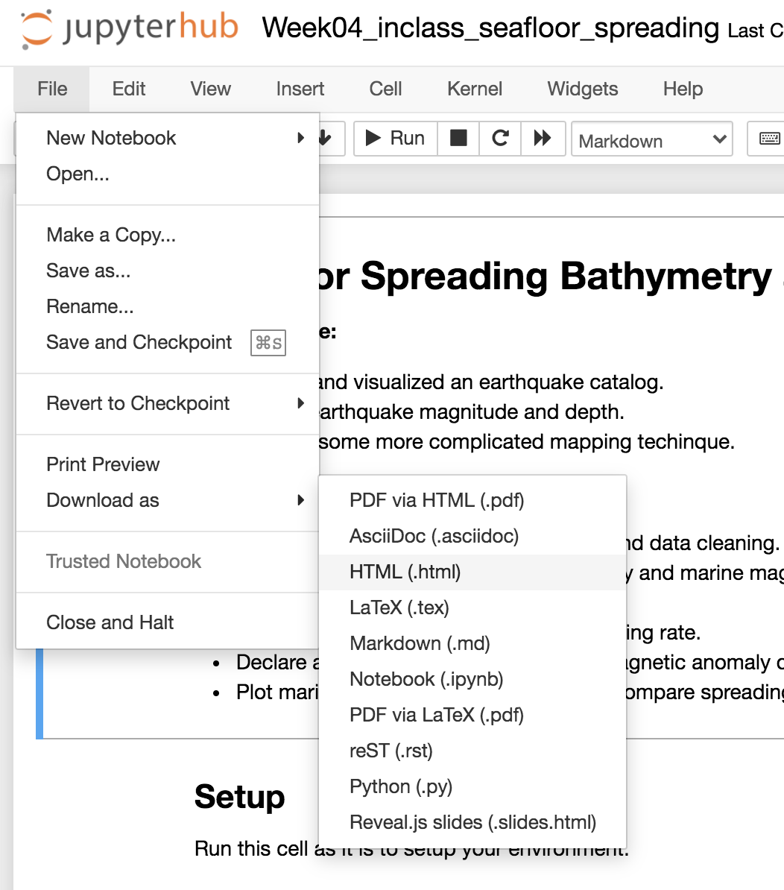

Slide 7
