Slide 1
Telecom Churn Prediction Project
Team N
Team Lead: Tanvi Barve | Co-Team Lead: Swapnali Patil

Slide 2
Project Overview
The Telecom Market Churn Prediction System predicts regional subscriber churn trends to help telecom operators manage investments, optimize marketing, and improve customer retention.
It leverages machine learning models to forecast churn probabilities and support strategic decisions.

Slide 3
Team N - Members & Roles
Team Lead: Tanvi Barve
Co-Team Lead: Swapnali Patil
Foundation & Market Analysis: Sumit Bhardwaj
Feature Engineering & Target Definition: Suhani Kumari
Baseline Model Development: Sumithi Pandian
Advanced Model Development: Subhash Patel
Business Analysis & Deployment: Swapnali Patil

Slide 4
Project Workflow
1. Data Collection & Preparation
2. Exploratory Data Analysis (EDA)
3. Feature Engineering & Target Definition
4. Baseline Model Development
5. Advanced Model Development (Random Forest, XGBoost)
6. Business Analysis & Deployment

Slide 5
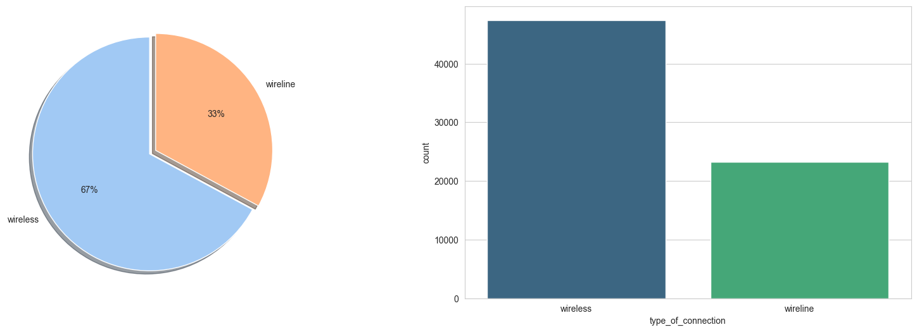
Type of Connection

Slide 6
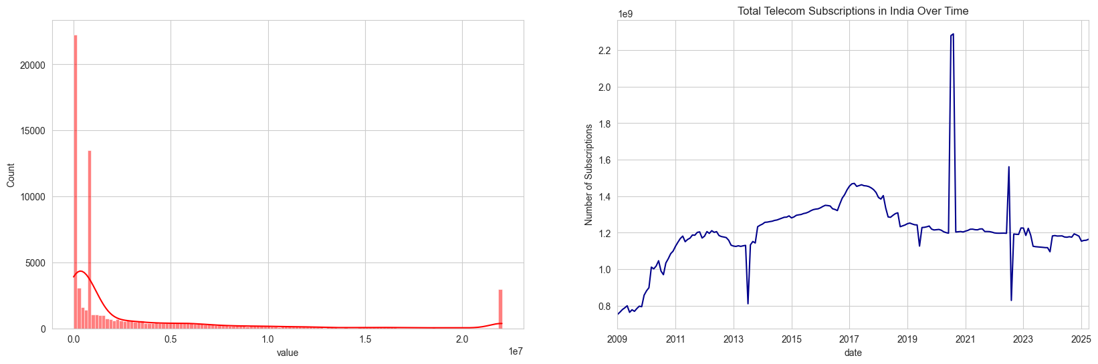
Telecom Subscription in India

Slide 7
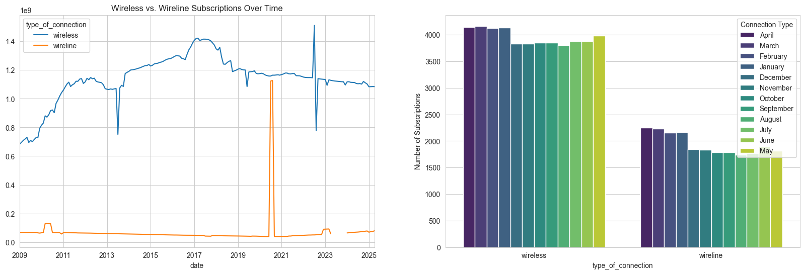
Subscriptions Over Time

Slide 8
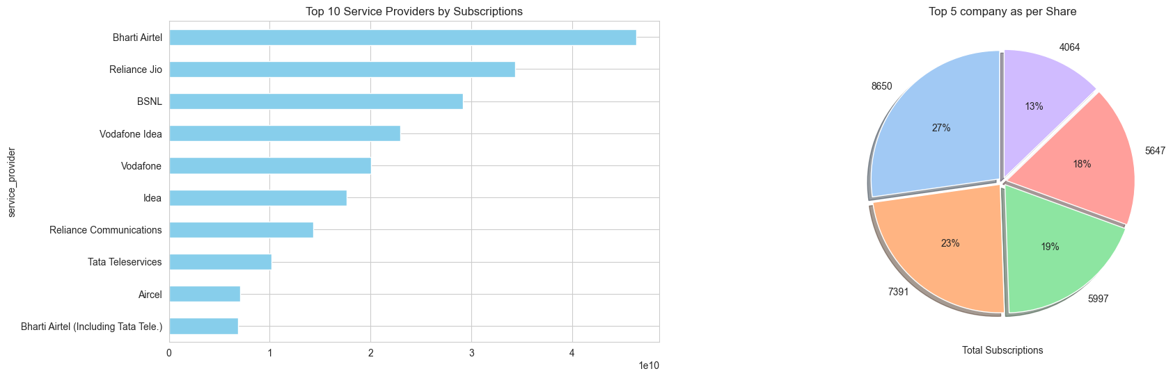
Top 10 Service Providers

Slide 9
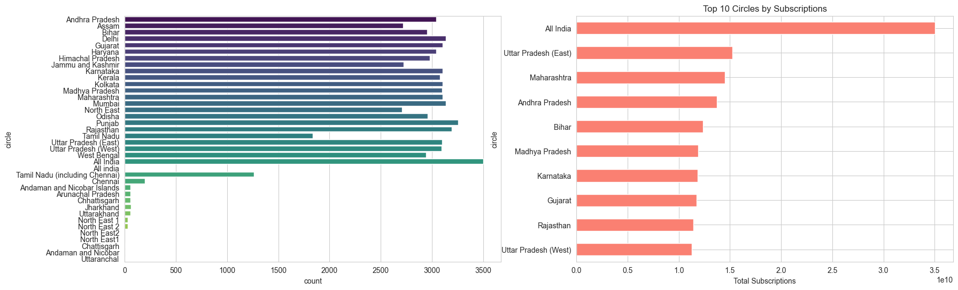
Top 10 Circles/Regions

Slide 10
Model Performance Summary
• Logistic Regression – Accuracy: 0.85 | ROC-AUC: 0.61
• Random Forest – Accuracy: 0.92 | ROC-AUC: 0.97
• XGBoost (Final) – Accuracy: 0.95 | ROC-AUC: 0.9847
• Stacked Ensemble – Accuracy: 0.93 | ROC-AUC: 0.9720

Slide 11
Business Impact
• Customer Retention: Identify at-risk segments early
• Revenue Protection: Prevent potential losses
• Marketing Optimization: Enable targeted campaigns
• Strategic Planning: Support investment & engagement decisions

Slide 12
Thank You
Presented by Swapnali patil

