Slide 1


Basic Implementation of Smart Grid Using Block-chain.
Under the guidance of
Prof. Sofoklis Efremidis
Prof. Gregory Yovanof
Group members
Parthit Patel
Swapnil Shinde

Slide 2
Agenda
Introduction
Objective
Overview
Model Layout
Proposed System
Technologies Used
Code Snippets
Conclusion
References

Slide 3
Introduction
Blockchain can be defined as a distributed ledger technology that can record transactions between parties in a secure and permanent manner.
Using the solidity programming language we are developing a Smart grid Application.
A Smart grid consists of many producers, providers, consumers and their transactions of energy and respective funds. We have made an application which keeps a track of these transactions.

Slide 4
Objective
To develop Decentralized Autonomous System for a Smart Grid
To develop a Supply Chain for Energy and Funds Transfer.
Increasing the trust between various participants and bringing transparency in the supply chain.
Flow of money should be secure and it should use any type of Digital Currency.
Using BlockChain technology in Smart Grid application can achieve cost savings by more automated, error-free and less paper work processes.
To manage the ownership of digital assets and facilitate asset transfers.

Slide 5
Why This System Is Needed ?
BLOCK CHAIN TECHNOLOGY IS –
Transparent and Tractable.
Secure and Authorized Transactions and digital ledgers.
Creates trust among several individuals and entities.
Keeps the track and information about product to every stake holder.
Less paperwork.
Decentralized system.

Slide 6
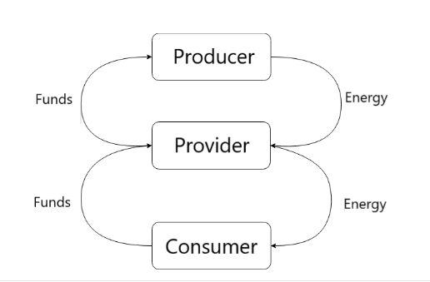
Model Layout

Slide 7
Proposed System
What we are proposing –
A Decentralized autonomous system for tracking the fund and energy transfer between different entities .
Multiple entities with different databases.
Permission rights and authentication for every entities are defined.
All entities work on a global platform
Whole process is governed by smart contracts.
Payments through the cryptocurrencies can be done.
Automatically change of ownership of product from one entity to another.

Slide 8
Smart Contracts
A smart contract is a computer protocol intended to digitally facilitate, verify, or enforce the negotiation or performance of a contract.
Smart contracts allow the performance of credible transactions without third party interference or dependency.
The aim of smart contracts is to provide security that is superior to traditional contract law and to reduce other transaction costs associated with contracting.

Slide 9
Functionality of the Producer
Has a unique Cost Per Unit.
Has a maximum production capacity.
Has an account to keep a tab on the funds remaining.
Every time energy is transferred, it is written on the BlockChain.
Has the sole right to produce Energy.
Has a tab for every time energy is produced.

Slide 10
Functionality of the Provider
Has a unique Cost Per Unit.
Has a maximum storage capacity.
Has an account to keep a tab on the funds remaining.
Every time energy is transferred, it is written on the BlockChain.

Slide 11
Functionality of the Consumer
Has the sole right to consume energy.
Has a maximum storage capacity.
Has an account to keep a tab on the funds remaining.
Every time energy is transferred, it is written on the BlockChain.
Has a tab for every time energy is consumed.
If Consumer runs out of energy, energy is automatically transferred from the Provider to the Consumer at a hiked price.

Slide 12
Technology Used
Solidity programming:
-Used to design and code various contracts .
Digital payment transfer.

Slide 13
Conclusion
We have designed a basic working model of A Blockchain-based Application for a Smart Grid.

Slide 14
References
-https://www.youtube.com/watch?v=vWnFei-ugT8
-https://cryptozombies.io/
-https://blockgeeks.com/guides/solidity/
-https://medium.com/@robbertvermeulen/learn-solidity-the-ethereum---smart-contract-programming-language-7f106fc26d6
-http://solidity.readthedocs.io/en/v0.4.24/units-and-global-variables.html

Slide 15
Future Enhancement
Add a GUI.
Add more sophisticated and efficient programming.
Modify the Consumer to be a Prosumer.
Peer to Peer sharing
Add a periodic function to simulate the scenario instead of manually typing everything in.

Slide 16
Thank you..
Any Questions??

