Slide 1


TRACKING APPLICATION USING BLOCKCHAIN
Group members
Harshini eggoni
Rohan
Deepak khamkar
amit sawant
swapnil shinde
Under the guidance of
Prof. Sofoklis Efremidis
PROF. gregory YOVANOF

Slide 2
Agenda
Introduction
Motivation
Objective
Overview
Model Layout
Proposed System
Protocols
Technologies Used
Code Snippets
Conclusion
References

Slide 3
Introduction
Blockchain can be defined as a distributed ledger technology that can record transactions between parties in a secure and permanent.
Using solidity programming language we are developing the tracking application of products.
A supply chain consists of many different participants exchanging goods, services, and payments. It is often desirable to track the physical assets digitally to be informed about the whereabouts, to trigger processes, certify the ownership, and perform corresponding payments.

Slide 4
Motivation
Nowadays, Consumers are becoming more and more interested in the stories behind a product and do not settle with only the quality of it. So everyone need to Boost their product ensuring the authenticity/appellation of origin of that and make visible the process that reminds behind.
There are many shopping web-apps working as a third party in logistics. So for every order they need to notify particular element of the system. It is somewhat tedious process. Then we came to know about Blockchain.
Blockchain can be defined as a distributed ledger technology that can record transactions between parties in a secure and permanent way.
Blockchain is a decentralized autonomous system from which every element of will get the details of order By ‘sharing’ databases between multiple parties.
That’s why we are using Blockchain in tracking system. So that whole system will be decentralized.

Slide 5
Objective
To develop Decentralized Autonomous System for tracking the products.
To develop Supply Chain for International Trade using Blockchain Technology.
Increasing the trust between various participants and bringing transparency in the supply chain.
Flow of money should be secure and it should use any type of Digital Currency.
Using blockchain technology in tracking application can achieve cost savings by more automated, error-free and less paper work processes.
To manage the ownership of digital assets and facilitate asset transfers.

Slide 6
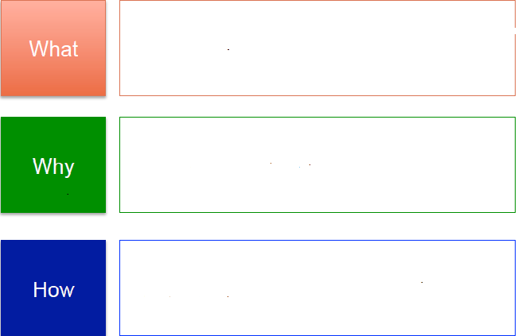
Overview
…are the problems in International Supply Chain Trade ?
…to use blockchain technology
in International Supply Chain trade ?
…we proposed Supply chain trade using blockchain technology ?

Slide 7
What ?
Complexity and lack of transparency of our current supply chains system.
Multitude of invoices and payments.
Security and Authorization Issues.
No trust among several individuals and entities.
No well defined tracking and information about product to every stake holder.
More paperwork and maintenance
Limited Communication due to Centralized system
Inflexibilty
Possibilty of power misuse
Delegate Authority

Slide 8
Why ?
BLOCK CHAIN TECHNOLOGY IS –
Transparent and Tractable
Secure and Authorized Transactions and digital ledgers.
Creates trust among several individuals and entities.
Keeps the track and information about product to every stake holder.
Less paperwork
Decentralized system
flexible
Smart Contracts
Assets management

Slide 9
How ?
Involved Entities
Manager
Manufacturer
Warehouse of Manufacturer
Land Transport
Customs Authority
Port Authority
Shipping
Escrow Account
Customer

Slide 10
Model Layout
FRONT - END
W3.JS
MANAGER
MANUFACTURER
CUSTOMS
PORT
SHIPMENT
LAND
ESCROW
CUSTOMER
SMART CONTRACTS
ETHEREUM
ESCROW
BLOCKCHAIN

Slide 11
Proposed System
What we are proposing –
A Decentralized autonomous system for tracking the product ,which works on blockchain.
Multiple entities with different database.
Permission rights and authentication for every entities are defined.
All entities work on global platform
Recording and Invoking the Events
Whole process is governed by smart contracts.
Payment through escrow account
Automatically change of ownership of product from one entity to another.

Slide 12
Protocols
Chain
Host the no. of assets including securities and currencies.
Core functionalities of blockchain.
BigChainDB
Decentralized database
Escrow
Platform used to do digital transactions
Ethereum
It is known for smart contracts, which have applications that run has programmed and with minimal interference with the third party

Slide 13
Technology Used
BLOCKCHAIN:
-Technology is primarily used to verify transactions, within digital currencies though it is possible to digitize, code and insert practically any document into the blockchain
Solidity programming:
-Used to design and code various contracts .
Digital payment transfer .

Slide 14
Code Snippets
We have designed the well defined model for tracking application.
Designed contracts:
- contract manager
- contract customer
- contract customs
- contract escrow
- contract port
- contract shipment
- contract manufacturer
- contract land transportation

Slide 15
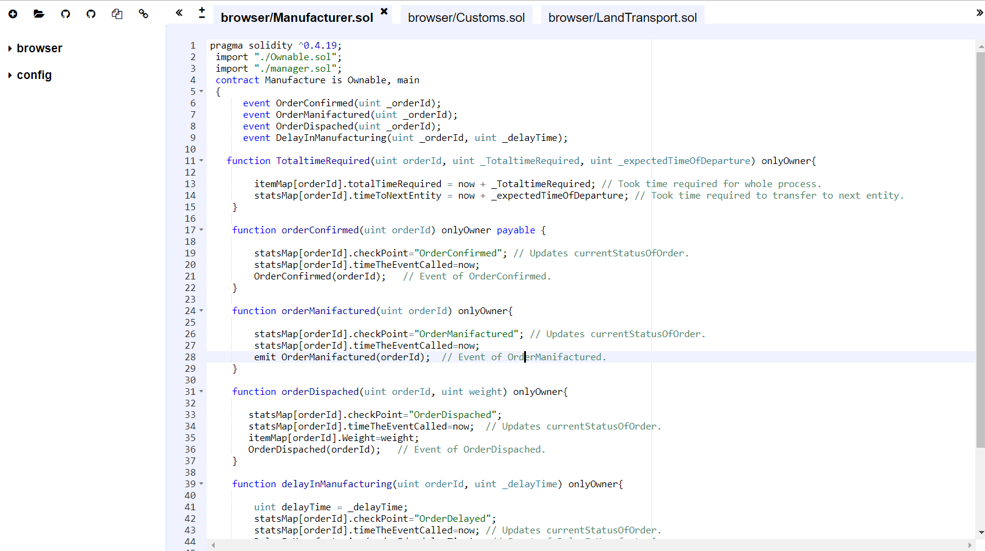
MANUFACTURER

Slide 16
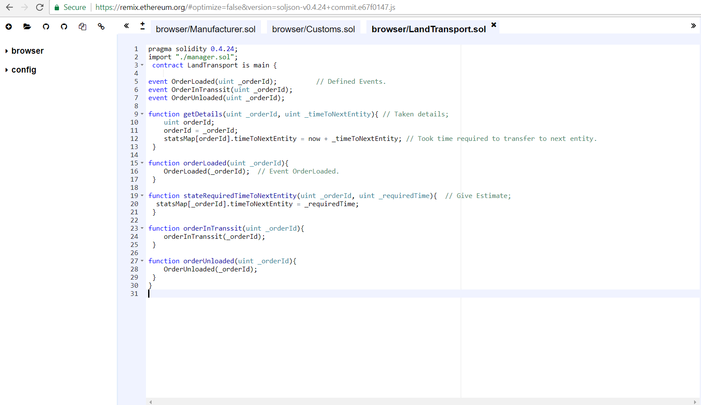
LAND TRANSPORT

Slide 17
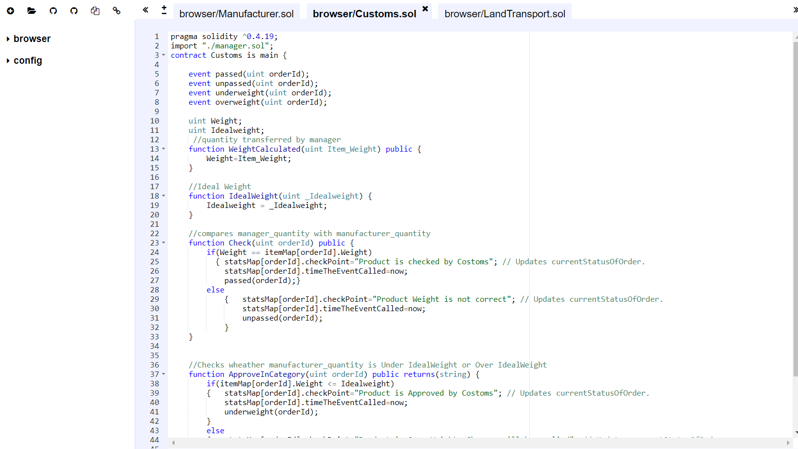
CUSTOMS

Slide 18
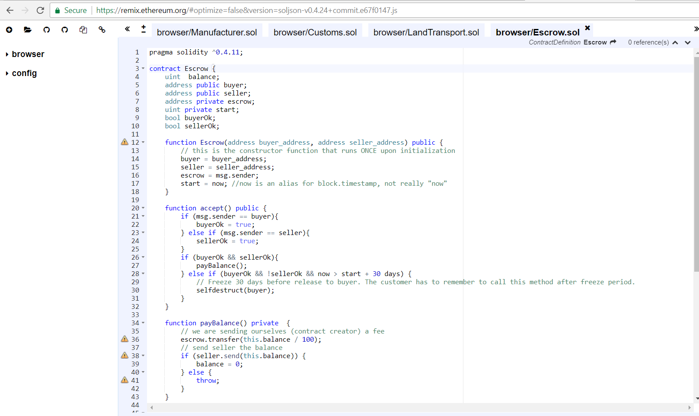
ESCROW

Slide 19
Conclusion
We have designed the full working model of tracking application using blockchain.
We have started working on the real implementation and working on the frontend using web3js. At the last we are expecting the well developed tracking system for a product where an customer can order the product by frontend and their will be link between all the nodes of contracts and manager will initiate the process and at last it will be deliver to the customer respectively.

Slide 20
References
-https://www.ibm.com/blockchain/what-is-blockchain.html
-https://www.youtube.com/watch?v=r0LsnzAe1Yg
-https://www.youtube.com/watch?v=vWnFei-ugT8
-https://cryptozombies.io/
-https://blockgeeks.com/guides/solidity/
-https://medium.com/@robbertvermeulen/learn-solidity-the-ethereum---smart-contract-programming-language-7f106fc26d6
-http://solidity.readthedocs.io/en/v0.4.24/units-and-global-variables.html

Slide 21
Thank you..
Any Question??

